Slide 1
IceCube: Evolving Work Flows
Steve Barnet
University of Wisconsin – Madison
WIPAC

Slide 2
Overview
The Basics of IceCube
Data Handling
Computing Model
Summary

Slide 3
The IceCube Neutrino Observatory
A kilometer scale neutrino detector
Located at geographic South Pole
Detects Cherenkov light from neutrino interactions

Slide 4
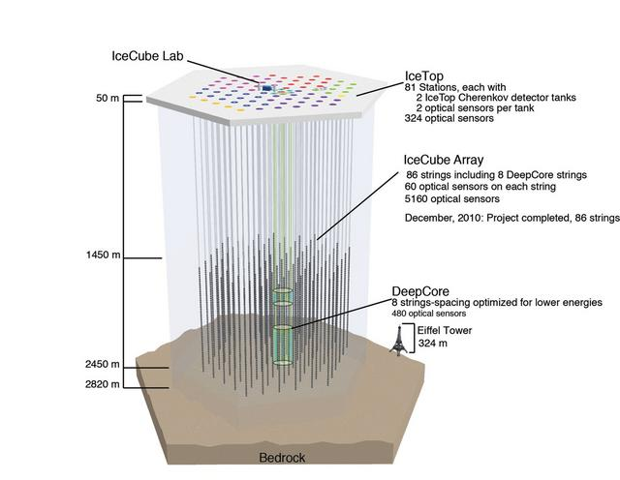

Slide 5
Location, Location, Location
Why the South Pole?
Lots of ice – a great detection medium
The ice is very clear
Thick ice sheet – sensors deep enough to provide significant background reduction

Slide 6
IceCube Overview
400 people
39 Institutions
11 Countries
Exotic Locales

Slide 7
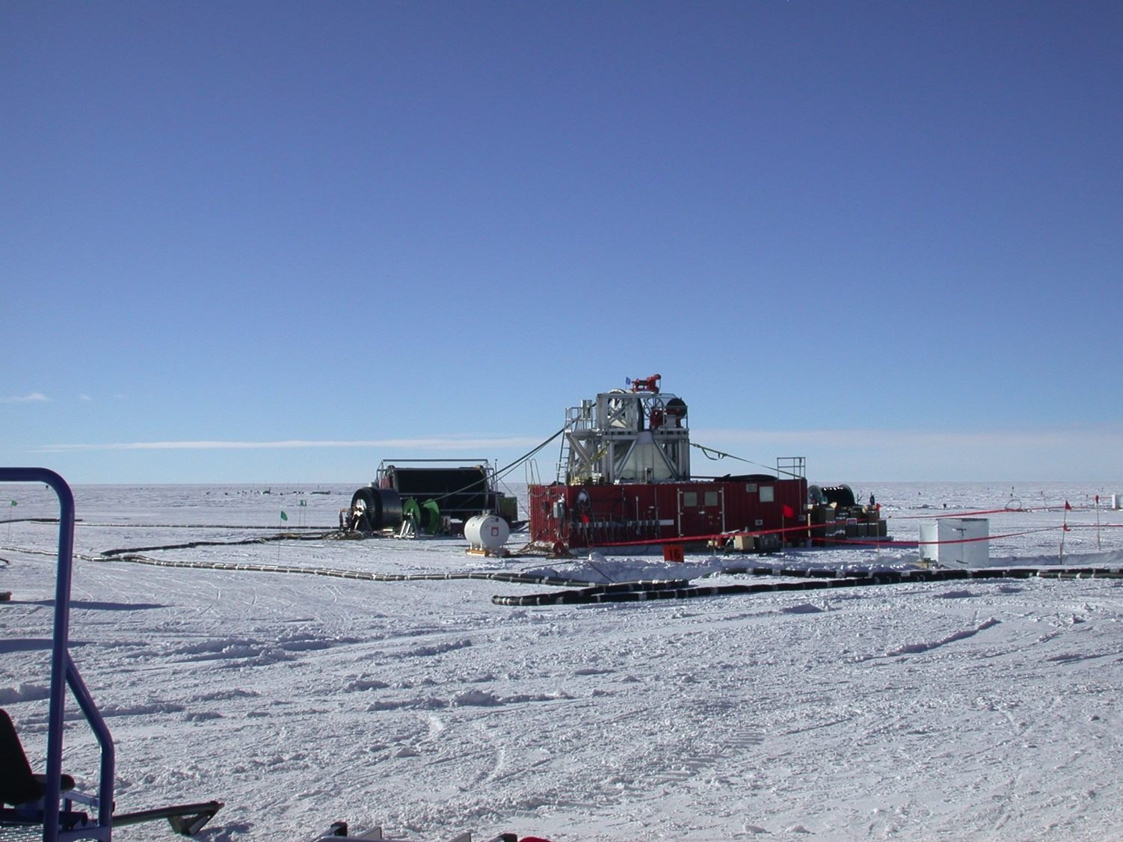

Slide 8
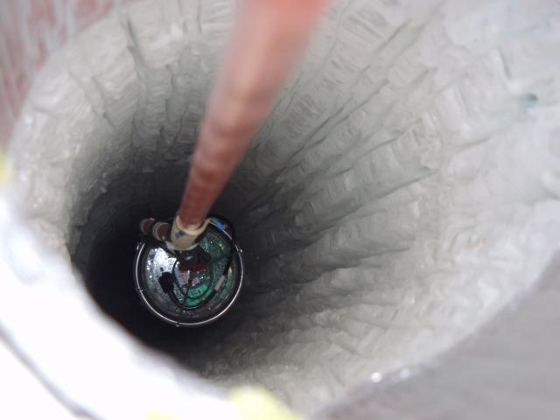

Slide 9
Data Volume
Event rate of 3000 Hz
1 TB/day raw data
Reduced to 100 GB/day
Based on available satellite bandwidth
Tapes shipped North every year

Slide 10
Computing Model
University of Wisconsin - Madison – Tier 0
Raw data collection and archive
Data production to Level 3
Coordinate simulation production
DESY-Zeuthen – Tier 1
Second copy of Level 2 data
Hold simulation data sets in Europe

Slide 11
Tier 0 Capacity
Compute cluster
1400 cores, memory at least 4 GB/core
HTCondor managed
Experimental data
1 PB Lustre filesystem
Simulation data
1.2 PB Lustre filesystem
Analysis data sets
250 TB Lustre filesystem

Slide 12
Data Production
Level 1
Filtered stream from Pole
Level 2 – Science Ready
Calibrations, basic reconstructions
Common processing needed by all analyses
Level 3 – set by each working group
Event selection
Stream separation

Slide 13
Simulation Production
Driver of our distributed computing
Collaboration institutions contribute to simulation production
Production is coordinated with a central DB at UW Madison
Output is collected at either DESY-Zeuthen or UW Madison

Slide 14
Simulation Framework
Software framework to coordinate components
Central DB at UW-Madison to coordinate and track production
First versions were monolithic – photonics tables made grids difficult
Newer versions broken into finer steps

Slide 15
Simulation
Event generation
CORSIKA for cosmic ray background
Several neutrino generators
Photon propagation
Lookup tables
Direct simulation on GPUs
Detector simulation

Slide 16
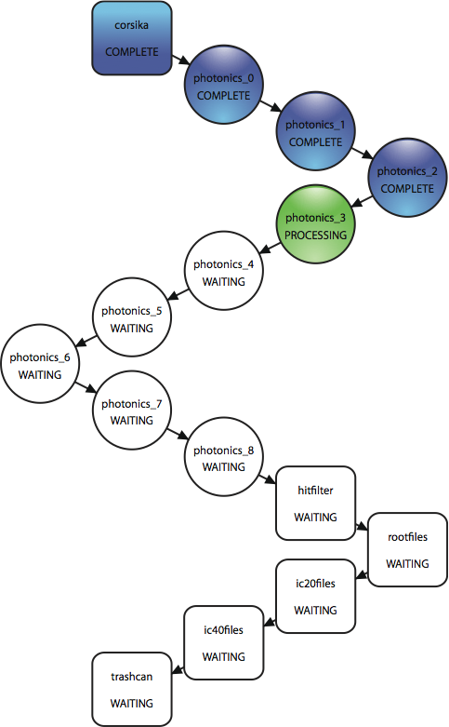
First Monolithic WorkFlow
This was a single job
A data set is O(100,000) jobs
Long Photonics chain
Lots of waiting
Multiple detectors simulated
Worked Locally, grids difficult

Slide 17
OSG – Attempt 1
Refactor work flow using DAGMan
glideinWMS is now on the scene
+ lots of local caching and clever job routing

Slide 18
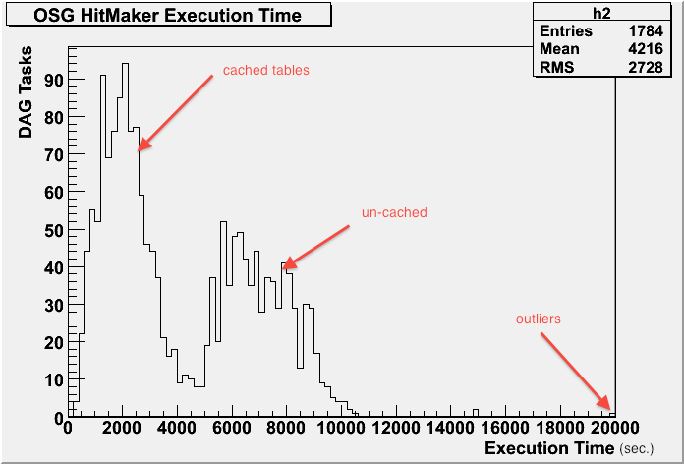
Workable with caching

Slide 19
Enter GZK-9000

Slide 20
The Name
Or: what happens when you give clever grad students a mission and some time
Derived from HAL-9000 (2001: A Space Odyssey)
IBM << 1 == HAL
HAL << 1 == GZK
GZK is a predicted limit on the energy of cosmic rays

Slide 21
The Hardware
6x Dell C6145 series chassis for CPUs
3x Dell C410 Chassis for GPUs
16x GPUs each
nVidia Tesla M2070

Slide 22
The Place
CHTC pool
Shared resource – Available to other CHTC users
WID/MIR data center
29 U of rack space
15 KW power dissipation

Slide 23
The Reason
Improves the science
Eliminates many binning artifacts associated with tables
Required many improvements to our understanding of the ice
Greatly reduces the need for Photonics tables

Slide 24
Simplifies the Work Flow

Slide 25
OSG Attempt 2
Move top tier of DAG to OSG
Results:
GPU processing at UW
Use local GPUs if available
Turns our “tables problem” into a data movement problem – may be more tractable

Slide 26
Approach
Start small scale with CHTC resources
Submit machine and glideinWMS
Shake out the bugs and surprises
Add IceCube resources as needed to feed the beast
CVMFS – software distribution, remaining tables
Squid caching
Expand gridFTP service

Slide 27
Future Workloads
Analysis – get Jane the Physicist doing regular analysis using OSG
Data processing (Level 2 production)
Reformatting old data into archival format

Slide 28
GPUs
Better integration with HTCondor
CPU/GPU ratios – 2:1, 1:4 - ?
Limit jobs to assigned GPUs

Slide 29
Summary
IceCube is a km scale neutrino detector
Work well locally with HTCondor
Expanding to OSG – involves work
Extensive use of GPUs
We may not be the coolest experiment on the planet, but we are one of the coldest.

Slide 30
Credits
Juan Carlos Diaz-Velez, David Schultz – IceProd framework
Dima Chirkin, Claudio Kopper – GPU simulation development
Heath Skarlupka – GPU wrangling
CHTC – Hosting the GZK cluster, OSG support, HTCondor GPU efforts
UW Madison – Fast networks
NSF – IceCube M&O funding

Slide 31
Questions?

