Slide 1
How I learned to Stop Worrying and Love Preemption

Slide 2
Best thing about Condor?
The Community
Community as Metaphor

Slide 3
Two Questions
How much more room in OSG?
How long can jobs (effectively) run?

Slide 4
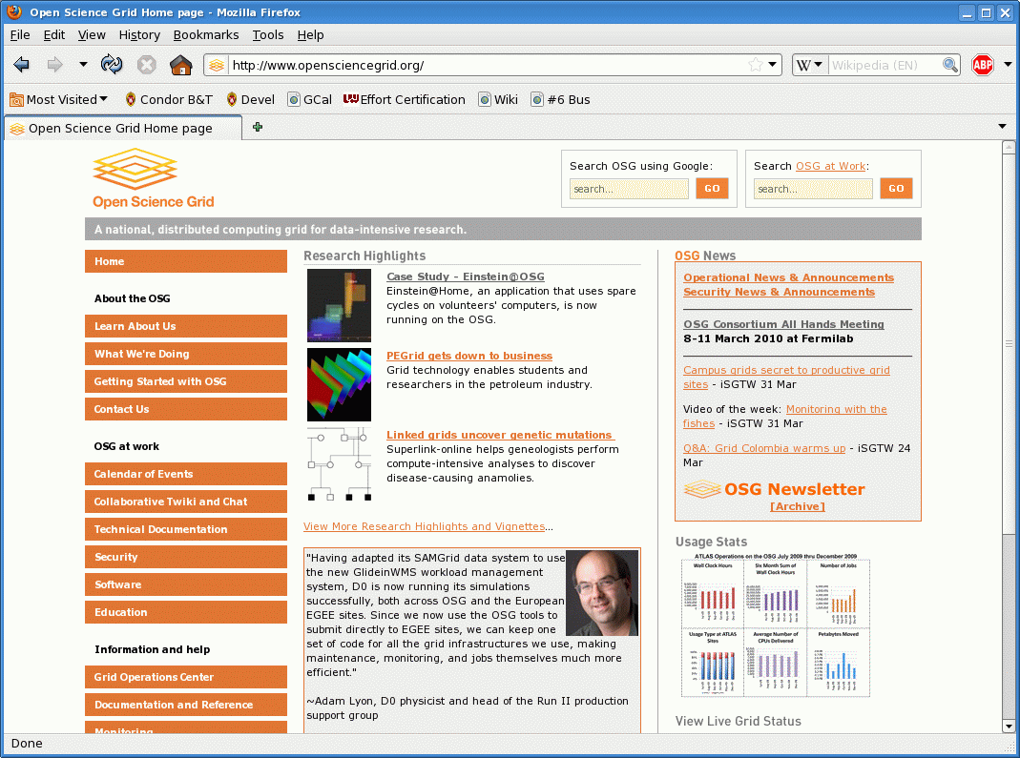

Slide 5
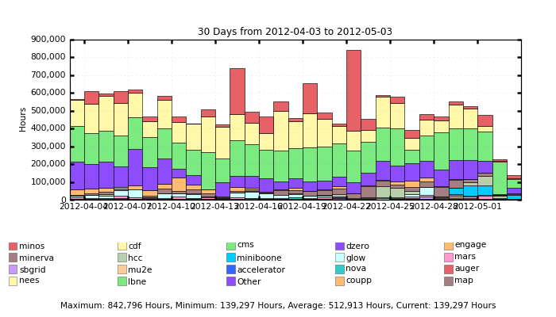
Not an OSG talk

Slide 6
3 method for performance analysis
Modeling
Difficult in opportunistic pools
Simulation
Difficult in opportunistic pools
Measurement

Slide 7
Measurement
Simply submit a ton of jobs
All measurement via user log

Slide 8
User log trick:
+TheSite="$$(GLIDEIN_Site)"
job_ad_information_attrs = TheSite

Slide 9
028 (4.1.0) 02/17 18:38:03 Job ad information event triggered.
TriggerEventTypeNumber = 1
EventTypeNumber = 28
TriggerEventTypeName = "ULOG_EXECUTE"
Proc = 87
Subproc = 0
TheSite = "Purdue"
CurrentTime = time()
MyType = "ExecuteEvent"

Slide 10
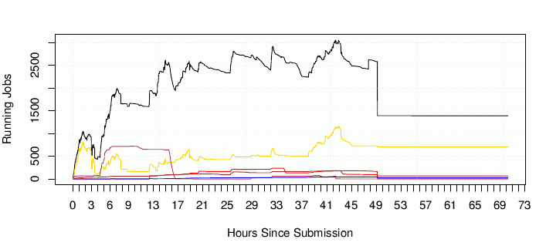
76,161 total cpu-hours

Slide 11
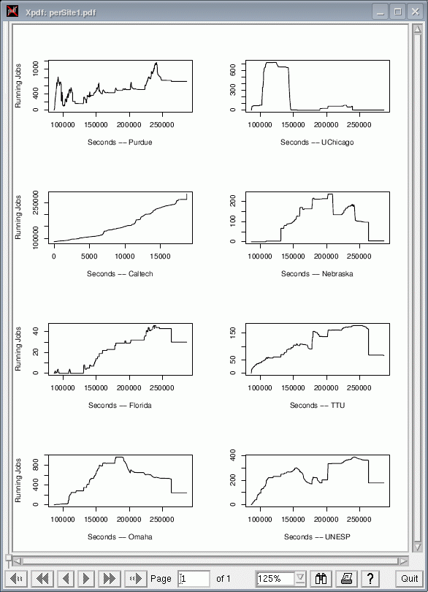

Slide 12
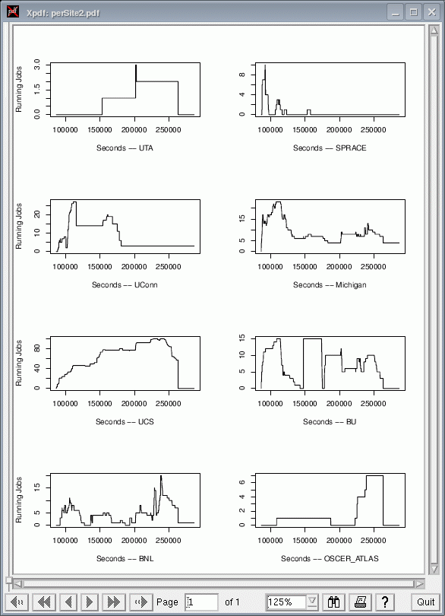

Slide 13
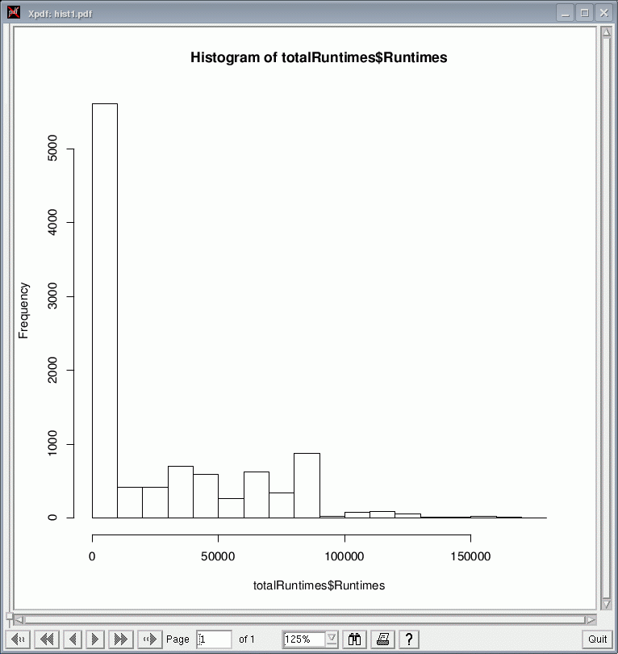

Slide 14
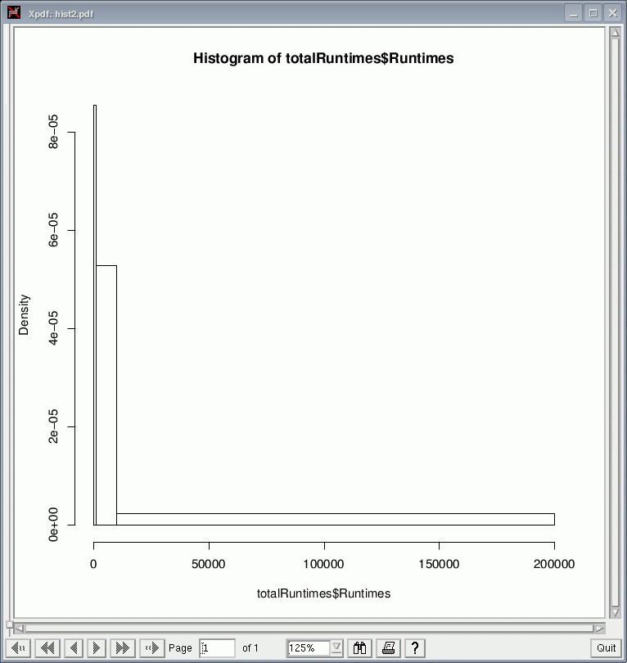

Slide 15
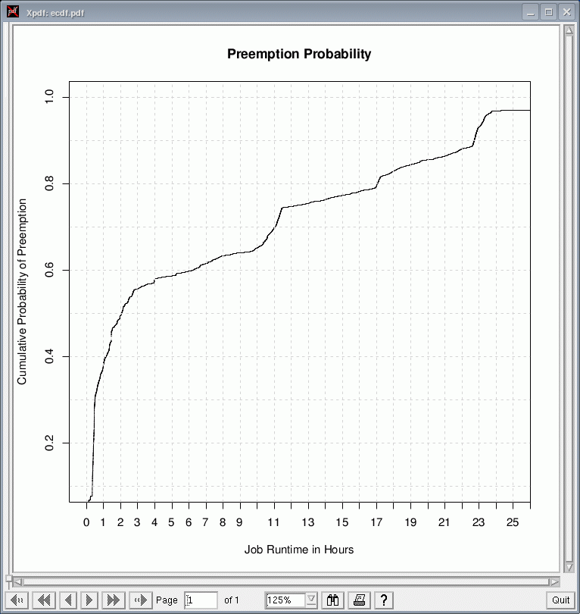

Slide 16
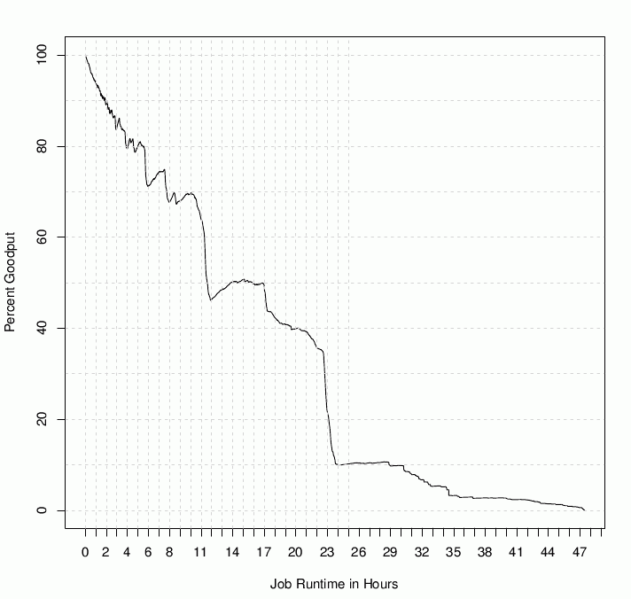

Slide 17
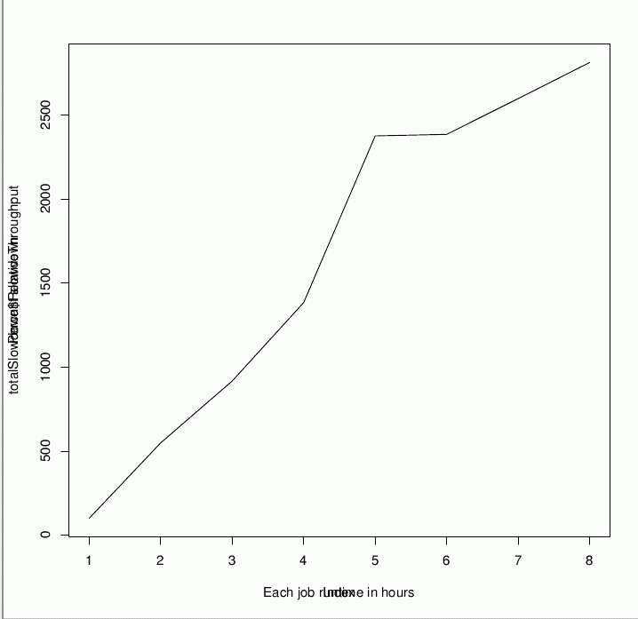
Wall clock slowdown

Slide 18
How to fix?
Mix and match
Opportunistic for throughput
Local resources for tail chopping

Slide 19
Summary
Opportunistic cycles are still very useful
Fairness and Throughput can be duals
Opportunistic + dedicated very powerful

