Slide 1
People Power Academic + Private Collaboration for Better Electric Motors Condor Week May 2012 Brooklin Gore

Slide 3
Dynasty? U of W Repeats as National Cyber Defense Champ.
- Government Computer News (04/25/12) William Jackson
She notes that teamwork helped the Washington team win the competition.
“The most important component was how they interact with each other,”
Kadenko says.
“They already had the knowledge ... but you can’t teach how to get along with somebody.”

Slide 6
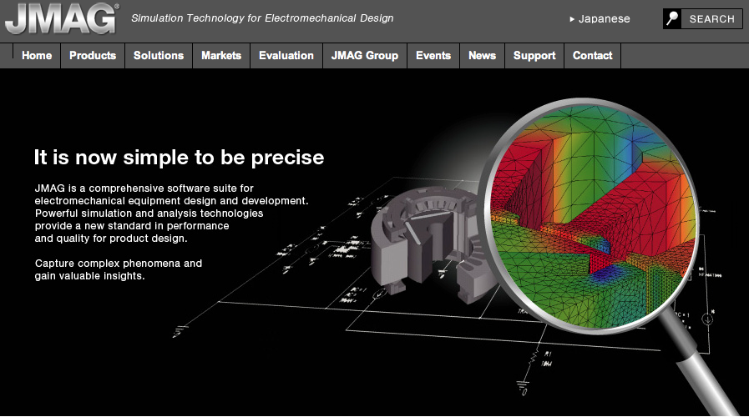

Slide 7
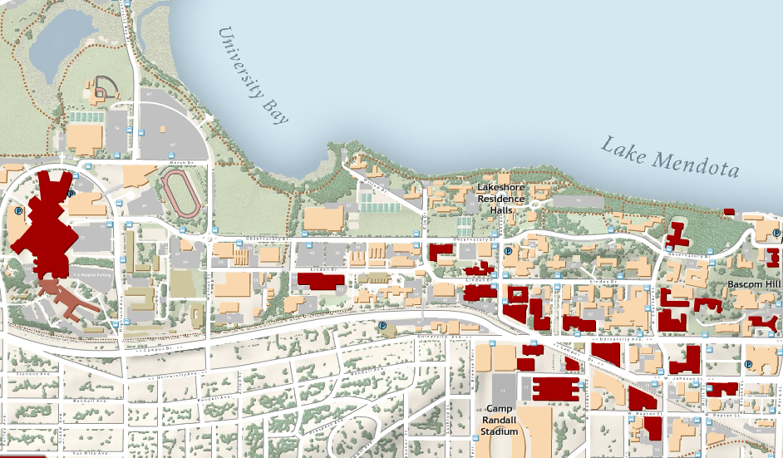
http://chtc.cs.wisc.edu
From July 2010 – June 2011:
45 million hours used by
54 research groups in
35 departments

Slide 8
Accomplishments:
JMAG enabled 100 Windows licenses for the WEMPEC
CHTC Staff worked with JMAG to get Windows App running via VM on Linux servers and inject parameters and extract data between runs.
WEMPEC researchers developed evolutionary algorithm to marshal optimization
Optimization now runs in ~24 hours
Presented results at 2011 JMAG Users Conference.
Next Steps:
CHTC work with JMAG to enable Linux version of solver
CHTC to continue driving speedup toward theoretical
WEMPEC to enable multi-physics optimizations considering not just E-M, but also thermal, structural and acoustic

Slide 9
HTC Theoretical vs. Actual Optimization Speedup
Hours
Difference between theoretical and actual due to:
Time to match job to machine
Time to inject parameters into Virtual Machine
Time to transfer and start VM on remote machine
Time to retrieve VM and extract results
720
30
Actual
4,800 jobs
2-D Transient simulation
Optimizing 6 parameters
10
Theoretical
Machines
1
80

Slide 10
One of the most important factors that has enabled success in this project has been the availability of three critical elements:
Expertise in JMAG (Yusaku Suzuki & team)
Expertise in machine design optimization (Wenying)
Expertise in UW HTC facilities (Bill Taylor & team)
Our progress would not have been possible if any one of the three components had been missing. We feel very fortunate to have this wonderful opportunity to work together.
-- Thomas Jahns, Co-Director, WEMPEC

Slide 11
Thank You. Questions? People Power Academic + Private Collaboration for Better Electric Motors

