Slide 1
Condor Release Lifecycle
May 5th 2011
Scot Kronenfeld
Greg Thain

Slide 2
Release Cycle Overview
Share our release process
Define development vs. stable
Notes:
Evolving process – this is a current snapshot for the Condor 7.7 series.

Slide 3
Stable vs. Development
7.4 stable series
7.4.1
7.6 stable series
7.4.0
7.4.2
7.4.3
7.4.4
From 7.3
7.6.0
7.5.0
7.5.2
7.5.4
7.5.6
7.5.1
7.5.3
7.5.5
7.5 development series
7.7 development series

Slide 4
Jan
Mar
3 weeks
Todd Tannenbaum’s talk will discuss upcoming features in Condor 7.7 and beyond.
Integrate w/
Twitter
Scheduling
IPv6
cgroups
Port to
iPad
Notes:
If you have a feature request for Condor 7.7. catch Todd T. during Condor Week or email condor-admin@cs.wisc.edu

Slide 5
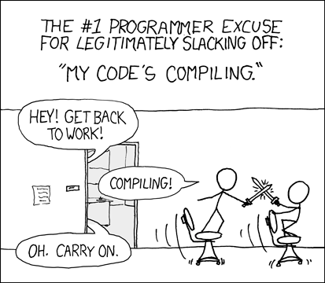
Jan
Mar
4 weeks
Gittrac: https://condor-wiki.cs.wisc.edu/index.cgi/wiki
Notes:
Development process includes:
- architecture and design planning
- peer review
- code is written in milestones
- code review
Condor team Gitweb at https://condor-wiki.cs.wisc.edu/index.cgi/wiki
Gitweb contains info on:
How to contribute: https://condor-wiki.cs.wisc.edu/index.cgi/wiki?p=MakingContributions
Info about our Git repository. How to get source: https://condor-wiki.cs.wisc.edu/index.cgi/wiki?p=DownloadingSource
Ticketing system for pending work
And more

Slide 6
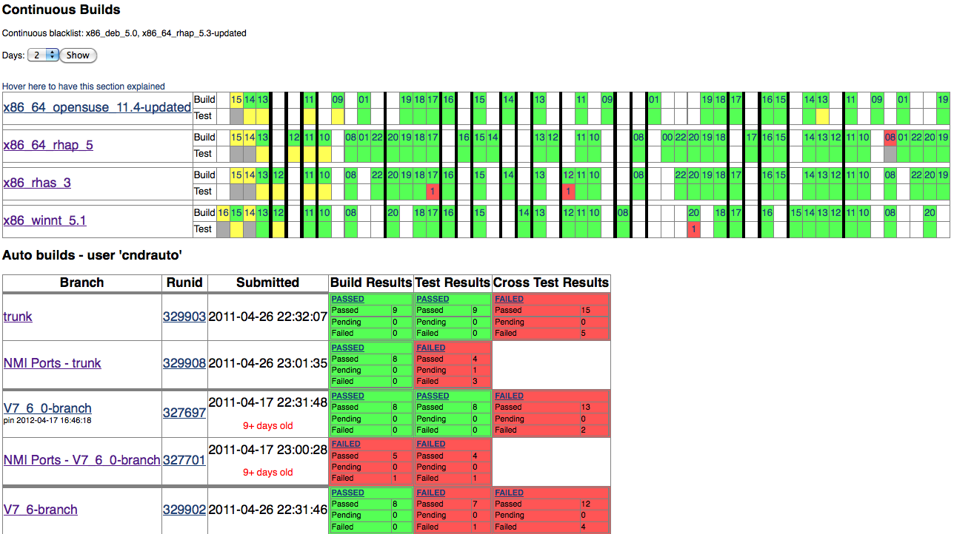
Jan
Mar
4 weeks
Dashboard: http://nmi-s006.cs.wisc.edu/results
Notes:
Manual developer testing
Automated regression test suite with

Slide 7
Jan
Mar
4 weeks
Local:
Center for High Throughput Computing
Build and Test Lab
Community:
UC San Diego / Fermi: Glidein stress test
Brookhaven National Laboratory: Condor-G test
More testing is welcome!
LIGO: standard universe regression test

Slide 8
Jan
Mar
4 weeks
Develop and testing happen in parallel:
Plan
Develop
Test
7.7.0
Plan
Develop
Test
7.7.1
Plan
Develop
Test
7.7.2

Slide 9
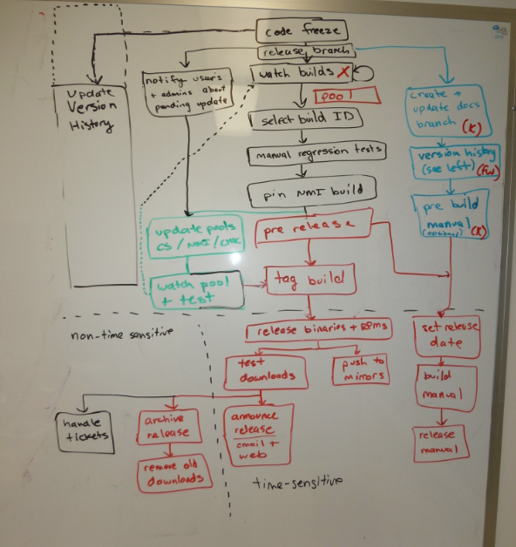

Slide 10
Native packages:
Wikipedia
http://en.wikipedia.org/wiki/Condor_High-Throughput_Computing_System

Slide 11
Condor Support Dialogue:
Start
Ask admin to reboot Condor
Problem goes away
Error
persists
No logs
created
Blame the hardware
Ask admin for logs
Admin never replies
No obvious
errors
OK
Examine logs
Trivial error
Obscure
error
Check
condor-users
Ian Chesal replies
Does a new
problem
occur?
No luck
Ask admin to update Condor
Ask Dan Bradley
Success!
Notes:
Condor-users mailing list info:
Join: https://lists.cs.wisc.edu/mailman/listinfo/condor-users
Archive: https://www-auth.cs.wisc.edu/lists/condor-users/

Slide 12
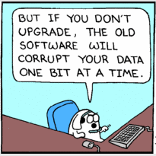
Development team is our support team
Support previous 18 months
Notes:
Community support email – condor-users@cs.wisc.edu
Condor team support email - condor-admin@cs.wisc.edu
Paid support information - http://www.cs.wisc.edu/condor/uw-support/

Slide 13
Summary
Stable vs. Development
Want to contribute?
Feature requests
Provide patches
Ideas for testing
Run pre-releases
Run developer releases
Condor-users

