Slide 1
Condor at the RACF
Migration to 7.4,
Group Quotas, and More
William Strecker-Kellogg
Brookhaven National Lab

Slide 2
RHIC/ATLAS Computing Facility Overview
Physics Dept. at Brookhaven National Lab—provides computing and storage to active RHIC experiments
Serves as a Teir-1 for ATLAS computing
Uses Condor to manage RHIC and ATLAS compute clusters
14.4k cores running SL5.3 currently
With new hyper-threaded 12-core Westmere systems, to grow to over 20k cores

Slide 3
RHIC/ATLAS Computing Facility Overview
One instance for ATLAS
5100 slots
2 submit nodes manage all production/analysis jobs
Other smaller queues managed on 3 other submit nodes
Instance each for STAR and PHENIX experiments
4300, 4500 slots resp.
20 submit nodes each
“General Queue”—flocking between RHIC pools
Smaller experiments grouped into another instance

Slide 4
New Since Last Year
New condor administrator
Migration to 7.4.2
Up from 6.8.9—long overdue
Move ATLAS to Group Quotas
Easier configuration—from 16 configuration files to 5—90% of slots use just 1)
Management via web-interface
Some problems we’ve had to solve…more later

Slide 5
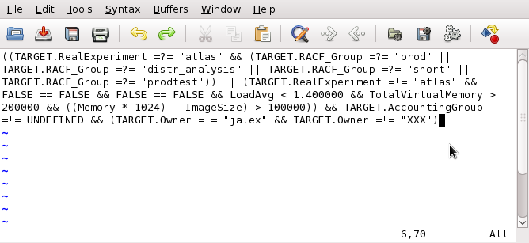
Upgrade to 7.4.2
Get rid of suspension model
Undesirable to have slots =!= real cores
Simplify START expression
Better negotiator performance, results later
Bugfixes all around
From this
To this

Slide 6
Group Quotas
ATLAS only, for now
PHENIX to follow suit in a few months
No plans for STAR
What groups buy us:
Manage ATLAS production/analysis jobs separately from many other smaller queues
Unify configuration files—one config for vast majority of ATLAS nodes

Slide 7
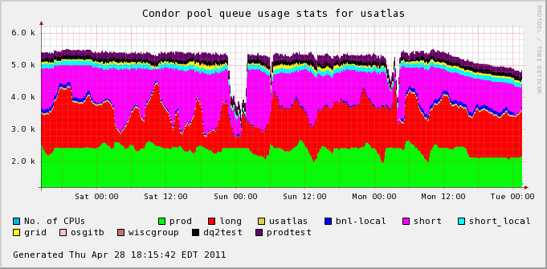
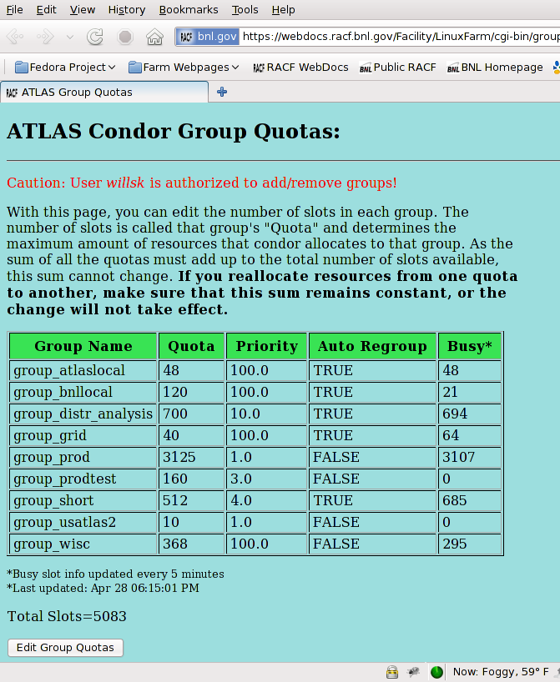
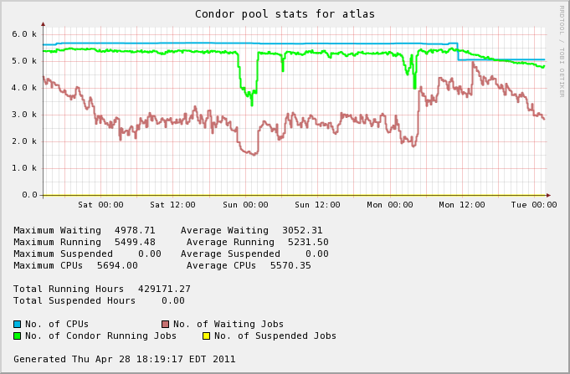
ATLAS Group Quotas
Reallocation of resources between queues managed via web interface
A Day in the Life of ATLAS

Slide 8
Issues Moving to Group Quotas
Backwards compatibility with our accounting and monitoring systems
Solution: Retain previous job-type flag that used to hard-partition slots
How does it interact with flocking?
Fairness / Enforcement of group memberships
“We rely on societal enforcement”
Not good enough…solution for ATLAS
ATLAS uses PANDA, we control local submission
Other users few enough to monitor individually

Slide 9
Issues Moving to Group Quotas
PHENIX: two classes—user and special jobs
Special jobs submitted from few machines, separate users
User jobs from 20 submit nodes
Two solutions
Submit node based partition: regex-match GlobalJobID ClassAd against list of valid sources in START expr.
Coexist with users: three configs, user nodes w/ no AccountingGroup flag, shared nodes that run anything but are ranked last by user and special jobs, and special nodes requiring AG flag

Slide 10
Group Priorities
ATLAS setup: three main groups
Production: highest prio., hard quota, no preemption
Short analysis: medium prio., auto-regroup on, preemption enabled
Long analysis: lowest prio., auto-regroup on, preemption enabled
Idea—short and long analysis spill over into each other as needed and not be squeezed out by production
Problem—sometimes short and long will “eat into” production even when they are over-quota and production is under its quota

Slide 11
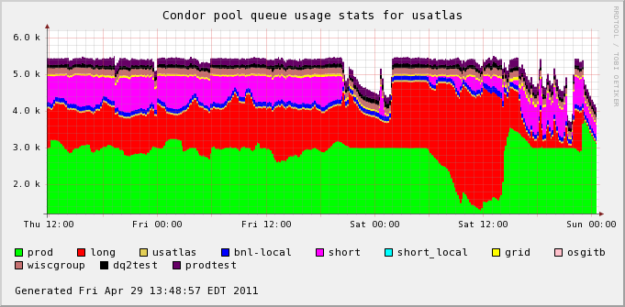
ATLAS Priority Inversion
Group-priority affects only order of negotiation
When an analysis queue starts up after a quiet period, production starts to lose out. Even though production is below its quota it loses slots to analysis jobs because they get negotiated for first.
Negotiation should stop for a queue that is over quota (w/ auto-regroup on) and there are other queues with waiting jobs below their quotas.
Problem area

Slide 12
ATLAS Priority Inversion
Solution? Increasing the spread of priority factors as more lots get added to production. Required spread scales with size of the largest queue, and if another queue quiesces for long enough it will outrank production
E.g. Production goes from 3k to 4k slots: usage increases 33% making its priority that much worse and an inversion that much more likely to occur…

Slide 13
Negotiator Performance
Performance from one day of the STAR negotiator
Cycle occasionally blocks waiting for a schedd (many successes near the default 30s timeout)
In case where many submitters are on many machines each, much wasted time

Slide 14
Issues with Scheduler/Negotiator
User frequently polling large queue
Schedd would fork a child which would use 5-10s of CPU time to answer query (1.6Gb Size!)
Auto-clustering sometimes doesn’t skip similar jobs
Globally-scoped ClassAds would be nice, e.g. for the usage of a shared scratch NFS filesystem

Slide 15
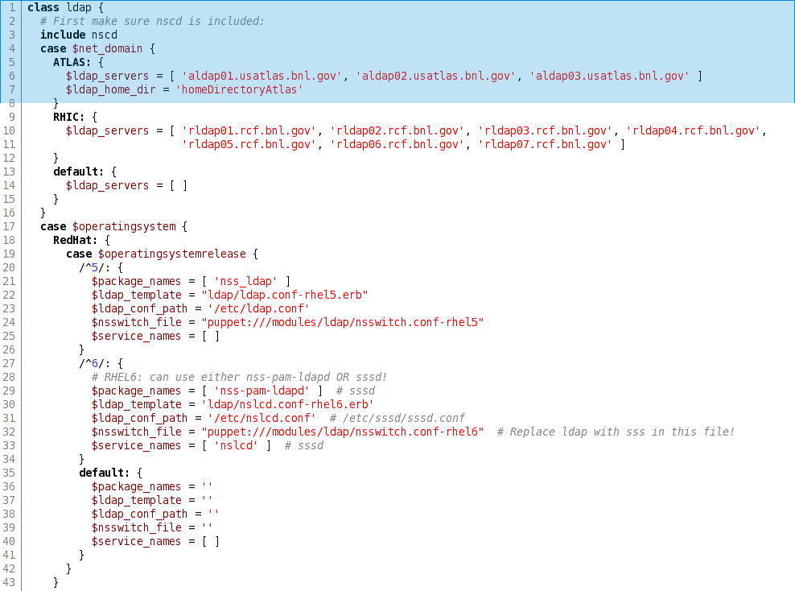
Puppet-ize Configuration Files
New Puppet-based centralized configuration management system of general-purpose servers
Will templatize condor configuration
Configuration done using a Ruby-based object-oriented templating language
Suitably scary at first…but worth the effort
http://www.puppetlabs.com

Slide 16
Motivation to use Puppet
Configuration is similar in structure between experiments
Memory Limits for regular and flocked jobs
Preemption/Retirement-time on a per-job-type basis
Policy expressions (RANK/START/etc…)
List of currently blocked users
Recent blocking/unblocking of users took editing 6 different files and a reconfig everywhere
Using Puppet would separate each logical entity, making it easy to change things on a per-entity basis, and would automate pushing of changes and reconfiguration. All changes versioned in git—accountability and reliability

Slide 17
Thanks!
Questions? Comments?

Slide 18
CRS Job System
Written in Python, submits to condor
Asynchronous IO for staging data from tape
Stages in and out are done outside of condor
Previously done with extra slots, not good aesthetically and otherwise
Can combine stage requests for jobs intelligently
Abstraction layer for IO, similar to plugins
Own basic workflow tools—DAGs not suitable

Slide 19
ATLAS Shared Pool
Allow smaller ATLAS queues and OSG grid jobs to run in their own queue that can utilize a small shared pool of resources
Implemented with Group Quotas
Jobs “compete” for extra slots made available by ATLAS
Necessitates adding AG flag by users (small enough it works)

