Slide 1
The Deconstruction of Dyninst
ProcControlAPI, ParsingAPI, and Binary Analysis

Slide 2
This Talk
Componentization
Overview
Principles
Challenges
Techniques
ProcControlAPI
ParsingAPI
Binary Analysis Components

Slide 3
Dyninst and the Components
= Existing Component
= New Component
= Proposed
AST
DyninstAPI
Code
Gen
SymtabAPI
Parsing
API
Process
Binary
Patching
Binary
Binary
Instruction API
DepGraph
API
ProcControl API
SymEval
Stackwalker
API

Slide 4
Guiding Principles
Clean Abstractions
Hide complexity
Necessary for portability
Portability
Same interface across multiple systems
System differences not visible
Sharing
Quickly build new tools
Notes:
Not why hard—but why important

Slide 5
Challenges
Interface and Abstractions
Finding the right level of detail
Building general components
Allowing inter-operability between components
Implementation
Integrating back into DyninstAPI

Slide 6
Challenges – The Right Abstractions
Ask “What will a user do with our tool?”
e.g., “Why does someone need dynamic linking info from SymtabAPI?”
Get the right level of detail in interface
Don’t want to provide “thin wrapper” libraries.
e.g., SymtabAPI vs. libbfd or libelf
High level interface allows platform independence

Slide 7
Challenges – General Components
Did we ask the right questions?
DyninstAPI:
Operates third-party
Focuses on instrumentation
Used in HPC and security
Embedded systems, software testing, …?
Hard to anticipate users’ needs
E.g., StackwalkerAPI written in C++

Slide 8
Challenges – Interoperable components
Easy to combine components we built:
StackwalkerAPI depends on SymtabAPI
ParsingAPI depends on InstructionAPI
Harder to combine components between groups:
Abstraction mismatch between MRNet and LaunchMON
How strong should dependencies between components be?

Slide 9
Challenges – Put it back together
Re-integration can temporarily leave two implementations.
Actual:
Ideal:
DyninstAPI
InstructionAPI
IA-64/Sparc
Instruction Parsing
SymtabAPI
ProcControl
API
Control Flow API
Extra maintenance costs

Slide 10
Examples of What We Did Right
Function abstraction in SymtabAPI
Level of detail in InstructionAPI
Flexibility in StackwalkerAPI
Hiding complexity in ProcControlAPI

Slide 11
SymtabAPI Function Abstraction
“Why do users look up code symbols?”
Because they care about functions!
Function
Symbol
Type
Signature
Local Variables
Code Range
Symbol
Symbol

Slide 12
InstructionAPI Level of Detail
Instructions are very platform dependent
Don’t want to hide all platform details
Don’t want to show all platform details
Targeting binary analysis
Common operations platform independent
Read/Write sets
Bind/Eval
…

Slide 13
StackwalkerAPI’s Flexibility
StackwalkerAPI easily customized
Plug-in interface
1st vs. 3rd party Stackwalking
Custom symbol access layer
Custom frame stepping routines
Defaults provided for common case

Slide 14
Achievements
More flexibility within our tools
Static binary rewriter benefited from componentization
DyninstAPI more maintainable
Fine-grained testing
Easier internal learning curve
Opportunity to spring-clean code base.

Slide 15
Achievements
Easier to adopt
More users
HPCToolkit, STAT, Libra, CBI, Cray APT, Open|SpeedShop, TAU, …
Quickly develop new end user tools
STAT uses MRNet, StackwalkerAPI, SymtabAPI and LaunchMON

Slide 16
ProcControlAPI
A component library for controlling and monitoring processes.
Target Process
Controller Process
Control/Query Process
Target Process
ProcControlAPI Library
Target Process
Receive Events
Notes:
Control = better word

Slide 17
Example Operations
Control Processes
Read/Write memory and registers
Pause/Resume threads
Insert Breakpoints
Receive Events
Thread creation/destruction
System calls (fork/exec/…)
Signals

Slide 18
ProcControlAPI Use Cases
StackwalkerAPI
Read stack memory from target processes
Get list of loaded libraries
DyninstAPI
Write instrumentation to processes
Handle process events (fork/exec)
Monitor threads
Debugger
Everything

Slide 19
ProcControlAPI Goals
Platform Independent Interface
Implemented On: Linux, Windows, BlueGene, AIX, Solaris, VXWorks, FreeBSD
Simple Interface (also powerful)
High-level abstractions in interface. E.g.,
Breakpoints
Inferior RPCs

Slide 20
Complexities
Handle multiple inputs
Process Control
OS Debug Interface
User API Calls
Event Pipe

Slide 21
Complexities
Handle multiple inputs
Event Generator Threads
Event Generator Threads
Process Control
OS Debug Interface
User API Calls
Event Pipe
Add threads for each input!

Slide 22
Complexities
Event handling may block
Event Generator Threads
Event Generator Threads
Process Control
OS Debug Interface
User API Calls
Event Pipe
Event Handler Thread
Add thread for event handling!

Slide 23
Complexities
May be handling multiple events
Event Generator Threads
Event Generator Threads
Process Control
OS Debug Interface
User API Calls
Event Pipe
Event Handler Threads
Add multiple event handler threads!

Slide 24
Complexities
Linux allows only one thread to call ptrace
Event Generator Threads
Event Generator Threads
Process Control
OS Debug Interface
User API Calls
Event Pipe
Event Handler Threads
Ptrace Thread
Add dedicated ptrace thread!

Slide 25
Complexities
Don’t want handlers delivering callbacks
Event Generator Threads
Event Generator Threads
Process Control
OS Debug Interface
User API Calls
Event Pipe
Event Handler Threads
Ptrace Thread
Send callbacks to user thread for delivery!

Slide 26
Complexities
Linux 2.4 wants waitpid and ptrace on same thread
Event Generator Threads
Event Generator Threads
Process Control
OS Debug Interface
User API Calls
Merged Ptrace & Generator Thread
Event Pipe
Event Handler Threads
Ptrace Thread
Merge ptrace and OS generator threads!

Slide 27
Complexities
Windows wants continue calls on generator thread
Event Generator Threads
Event Generator Threads
Process Control
OS Debug Interface
User API Calls
Merged Ptrace & Generator Thread
Event Pipe
Event Handler Threads
Ptrace Thread
Send continue events to generator!

Slide 28
More Complexities
Some Linux versions kernel panic if children are forked by a non-ptracer thread.
Need to handle multiple target processes.
Need to handle multi-threaded target processes.
BlueGene has high-latency debug interface

Slide 29
Interface
Hide complexity
User sees only one thread
High level abstractions
Consistent across platforms
Two primary interfaces:
Query/Control target process.
Receive and handle events

Slide 30
Process Class
Handle to target process
Create and attach to processes
Access process memory
Insert breakpoints
Track library loads/unloads
Track thread creation and destruction
Stop/Continue all threads
Detach from/terminate target process

Slide 31
Thread Class
Handle to thread in target process
Stop/Continue individual thread
Get/Set registers
Single step
Thread represents OS level handle for threads
May also provide thread library information

Slide 32
Inferior RPCs
Insert and invoke code in target process
(gdb) call getpid()
$1 = 14218
(gdb)
User provides machine code to run.
ProcControlAPI allocates memory, saves registers, runs code, restores registers and memory.
Returns result of iRPC

Slide 33
Events
Can register callbacks for process events:
Fork
Exec
Thread Create
Thread Destroy
Library Load
Library Unload
Breakpoint
RPC Completion
Exit
Crash
Single Step
Signal
Some events can have pre/post times
E.g., pre-exit and post-exit

Slide 34
Callbacks
Events are delivered via callbacks
User registers callbacks for interesting events
Only certain ProcControlAPI functions will trigger callbacks
Restrictions on callback functions
Can not call anything that would recursively trigger more callbacks.
This prevents races
Notes:
Races is not a restrictions

Slide 35
Notification
Want to deliver callback on user thread
User thread may be busy or blocked
User Code
ProcControlAPI
on_fork_callback() { …
}
{
}
Fork Event
handleEvents()
read(...)
Notify user that event is pending via Callback or FD

Slide 36
Implementation
Internally threaded
One thread to receive events (Generator)
One thread to handle events (Handler)
One thread to perform ptrace calls on Linux
User thread to handle events, receive callbacks, or trigger operations.
Event handling is a state machine to avoid recursive events.
Notes:
One Thread to bring them all and in the darkness bind them

Slide 37
Implementation
Event Generator Threads
User Thread
ProcControlAPI
OS Debug Interface
User API Calls
Ptrace Thread
Event Handler Thread
Use state machine to keep one handler thread.
No support for “problematic” OSs (Linux 2.4)
May expand thread model for parallelism on BlueGene

Slide 38
Current Status
Currently on Linux/x86, Linux/x86_64
Next platforms are Linux/ppc, BlueGene, and FreeBSD.
Windows, AIX, and Solaris support to follow.
Beta release available upon request.

Slide 39
Intermission

Slide 40
Binary parsing
main
foo
_lock_foo
dynamic instrumentation, debugger, static binary analysis tools, malware analysis, binary editor/rewriter, …

Slide 41
Familiar territory
Richard L. Sites, Anton Chernoff, Matthew B. Kirk, Maurice P. Marks, and Scott G. Robinson. Binary translation. 1993.
Amitabh Srivastava and Alan Eustace. ATOM: a system for building customized program analysis tools. 1994.
Barton Miller, Jeffrey Hollingsworth, and Mark Callaghan. Dynamic Program Instrumentation for Scalable Performance Tools. 1994.
Cristina Cifuentes and K. John Gough. Decompilation of binary programs. 1995
HenrikTheiling. Extracting safe and precise control flow from binaries. 2000.
Benjamin Schwarz, Saumya Debray, and Gregory R. Andrews. Disassembly of executable code revisited. 2002
J. Troger and C. Cifuentes. Analysis of virtual method invocation for binary translation. 2002.
Christopher Kruegel, William Robertson, Fredrik Valeur, and Giovanni Vigna. Static disassembly of obfuscated binaries. 2004.
Laune C. Harris and Barton P. Miller. Practical analysis of stripped binary code. 2005.
Ramkumar Chinchani and Eric van den Berg. A fast static analysis approach to detect exploit code inside network flows. 2005.
Nathan Rosenblum, Xiaojin Zhu, Barton P. Miller, and Karen Hunt. Learning to analyze binary computer code. 2008.

Slide 42
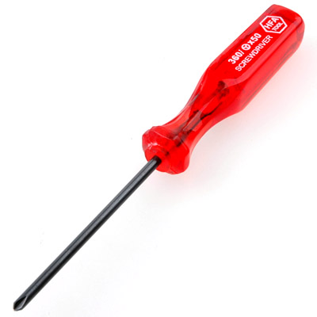
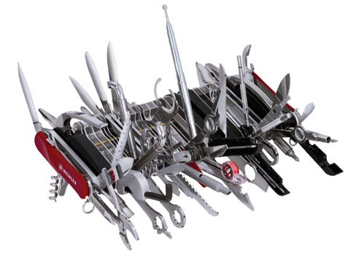
We’ve been down this road…
the DYNINST binary parser
recursive traversal parsing
“gap” parsing heuristics
probabilistic code models
non-contiguous functions
code sharing
non-returning functions
preamble scanning
handles stripped binaries
learn to recognize function entry points
very accurate gap parsing

Slide 43
What makes a parsing component?
2
simple, intuitive representation
1
abstraction
011101011010101010101110101001010101110001001001011010110011010101010101010010011110
Binary
code
source
Parsing API
functions
InstructionAPI
edges
blocks
0101110010110
SymtabAPI
3
platform independence supported by previous Dyninst components

Slide 44
Flexible code sources
Parser code source requirements:
code location
access to code bytes
a few (optional) facts
unsigned char * buf
pointer width
function hints & names
external linkage
41 56 49 89 fe 41 55 …
PLT
code
data
a binary code object
main
foo
bar
baz

Slide 45
Code source contract
bool | isValidAddress
bool | isExecutableAddress
void * | getPtrToInstruction
void * | getPtrToData
unsigned | getAddressWidth
bool | isCode
bool | isData
Address | codeOffset
Address | codeLength
Nine mandatory methods
SymtabAPI implementation in 232 lines (including optional hints, function names)
Any binary code object that can be memory mapped can be parsed

Slide 46
Simple control flow interface
Functions
contain
Blocks
joined by
Edges
start addr.
in edges
start addr.
type
src
targ
extents
end addr.
out edges

Slide 47
Views of control flow
Walking a control flow graph
starting here
while(!work.empty()) {
Block *b = work.pop();
/* do something with b */
edgeiter eit = b->out().begin();
while(eit != b->out().end()) {
work.push(*eit++);
}
}
✗
What if we only want intraprocedural edges?

Slide 48
Edge predicates
Walking a control flow graph
Edge Predicates
while(!work.empty()) {
Block *b = work.pop();
/* do something with b */
IntraProc pred;
edgeiter eit = b->out().begin(&pred);
while(eit != b->out().end()) {
work.push(*eit++);
}
}
Tell iterator whether Edge argument should be returned
Composable (and, or)
Examples:
Intraprocedural
Single function context
Direct branches only

Slide 49
Extensible CFG objects
ParseAPI Function
Simple, only need to represent control flow graph
Dyninst image_func
Complex, handles instrumentation, liveness, relocation, etc.
image_func
Special callback points during parsing
Factory interface for CFG objects
Function
parse parse parse
custom factory
unresBranchNotify(insn)
mkfunc()
(Function*)
image_func
[derived class does stuff]
parser
parse parse parse
Notes:
Image_func takes up only ~ 80 bytes more than a Function but has almost ten times as many methods

Slide 50
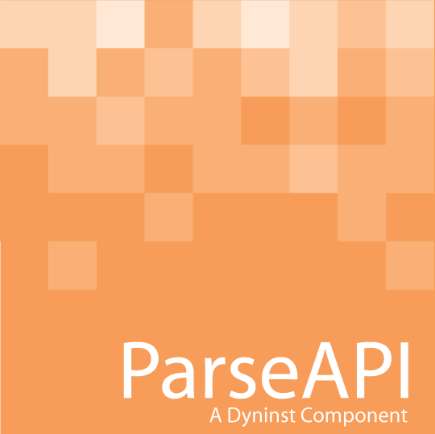
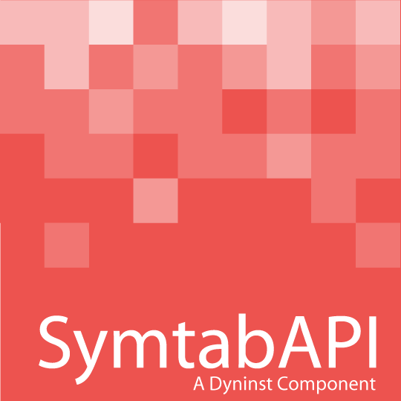
What’s in the box?
* box to be released soon
Control Flow Graph Representation
SymtabAPI-based Code Source
Binary Parser
recursive descent parsing
speculative gap parsing
cross platform: x86, x86-64, PPC, IA64, SPARC
graph interface
extensible objects for easy tool integration
exports Dyninst InstructionAPI interface
cross-platform
supports ELF, PE, XCOFF formats

Slide 51
Status
✓
✓
✓
Dyninst re-integration
(major test case)
conception
code refactoring
interface design
other major test case: compiler provenance (come tomorrow!)

Slide 52
Intermission

Slide 53
Binary Analysis
SymEval
Components
Instruction Semantics
DepGraphAPI
Alias Analysis
AST Simplification

Slide 54
Instruction Semantics
=
eax
+
add 4,%eax
eax
4
Instruction Semantics
InstructionAPI
ROSE
Instructions into semantic ASTs
Built with ROSE

Slide 55
Alias Analysis
push %ebp
mov %esp,%ebp
sub $12,%esp
lea 4(%ebp),%eax
mov $12,(%eax)
mov 16(%esp),(%ebx)
mov 4(%ebp),0x8084100
leave
ret
push %ebp
mov %esp,%ebp
sub $12,%esp
lea 4(ebp), %eax
mov $12,(%eax)
mov -8(%esp), %ebp
mov 4(ebp),0x8084100
leave
ret
Local 1
Local 1
Param 1
Unknown
Local 1
Global
Identify stack and global variables
Plug-in more sophisticated analysis

Slide 56
AST Simplification
=
ebx
10
=
=
mov $10,%ebx
shl $2,%ebx
add $2,%ebx
add %ebx,%eax
mov $5,(%eax)
ebx
<<
*
5
ebx
2
+
=
eax
42
ebx
+
ebx
2
…

Slide 57
DepGraphAPI
Build Control Dependence Graphs (CDG)
“Why am I executed”
Build Data Dependence Graphs (DDG)
“Where do my inputs come from?”
“Where do my outputs go?”
Already beta released in Dyninst 6.0

Slide 58
DepGraphAPI - Slicing
sub $4,%esp
inc %edx
pop %ebx
mov 0x1000,%ecx
lea 10(%ebx),%eax
add $2,%ecx
call %eax
sub $4,%esp
pop %ebx %esp
lea 10(%ebx),%eax
call %eax
Derive slices from CDG and DDG
New features to build slices on-the-fly.
Cheaper for small numbers of slices

Slide 59
Example: Jump Tables
...
cmp $0xa,%eax
ja 0x804c900
inc %ecx
lea 0x1920(%rip),%rdx
mov (%rdx,%rax,4),%rax
add %rdx,%rax
jmpq *%rax
Where can the jump go? What is %rax’s final value?

Slide 60
Example: Jump Tables
...
cmp $0xa,%eax
ja 0x804c900
inc %ecx
lea 0x1920(%rip),%rdx
mov (%rdx,%rax,4),%rax
add %rdx,%rax
jmpq *%rax
cmp $0xa,%eax
ja 0x804c900
lea 0x1920(%rip),%rdx
mov (%rdx,%rax,4),%rax
add %rdx,%rax
jmpq *%rax
1. Slice from jump for relevant instructions

Slide 61
Example: Jump Tables
cmp $0xa,%eax
ja 0x804c900
lea 1920(%rip),%rdx
mov (%rdx,%rax,4),%rax
add %rdx,%rax
jmpq *%rax
cmp $0xa,%eax
ja 0x804c900
lea 0x1920(%rip),%rdx
mov (%rdx,%rax,4),%rax
add %rdx,%rax
jmpq *%rax
Code
Data@804e100
2. Run alias analysis to simplify

Slide 62
Example: Jump Tables
=
cmp $0xa,%eax
ja 0x804c900
lea 0x1920(%rip),%rdx
mov (%rdx,%rax,4),%rax
add %rdx,%rax
jmpq *%rax
rax
+
=
rdx
x
Code
rax
rax
+
4
Data@804e100
rdx
rax
=
rdx
Data@804e100
3. Use Instruction semantics to convert to ASTs

Slide 63
Example: Jump Tables
=
=
rax
+
rip
+
=
rdx
x
Data@804e100
*
rax
+
rax
4
rax
+
rdx
Data@804e100
x
=
rax
4
rdx
Data@804e100
4. Use AST Simplification to get single AST

Slide 64
Example: Jump Tables
=
rip
+
Data@804e100
*
Reference to RO data
+
Data@804e100
x
rax
4
Single Unknown Input

Slide 65
Status of Analysis Components
Work in progress
Build public interfaces
Finish implementations
Currently being used for
Concolic execution
Safe code relocation
Jump tables
Fingerprinting
DepGraphAPI in beta

Slide 66
Conclusions
ProcControlAPI & ParsingAPI
New components
Available for friendly beta
Binary Analysis
Set of components for binary analysis
Still under development.

Slide 67
Questions?

