Slide 1
A configurable binary instrumenter
making use of heuristics to select relevant instrumentation points

Slide 2
Presentation outline
Introduction
Instrumentation
Configurable instrumenter
Heuristics to select relevant points
Architecture
Example

Slide 3
Introduction
Student at the RWTH Aachen, Germany
Helmholtz-University Young Investigators Group
“Performance Analysis of Parallel Programs”
Lead by Professor F. Wolf
Located at the “Jülich Supercomputing Center”

Slide 4
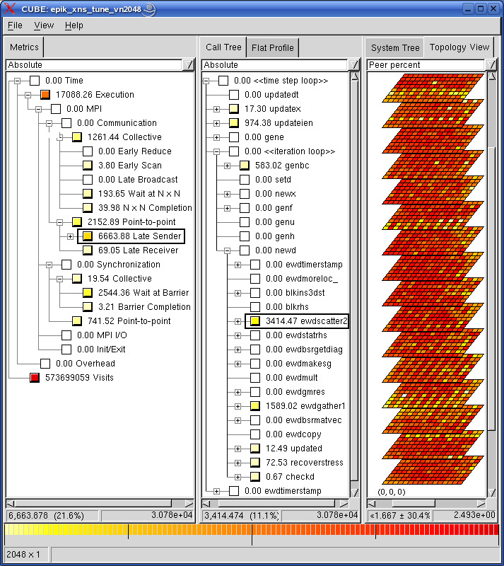
Integrated measurement & analysis toolset
Runtime summarization (aka profiling)
Automatic event trace analysis
Objective
Development of a scalable performance analysis toolset
Specifically targeting large-scale applications
Supports various languages & parallel programming paradigms
Fortran, C, C++
MPI, OpenMP & hybrid MPI/OpenMP
More information at:
www.scalasca.org

Slide 5
Presentation outline
Introduction
Instrumentation
Configurable instrumenter
Heuristics to select relevant points
Architecture
Example

Slide 6
Instrumentation
Two ways to gather information
By direct instrumentation
By sampling, periodic measurement
Link between program and measurement system
Trace events during program execution
Profile to evaluate where time is spent

Slide 7
Possibilities of instrumentation
Source code transformation
Manually added by user
Automatically, e.g. TAU, OPARI
Compiler supported
Wrapper functions
Adding function calls
Library interposition
MPI <-> PMPI
Binary instrumentation
Static, e.g. TAU
Dynamic, e.g. Paradyn

Slide 8
Static binary instrumentation
Advantages
Language independent
Instrumentation of optimized code
Possible if no source available, e.g. libraries
Templates are instantiated
No need to recompile
Disadvantages
Limited information available
Not all platforms are supported

Slide 9
Information provided by Dyninst
Method identification
E.g. Namespace::Class::Method in C++
List of called subroutines in given function
Control flow graph and loop tree
Possibility to access basic blocks
What information is available?
Depends in part on available symbol table
Improves when debug information are present
Sourcefile and sourceline become available

Slide 10
Presentation outline
Introduction
Instrumentation
Configurable instrumenter
Heuristics to select relevant points
Architecture
Example

Slide 11
Configurable binary instrumenter
Configurable by both the tool provider and user
Tool provider focuses on adapter specification
Define code for initialization
Define code for instrumentation
Includes filter for the measurement system
User starts with provided filter
Refines the filter to his or her needs

Slide 12
Possible instrumentation points
Functions
Function enter and exit
Loops
Before and after the loop
Loop body enter and exit
Callsites
Before the function call
After the return

Slide 13
Filter requirements
Selective binary instrumentation
Provide a usable default filter
Allow the user to refine which parts to instrument
Configurable set of instrumentation points
Filter by function, class and module names
Filter by properties
Ability to combine filters

Slide 14
Filter
Patterns
Modules
Properties
What to instrument?
Start with set of functions
All
None
Filter set further using
String patterns for
Filename (module)
Namespace, classname
Properties
E.g. callgraph, depth

Slide 15
Filter specifcation
A single XML document
Patternlists as plain text for elements taking lists
Filter
Include or exclude elements containing
„and“, „or“, „not“ and „true“ or „false“
Functions, classes, namespaces, modules
Property
Callsite filter for restricting instrumentation

Slide 16
Filter specification example
<filter name="pathtest" instrument="functions=handletest" start="all">
<exclude>
<or>
<not>
<property name="path">
<functionnames match="simple">
MPI*
</functionnames>
</property>
</not>
<functionnames>main</functionnames>
</or>
</exclude>
</filter>

Slide 17
Inserted code
The instrumenter has to support
Additional dependencies (measurement system)
Variable declarations (e.g. region handles )
Code for initialization (run once at startup )
Code to be executed at points
Enter / exit
Before / after
Provide access to context information
@linenumber@, @functionname@,…

Slide 18
Instrumentation specification
Independent XML document
Include adapter filter
Dependencies
Add dynamic libraries
Variable element
Type information
Memory to allocate
Code in plain text
C-like syntax
Code
Variables
Init
Before
Enter
Exit
After
Var
Var

Slide 19
Example specification
<code name="handletest">
<variables>
<var name="handle" type="void*" size="4" />
</variables>
<init>
initNotify(@functionname@,@linenumber@,@filename@);
handle = createHandle(@functionname@);
</init>
<enter>enterHandle(handle);</enter>
<exit>exitHandle(handle); </exit>
</code>

Slide 20
Presentation outline
Introduction
Instrumentation
Configurable instrumenter
Heuristics to select relevant points
Architecture
Example

Slide 21
Goal Automatic selection of relevant instrumentation points

Slide 22
How to select instrumentation points
What makes a point relevant?
Granularity of trace to locate possible problems
Ability to profile where time is spent
Communication
I/O
Is decision possible with available information?

Slide 23
Heuristics using binary code
Aim here: do not instrument short functions
Instrumentation costs exceed function costs
Complexity of function
Contains „if“ and „loop“ statements
Amount of instructions
Subroutine calls
Cyclomatic Complexity
Complexity M = E(dges) – N(odes) + 1

Slide 24
Heuristics using debug information
Lines of code
May be obscured by comments and code style
Method name hints
Exclude e.g., helper functions „get*“, „set*“
Include „do*“ ,“process*“, „calculate*“, or „solve*“
Classname and namespace

Slide 25
Heuristics using callpath
Callpath of functions
Leads to I/O functions?
Leads to MPI functions?
Leads to functions using OpenMP?
Depth of function in call graph
Instrument only to specified depth
Problem for static callpath construction
Virtual functions, function pointers

Slide 26
Unevaluated results
CP2K Fortran code with Intel 10 compiler
12652 functions ( 50MB binary )
Using MPI path reduced to 5194
Using adapter filter and mpi path 767 remain
GENE Fortran code
7095 functions ( 13MB binary )
Using adapter filter and MPI path reduced to 3144
Remove nodes on direct path, leaves 2510 function
BT (NAS Parallel Benchmark)
Reduced to 27 functions with MPI callpath filter
More in the example later

Slide 27
Presentation outline
Introduction
Instrumentation
Configurable instrumenter
Heuristics to select relevant points
Architecture
Example

Slide 28
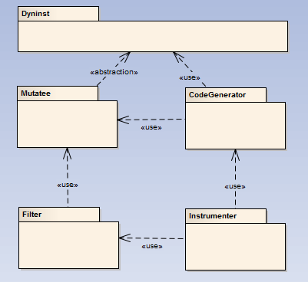
Architecture
Mutatee
Layer between Dyninst and filter component
Filter
Responsible for reading filter
Evaluate filter
CodeGenerator
Parses code specification
Generates Dyninst snippets
Instrumenter
Instruments the filtered set with generated code

Slide 29
Dependencies
Dyninst
Boost
Spirit – Parser for adapter code
Regex – Regular expressions in filter
Tokenizer
Apache Xerces
XML DOM parser for the adapter and filter files

Slide 30
Open issues
Binaries contain a lot of functions
Compiler-specific functions added
Scalasca does not provide dynamic library
Need to preinstrument with “skin –comp=none –user”

Slide 31
Future work
Adding more properties
sourceLines, hasControlStructure, calledInLoop
Evaluate reduction in instrumented functions
Instrument benchmarks
Instrument sample application
Evaluate advantage over filtering at runtime
Evaluate advantage of instrumenting optimized code

Slide 32
Example
Instrumenting NAS Parallel Benchmark BT
preinstrument
binary instrumenter
analyze
skin = scalasca –instrument –comp=none –user
scan = scalasca –analyze mpirun –n 4 ./mutated

