Slide 1
Automatically Adapting Sampling Rates to Minimize Overhead
Geoff Stoker

Slide 2
Sample of Sampling Practices
200 samples/sec [T09]
20,000 samples/sec [A05]
2.5% of all memory operations [O05]
15 sec periods of detailed CPU analysis; 10 sec periods for memory [R08]
1,000,000 consecutive memory accesses – then skip 9,000,000 [W08]

Slide 3
Intuition
Best Possible
Measurement
Performance
(time)
Measurement
Error
Perturbation
Error
actual program performance
# of samples

Slide 4
Mathematical Model
How much run time is attributable to foo() ?
T(n) = measured time when taking n samples
p = proportion of given function
o = overhead cost per sample
T_{a} = running time of entire program
z = confidence level z value

Slide 5
Mathematical Model

Slide 6
Example
T_{a} = may not know it, so best guess
z = 1.96 for 95% CL
p = probably don’t know it, so use .15
Why? 0<=p<=1; p(1-p) ranges .00 - .25; when p=.15, p(1-p) is .1275, a middle value
o = 250 µseconds (empirical tool use)

Slide 7
Example Continued
Time in seconds, # of samples to best measurement is:
T_{a} = 300, n = 19,863
T_{a} = 600, n = 31,531
T_{a} = 900, n = 41,317
Observation: sampling rate decreases non-linearly as time increases
T_{a} = 300, sample rate = 66/s
T_{a} = 600, sample rate = 53/s
T_{a} = 900, sample rate = 46/s

Slide 8
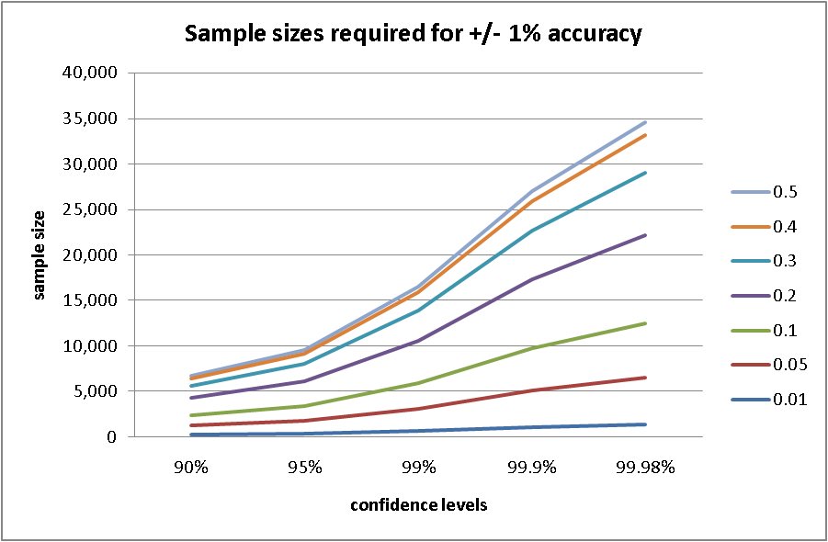
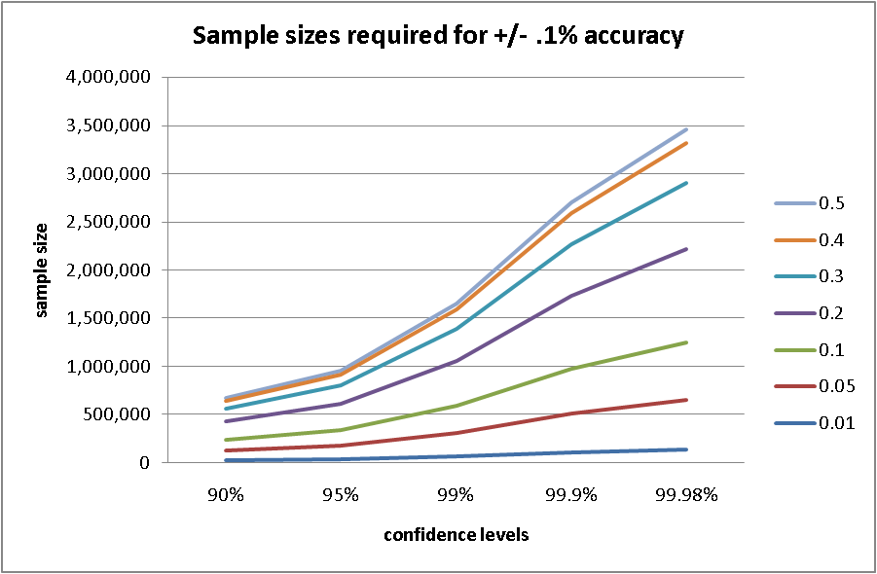
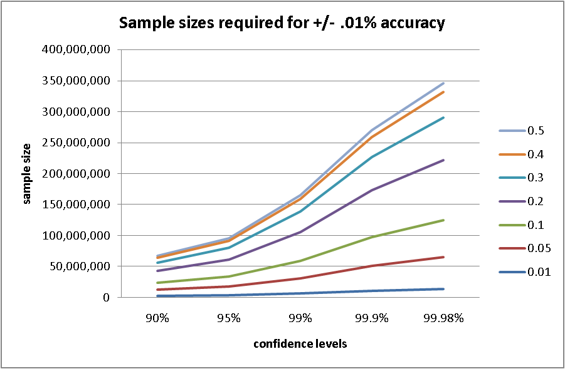
Sample Size vs Accuracy
One order of magnitude accuracy change
Two orders of magnitude sample size change

Slide 9
Adapting Sampling Rates
Prior to a performance analysis run
Calculate “best” sampling rate per parameters of run
Confidence level
Confidence interval
Estimated execution time
Sampling overhead
During a performance analysis run
Adjust the sampling rate based on intermediate analysis
Function taking largest proportion of execution time
Total observed execution time

Slide 10
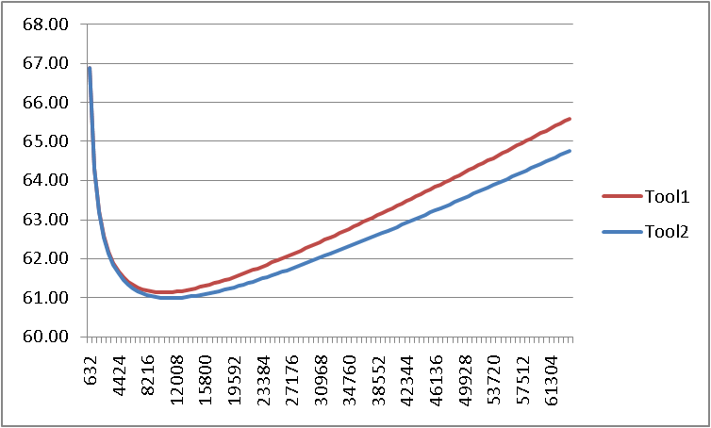
Example Simulation Result
Best Possible
Measurement
Measured value for target function
(time)
# of samples

Slide 11
Future Work/Conclusion
Finish tool construction
Generate results
Validate simulation results on test programs
Test technique with real programs
Explore dynamic overhead calculation
Questions?

Slide 12
Back-up slides

Slide 13
Jain vs Lilja
Sample size for determining proportions
J: r is CI for p/100
L: r is CI for ci/p
J, The Art of Computer Systems Performance Analysis, 1991, pg 217.
L, Measuring Computer Performance, 2000, pg 55.

Slide 14
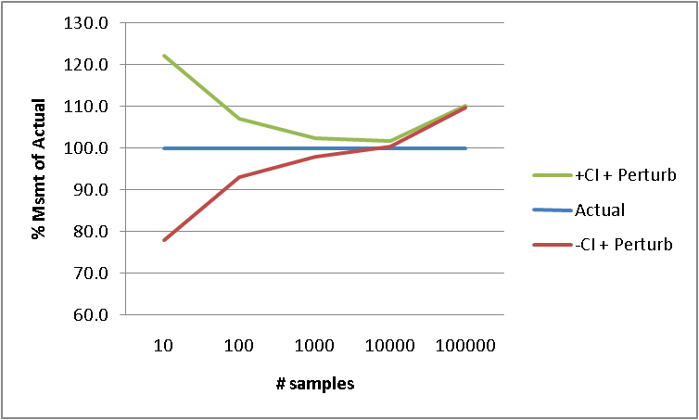
Intuition Refined
Best Possible
Measurement

