Slide 1
Infrastructure Challenges for Scalable Data Analysis Algorithms April 12, 2010
Todd Gamblin
Center for Applied Scientific Computing
Lawrence Livermore National Laboratory
This work performed under the auspices of the U.S. Department of Energy by Lawrence Livermore National Laboratory under Contract DE-AC52-07NA27344

Slide 2
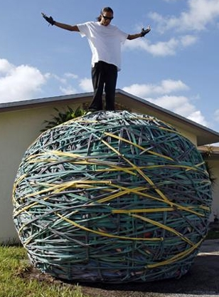
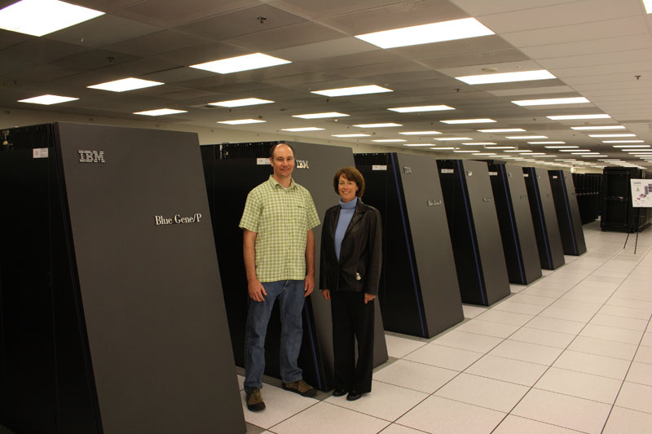
High Concurrency Levels Lead to Unmanageable Performance Data
Architectures are becoming more complex to support massive concurrency
Performance data volume scales linearly with number of concurrent tasks
Exascale:
500 million to 4 billion threads!
Sequoia:
1.6 million cores
6 million threads
Blue Gene/L: 208k cores

Slide 3
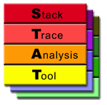
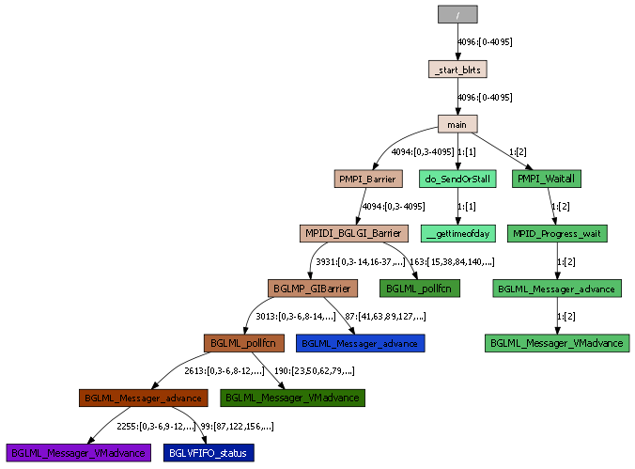
We already have STAT for reducing call stack data
STAT uses MRNet to merge call stacks
Has scaled up to 208k cores
Symbols in call stacks are translated dynamically using 3rd-party SymtabAPI
String representation aggregated and merged
Member ranks of classes merged in bit vectors
Can also merge temporal ordering information
Loop info in call stack

Slide 4
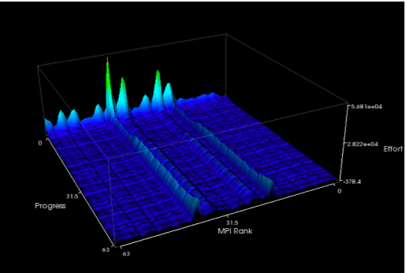
How do you scalably aggregate and analyze numerical performance data?
This talk is about two tools for in-situ analysis
Libra
Tool for scalable load balance measurement
Splits code into regions using StackwalkerAPI
Visualizes load balance of regions
CAPEK
Scalable clustering algorithm for distributed data
Up to 131,072 cores, O(log(P)) performance
For this talk, I am focusing on:
Communication patterns of the tools
Stackwalker-related infrastructure challenges

Slide 5
Libra Tool: The Effort Model
Progress Loops
Typically the outer loops in SPMD applications
Represent absolute progress toward completion
Usually correspond to time steps, fixed # of iterations
Effort Regions
Variable-time regions of code in SPMD applications
Nested within progress loops
Represent variable work that must be done
Data dependent case: Adaptive/convergent solvers
Environment-dependent case: Slow nodes, misconfiguration

Slide 6
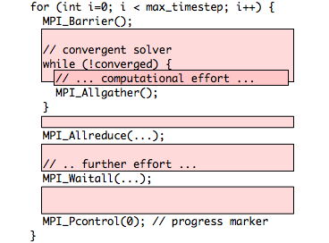
Libra Instrumentation slices applications into effort regions
Manually instrument progress loop
Gives us time axis
Use StackwalkerAPI
Collect start and end callpaths of synchronous MPI operations
Every progress step:
Record cumulative time spent in effort regions
We get a region per pair of dynamic callpaths
One surface plot per region
“Slice” code into different load behaviors

Slide 7
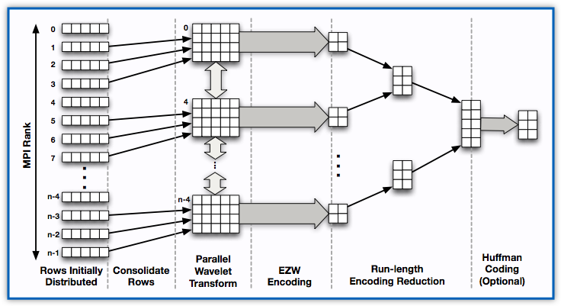
We manage data volume with parallel compression
Four phases of compression algorithm:
Row consolidation
Parallel Wavelet Transform
Local encoding
Reduction

Slide 8
Libra: Parallel Compression
Row Consolidation
Effort data for one region is initially distributed, 1 row per process
Local gathers consolidate data to a smaller set of processes
Grouping by R rows enables R simultaneous compressionsTask and data parallelism

Slide 9
Libra: Parallel Compression
Parallel Wavelet Transform
Wavelet transform applied to consolidated data
Transform requires only nearest-neighbor communication
Near-perfect scaling

Slide 10
Libra: Parallel Compression
Parallel Wavelet Transform
Wavelet transform applied to consolidated data
Transform requires only nearest-neighbor communication
Near-perfect scaling

Slide 11
Parallel Compression
Local Encoding + Reduction
Local EZW coding
Run-length encoding reduction
Huffman coding of output (optional)

Slide 12
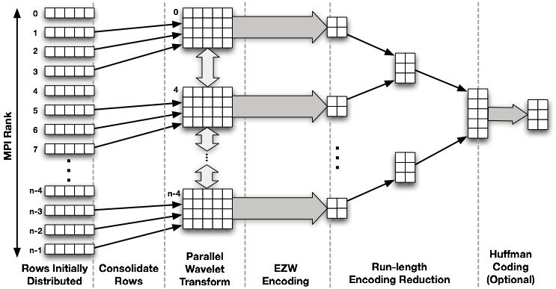
Task Parallelism in Libra
Aggregation of one region loses parallelism
Libra has hundreds of distributed matrices of load balance data to compress
Can compress one such region with a parallel wavelet compression algorithm
Need to aggregate distributed rows to smaller set of processes, so we lose some parallelism.

Slide 13
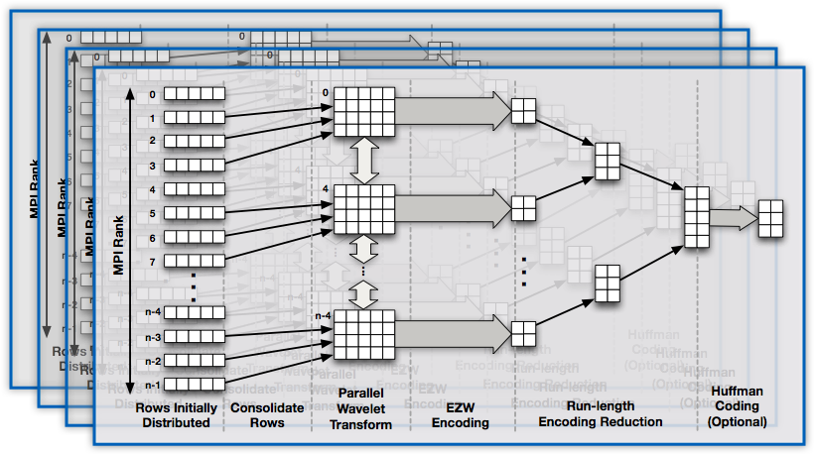
Task Parallelism in Libra
Make up for lost data parallelism with task parallelism
Solution: compress all such regions very fast using homogeneous task parallelism
Aggregate multiple regions to smaller subsets, then use all processes to do simultaneous compression

Slide 14
Compression Scalability in Libra
We have run Libra on up to 16,384 processes on BlueGene/P
Observed sub-linear compression time scaling
Variability comes from open()
Other operations are near-constant, keeps total time under 3 seconds at scale.
Compression:
2-3 orders of magnitude
4-5% error

Slide 15
Coordinating compression in Libra
We need a way to correlate rows from the same region across processes
Recall that each region is identified by its start and end callpaths
Region identifiers shown as circles ( ) at right
Need to match region ids between processes
Requires a process-independent callpath representation
Compression is collective; need to dispatch with the right rows simultaneously
Addresses can vary due to different load addresses for the same library in different processes.
May be different sets of region ids on different processes due to differences in execution
MPI Rank
1 local row from each effort region

Slide 16
Module-offset representation
STAT is able to merge callpaths because translation is done in the back end
Call frames are graph elements w/string labels
Names are process-independent
Libra runs inside instrumentation
Can’t afford 1st-party SymtabAPI translation on every stackwalk b/c it’s too frequent
We use getLibOffset() call in StackwalkerAPI
Each call frame is a library and an offset into that library rather than an absolute address.
Translation is done in the front-end or offline
Runtime representation doesn’t require translation, so still fast.
_start
_libc_start_main
main
someFunctionName
MPI_Barrier
Stackwalk in STAT (strings)
bool Frame::getLibOffset(std::string &lib, Dyninst::Offset &offset, void* &symtab);
0x347
/usr/lib64/libc.so.6
0x54a
/home/foo/a.out
0x37d
/usr/lib64/libmpich.so
0xc1f
Module Table
0x4fa
Stackwalk in Libra (module-offset)

Slide 17
Module-offset representation
Advantages:
Process-independent representation of call frames
Frame handles are small, can be compared fast by value
Doesn’t require 1st-party translation on the backend
Disadvantages:
Doesn’t save you if there’s library skew
e.g. Ranger system actually has different versions of libc on different nodes
We claim you’re hosed anyway if this happens
Paths are not self-contained – need to transfer translation table when we ship things between processes
This is pretty low overhead, encapsulated in transfer routines
Need to have binaries around on the front-end when it’s time to translate
Disadvantages are not significant for most of our use cases

Slide 18
Module-offset representation lets us sort regions
Union all callpath pairs
Broadcast union to all processes
Sort rows locally by callpath pairs
Dispatch instances of compression
algorithm in sort order
With module-offset representation, we can coordinate the collective compression operations:
Union all callpath pairs to root
Broadcast full set of callpath pairs to all processes
Sort callpath pairs
Match rows between processes using sort ordering

Slide 19
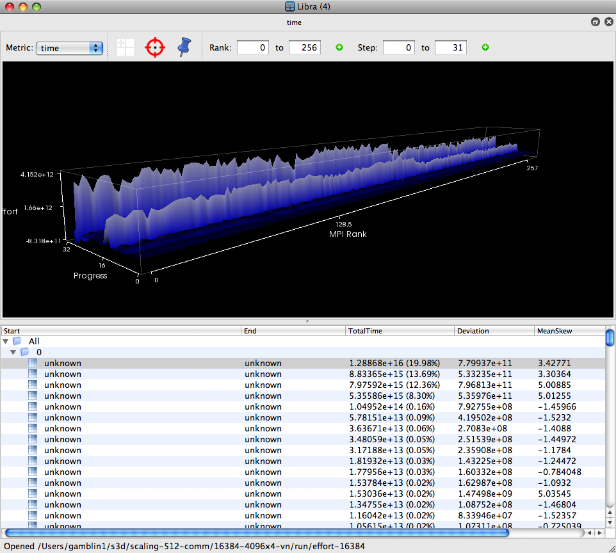
Libra Front-end GUI
Libra GUI supports off-line viewing
Displays effort surfaces for different regions of code
Translation is done using SymtabAPI
GUI is written in Python with VTK and PyQt4
Can view large datasets with multiscale wavelet representation
Scalable Visualization
Load-balance statistics
Source Correlation

Slide 20
Future Directions for Libra
Modify GUI to support streaming and interactive visualization
Likely will need MRNet support to get data out of system and into front-end
Map parallel wavelet transform and compression techniques to MRNet
Wavelet transform is most difficult part
Currently requires nearest neighbor communication

Slide 21
Cluster analysis at scale
Tools frequently have lots of data distributed over many processes
Would like some scalable way to get equivalence classes from numerical data in a system
Don’t want to aggregate all the data
O(P) data for P processes is unscalable
Existing clustering algorithms do not scale and can’t handle distributed data
Hierarchical clustering can be run in a tree, but complexity is still O(PlogP). This is not fast enough for on-line use.
Existing parallel partitioning algorithms have poor scaling after ~100s of processes.

Slide 22
K-Medoids clustering
Like K-Means, but slower and less sensitive to outliers
Given K, find K representatives, or medoids that minimize total distance from each object to its nearest medoid.
Minimizes intra-cluster dissimilarity
Can apply criteria like Bayesian Information Criterion to get rid of requirement for fixed K
User supplies Max K and algorithm finds an ideal K < Max K.
Complexity of sequential algorithm PAM is O(n^2)
Sampled sequential algorithm CLARA is O(n)

Slide 23
CAPEK Clustering Algorithm
We have come up with a sampled partitioning algorithm that can run in O(log(P)) time for P processes
Looked at existing algorithms and eliminated linear scaling factors
Our algorithm runs in less than a second on 131,072 processes on BlueGene/P for simple data
Enables cluster analysis on performance data in-situ in parallel applications.
Clustering Algorithm with Parallel Extensions to K-Medoids (CAPEK)
Based on CLARA sampled K-Medoids algorithm
Designed for very large machines and distributed data

Slide 24
CAPEK Algorithm Overview

Slide 25
CAPEK Scalability
Performance on up to 131,072 cores
Algorithm runs in < 1 second for simple vector data
More complex data may take slightly longer but will not affect scalability

Slide 26
Cluster Quality
Figure shows error of CAPEK compared to sequential, un-sampled K-Medoids
Error < 8% from optimal clustering on up to 4096 processes

Slide 27
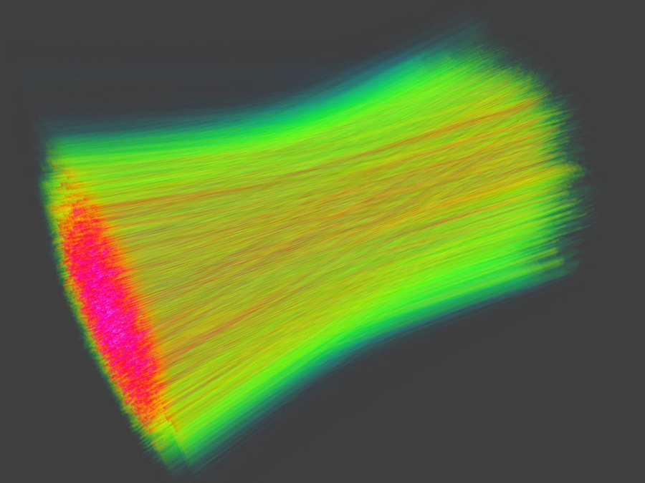
Future directions for CAPEK
As with Libra, we would like to pull CAPEK out into an MRNet tree.
Minimize perturbation to the application, perform clustering out-of-band
Also like Libra not a perfect fit for MRNet
Working on a scalable I/O profiler using CAPEK
Evaluate performance of scalable I/O dump schemes in pF3D laser-plasma code
Use clustering to avoid gathering 100k+ profiles
Correlate clusterings of MPI profiles, I/O profiles, and bandwidth traces to diagnose root causes

