Slide 1
High Throughput Parallel Computing (HTPC)
Dan Fraser, UChicago
Greg Thain, UWisc
Condor Week
April 13, 2010

Slide 2
The players
-Dan Fraser
Computation Inst.
University of Chicago
Miron Livny
U Wisconsin
John McGee
RENCI
Greg Thain
U Wisconsin
Funded by NSF-STCI

Slide 3
The two familiar HPC Models
High Throughput Computing
Run ensembles of single core jobs
Capability Computing
A few jobs parallelized over the whole system
Use whatever parallel s/w is on the system

Slide 4
HTPC – an emerging model
Ensembles of small- way parallel jobs
(10’s – 1000’s)
Use whatever parallel s/w you want ☺
(It ships with the job)

Slide 5
Who’s using HTPC?
Oceanographers:
Brian Blanton, Howard Lander (RENCI)
Redrawing flood map boundaries
ADCIRC
Coastal circulation and storm surge model
Runs on 256+ cores, several days
Parameter sensitivity studies
Determine best settings for large runs
220 jobs to determine optimal mesh size
Each job takes 8 processors, several hours

Slide 6
Tackling Four Problems
Parallel job portability
Effective use of multi-core technologies
Identify suitable resources & submit jobs
Job Management, tracking, accounting, …

Slide 7
Current plan of attack
Force jobs to consume an entire processor
Today 4-8+ cores, tomorrow 32+ cores, …
Package jobs with a parallel library (schedd)
HTPC jobs as portable as any other job
MPI, OpenMP, your own scripts, …
Parallel libraries can be optimized for on-board memory access
All memory is available for efficient utilization
Submit the jobs via OSG (or Condor-G)

Slide 8
Problem areas
Advertising HTPC capability on OSG
Adapting OSG job submission/mgmt tools
GlideinWMS
Ensure that Gratia accounting can identify jobs and apply the correct multiplier
Support more HTPC scientists
HTPC enable more sites

Slide 9
Configuring Condor for HTPC
Two strategies:
Suspend/drain jobs to open HTPC slots
Hold empty cores until HTPC slot is open

Slide 10
Configuring Condor
# require that whole-machine jobs only match to Slot1
START = ($(START)) && (TARGET.RequiresWholeMachine =!= TRUE || SlotID == 1)
# have the machine advertise when it is running a whole-machine job
STARTD_JOB_EXPRS = $(STARTD_JOB_EXPRS) RequiresWholeMachine
# Export the job expr to all other slots
STARTD_SLOT_EXPRS = RequiresWholeMachine
# require that no single-cpu jobs may start when a whole-machine job is running
START = ($(START)) && (SlotID == 1 || Slot1_RequiresWholeMachine =!= True)
# suspend existing single-cpu jobs when there is a whole-machine job
SUSPEND = ($(SUSPEND)) || (SlotID != 1 && Slot1_RequiresWholeMachine =?= True)
CONTINUE = ( $(SUSPEND) =!= True )

Slide 11
Get all that?
http://condor-wiki.cs.wisc.edu

Slide 12
How to submit
universe = vanilla
requirements = (CAN_RUN_WHOLE_MACHINE =?= TRUE)
+RequiresWholeMachine=true
executable = some job
arguments = arguments
should_transfer_files = yes
when_to_transfer_output = on_exit
transfer_input_files = inputs
queue

Slide 13
MPI on Whole machine jobs
Whole machine mpi submit file
universe = vanilla
requirements = (CAN_RUN_WHOLE_MACHINE =?= TRUE)
+RequiresWholeMachine=true
executable = mpiexec
arguments = -np 8 real_exe
should_transfer_files = yes
when_to_transfer_output = on_exit
transfer_input_files = real_exe
queue

Slide 14
How to submit to OSG
universe = grid
GridResource = some_grid_host
GlobusRSL = MagicRSL
executable = wrapper.sh
arguments = arguments
should_transfer_files = yes
when_to_transfer_output = on_exit
transfer_input_files = inputs
transfer_output_files = output
queue

Slide 15
What’s the magic RSL?
Site Specific
We’re working on documents/standards
PBS
(host_xcount=1)(xcount=8)(queue=?)
LSF
(queue=?)(exclusive=1)
Condor
(condorsubmit=(‘+WholeMachine’ true))

Slide 16
What’s with the wrapper?
Chmod executable
Create output files
#!/bin/sh
chmod 0755 real.ex
touch output
./mpiexec –np 8 real.ex

Slide 17
Who’s using HTPC?
Chemists
UW Chemistry group
Gromacs
Jobs take 24 hours on 8 cores
Steady stream of 20-40 jobs/day
Peak usage is 320,000 hours per month
Written 9 papers in 10 months based on this
This could be you!

Slide 18
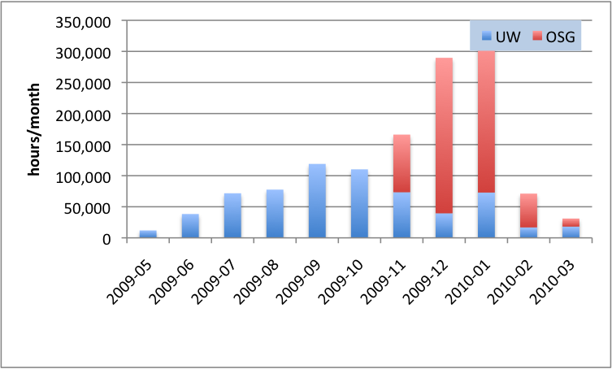
Chemistry Usage of HTPC

Slide 19
Current operations
OU, slots based on priority
Logged over 2M HTPC hours so far
Purdue, # of slots
Clemson, # of slots
San Diego, CMS T2, 1 slot
Your OSG site can be on this list!

Slide 20
Future Directions
More Sites, more cycles!
More users – any takers here?
Use glide-in to homogenize access

Slide 21
Conclusions
HTPC adds a new dimension to HPC computing – ensembles of parallel jobs
This approach minimizes portability issues with parallel codes
Keep same job submission model
Not hypothetical – we’re already running HTPC jobs
Thanks to many helping hands

