Slide 1

Condor World 2010
Condor-G – A few lessons learned
by Igor Sfiligoi @ UCSD

Slide 2
How do I use Condor-G
GlideinWMS
  Part of the development team
  Operate the OSG glidein factory
  Condor-G is used for glidein submission
OSG Scalability, Reliability and Usability area
  Testing CE scalability using Condor-G
    Both production and in-development CE software

Slide 3
Condor-G is old, nothing to learn
This is what one would expect
This is why we use Condor-G in glideinWMS
  Solid reliable technology
  Use-and-forget
  etc.
Turns out, it is not really like that

Slide 4
Condor-G is not old
Just been around for a long time
  since v6.2 – year 2001
It is changing all the time
  New Grid universes added with time
    v6.8 adds Condor, GT3 and GT4
    v7.0 adds nordugrid, unicore, pbs and lsf
    v7.2 adds Amazon EC2
    v7.4 adds CREAM and GT5
  Existing protocols being tuned

Slide 5
Some benchmarks first
As part of the OSG Scalability effort
Tested
  GT2 (still by far the most used Grid universe in OSG)
  GRAM5
  CREAM
Using a mix of v7.4.X and v7.5.X

Slide 6
What about the other universes?
GT4, the WS-based Globus Gatekeeper
has never got wide acceptance in OSG
  Plus Globus has deprecated it (not in Globus 5)
I plan to test Nordugrid soon
  Just did not have time yet
Amazon is interesting but it is quite different
Unicore, pbs, lsf and Condor-C
not interesting for OSG right now
Do I need
to mention GT3?

Slide 7
GT2 performance
How fast can I submit GT2 jobs?
It really depends what you want to measure
(with 10 jobmanagers, single user)
  Job submission alone – 45 jobs/min
  Job submission while jobs terminating – 33 jobs/min
  Processing job termination – 15 jobs/min
  Processing job termination
  while jobs being submitted – 7.5 jobs/min

Slide 8
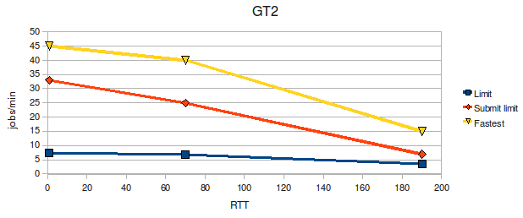
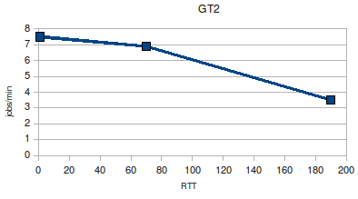
GT2 performance
How fast can I submit GT2 jobs?
It also depends how far away are you from the Grid gatekeeper
  Submitting across the world will cut rates in half

Slide 9
GT2 performance
How fast can I submit GT2 jobs?
It also depends how many jobs you have in the queue
  Try submitting 20k jobs at the same time and you may have to wait hours to get the first job started!
  Use
  dagman -maxidle 1000
  if you have a lot of jobs

Slide 10
GRAM5
What is GRAM5?
  The new non-WS Gatekeeper coming with Globus 5
  Major scalability improvement over GT2
Almost backwards compatible with GT2
  Removed just streaming support
  Too bad Condor-G relies on this feature in GT2!
Condor 7.4 adds explicit GT5 support

Slide 11
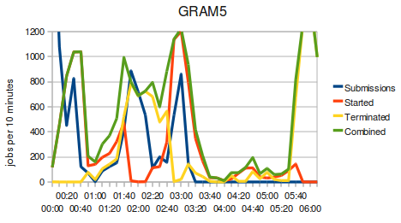
GRAM5 performance
Is it really faster than GT2?
Yes!
  Both submit and termination
  rates exceeded 100 jobs/min
  But a lot of variation in time
  Average still over 2x of GT2
Globus 5.0.0 still has bugs
  Not ready for production yet, but looks promising!

Slide 12
CREAM
What is CREAM?
  A brand new Grid Gatekeeper coming from Italy
  Web-based, runs inside Tomcat
  State stored in a relational database
  Support of multi-home deployments planned
Uses its own protocol
  Condor 7.4 adds the CREAM Grid universe

Slide 13
CREAM performance
How it compares to GT2 and GT5?
Much faster!
  Consistent rates in the 50 jobs/minute range
  About 5x faster than GT2, and 2x faster than GT5
But the reliability is dismal
  Out of 10k jobs, over 2k failed to run!
  We managed to overload the Condor-G client!

Slide 14
How did CREAM overload the client?
CREAM moves files directly to and from the worker nodes
  No intermediate staging to the CE like in Globus
Each worker node will independently contact the GridFTP server running on the Condor-G node
  No coordination between WNs
in files
Condor-G
WN
Condor-G
WN
out files
in files
job
job
out files
job
in files
CREAM
job
Globus
out files

Slide 15
GridFTP on the client?
Wait! I have a GridFTP running on my client?
That can access any file I own?
  Can read /etc/passwd? My tax return?
  Can overwrite ~/.bashrc? ~/.ssh/authorized_keys?
  My proxy is of course needed,
  but I delegated the proxy to the Grid node!
I am not sure I want to use CREAM anymore
  But Globus uses an equivalent GASS Server

Slide 16



Condor-G basically insecure!
It takes a lot of trust to use Condor-G
  At least for GT2, GT5 and CREAM
If any Grid admin wants to compromise
your client node, it can
  And there is no way to prevent that!
The good news is that vanilla Condor
is much more secure
  Condor team tells me remote admins can only access/modify files in the submit directory
You have to
log in, right?

Slide 17


What about portals?
Portals can submit Grid jobs for multiple users
  Using user-provided proxies
I know of portals that use a single system account to host all the user files
  No user run code on the portal node, so why not?
  Makes administration easier
Use of Condor-G gives every user they serve access to all portal files

Slide 18
The glideinWMS factory
The glideinWMS factory used that philosophy
  Had to find a solution!
We now have one user account per user served
  For storing user files and submitting user jobs
  But no logins!
Factory processes run as a dedicated user
  Need a way to switch to the user account when needed
  But do not want to run as root!

Slide 19
Condor privsep
Since v7.0, Condor ships with a tool that allows account switching without becoming root
  Sort of a lightweight sudo
  But more limited in scope, thus
    easier to configure
    more secure, if you can live within the limits
GlideinWMS v2.4 now uses Condor privsep to operate safely with Condor-G

Slide 20
Condor privsep
Documentation was a problem
  The switchboard configuration is actually well documented
  But how to use it.... had to look through the code!
It is relatively easy to use
  But not by hand
  Wrote a python module that made the use simple
  in glideinWMS

Slide 21
Summary
Condor-G a wonderful tool to access the Grid
  Easy to use, flexible, etc.
But its security model can be a real problem
  Not really Condor's fault
  But users only know about Condor, so
  security implications should be clearly stated
Condor privsep can help
  Although this is currently not a supported use-case

Slide 22
Condor Week 2010
Additional resources

Slide 23
Links
OSG Scalability area results
  http://hepuser.ucsd.edu/twiki2/bin/view/UCSDTier2
OSG Scalability test tools
  http://sourceforge.net/projects/osgscal/
GlideinWMS home page
  http://www.uscms.org/SoftwareComputing/Grid/WMS/glideinWMS/

Slide 24
Acknowledgements
Many thanks to the whole Condor team for the continuous support
  And in particular to Dan Bradley and Jaime Frey
This work was partially supported by
  DoE grant DE-FC02-06ER41436
  NSF grants PHY-0533280, PHY-0612805 and OCI-0943725

