Slide 1
Extending Rocks Clusters into Amazon EC2 Using Condor
Philip Papadopoulos, Ph.D
University of California, San Diego
San Diego Supercomputer Center
California Institute for Telecommunications and Information Technology (Calit2)

Slide 2
Background:
So, You want to build a cluster?
Triton Resource
Large Memory PSDAF
256 GB & 512 GB Nodes (32 core)
8TB Total
128 GB/sec
~ 9TF
Shared Resource
Cluster
16 GB/Node
4 - 8TB Total
256 GB/sec
~ 20 TF
x256
x28
UCSD Research Labs
Large Scale Storage
(Working on RFP)
2 – 4 PB
50-125 GB/sec
3000 – 6000 disks
Campus Research Network

Slide 3
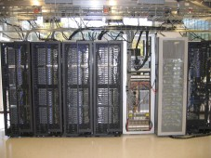
The Modern “Cluster” Architecture is Not Just an MPI Cluster
Standard Compute Cluster
CAMERA Bioinformatics
Each logical Configuration is a Rocks Appliance

Slide 4
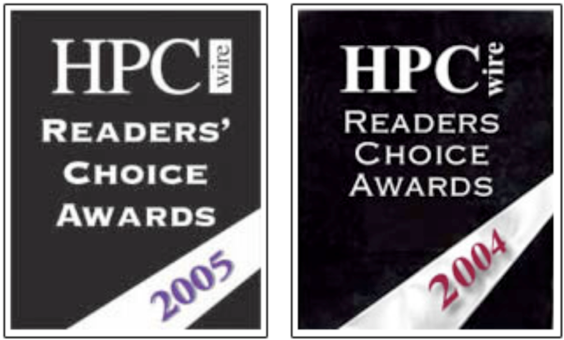
Rocks www.rocksclusters.org
Technology transfer of commodity clustering to application scientists
“make clusters easy”
Rocks is a cluster on a CD
Clustering software (PBS, SGE, Ganglia, Condor, … )
Highly programmatic software configuration management
Put CDs in Raw Hardware, Drink Coffee, Have Cluster.
Extensible using “Rolls”
Large user community
Over 1PFlop of known clusters
Active user / support list of 2000+ users
Estimate > 2000 installed cluster
Active Development
2 software releases per year
Code Development at SDSC
Other Developers (UCSD, Univ of Tromso, External Rolls
Supports Redhat Linux, Scientific Linux, Centos and Solaris
Can build Real, Virtual, and Hybrid Combinations

Slide 5
Rocks Breaks Apart the Software Stack into Rolls

Slide 6
Rolls on a Simple Cluster

Slide 7
Condor Roll
Condor 7.4.1 (updating to 7.4.2)
Integration with Rocks command line to do basic Condor configuration customization
To build a Condor Cluster with Rocks
Base, OS, Kernel, Condor Roll
Gives you local collector, scheduler
Basic, Working Configuration that can be customized as required.

Slide 8
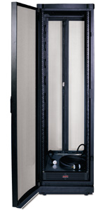
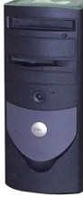
Virtual Clusters in Rocks Today
Virtual Cluster 1
Require:
Virtual Frontend
Nodes w/disk
Private Network
Power
Virtual Cluster 2
Virtual Clusters:
May overlap one another on physical HW
Need network isolation
May be larger or smaller than physical hosting cluster
Physical Hosting Cluster
“Cloud Provider”

Slide 9
How Rocks Treats Virtual Hardware
It’s just another piece of HW.
If RedHat supports it, so does Rocks
Allows mixture of real and virtual hardware in the same cluster
Because Rocks supports heterogeneous HW clusters
Re-use of all of the software configuration mechanics
E.g., a compute appliance is compute appliance
Virtual HW must meet minimum HW Specs
1GB memory
36GB Disk space*
Private-network Ethernet
+ Public Network on Frontend
* Not strict – EC2 images are 10GB

Slide 10
Rocks Hybrid: Linux/Solaris/Physical/Virtual
Linux
Xen VM
Phys
Solaris

Slide 11
Basic EC2
Elastic Compute Cloud (EC2)
Amazon Cloud Storage
Copy AMI &
Boot
S3 – Simple Storage Service
EBS – Elastic Block Store
AMIs are copied from S3 and booted in EC2 to create a “running instance”
When instance is shutdown, all changes are lost
Can save as a new AMI
Amazon Machine Images (AMIs)

Slide 12
Basic EC2
AMI (Amazon Machine Image) is copied from S3 to EC2 for booting
Can boot multiple copies of an AMI as a “group”
Not a cluster, all running instances are independent
If you make changes to your AMI while running and want them saved
Must repack to make a new AMI
Or use Elastic Block Store (EBS) on a per-instance basis

Slide 13
Some Challenges in EC2
Defining the contents of your Virtual Machine (Software Stack)
Understanding limitations and execution model
Debugging when something goes wrong
Remembering to turn off your VM
Smallest 64-bit VM is ~$250/month running 7x24

Slide 14
What’s in the AMI?
Tar file of a / file system
Cryptographically signed so that Amazon can open it, but other users cannot
Split into 10MB chunks, stored in S3
Amazon boasts more than 2000 public machine images
What’s in a particular image?
How much work is it to get your software part of an existing image?
There are tools for booting and monitoring instances.
Defining the software contents is “an exercise left to the reader”

Slide 15
The EC2 Roll
Take a Rocks appliance and make it compatible with EC2:
10GB disk partition (single)
DHCP for network
ssh key management
Other small adjustments
Create an AMI bundle on local cluster
rocks create ec2 bundle
Upload a bundled image into EC2
rocks upload ec2 bundle
Mini-tutorial on getting started with EC2 and Rocks

Slide 16
Putting all together: Virtual Cluster Experiment
Nimrod – Monash University
Rocks® – UC San Diego
Condor – U. Wisconsin
Amazon EC2 – Brought to you by Visa®

Slide 17
Virtual Clusters in Rocks Today
Virtual Cluster 1
Require:
Virtual Frontend
Nodes w/disk
Private Network
Power
Virtual Cluster 2
Virtual Clusters:
May overlap one another on physical HW
Need network isolation
May be larger or smaller than physical hosting cluster
Physical Hosting Cluster
“Cloud Provider”

Slide 18
Extended Cluster Experiment in PRAGMA
NIMROD – Parameter Sweep/Optimization
Monash eScience and Grid Engineering Laboratory
Amazon EC2 Cloud
Nimrod.rockscluster.org
Rocks –Created VM
fiji.rocksclusters.org Hosting Cluster
for Job Management

Slide 19
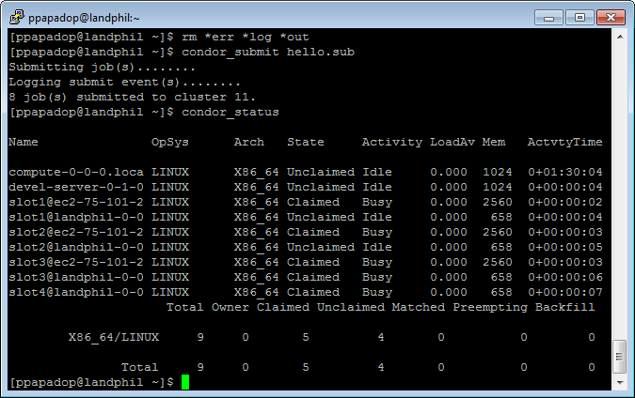
Extended Cluster Using Condor

Slide 20
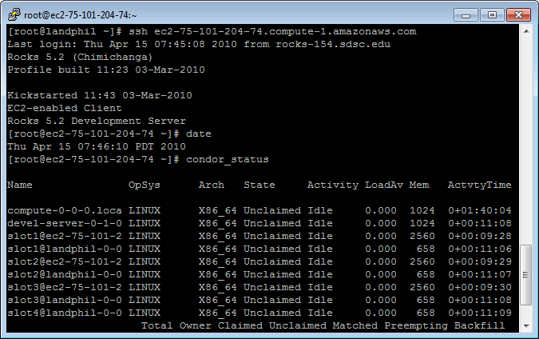
Can Log into the Running VM

Slide 21
Steps to Make this Work
Build Local Cluster with appropriate rolls
Rocks + Xen Roll + EC2 Roll + Condor Roll (+ NIMROD + … )
Create local appliance as VM using standard Rocks tools
Set ec2_enable attribute to build it as an EC2-Compatible VM
Build and test locally
Bundle, Upload, Register as an EC2 AMI
Rocks command line tools
PREPARATION
RUN
Boot with appropriate meta data to register automatically with your local collector.
ec2-run-instances -t m1.large ami-219d7248 -d "condor:landphil.rocksclusters.org:40000:40050"
Requires one-time EC2 firewall settings
Use your extended Condor Pool

Slide 22
Summary
Easily Extend your Condor pool into EC2
Others can do this as well
Condor supports the public/private network duality of EC2
Have your software on both local cluster and remote VM in EC2
Mix and match
Local Physical, Local Virtual, Remote Virtual
If you use Rocks, does not take extra effort

