Slide 1
Dynamic Slot Tutorial

Slide 2
Outline
Why we need partitionable slots
How they’ve worked since 7.2
What’s new in 7.8
What’s still left to do

Slide 3
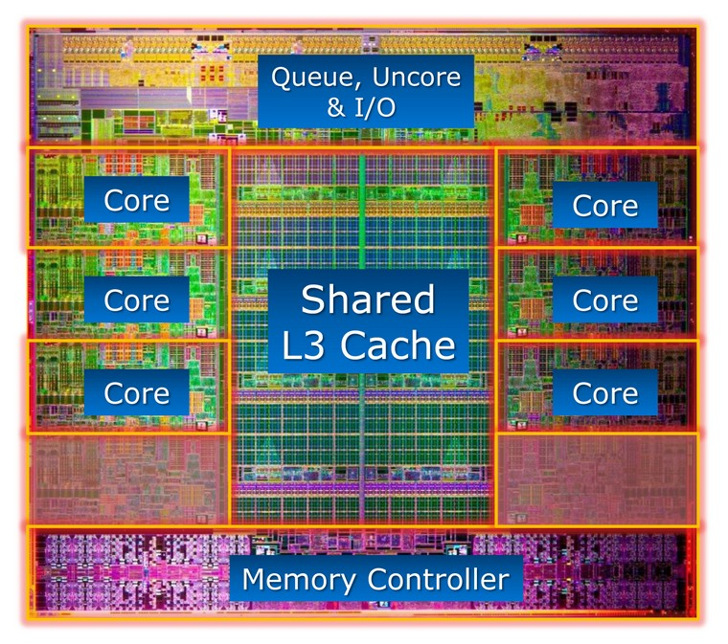
What’s the Problem?

Slide 4
Example Machine:
8 cores
8 Gigabytes memory
2 disks

Slide 5
The old way (Still the default)
$ condor_status
Name OpSys Arch State Activity LoadAv Mem ActvtyTime
slot1@chevre.cs.wi LINUX X86_64 Unclaimed Idle 0.110 1024 0+00:45:04
slot2@chevre.cs.wi LINUX X86_64 Unclaimed Idle 0.000 1024 0+00:45:05
slot3@chevre.cs.wi LINUX X86_64 Unclaimed Idle 0.000 1024 0+00:45:06
slot4@chevre.cs.wi LINUX X86_64 Unclaimed Idle 0.000 1024 0+00:45:07
slot5@chevre.cs.wi LINUX X86_64 Unclaimed Idle 0.000 1024 0+00:45:08
slot6@chevre.cs.wi LINUX X86_64 Unclaimed Idle 0.000 1024 0+00:45:09
slot7@chevre.cs.wi LINUX X86_64 Unclaimed Idle 0.000 1024 0+00:45:10
slot8@chevre.cs.wi LINUX X86_64 Unclaimed Idle 0.000 1024 0+00:45:03
Total Owner Claimed Unclaimed Matched Preempting Backfill
X86_64/LINUX 8 0 0 8 0 0 0
Total 8 0 0 8 0 0 0

Slide 6
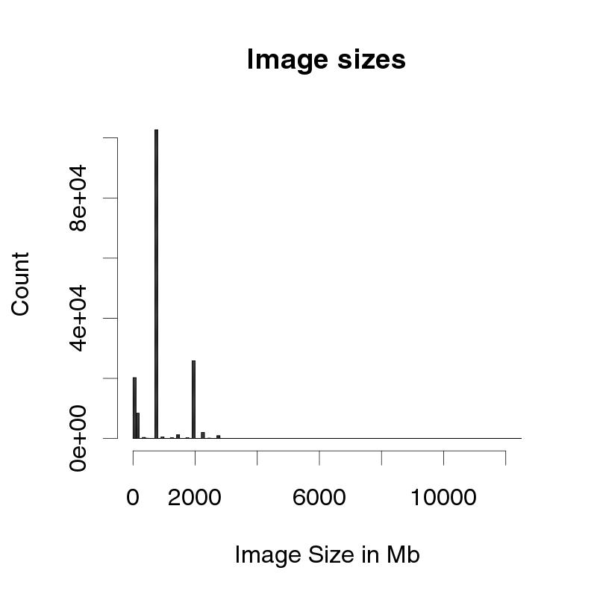
Problem: Job Image Size

Slide 7
Simple solution: Static non-uniform memory
# condor_config
NUM_SLOTS_TYPE_1 = 1
NUM_SLOTS_TYPE_2 = 7
SLOT_TYPE_1 = mem=4096
SLOT_TYPE_2 = mem=auto

Slide 8
Result is
$ condor_status
Name OpSys Arch State Activity LoadAv Mem ActvtyTime
slot1@chevre.cs.wi LINUX X86_64 Unclaimed Idle 0.150 4096
slot2@chevre.cs.wi LINUX X86_64 Unclaimed Idle 0.000 585
slot3@chevre.cs.wi LINUX X86_64 Unclaimed Idle 0.000 585
slot4@chevre.cs.wi LINUX X86_64 Unclaimed Idle 0.000 585
slot5@chevre.cs.wi LINUX X86_64 Unclaimed Idle 0.000 585
slot6@chevre.cs.wi LINUX X86_64 Unclaimed Idle 0.000 585
slot7@chevre.cs.wi LINUX X86_64 Unclaimed Idle 0.000 585
slot8@chevre.cs.wi LINUX X86_64 Unclaimed Idle 0.000 585
Total Owner Claimed Unclaimed Matched Preempting Backfill
X86_64/LINUX 8 0 0 8 0 0 0
Total 8 0 0 8 0 0 0

Slide 9
Better, still not good
Job requirements:
Requirements = memory > 2048
How to steer small jobs to small slot?
Trivia question in classads?
How to pick correct sizes?
Changes require startd restarts

Slide 10
8 Gb machine partitioned into 5 slots
4Gb Slot
1Gb
1Gb
1Gb
4 Gb Job
1Gb
1Gb

Slide 11
8 Gb machine partitioned into 5 slots
4Gb Slot
1Gb
1Gb
1Gb
1Gb
1Gb
1Gb

Slide 12
8 Gb machine partitioned into 5 slots
4Gb Slot
1Gb
1Gb
1Gb
1Gb
7 Gb free, but idle job
4 Gb Job

Slide 13
New: Partitionable slots
Work in progress
First landed in 7.2
More work in 7.8
Even more goodness to come…
But very usable now

Slide 14
The big idea
One “partionable” slot
From which “dynamic” slots are made
When dynamic slot exit, merged back into “partionable”
Split happens at claim time

Slide 15
(cont)
Partionable slots split on
Cpu
Disk
Memory
(Maybe more later)
When you are out of one, you’re out of slots

Slide 16
3 types of slots
Static (e.g. the usual kind)
Partitionable (e.g. leftovers)
Dynamic (usableable ones)
Dynamically created
But once created, static

Slide 17
8 Gb Partitionable slot
4Gb

Slide 18
8 Gb Partitionable slot
5Gb

Slide 19
How to configure
NUM_SLOTS = 1
NUM_SLOTS_TYPE_1 = 1
SLOT_TYPE_1 = cpus=100%
SLOT_TYPE_1_PARTITIONABLE = true

Slide 20
Looks like
$ condor_status
Name OpSys Arch State Activity LoadAv Mem ActvtyTime
slot1@c LINUX X86_64 Unclaimed Idle 0.110 8192
Total Owner Claimed Unclaimed Matched
X86_64/LINUX 1 0 0 1 0
Total 1 0 0 1 0

Slide 21
When running
$ condor_status
Name OpSys Arch State Activity LoadAv Mem ActvtyTime
slot1@c LINUX X86_64 Unclaimed Idle 0.110 4096
slot1_1@c LINUX X86_64 Claimed Busy 0.000 1024
slot1_2@c LINUX X86_64 Claimed Busy 0.000 2048
slot1_3@c LINUX X86_64 Claimed Busy 0.000 1024

Slide 22
All this in 7.2
What are the problems?
Slow matching
Broken for parallel universe
Dedicated slots users broken
Fragmentation
Selection of dynamic slots sizes tricky

Slide 23
Fixed in 7.8
Matching faster
CLAIM_PARTITIONABLE_LEFTOVERS
= false to make slow again..
Parallel universe fixed
Dedicated slot users fixed
Support for defragging!

Slide 24
Answer to triva question
Requirements = (Memory > 1024)
How can startd parse?
It Can’t!

Slide 25
THIS IS BIG!
Memory requirements deprecated
Don’t do
Requirements = memory > 1024
Generates a warning now:
condor_submit submit7
Submitting job(s)…
WARNING: your Requirements expression refers to TARGET.Memory. This is obsolete. Set request_memory and condor_submit will modify the Requirements expression as needed.
.

Slide 26
Instead, use
request_memory = 2048 # mbytes
Same is true for disk, cpus
request_disk = 16384 # kbytes
request_cpus = 1
Requirements automatically fixed

Slide 27
I have to change all my submit files?
There’s a knob for that ™
JOB_DEFAULT_REQUESTMEMORY
JOB_DEFAULT_REQUESTDISK
JOB_DEFAULT_REQUESTCPUS
submit side defaults
Can be expressions…

Slide 28
I don’t want to change the config file
JOB_DEFAULT_REQUEST_MEMORY
ifthenelse(MemoryUsage =!= UNDEF, Memoryusage, 1)
JOB_DEFAULT_REQUEST_CPUS
1
JOB_DEFAULT_REQUEST_DISK
DiskUsage

Slide 29
What about the startd side?
Startd has a say, too:
MODIFY_REQUEST_EXPR_REQUESTCPUS
quantize(RequestCpus, {1})
MODIFY_REQUEST_EXPR_REQUESTMEMORY
quantize(RequestMemory, {TotalSlotMem/TotalSlotCpus / 4})
MODIFY_REQUEST_EXPR_REQUESTDISK
quantize(RequestDisk, {1024})

Slide 30
Why quantize?
Allow slot reuse
Name OpSys Arch State Activity LoadAv Mem
slot1@c LINUX X86_64 Unclaimed Idle 0.110 4096
slot1_1@c LINUX X86_64 Claimed Busy 0.000 2048
slot1_2@c LINUX X86_64 Claimed Busy 0.000 1024
slot1_3@c LINUX X86_64 Claimed Busy 0.000 1024

Slide 31
Also holds for cpus
Much easier way to do whole machine
Basically same as memory requirements
Easier to set up than Parallel universe

Slide 32
Fragmentation
Name OpSys Arch State Activity LoadAv Mem
slot1@c LINUX X86_64 Unclaimed Idle 0.110 4096
slot1_1@c LINUX X86_64 Claimed Busy 0.000 2048
slot1_2@c LINUX X86_64 Claimed Busy 0.000 1024
slot1_3@c LINUX X86_64 Claimed Busy 0.000 1024
Now I submit a job that needs 8G – what happens?

Slide 33
Solution: New Daemon
condor-defrag (new in 7.8)
One daemon defrags whole pool
Central manager good place to run
Scan pool,try to fully defrag some startds
Only looks at partitionable machines
Admin picks some % of pool that can be “whole”

Slide 34
Oh, we got knobs…
DEFRAG_DRAINING_MACHINES_PER_HOUR
default is 0
DEFRAG_MAX_WHOLE_MACHINES
default is -1
DEFRAG_SCHEDULE
graceful (obey MaxJobRetirementTime, default)
quick (obey MachineMaxVacateTime)
fast (hard-killed immediately)

Slide 35
Defrag vs. Preemption
Defrag can be general purpose
Looks only at startds, not at demand
Can also preempt non-partitionable slots
(if so configured)
Negotiator preemption looks at 2 jobs

Slide 36
Advanced Topics
More than one Partitionable slot
Mix and match partionable slots
Overcommitting partionable sltos
Parallel universe

Slide 37
Future work
Claiming partitionable slots
So RANK based preemption works
condor_q –analyze
More knobs!

Slide 38
Thank you

