Slide 1
Building a Virtualized Desktop Grid
Eric Sedore
essedore@syr.edu

Slide 2
Why create a desktop grid?
One prong of an three pronged strategy to enhance research infrastructure on campus (physical hosting, HTC grid, private research cloud)
Create a common, no cost (to them), resource pool for research community - especially beneficial for researchers with limited access to compute resources
Attract faculty/researchers
Leverage an existing resource
Use as a seed to work toward critical mass in the research community

Slide 3
Goals
Create Condor pool sizeable enough for “significant” computational work (initial success = 2000 concurrent cores)
Create and deploy grid infrastructure rapidly (6 months)
Secure and low impact enough to run on any machine on campus
Create a adaptive research environment (virtualization)
Simple for distributed desktop administrators to add computers to grid
Automated methods for detecting/enabling Intel-VT (for hypervisor)
Automated hypervisor deployment

Slide 4
Integration of Existing Components
Condor
VirtualBox
Windows 7 (64 bit)
TCL / FreeWrap – Condor VM Catapult (glue)
AD – Group Policy Preference

Slide 5
Typical Challenges introducing the Grid (FUD)
Security
You want to use “my” computer?
Where does my research data go?
Technical
Hypervisor / VM Management
Scalability
After you put “the grid” on my computer…
Governance
Who gets access to “my” resources?
How does the scheduling work?

Slide 6
Security

Slide 7
Security on the client
Grid processes run as a non-privileged user
Virtualization to abstract research environment / interaction
VM’s on the local drive are encrypted at all times – (using certificate of non-privileged user)
Local cached repository and when running in a slot
Utilize Windows 7 encrypted file system
Allows grid work on machines with end users as local administrators
To-do – create a signature to ensure researcher (and admins) that the VM started is “approved” and has not been modified (i.e. not modified to be a botnet)

Slide 8
Securing/Protecting the Infrastructure
Create an isolated private 10.x.x.x. network via VPN tunnels (pfSense and OpenVPN)
Limit bandwidth for each research VM to protect against a network DOS
Research VM’s NAT’d on desktops
Other standard protections – Firewalls, ACL’s

Slide 9
Public Network
Research VM’s
ITS-SL6-LSCSOFT
ITS-SL6-LSCSOFT
ITS-SL6-LSCSOFT
ITS-SL6-LSCSOFT
ITS-SL6-LSCSOFT
ITS-SL6-LSCSOFT
OpenVPN End-Point (pfSense) / FW / Router
10.x.x.x network
Bottleneck for higher bandwidth jobs
Condor Infrastructure Roles
Condor Submit Server

Slide 10
Technical

Slide 11
Condor VM Coordinator (CMVC)
Condor’s VM “agent” on the desktop
Manage distribution of local virtual machine repository
Manage encryption of virtual machines
Runs as non-privileged user – reduces adoption barriers
Pseudo Scheduler
Rudimentary logic for when to allow grid activity
Windows specific – is there a user logged in?

Slide 12
Why did you write CVMC?
Runs as non-privileged user (and needs windows profile)
Mistrust in a 3rd party agent (condor client) on all campus desktops – especially when turned over to the research community – even with the strong sandbox controls in condor
Utilizes built-in MS Task Scheduler for idle detection – no processes running in user’s context for activity detection
VM repository management
Encryption
It seemed so simple when I started…

Slide 13
Job Configuration
Requirements = ( TARGET.vm_name == "its-u11-boinc-20120415" ) && ( TARGET.Arch == "X86_64" ) && ( TARGET.OpSys == "LINUX" ) && ( TARGET.Disk >= DiskUsage ) && ( ( TARGET.Memory * 1024 ) >= ImageSize ) && ( ( RequestMemory * 1024 ) >= ImageSize ) && ( TARGET.HasFileTransfer )
ClassAd addition
vm_name = "its-u11-boinc-20120415”
CVMC Uses vm_name ClassAd to determine which VM to launch
Jobs without vm_name can use running VM’s (assuming the requirements match) – but they won’t startup new VM’s

Slide 14
Condor Back -end
Condor Queue
Idle State
Web Server
Task Scheduler
Slot 1
CVMC
Slot 2
VM Repo
Slot …
VirtualBox
Win 7 Client

Slide 15
Technical Challenges
Host resource starvation
Leave memory for the host OS
Memory controls on jobs (within Condor)
Unique combination of approaches implementing Condor
CVMC / Web service
VM distribution
Build custom VM’s based on job needs vs. scavenging existing operating system configurations
Hypervisor expects to have an interactive session environment (windows profile)
Reinventing the wheel on occasion

Slide 16
How do you “ensure” low impact?
When no one is logged in CVMC will allow grid load regardless of the time
When a user is logged in CVMC will kill grid load at 7 AM and not allow it to run again until 5 PM (regardless if the machine is idle)
Leave the OS memory (512MB-1GB) so it does not page out key OS components (using a simple memory allocation method)
Do not cache VM disks – will keep OS from filling its memory cache with VM I/O traffic

Slide 17
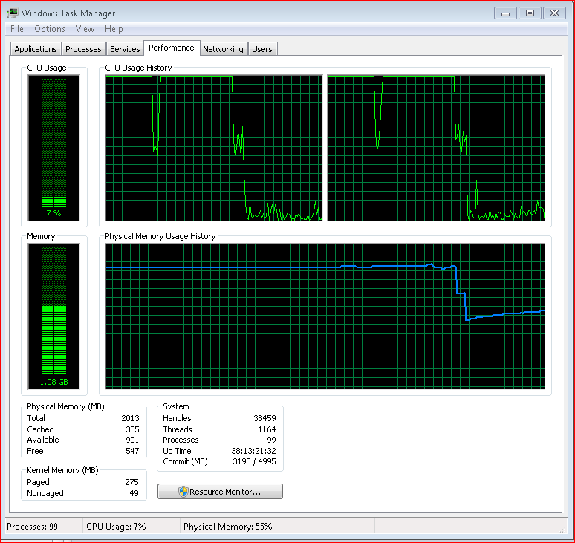

Slide 18
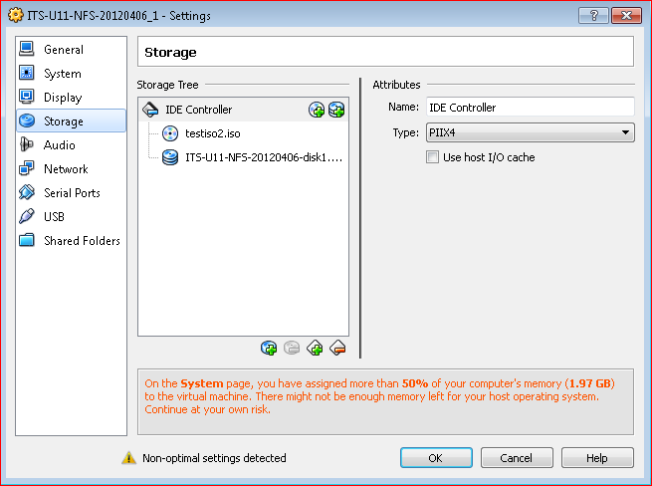
Keep OS from Caching VM I/O

Slide 19
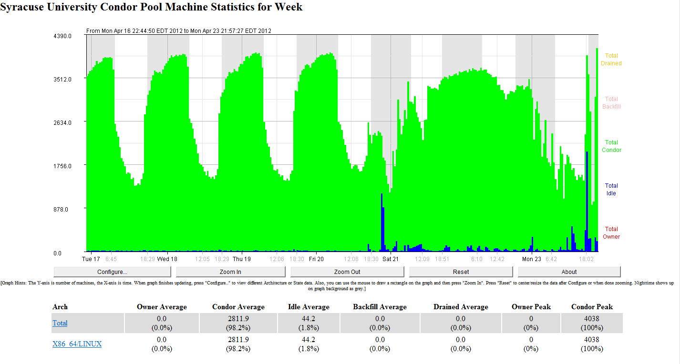

Slide 20
Next Steps
Grow the research community – depth and diversity
Increase pool size – ~12,000 cores which are eligible
Infrastructure Scalability
Condor (tuning/sizing)
Network / Storage (NFS – Parrot / Chirp)

Slide 21
Solving the Data Transfer Problem
Born from an unfinished side-project 7+ years ago.
Goal: maximize the compute resources available to LIGO’s search for gravitational waves
More cycles == a better search.
Problem: huge input data, impractical to move w/job.
How to...
Run on other LIGO Data Grid sites without a shared filesystem?
Run on clusters outside the LIGO Data Grid lacking LIGO data?
Tools to get the job done: ihope, GLUE, Pegasus, Condor Checkpointing, and Condor-C.
People: Kayleigh Bohémier, Duncan Brown, Peter Couvares. Help from SU ITS, Pegasus Team, Condor Team

Slide 22
Idea: Cross-Pool Checkpoint Migration
Condor_compiled (checkpointable) jobs.
Jobs start on a LIGO pool with local data.
Jobs read in data and pre-process.
Jobs call checkpoint_and_exit().
Pegasus workflow treats checkpoint image as output, and provides it as “input” to a second Condor-C job.
Condor-C job transfers and executes standalone checkpoint on remote pool, and transfers results back.

Slide 23
Devil in the Details
Condor checkpoint_and_exit() caused the job to exit with SIGUSR2, so we needed to catch that and treat it as success.
Standalone checkpoint images didn’t like to restart in a different cwd, even if they shouldn’t care, so we had to binary edit each checkpoint image to replace the hard-coded /path/to/cwd with .////////////
Will be fixed in Condor 7.8?
Pegasus needed minor mods to support Condor-C “grid” jobs w/Condor file transfer
Fixed for next Pegasus release.

Slide 24
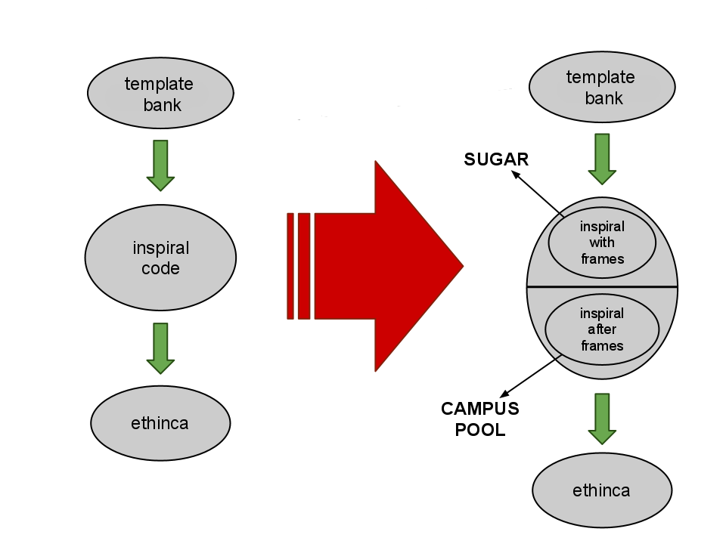
Working Solution
Before
After
Move jobs that do not require input files on the SUGAR cluster to the remote campus cluster.

