Slide 1
DeepDive Deep Linguistic Processing with Condor
Feng Niu, Christopher Ré, and Ce Zhang
Hazy Research Group
University of Wisconsin-Madison
http://www.cs.wisc.edu/hazy/
(see for students who did the real work)

Slide 2
Overview
Our research group’s hypothesis:
“The next breakthrough in data analysis may not be in individual algorithms…
But may be in the ability to rapidly combine, deploy, and maintain existing algorithms.”
With Condor’s help, use state-of-the-art NLU tools and statistical inference to read the web.
Today’s talk, demos.

Slide 3
Enhance Wikipedia with the Web
What about Barack Obama?
wife is Michelle Obama
went to Harvard Law School
…
Billions of webpages
Billions of tweets
Billions of events
Billions of videos
Billions of photos
Billions of blogs

Slide 4
Demo
Demo
http://research.cs.wisc.edu/hazy/wisci/
Key to demo: Ability to combine and maintain
(1) structured & unstructured data and
(2) statistical tools (e.g., NLP and inference).

Slide 5
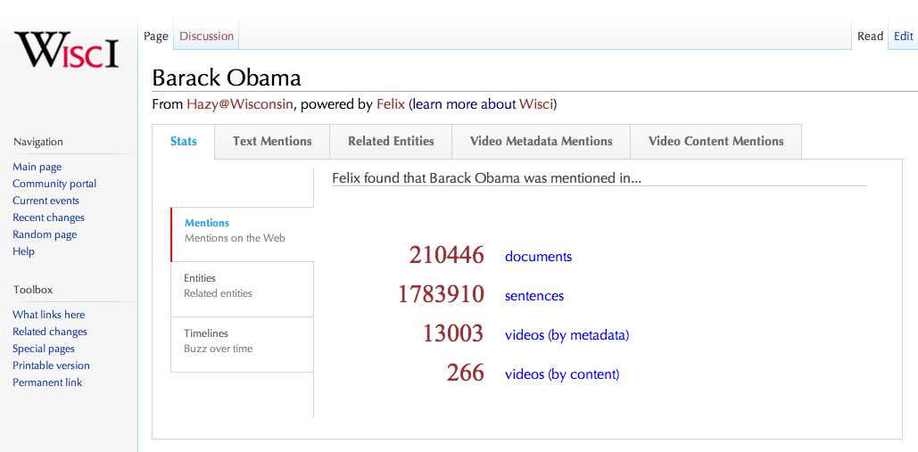
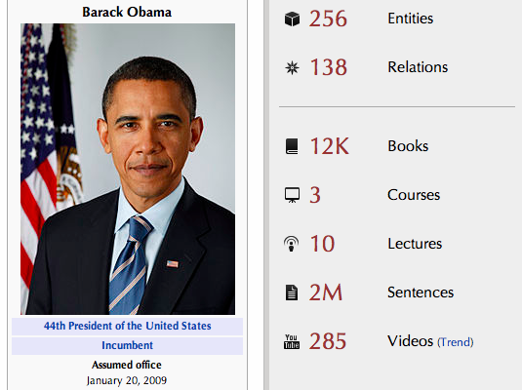
Some Statistics
Demo: GeoDeepDive
Some Information
50TB Data
500K Machine hours
500M Webpages
400K Videos
20K Books
7Bn Entity Mentions
114M Relationship Mentions
Tasks we perform:
Web Crawling
Information Extraction
Deep Linguistic Processing
Audio/Video Transcription
Tera-byte Parallel Joins

Slide 6
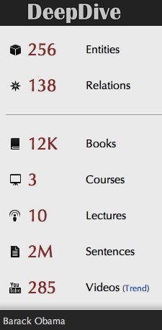
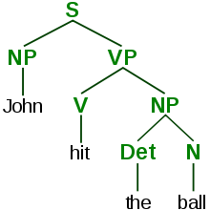
Data
Acquisition
Deep
NLP
Statistical
Inference
Web Serving
Magic Happens!
500M Webpages
500K Videos
50TB Data
14B structured sentences
3M Entites
7B Mentions
100M Relations
X 1000 @ UW-Madison
100 Nodes
100 TB
X 10 High-end Servers
X 100K @ US Open Science Grid
Raw Compute Infrastructure
Storage Infrastructure
Stats. Infrastructure

Slide 7
Data Acquisition with Condor
We overlay
an ad hoc MapReduce cluster
with several hundred nodes
to perform a daily web crawl
of millions of web pages
Crawl 400K Youtube Videos,
and invoke Google’s Speech API to
perform video transcription
in 3 days

Slide 8
Deep NLP with Condor
We finish deep linguistic processing
(Stanford NLP, Coreference, POS)
on 500M web pages (2TB text)
within 10 days
Using 150K machine hours
We leverage thousands of OSG nodes
to do deep semantic analysis
of 2TB of web pages
within 24 hours

Slide 9
High Throughput Data Processing with Condor
We run parallel SQL join (using Python)
over 8TB of TSV data
with 5X higher throughput than a 100-node parallel database

Slide 10
The Next Demos and Projects
A Glimpse at the Next Demos and Projects

Slide 11
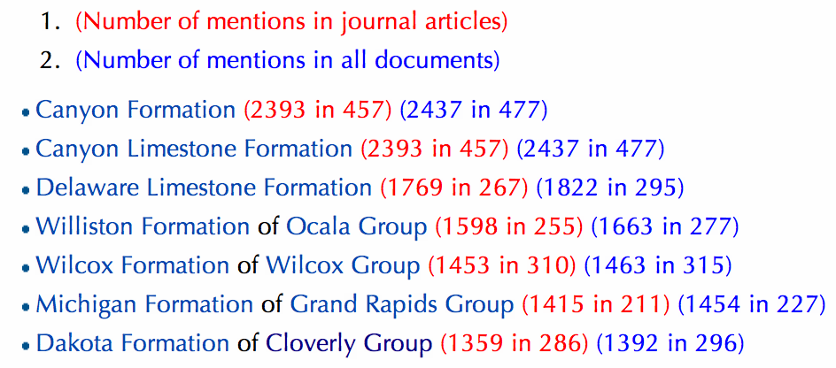
Demo: GeoDeepDive
Help Shanan Peters, Assoc. Prof., Geoscience, enhance a rock formation Database
Condor:
Acquire Articles
Feature Extraction
Measurement Extraction
We Hope to Answer: What is the carbon record of North America?

Slide 12
Demo: AncientText
Help Robin Valenza, Assoc. Prof., English understand 140K books from UK 1700-1900
Condor Helps:
Building Topic Models
Slice and Dice!
By Year, Author, …
Advanced OCR
Challenge how many alternatives to store?

Slide 13
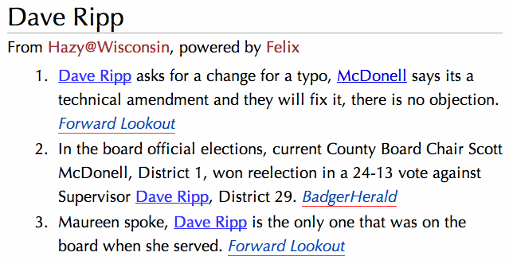
Demo: MadWiki
Machine-powered Wiki on Madison people with Erik Paulsen, Computer Sciences.

Slide 14
Conclusion
Condor is the key enabling tech across a large number of our projects
Crawling, Feature Extraction, and Data Processing, …. and even Statistical Inference
We started with a Hadoop-based infrastructure but are gradually killing it off.
Thank you to Condor and CHTC!
Miron, Bill, Brooklin, Ken, Todd, Zach,
and the Condor and CHTC Teams

Slide 16
Idea: Machine-Curated Wikipedia
What about Barack Obama?
wife is Michelle Obama
went to Harvard Law School
…
Billions of webpages
Billions of tweets
Billions of events
Billions of videos
Billions of photos
Billions of blogs

