Slide 1
Condor in Networked Clouds
A brief presentation for Condor Week 2012
Presenter: Jonathan Mills
Ilia Baldine, Yufeng Xin,, Anirban Mandal, Chris Heermann, Paul Ruth, Jeffery L.Tilson
RENCI, UNC-CH
Jeff Chase, Victor J. Orlikowski, Aydan Yumerefendi, Prateek Jaipuria
Duke University

Slide 2
Networked Clouds

Slide 3
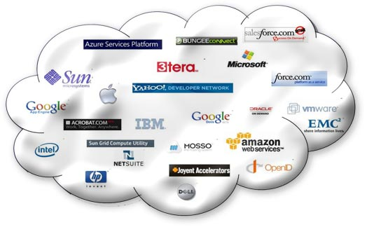
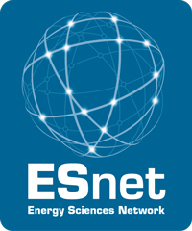
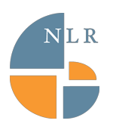

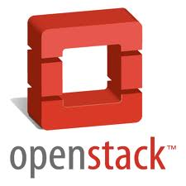


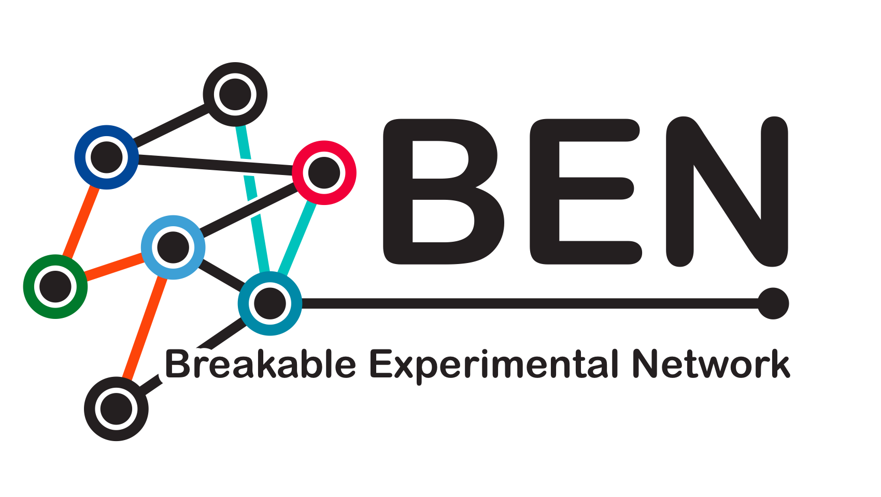
IaaS: Clouds and Network Virtualization
Virtual Compute and
Storage Infrastructure
Virtual Network Infrastructure
Cloud APIs (Amazon EC2 ..)
Network Provisioning APIs (NLR Sherpa, DOE OSCARS, Internet2 DRAGON, OGF NSI …)
Cloud Providers
Network Transit Providers

Slide 4
Networked Clouds
Virtual Infrastructure
Bandwidth Provisioned Networks
Cloud Providers

Slide 5

Networked Clouds
Virtual Infrastructure
Bandwidth Provisioned Networks
Cloud Providers
Network Transit Providers

Slide 6
Networked Clouds
Petri dish
Wind tunnel
Observatory
Cloud Providers

Slide 7
GENI is an IaaS
Each slice is infrastructure purpose-built to serve an application
May require
  Specific topology (e.g. “I need a mesh with specific average node degree”)
  Specific connectivity (e.g. “I need to connect resources A, B and C”)
A number of heterogeneous resources need to be co-scheduled
Principal focus on
  Repeatability of experiments
  Measurements (performance, packet capture, physical layer)
Also well-suited to science applications (computation- and data- intensive)
  Performance guarantees
  Simpler deployment of heterogeneous pieces
    Batch scheduling
    Map-reduce
    Highly-parallel
    Specialized (GPGPUs)
  Native resource interfaces
Notes:
GENI is the Global Environment for Network Innovations, an NSF project. GENI is an IaaS. In GENI, a slice is an infrastructure purpose-built to serve an application.
When we talk about ExoGENI, what we mean is an extended Infrastructure-as-a-Service cloud model with coordinated provisioning across multiple sites.
…and a high degree of control over intra- and inter-site networking functions. That control is provided by ORCA. (next slide)

Slide 8
ORCA: Open Resource Control Architecture
Notes:
(pause only briefly to read title before moving to next slide)

Slide 9
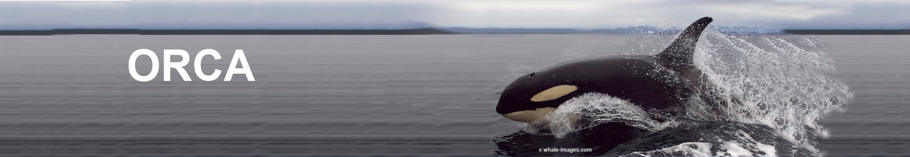
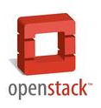
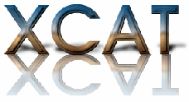

Open Resource Control Architecture
ORCA is a “wrapper” for off-the-shelf cloud and circuit networks etc., enabling federated orchestration:
  Resource brokering
  VM image distribution
  Topology embedding
  Stitching
  Authorization
GENI, DOE, NSF SDCI+TC
http://networkedclouds.org
http://geni-orca.renci.org
Notes:
**briefly**

Slide 10
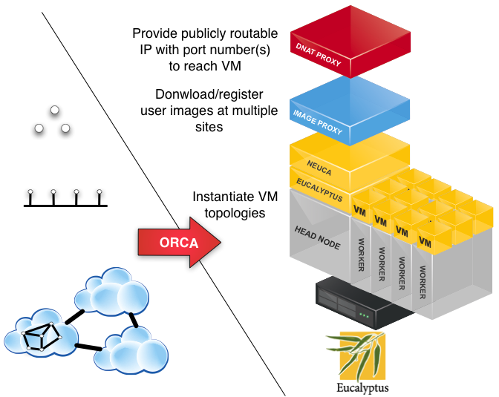
Overview
Notes:
This is a detail of a single provider’s cloud. Originally we used Eucalyptus, but we have mostly converted to OpenStack. At this low level you can see that ORCA has the ability to instantiate a topology by requesting a number of VMs (i.e. by essentially making an EC2 call via something like euca-run-instances).

Slide 11

Brokering Services
Site
Site
User facing
ORCA Agents
User
Provision a dynamic slice of networked virtual infrastructure from multiple providers, built to order for a guest application.
Stitch slice into an end-to-end execution environment.
Deploy Workflow into the slice.
Topology requests specified in NDL
Notes:
“We use a set of unified semantic schemas (ontologies) for representing the data models to describe resources in a reservation across the stages of its life cycle. We develop NDL-OWL - an extension of the Network Description Language using OWL. We use a number of tools to create and manipulate NDL-OWL ontologies. NDL-OWL gives us a flexible semantic query-based programming approach to implement the policies for resource allocation, path computation, and topology embedding. It enables these functions to be coded generically to operate on declarative specifications, rather than baking in assumptions about the resources.
Source: https://geni-orca.renci.org/trac/wiki/NDL-OWL

Slide 12
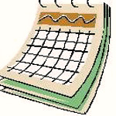
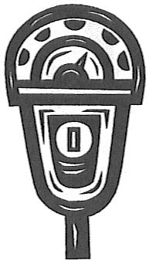
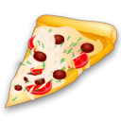
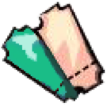
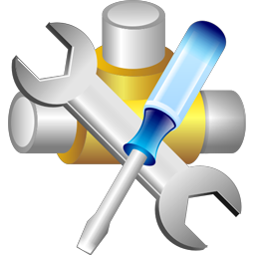


B
SM
AM
lease
Actor (server) roles in Open Resource Control Architecture
Notes:
I need to talk about “actors”. These are our ORCA actors: slice managers, aggregate managers, and brokers…
The substrate description is held by an Aggregate Manager. In other words, it knows about the available resources.
The Aggregate Manager thus also performs the substrate delegation, delegating resources to the Broker
3. A slice request (what a user requests) lands at the Slice, or Service, Manager (SM), who asks the Broker to fulfill it (if it can).
4. Assuming resources are available, a slice reservation is returned by a broker, like at ticket, with which it can communicate with the aggregate manager.
5. Finally, the aggregate manager returns a slice manifest to the service manager (and hence returned to the user)
From https://geni-orca.renci.org/trac/wiki/NDL-OWL

Slide 13
User/application access
Broker
(CH)
ORCA Actors
Web
portal
Operators
request
Java
ticket
Web portal
delegate
Web
portal
Slice
Manager
(SM)
XML – RPC
redeem
Authority/AM
Users and tools
lease
Substrate owners

Slide 14
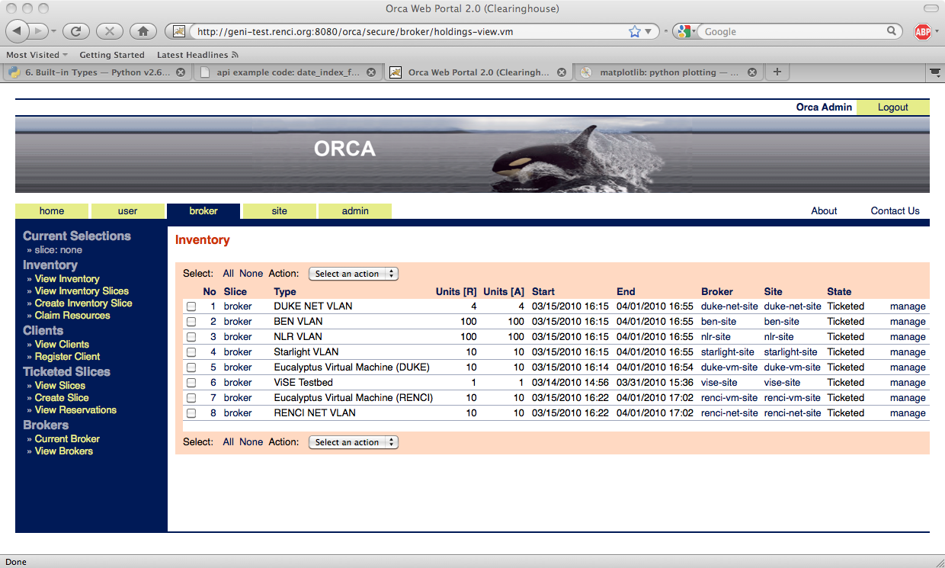
Operator portal interface to RENCI Clearinghouse (CH), listing AMs with substrate registered for brokering.
Notes:
This is what one of those Java web portals looks like….

Slide 15
Solar fuels workflow

Slide 16

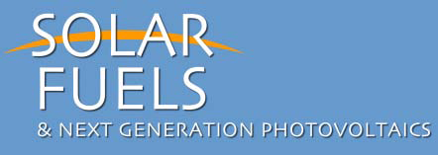
Solar Fuels: Creation of storable fuels using solar energy and catalysis
The Science
Research in Solar Fuels and Photovoltaics will integrate light absorption and electron transfer driven catalysis
Molecular assemblies to create efficient devices for solar energy conversion through artificial photosynthesis
      T Meyer, J Papanikolas, C Heyer, Catalysis Letters 141 (2011) 1-7.
A Theoretical Framework
Co-design strategy for creation of new scalable codes
Incorporation of workflow technologies to coordinate, launch, and enhance resilience of the design pipeline
Apply the developed codes to solve complex problems in electronic structure, kinetics, and synthesis
Collaborations - Working directly with
Experimentalists (UNC-CH)
Model and methods developers (Duke, UNC-CH)
Notes:
The Science: In this case Solar Fuels basically is the creation of liquid fuels ( but it could be in other physical states) using the energy from the Sun. This generally means needing
Catalysts the enable the process to occur. Much like photosynthesis uses Solar energy to create fuels ( carbohydrates etc.) for plant growth.
The Theoretical Framework.
Solar Fuels research requires more and faster theoretical research for a better understanding of the detailed chemistry. This understanding is essential in order to
Begin “designing” catalysts of the future. Much of this work is in the creation of new Methods, codes, and frameworks.
Collaborations:
A multi-institutional collaboration including experimentalists.

Slide 17
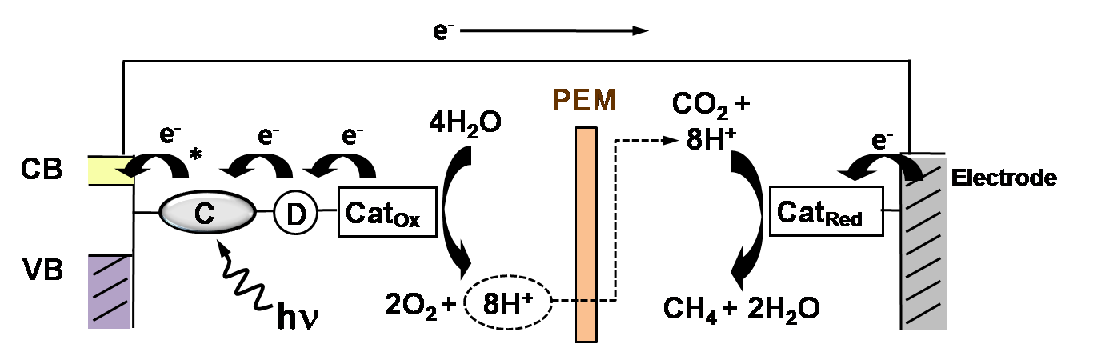
A multistep process for sustainable fuel creation
Dye Sensitized Photoelectrosynthesis Cell (DSPEC)
Solar -> Catalysts + abundant materials -> Liquid Fuel
Each step a significant research project
  Focus on Oxidation catalyst
Image provided by UNC-CH EFRC: http://www.efrc.unc.edu/
Oxidation catalysts
Notes:
Image provided by UNC-CH EFRC: http://www.efrc.unc.edu/
T Meyer, J Papanikolas, C Heyer, Catalysis Letters 141 (2011) 1-7.
This is a basic illustration of where the work is somewhat headed to. This depicts a model “device” that absorbs solar energy ( at the chromophore: C) causing
A hole-electron pair to form. The electron heads toward the conduction band (CB) of the electrode ( vertical line to the far left ). The hole heads to the
Oxidation catalyst to catalyze water oxidation.
The electron ends up at the 2nd electrode ultimately being used to reduce CO2.
PEM is a semi-permeable membrane that separates the two chemistries ( oxidation and reduction)

Slide 18
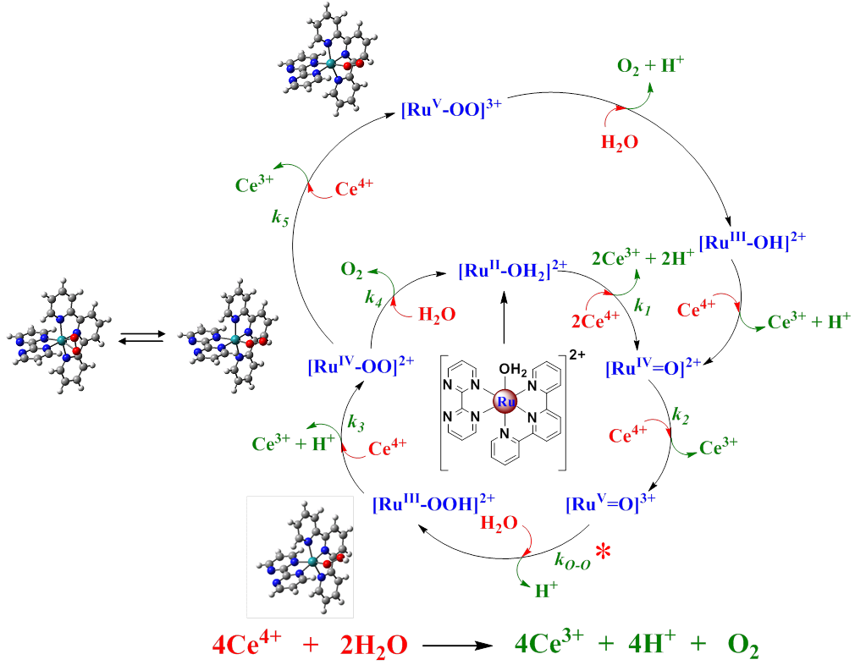
Model Catalyst: Single site system based on Ru
Catalytic oxidation of water
Multistep cyclic process
Several steps difficult to analyze experimentally
Desire to replace expensive Ru with earth abundant materials
J J Concepcion, J W Jurss, J L Templeton, T J Meyer, Journal of the American Chemical Society 130 (2008) 16462-63.
J J Concepcion, J W Jurss, M R Norris, Z Chen, J L Templeton, T J Meyer, Inorganic Chemistry 49 (2010) 1277-79.
Notes:
One piece of the cell. The catalyst part. Designing and understanding it can be hard.
Water oxidation works but how does the catalysts work? Can we understand this process well enough to design better versions of it AND replace the Ru with something earth-abundant?
Here is the oxidation cycle with a catalysts depicted in the center. We require comprehensive theoretical understanding of all intermediates.
A significant theoretical challenge.

Slide 19
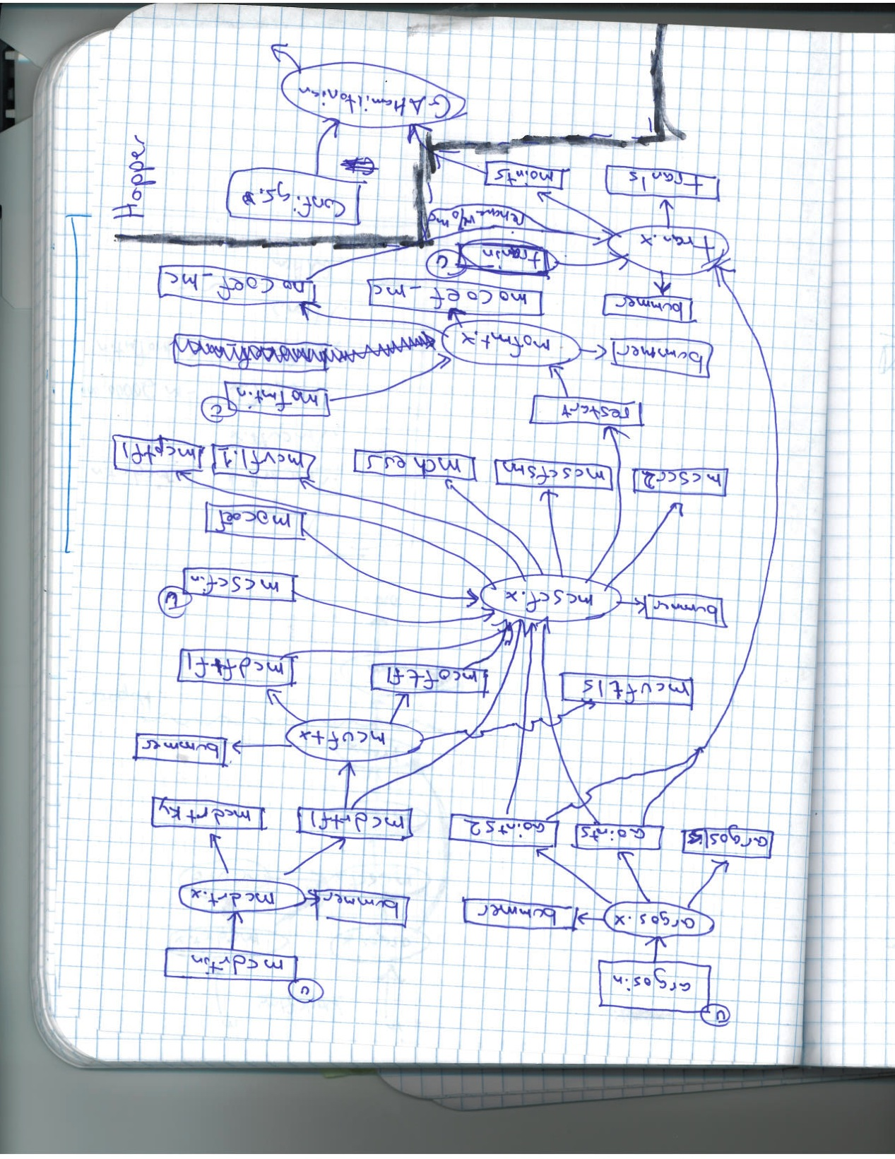
Solar Fuels Workflow
Notes:
This is Paul Ruth’s original drawing of the workflow.
It includes seven applications that communicate using files. The first six applications are executed on virtual computational resources provisioned from two clouds (Duke and RENCI). The final application is a large MPI application that scales well to several thousand processes and is executed on Hopper at NERSC.

Slide 20
Workflow
argos.x
mcdrt.x
mcscf.x
mcuft.x
mofmt.x
tran.x
Serial (Condor/Orca)
PSOCI.x
MPI (Hopper)
Notes:
A cleaned-up, simplified overview of one run of the workflow…..
“The workflow incorporates several stand-alone applications to compute the electronic structure of Ruthenium oxide moieties relevant to single site catalytic oxidation of water.
The electronic structure is determined using wavefunction methods constructed from an explicit spin-orbit (SO) operator and intermediately coupled multireference configuration interaction implemented in a new application (based on (1) ), that leverages massively parallel and many core systems. The workflow also leverages capabilities from the Columbus Programming Suite (2).
(1) J. L. Tilson, W.C. Ermler and R. M. Pitzer Computer Physics Communications, Vol. 128, pp. 128-138, 2000.
(2) H. Lischka, R. Shepard, I. Shavitt, R. M. Pitzer, M. Dallos, Th. Müller, P. G. Szalay, F. B. Brown, R. Ahlrichs, H. J. Böhm, A. Chang, D. C. Comeau, R. Gdanitz, H. Dachsel, C. Ehrhardt, M. Ernzerhof, P. Höchtl, S. Irle, G. Kedziora, T. Kovar, V. Parasuk, M. J. M. Pepper, P. Scharf, H. Schiffer, M. Schindler, M. Schüler, M. Seth, E. A. Stahlberg, J.-G. Zhao, S. Yabushita, Z. Zhang, M. Barbatti, S. Matsika, M. Schuurmann, D. R. Yarkony, S. R. Brozell, E. V. Beck, and J.-P. Blaudeau, M. Ruckenbauer, B. Sellner, F. Plasser, and J. J. Szymczak, COLUMBUS, an ab initio electronic structure program, release 5.9.2 (2008).

Slide 21
Workflow: Ensemble
Ensemble Generator
Collector
Notes:
The workflow, run many many times with an ensemble generator (i.e. using Pegasus).
The output of the workflow is a graph depicting the energy at each r value (needs more explanation). Each run through the workflow will produce the data for one r value. Subsequent runs will produce data for more r values.

Slide 22
Inter-cloud slice
ORCA negotiates a slice among a multitude of heterogeneous resource providers
Multiple independent cloud providers
  RENCI, UNC, Duke
Multiple network providers
  ESNet, NLR, BEN
Inter-provider VLAN stitching
  VLAN label agreement
Multi-layered connections in BEN
  Fiber, DWDM, VLAN/Ethernet layers provisioned in concert with each other
Notes:
We run the afore-mentioned Workflow ensemble in an ORCA-provisioned Inter-cloud slice.

Slide 23
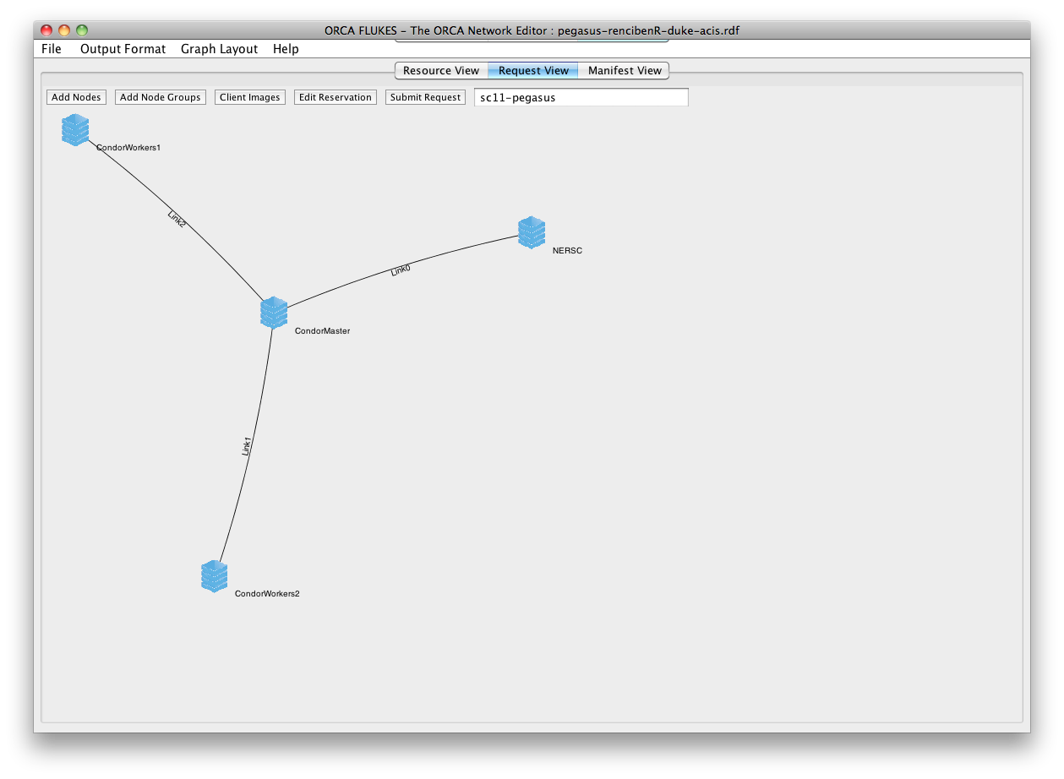
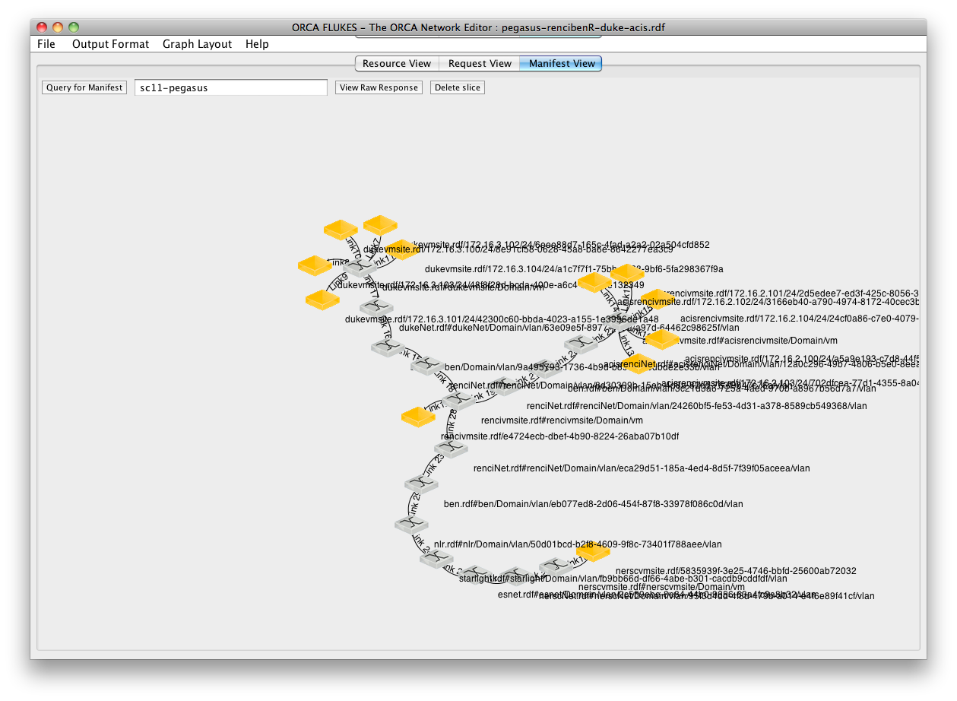
Notes:
“Flukes is a Java-based GUI that allows an experimenter to graphically inspect the state of ORCA substrates, create request topologies, submit requests to ORCA and inspect the returned substrate information (called 'manifest'). Several key features of Flukes:
Graphical intuitive interface
Uses native ORCA interfaces and resource descriptions (NDL-OWL) for maximum flexibility, unlike other interfaces to ORCA which use GENI RSpecs and GENI AM API and rely on conversions between these resource formats.
Allows the user to submit requests and inspect the output manifest in a graphical environment
Allows the user to login to provisioned resources”
Source: https://geni-orca.renci.org/trac/wiki/flukes

Slide 24
BEN Slice Detail

Slide 25
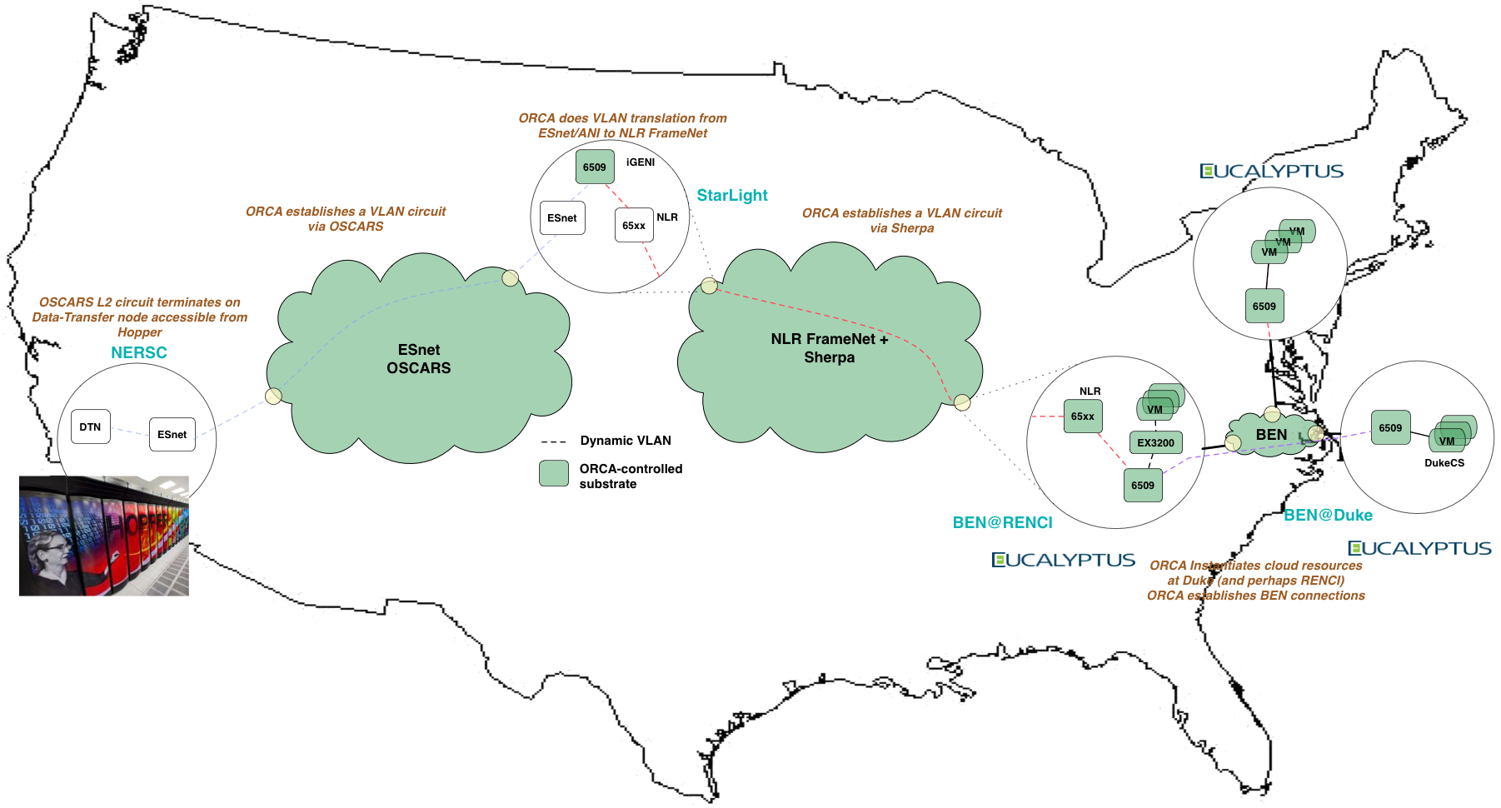

Resource/substrate providers

Slide 26
Challenges
Temporary
Diverse requirements
Isolation/Security
Authentication
Dynamic Applications
Data Access
Notes:
Temporary – right now, we haven’t run a slice longer than about two weeks. Some potential users have requested slices to last up to the length of a college semester, like a virtual classroom. Right now it’s not feasible, and we don’t know if/when such a situation could be.
Diverse Requirements – many software packages, configurations to manage (Puppet and LDAP can help in some areas, but not tall); nascent OpenFlow implemtations; coordinating with partners, VLAN translation for “stitching”.
Isolation/Security
Authentication – Looking forward towards ABAC (Attribute-Based Access Control)

Slide 27
Questions?

