Slide 1
Water into Wine:
Condor, PEST, and
Hydrologic Modeling
Mike Fienen and Randy Hunt
Research Hydrologists
USGS Wisconsin Water Science Center

Slide 2
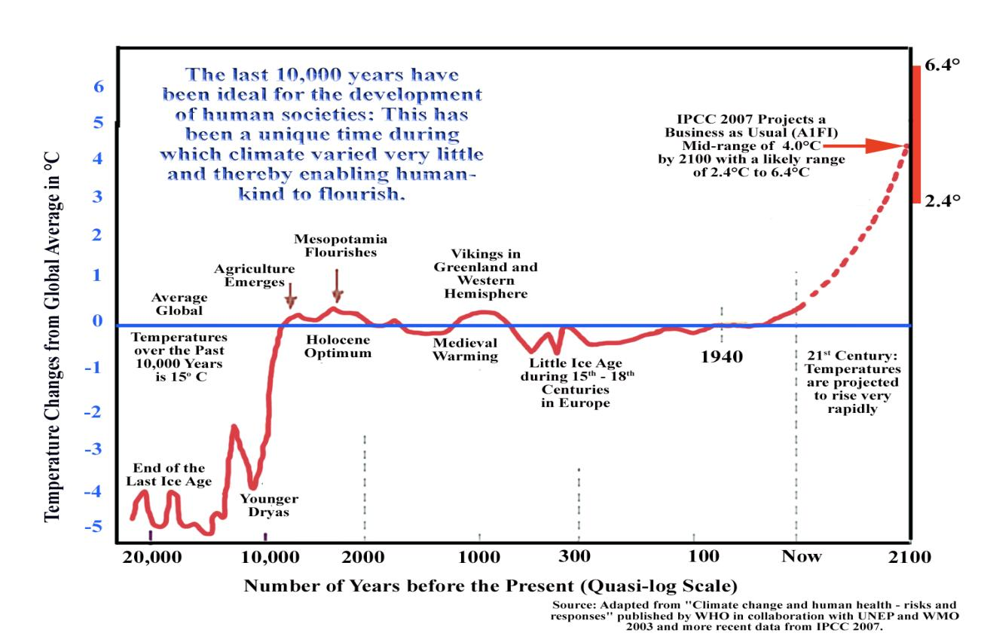
Sea Level Rise
The last 10,000 years have been ideal for the development of human societies. This has been a unique time during which climate varied very little and enabled humankind to flourish.

Slide 3
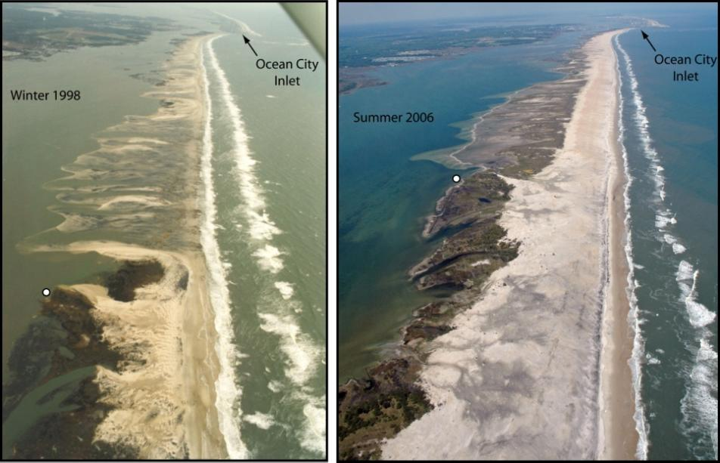
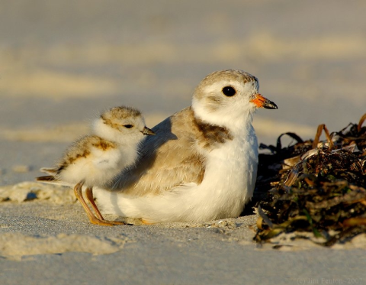
Piping Plover—vulnerable to Sea Level Rise
Among the impacts on Plover
habitat is depth to groundwater.
Small islands off the Atlantic Coast
like Assateague Island, are a
great early-warning system.
Have we always lived in this neighborhood?
1998
2006
Jim Fenton
Jane Thomas, IAN

Slide 4
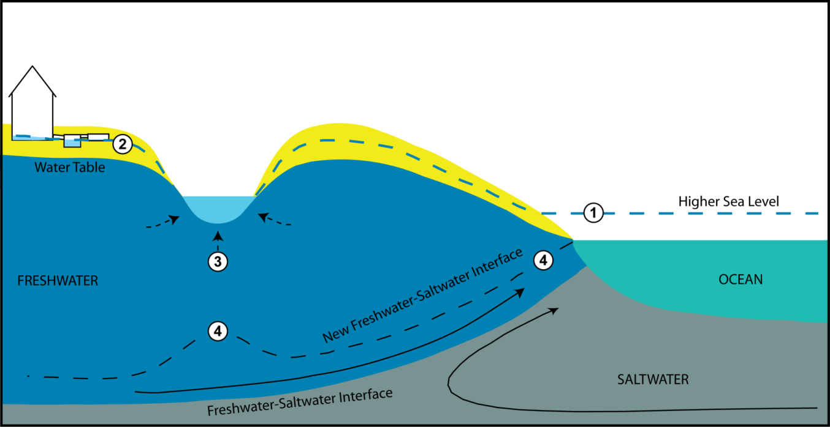
Groundwater Impacts—Important for Plovers and People

Slide 5
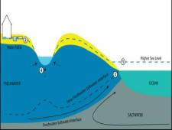
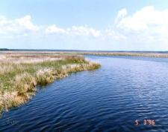
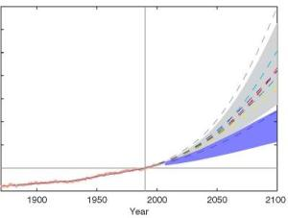
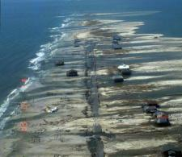
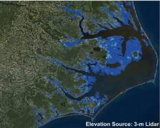
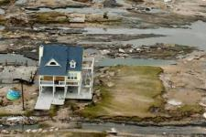
Sea-level rise impacts: A multivariate problem full of uncertainties
Driving
Forces
Groundwater Impact
Adaptation
Planning
Response
Habitat Loss
Wetland Loss
Climate Change & Sea Level Rise
Physical
& Biological Processes
Potential Impacts
Management
Decisions
Coastal Erosion
Initial
Conditions
Safety
Inundation

Slide 6
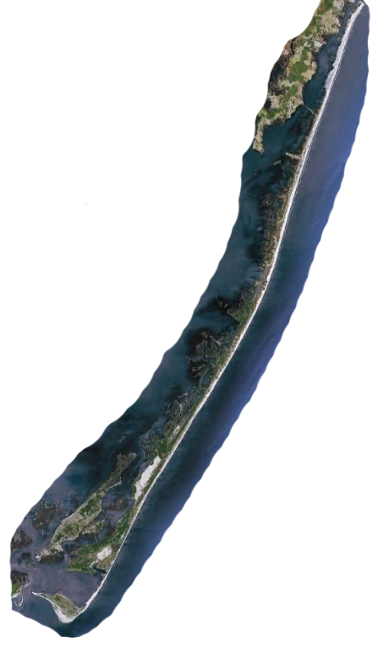
Assateague Island Groundwater Model

Slide 7
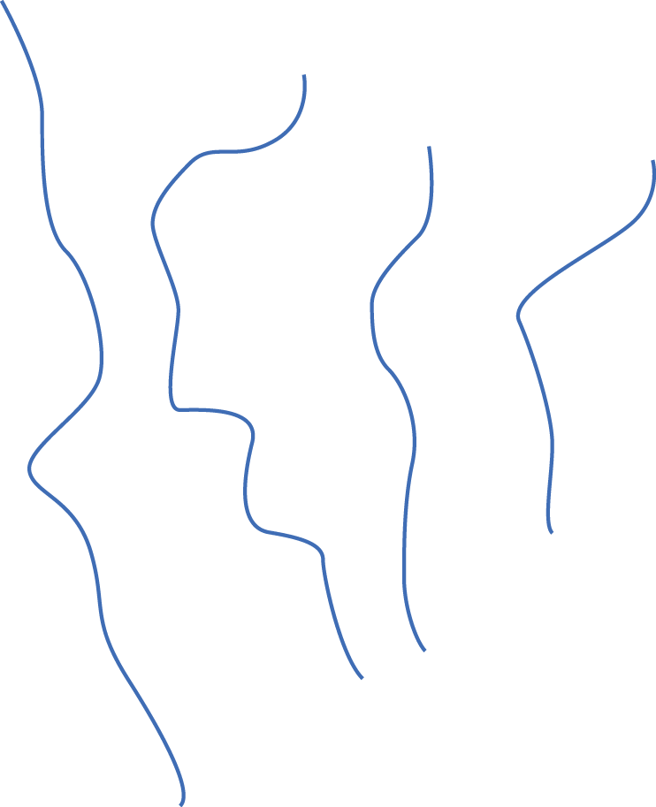
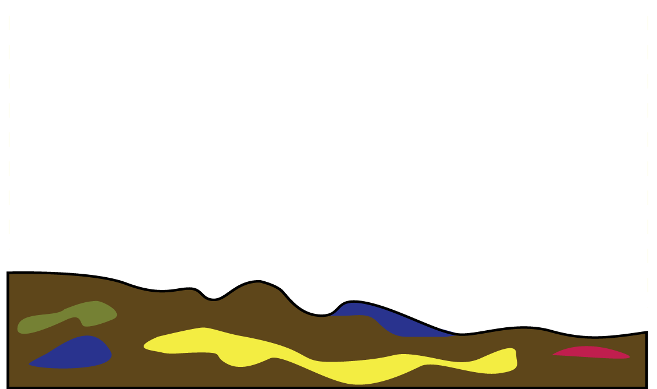
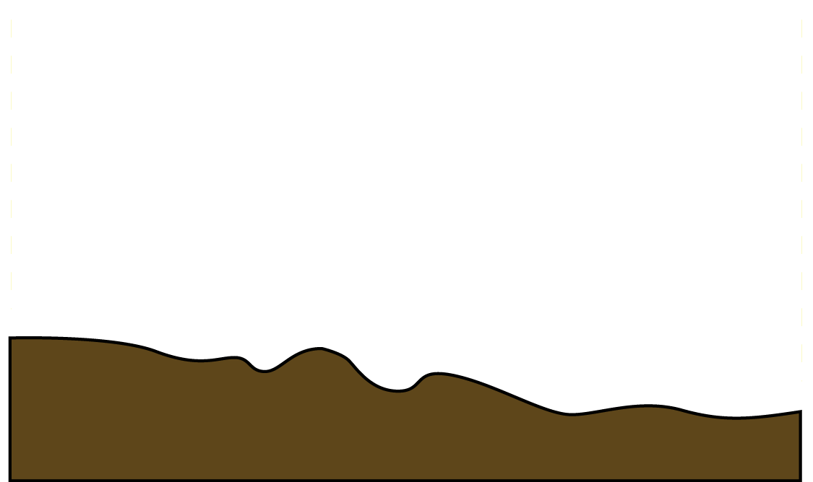
Groundwater Model Calibration
K
R
Notes:
7

Slide 8
Calibration and Uncertainty
More complex models → many parameters
Model must be run a multiple of number of parameters
Uncertainty analysis has similar computational needs
Can be run in parallel on many computers (embarrassingly)
pleasingly
R
R
R
R
R
R

Slide 9
What is PEST?
Written by John Doherty/Watermark Numerical Computing
Model-independent parameter estimation code
Writes ASCII model input, reads ASCII model output
Takes control of a model and runs it many, many times
Pleasingly parallel
PEST
input.txt
#stuff in here
par1: 1.0923
par2: 9.99E-04
. . .
model
output.txt
#stuff in here
time value
1.0 93.492
2.0 97.392
3.0 99.905
. . .

Slide 10
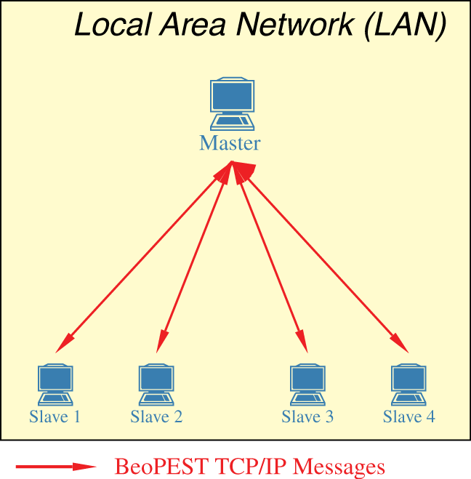
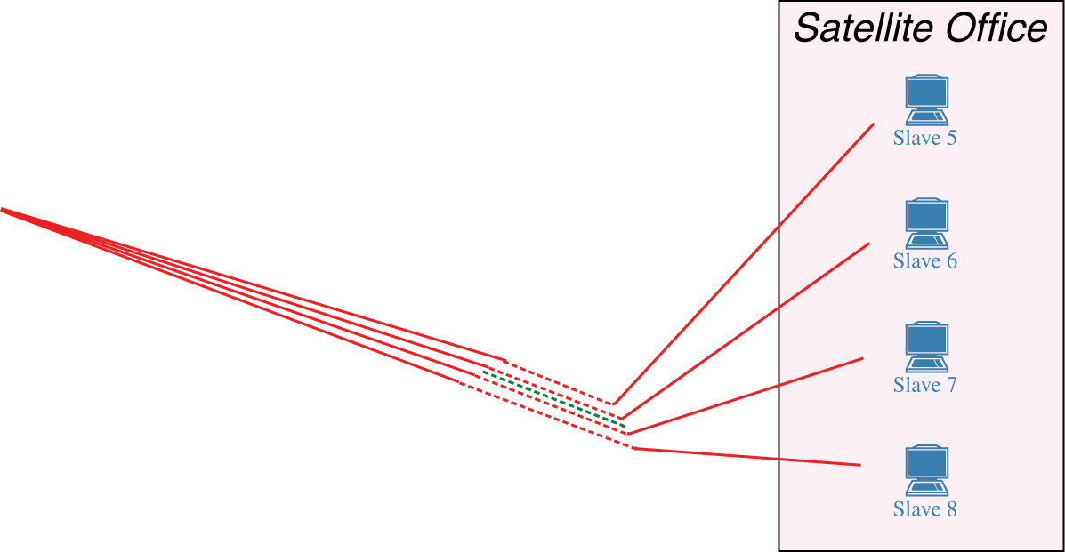
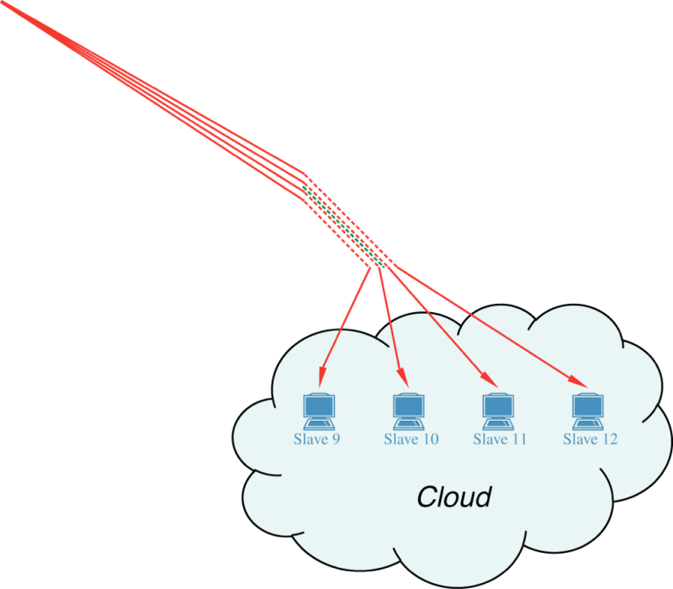
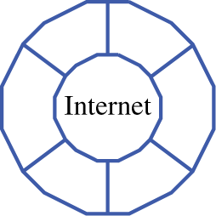
beoPEST is an ideal tool for model calibration
Need to launch remote slave processes
Each slave needs model files

Slide 11
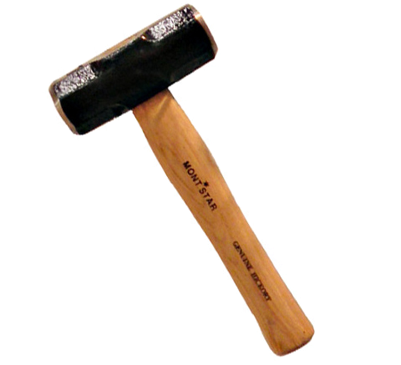
Condor with beoPEST
Condor Advantages:
Move data to each worker machine
Automate starting of worker processes
Provide monitoring
Allow us to accommodate both Linux and Windows user base
Started out with about 80 Linux cores and 450 Windows cores
Windows Issues:
Very expensive to access
more than 32GB RAM/blade
TCP/IP related memory trouble
Our parent agency proposed
$600/year/machine Windows license surcharge.

Slide 12
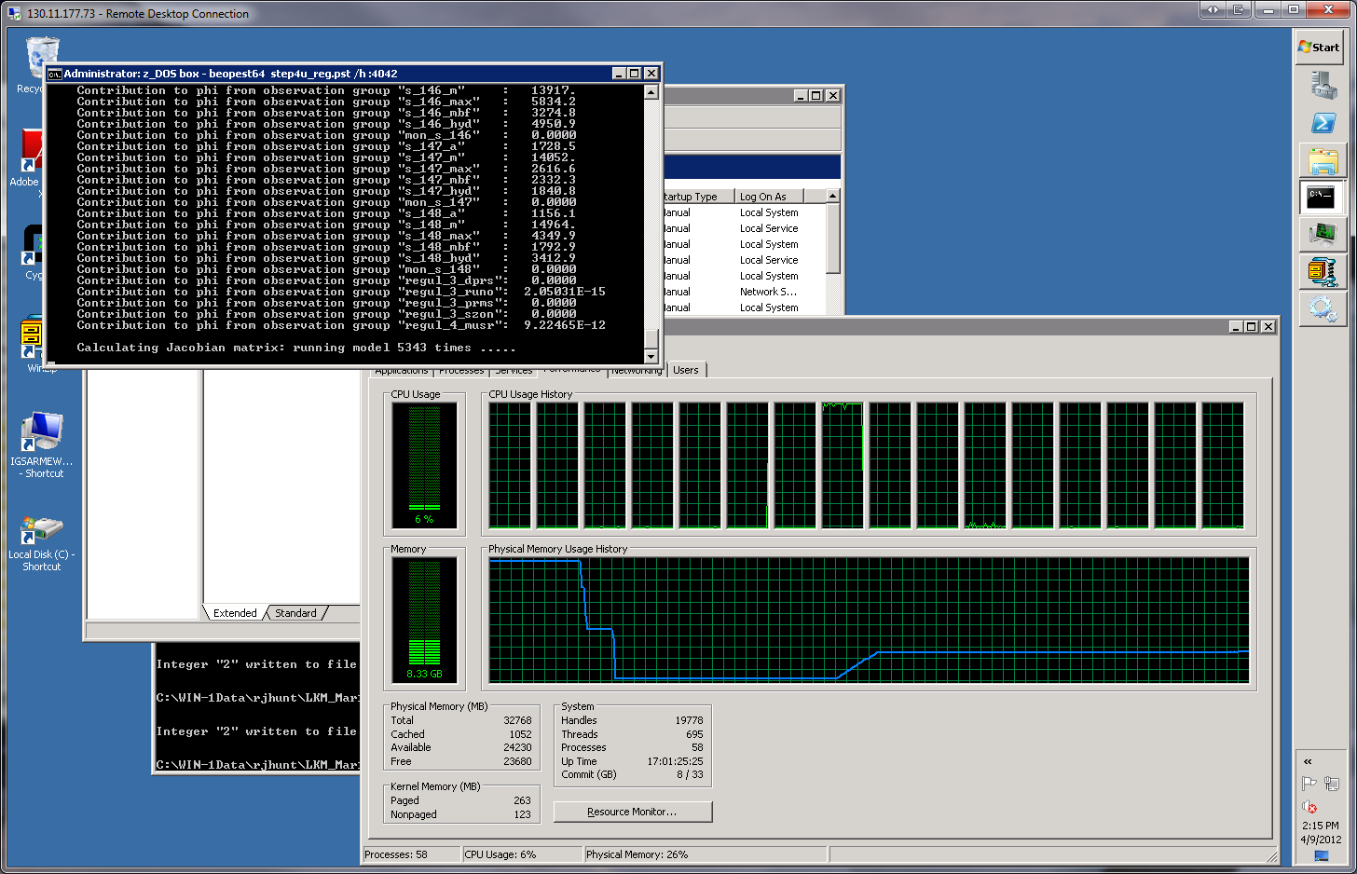
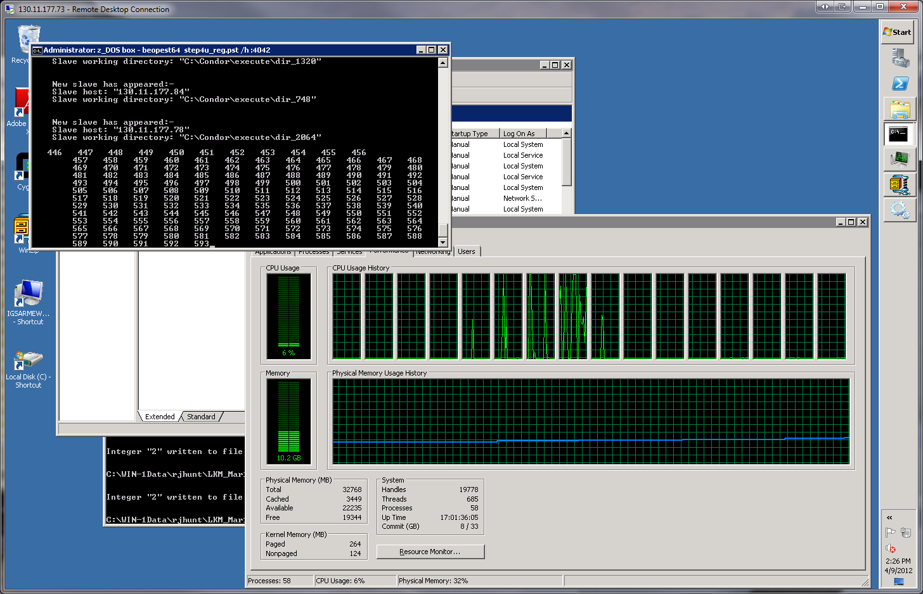
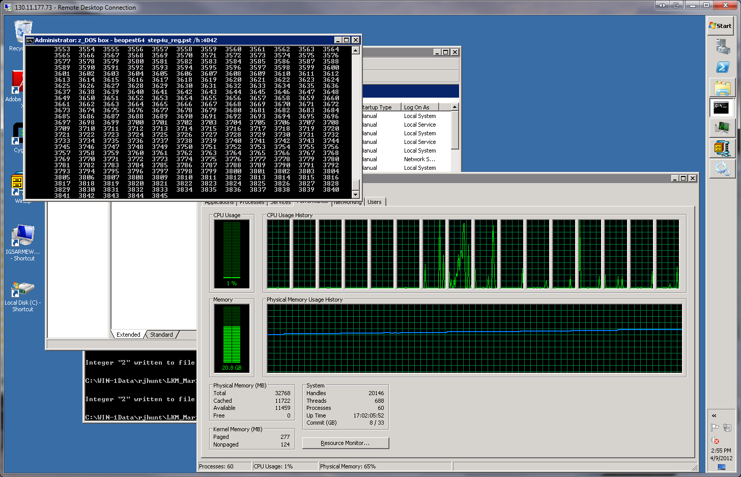
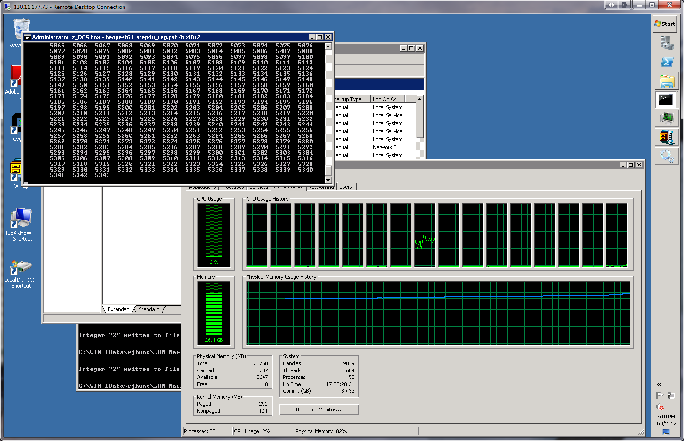
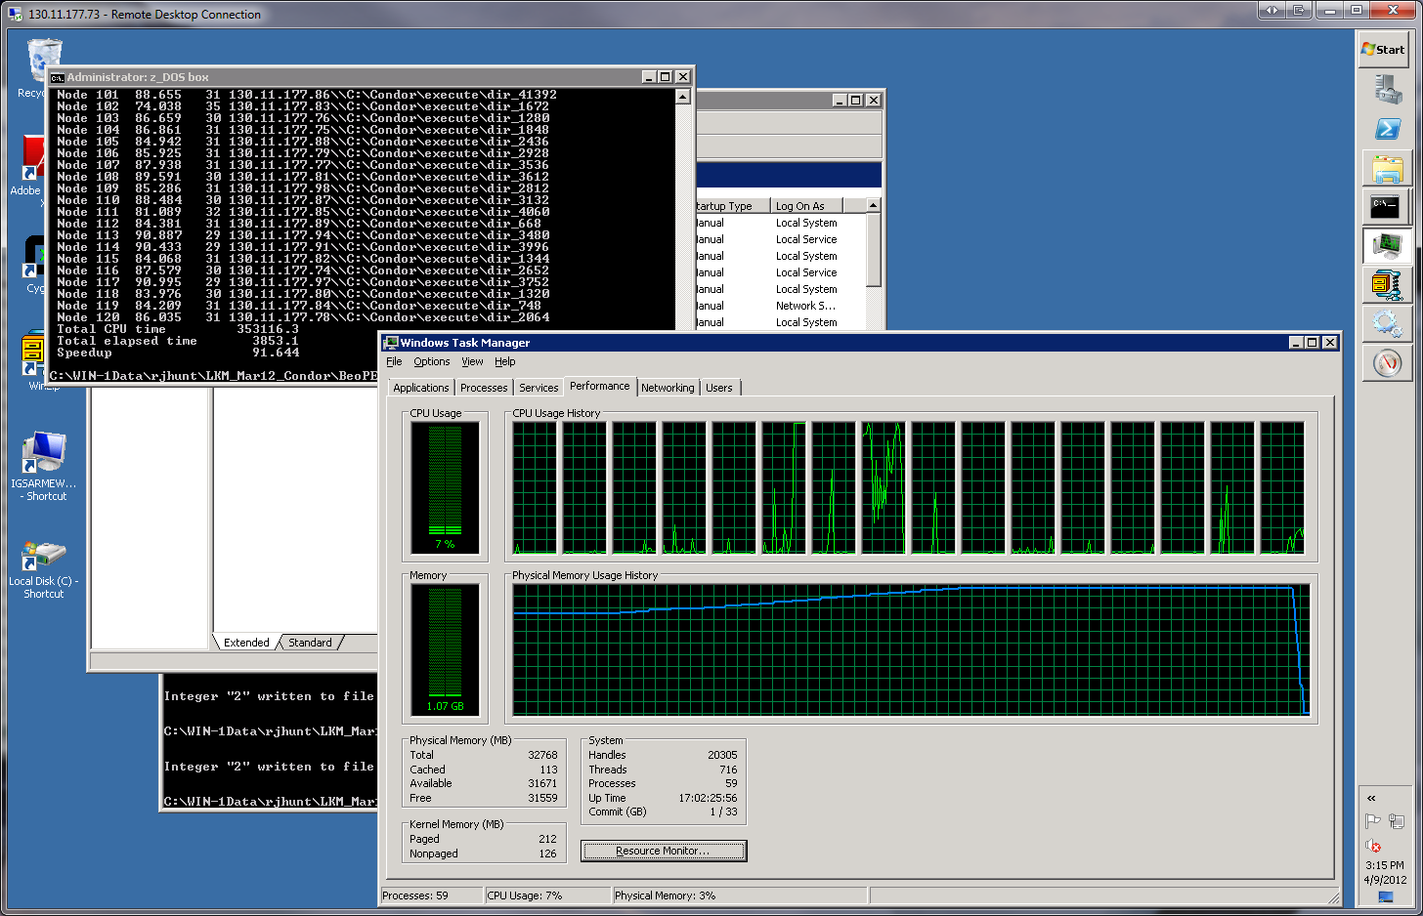
winsock.dll Sings the Blues—120 Workers
100% runs complete—
Jacobian calculations
(continued)
100% runs complete
100% runs complete—
Jacobian calculations
100% runs complete—
Jacobian calculations
(continued)
beoPEST finished
10% runs complete
50% runs complete
99% runs complete
120 slaves started
20 slaves started
120 slaves started
120 slaves started
Run done/slaves stopped
120 slaves started
120 slaves started
120 slaves started
120 slaves started

Slide 13
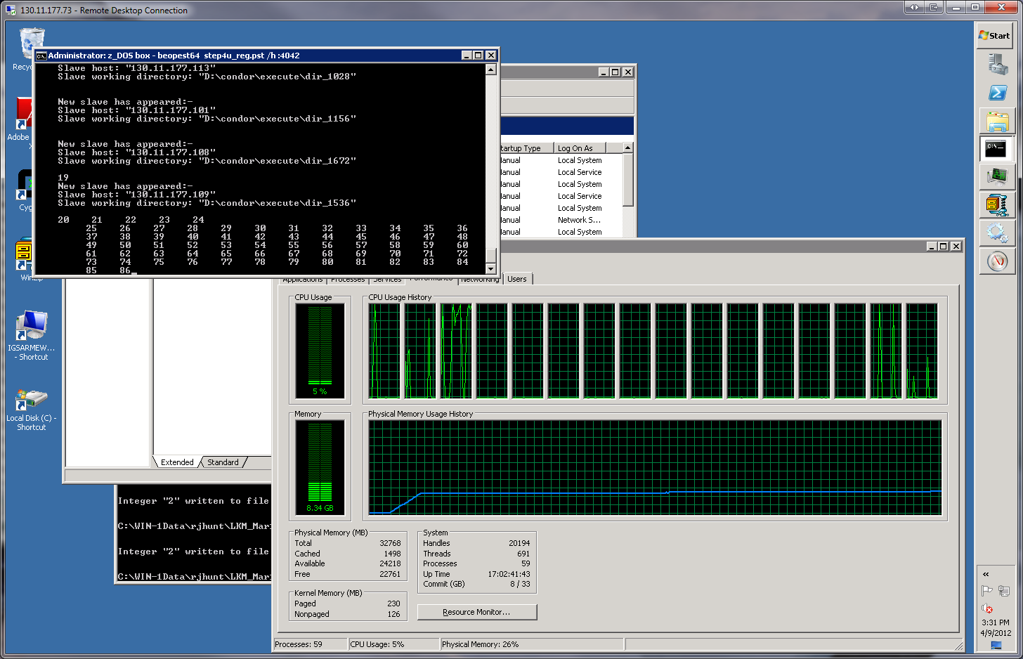
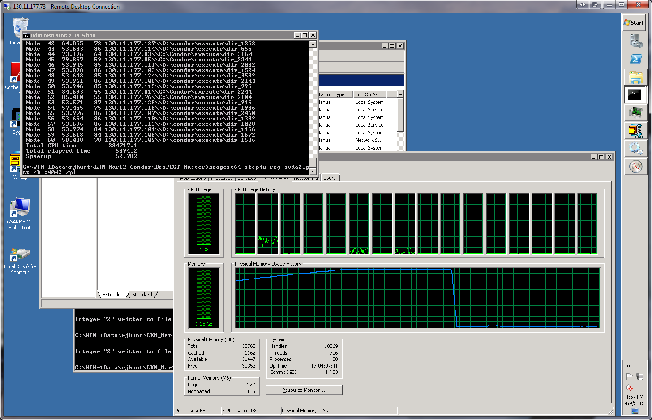
winsock.dll Sings the Blues—60 Workers
60 slaves started
20 slaves started

Slide 14
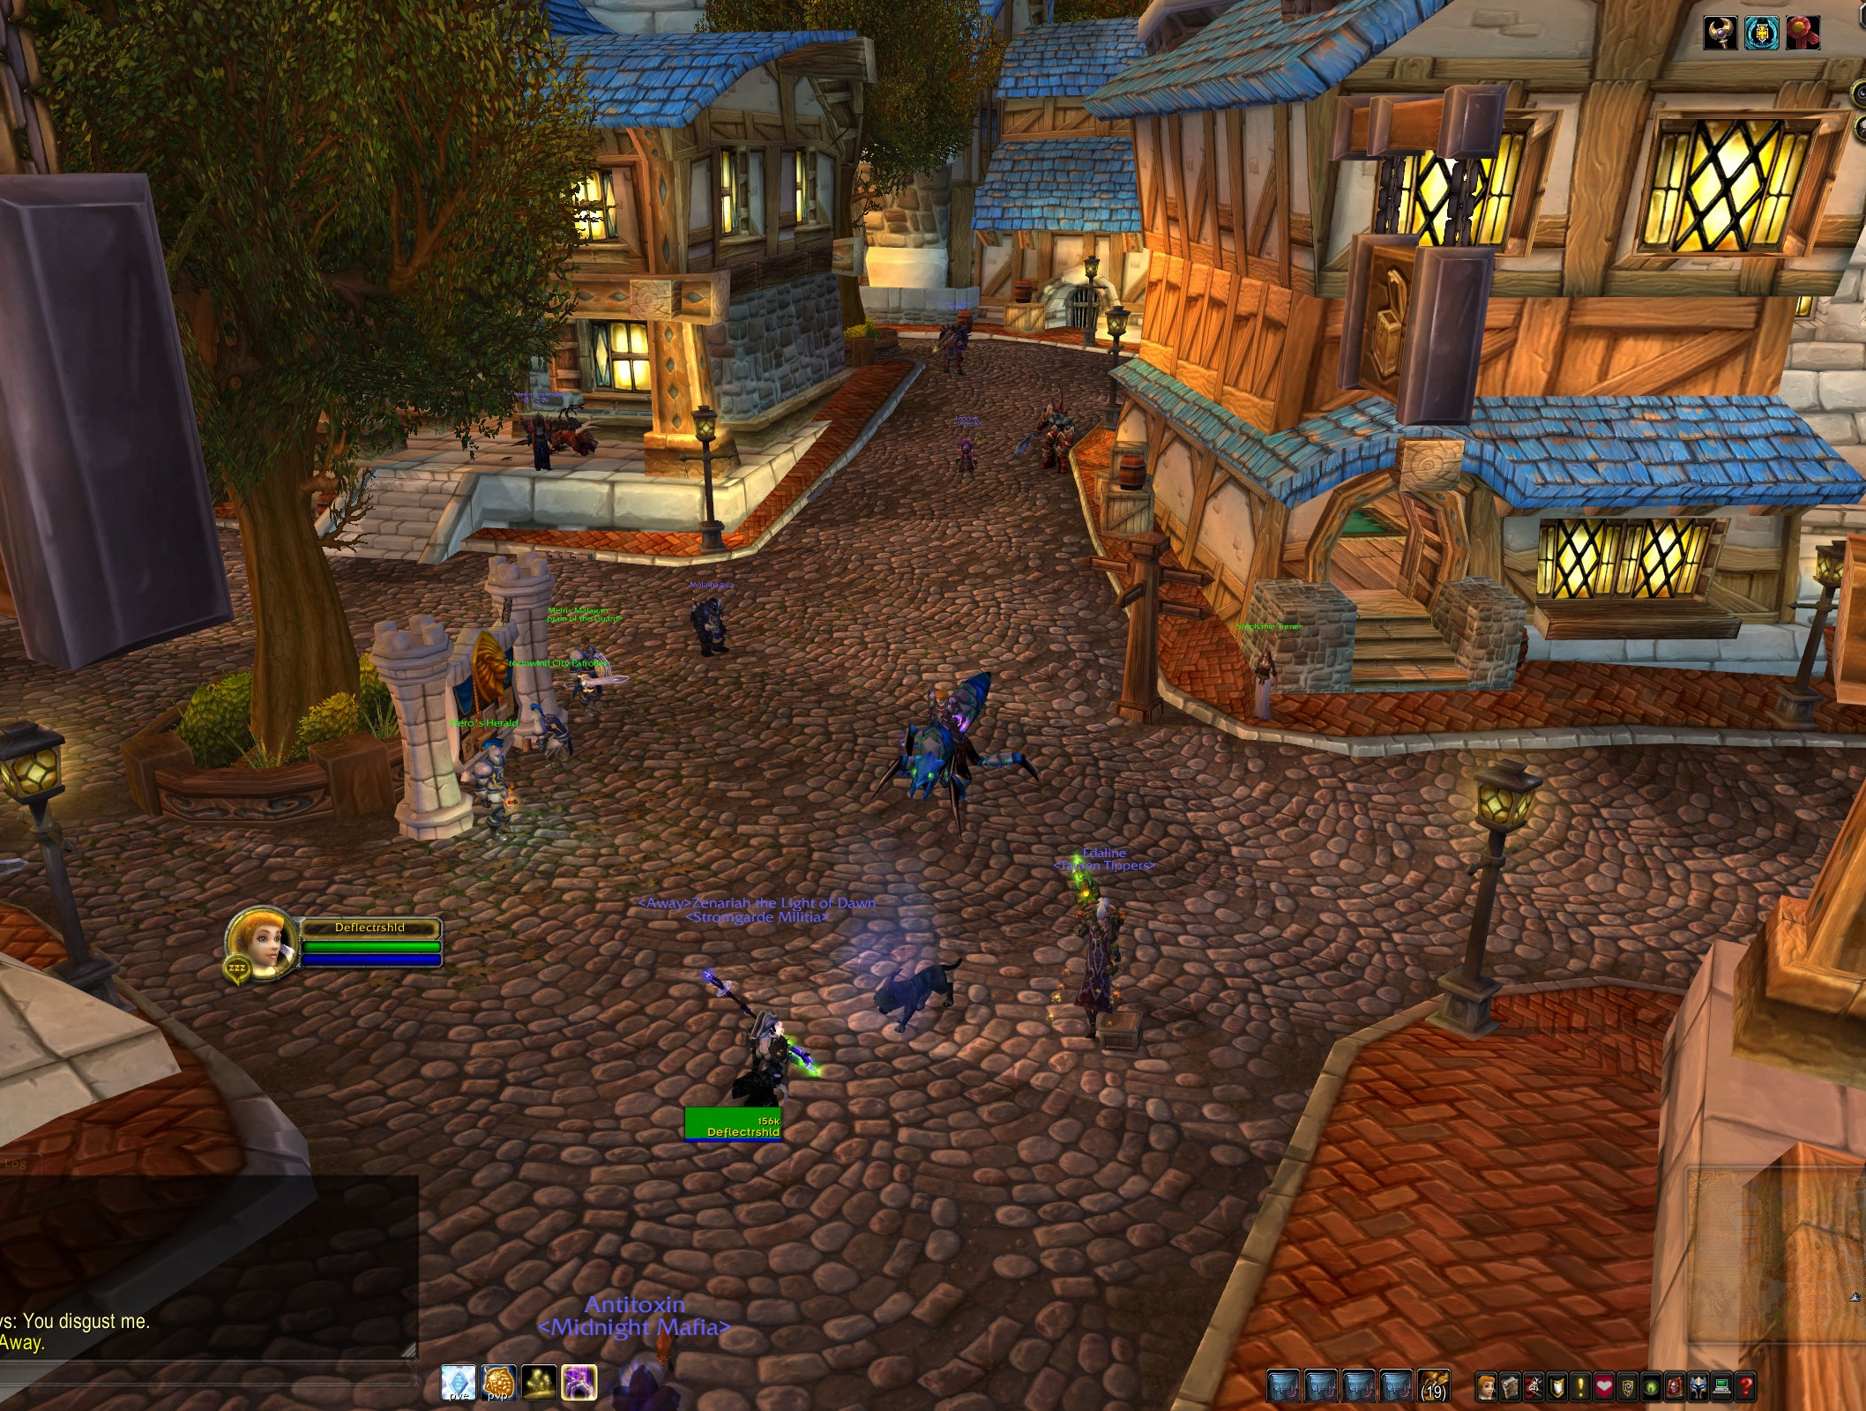

Slide 15
Making Wine Fine
WINEPREFIX=$_CONDOR_SCRATCH_DIR
Thanks Ian Chesal and
Rich Pieri via [condor-users]!!!

Slide 16
Sea Level Rise Impacts on Island Geometry—DRAFT
land
Back to our story…
sea
SLR +0.00m
SLR +0.20m
SLR +0.40m
SLR +0.60m
SLR +0.80m

Slide 17
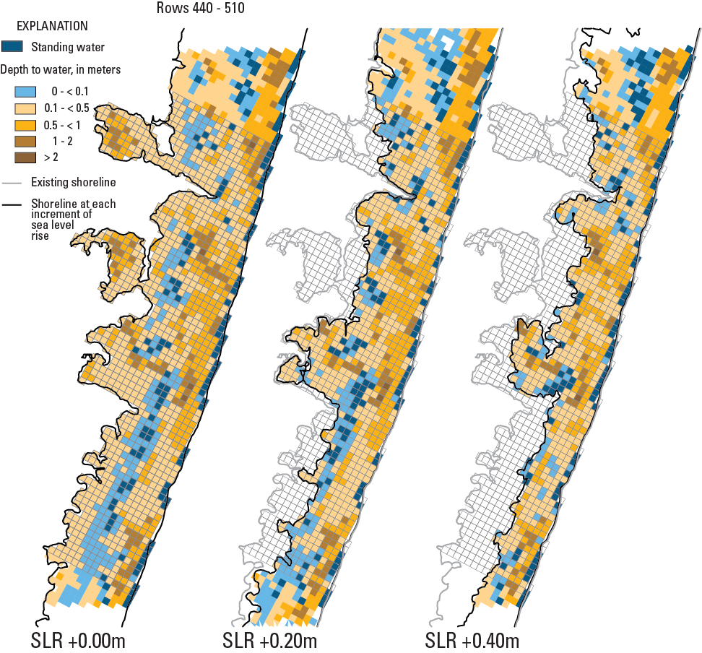
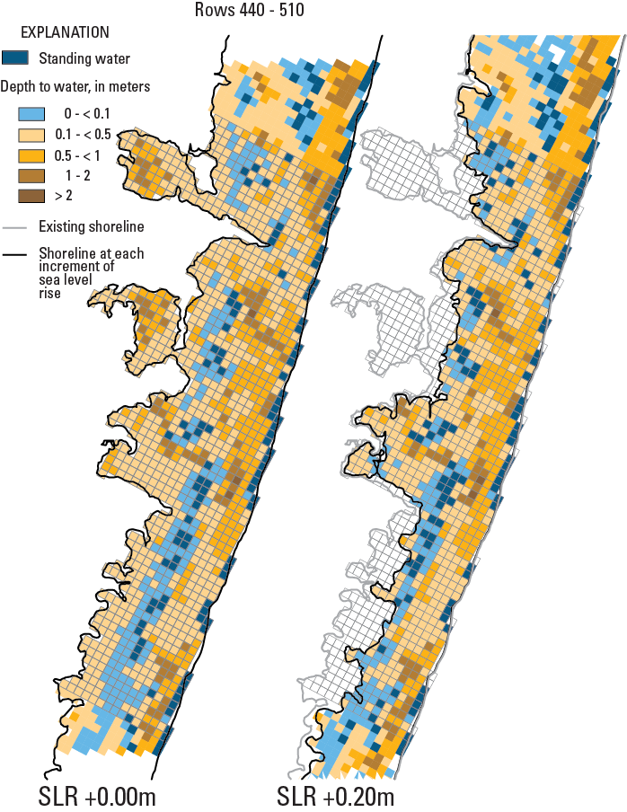
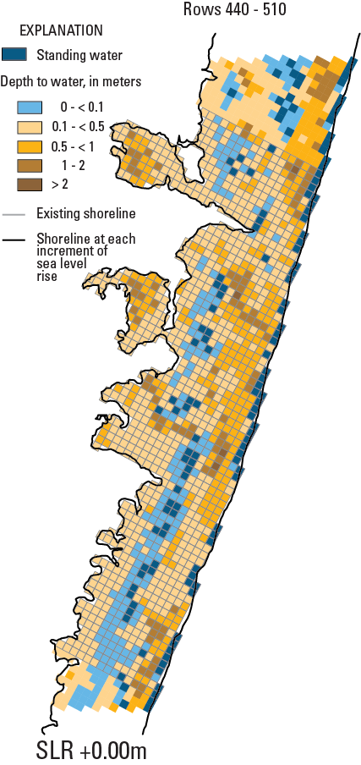
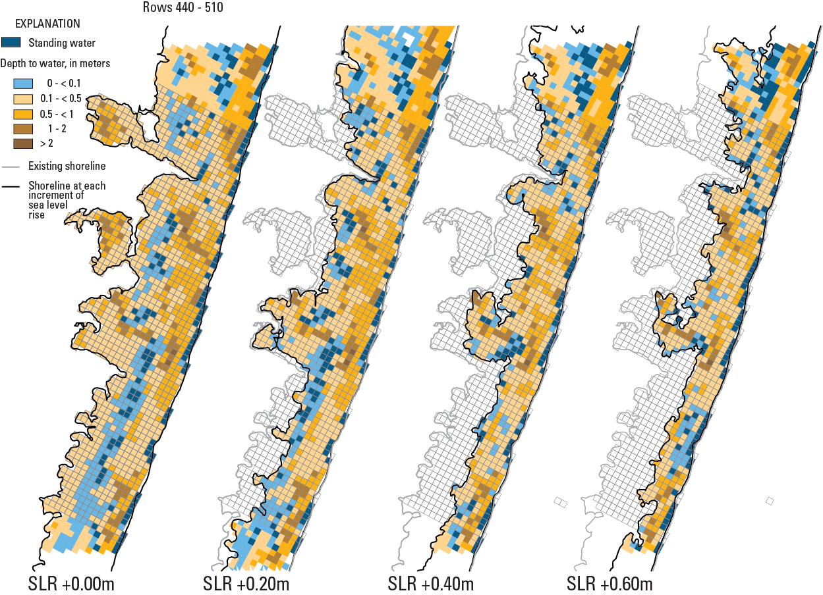
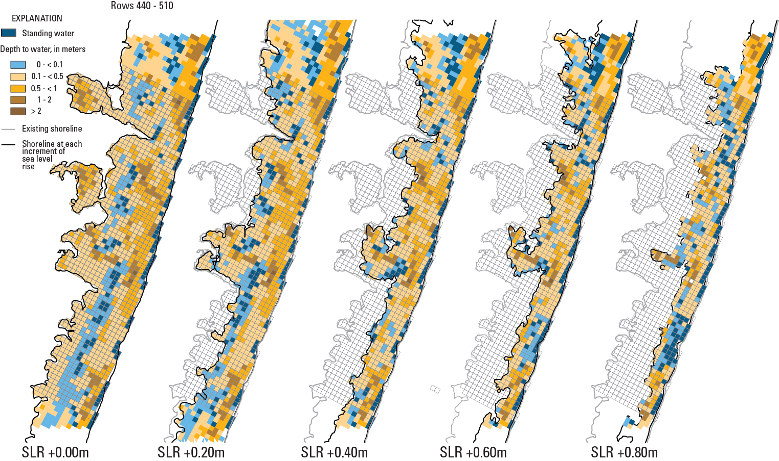
Groundwater Results of Sea Level Rise Simulations—DRAFT

Slide 18
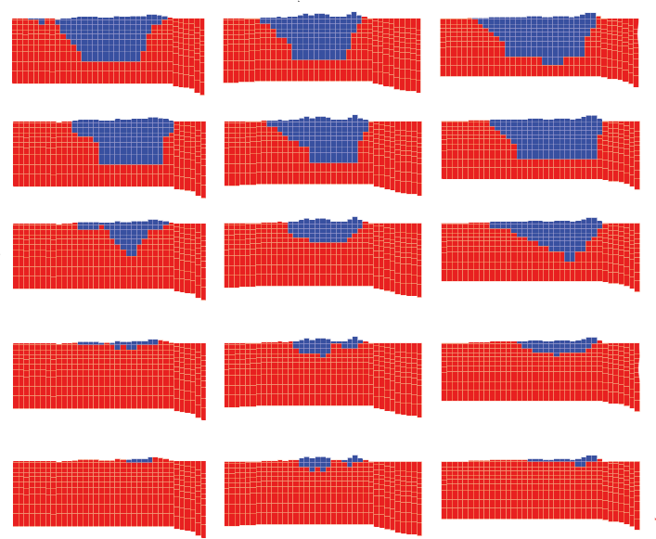
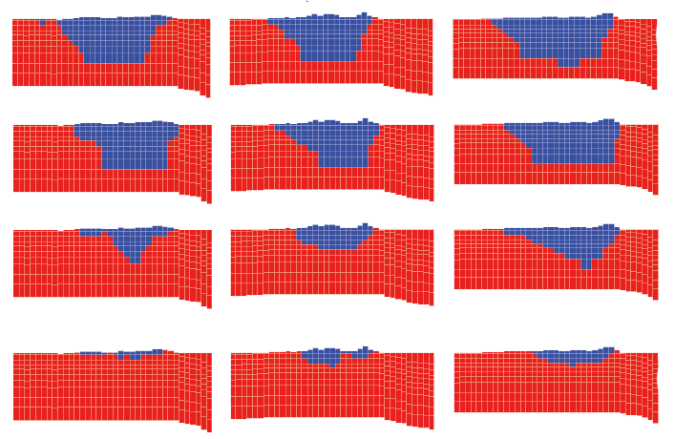
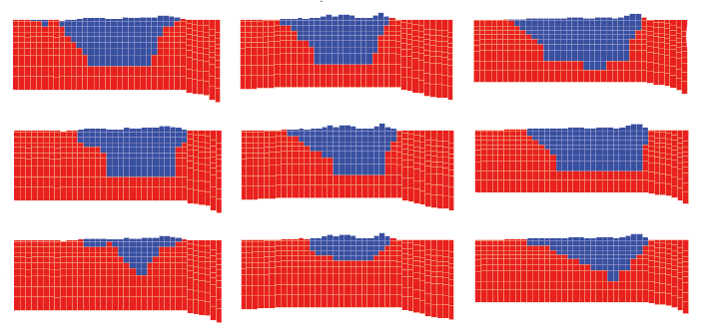
Salinity Results of Sea Level Rise Simulations—DRAFT
Cross-section 1
Cross-section 2
Cross-section 3
Blue=fresh
SLR +0.00m
Red=salty
SLR +0.02m
SLR +0.04m
SLR +0.06m
SLR +0.08m

Slide 19
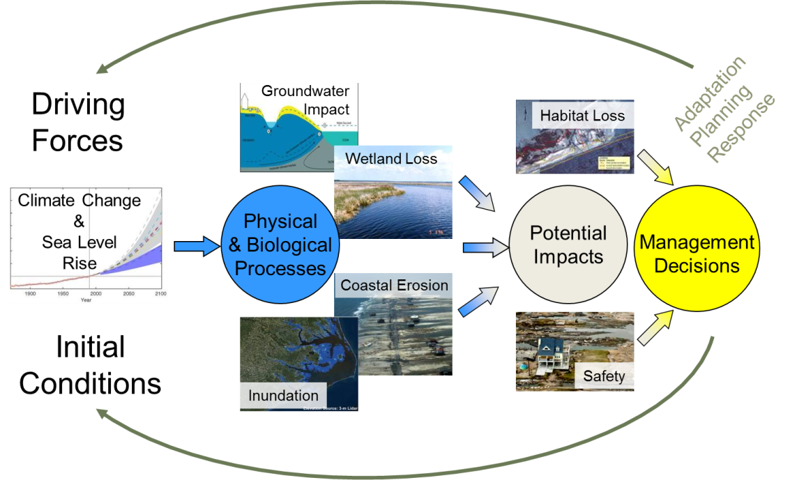
What’s next?
Continue refining how beoPEST and Condor interact.
More hardware.
Incorporate GW results into a Bayesian Decision Network along with other processes.
Start linking the process models explicitly which will require much more computational power and more adventures with Condor.

Slide 20
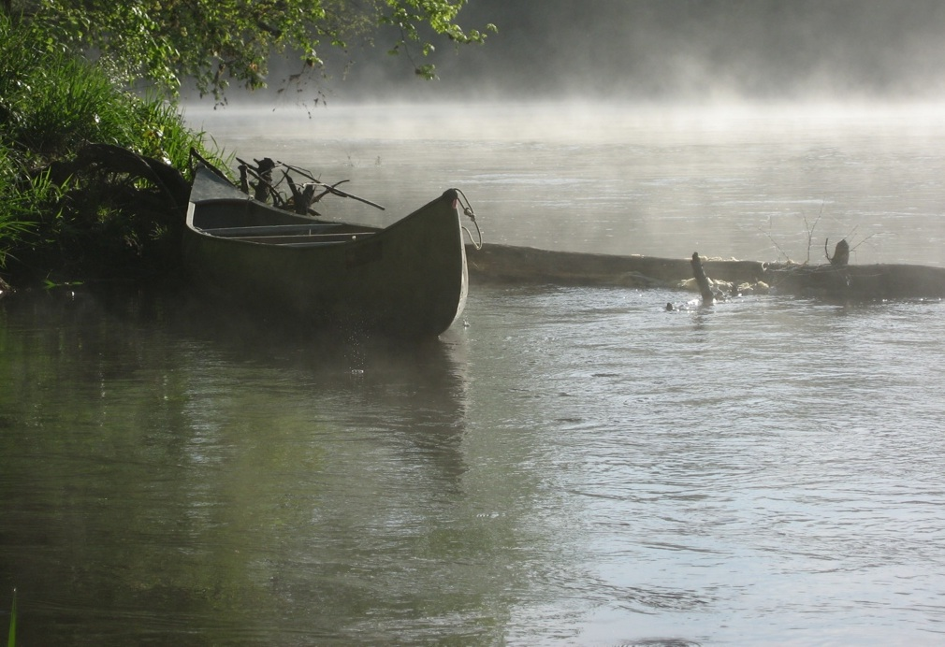
Thanks to:
John Doherty: Watermark Numerical Computing, Flinders University (Australia)
Willem Schreüder: Principia Mathematica
Miron Livny, Brooklin Gore, Todd Tannenbaum, Vladimir Brik, Cathrin Weiss: CHTC
Harry House, Daniel Kester, Ben Feinstein, Shirley Stephan: USGS—CIDA
Ryan Heath, John Masterson, Rob Thieler, Nathaniel Plant: USGS

