Slide 1

End-to-end Data-flow Parallelism for Throughput Optimization in
High-speed Networks
Esma Yildirim
Data Intensive Distributed Computing Laboratory
University at Buffalo (SUNY)
Condor Week 2011

Slide 2

Motivation
2
Data grows larger hence the need for speed to transfer it
Technology develops with the introduction of high-speed networks and complex computer architectures which are not fully utilized yet
Still many questions are out in the uncertainty
I have a 10G high-speed network and supercomputers connecting. Why do I still get under 1G throughput?
I can not receive the speed I am supposed to get from the network
I want to get high throughput without congesting the traffic too much. How can I do it in the application level?
I can’t wait for a new protocol to replace the current ones, why can’t I get high throughput with what I have at hand?
OK, may be I am asking too much but I want to get optimal settings to achieve maximal throughput

Slide 3
Introduction
3
Users of data-intensive applications need intelligent services and schedulers that will provide models and strategies to optimize their data transfer jobs
Goals:
  Maximize throughput
  Minimize model overhead
  Do not cause contention among users
  Use minimum number of end-system resources

Slide 4
Introduction
4
Current optical technology supports 100 G transport hence, the utilization of network brings a challenge to the middleware to provide faster data transfer speeds
Achieving multiple Gbps throughput have become a burden over TCP-based networks
  Parallel streams can solve the problem of network utilization inefficiency of TCP
  Finding the optimal number of streams is a challenging task
With faster networks end-systems have become the major source of bottleneck
  CPU, NIC and Disk Bottleneck
We provide models to decide on the optimal number of parallelism and CPU/disk stripes

Slide 5
Outline
5
Stork Overview
End-system Bottlenecks
End-to-end Data-flow Parallelism
Optimization Algorithm
Conclusions and Future Work

Slide 6
Stork Data Scheduler
6
Implements state-of-the art models and algorithms for data scheduling and optimization
Started as part of the Condor project as PhD thesis of Dr. Tevfik Kosar
Currently developed at University at Buffalo and funded by NSF
Heavily uses some Condor libraries such as ClassAds and DaemonCore

Slide 7
Stork Data Scheduler (cont.)
7
Stork v.2.0 is available with enhanced features
  http://www.storkproject.org
Supports more than 20 platforms (mostly Linux flavors)
Windows and Azure Cloud support planned soon
The most recent enhancement:
  Throughput Estimation and Optimization Service

Slide 8
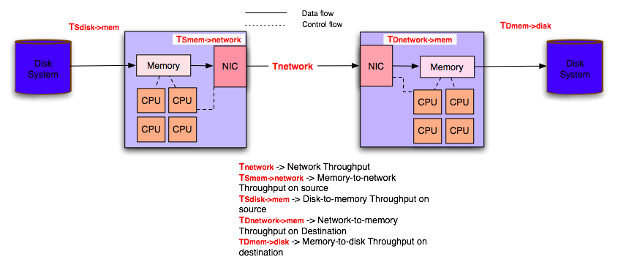
End-to-end Data Transfer
8
Method to improve the end-to-end data transfer throughput
  Application-level Data Flow Parallelism
    Network level parallelism (parallel streams)
    Disk/CPU level parallelism (stripes)

Slide 9

Network Bottleneck
9
Step1: Effect of Parallel Streams on Disk-to-disk Transfers
  Parallel streams can improve the data throughput but only to a certain extent
  Disk speed presents a major limitation.
  Parallel streams may have an adverse effect if the disk speed upper limit is already reached

Slide 10
Disk Bottleneck
10
Step2: Effect of Parallel Streams on Memory-to-memory Transfers and CPU Utilization
  Once disk bottleneck is eliminated, parallel streams improve the throughput dramatically
  Throughput either becomes stable or falls down after reaching its peak due to network or end-system limitations. Ex:The network interface card limit(10G) could not be reached (e.g.7.5Gbps-internode)

Slide 11
CPU Bottleneck
11
Step3: Effect of Striping and Removal of CPU Bottleneck
  Striped transfers improves the throughput dramatically
  Network card limit is reached for inter-node transfers(9Gbps)

Slide 12
Prediction of Optimal Parallel Stream Number
12
Throughput formulation : Newton’s Iteration Model
a’ , b’ and c’ are three unknowns to be solved hence 3 throughput measurements of different parallelism level (n) are needed
Sampling strategy:
  Exponentially increasing parallelism levels
    Choose points not close to each other
    Select points that are power of 2: 1, 2, 4, 8, … , 2^{k}
    Stop when the throughput starts to decrease or increase very slowly comparing to the previous level
Selection of 3 data points
  From the available sampling points
    For every 3-point combination, calculate the predicted throughput curve
    Find the distance between the actual and predicted throughput curve
    Choose the combination with the minimum distance

Slide 13
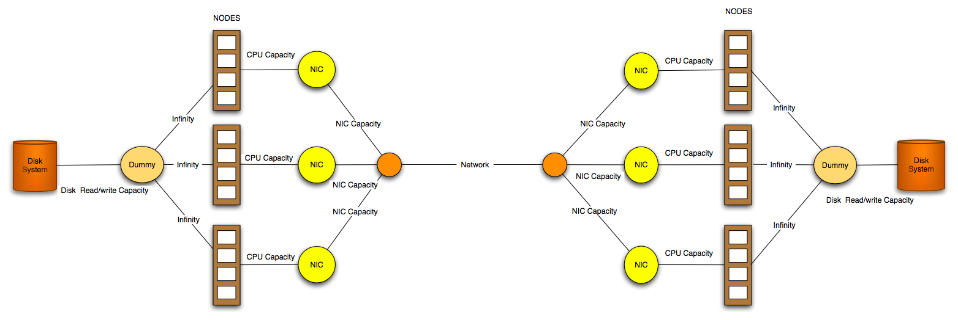
Flow Model of End-to-end Throughput
CPU nodes are considered as nodes of a maximum flow problem
Memory-to-memory transfers are simulated with dummy source and sink nodes
The capacities of disk and network is found by applying parallel stream model by taking into consideration of resource capacities (NIC & CPU)

Slide 14
Flow Model of End-to-end Throughput
Assumptions
  Parameters not given and found by the model:
    Available network capacity (U_{network})
    Available disk system capacity (U_{disk})
  Parameters given
    CPU capacity (100% assuming they are idle at the beginning of the transfer) (U_{CPU})
    NIC capacity (U_{NIC})
    Number of available nodes (N_{avail})
Convert the end-system and network capacities into a flow problem
Goal: Provide maximal possible data transfer throughput given real-time traffic (maximize(Th))
  Number of streams per stripe (N_{si})
  Number of stripes per node (S_{x})
  Number of nodes (N_{n})

Slide 15
Flow Model of End-to-end Throughput
Variables:
  Uij = Total capacity of each arc from node i to node j
  Uf= Maximal (optimal) capacity of each flow (stripe)
  N_{opt} = Number of streams for U_{f}
  X_{ij} = Total amount of flow passing i −> j
  X_{fk} = Amount of each flow (stripe)
  N_{Si}= Number of streams to be used for X_{fkij}
  Sx_{ij}= Number of stripes passing i− > j
  N_{n} = Number of nodes
Inequalities:
There is a high positive correlation between the throughput of parallel streams and CPU utilization
  The linear relation between CPU utilization and Throughput is presented as :
  a and b variables are solved by using the sampling throughput and CPU utilization measurements in regression of method of least squares

Slide 16
OPT_{B} Algorithm for Homogeneous Resources
This algorithm finds the best parallelism values for maximal throughput in homogeneous resources
Input parameters:
  A set of sampling values from sampling algorithm (Th_{N})
  Destination CPU, NIC capacities (U_{CPU}, U_{NIC})
  Available number of nodes (N_{avail})
Output:
  Number of streams per stripe (N_{si})
  Number of stripes per node (S_{x})
  Number of nodes (N_{n})
Assumes both source and destination nodes are idle

Slide 17
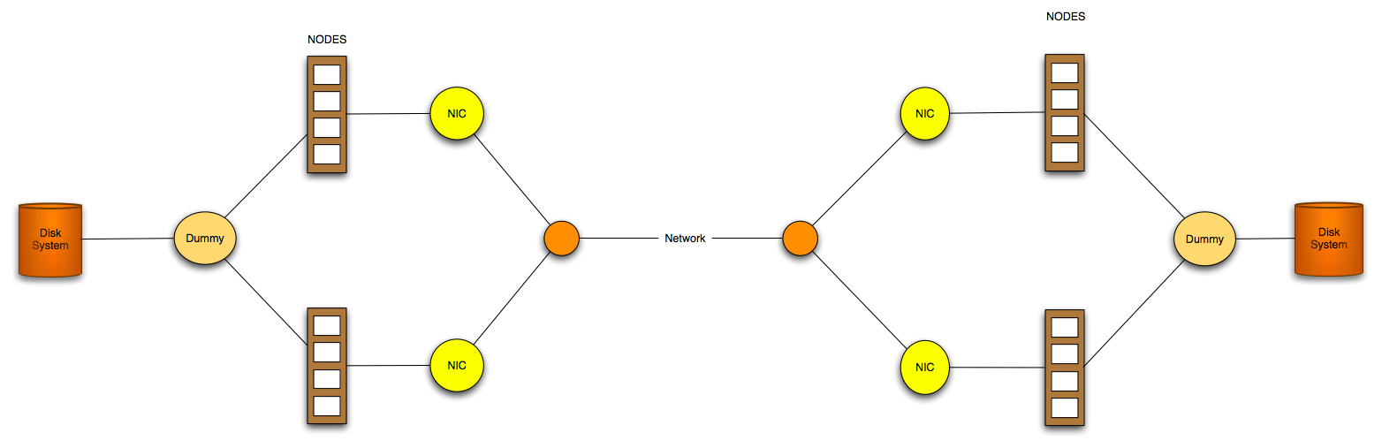
OPT_{B}-Application Case Study
9Gbps
Systems: Oliver, Eric
Network: LONI (Local Area)
Processor: 4 cores
Network Interface: 10GigE Ethernet
Transfer: Disk-to-disk (Lustre)
Available number of nodes: 2

Slide 18
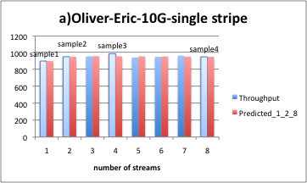
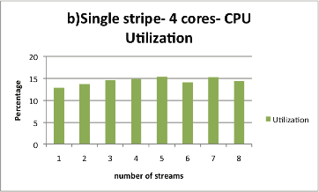
OPT_{B}-Application Case Study
9Gbps
1
2
4
8
1
2
4
8
Nsi=
Sxij=
Nsi=
Sxij=
Nsi=
Sxij=
1
Nsi=
Sxij=
1
2
4
8
1
1
2
4
8
1
2
4
8
1
2
4
8
Nsi=
Sxij=
1
1
Nsi=
Sxij=
1
1
1
2
4
8
Nsi=
Sxij=
Nsi=
Sxij=
1
2
4
8
Nsi=
Sxij=
1
2
4
8
1
1
1
Nsi=
Sxij=
0
0
Nsi=
Sxij=
0
0
0
0
Nsi=
Sxij=
Nsi=
Sxij=
Nsi=
Sxij=
0
0
0
Nsi=
Sxij=
0
0
0
Th_{Nsi}=903.41Mbps p=1
Th_{Nsi}=954.84 Mbps p=2
Th_{Nsi}=990.91 Mbps p=4
Th_{Nsi}=953.43 Mbps p=8
N_{opt}=3 N_{si}=2

Slide 19
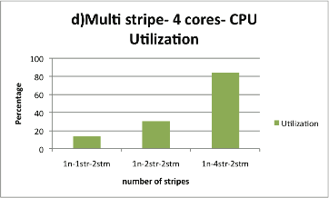
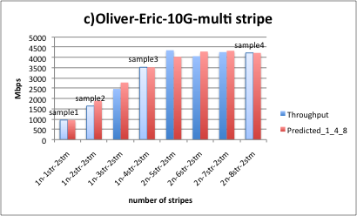
OPT_{B}-Application Case Study
9Gbps
2
2
Nsi=
Sxij=
Nsi=
Sxij=
Nsi=
Sxij=
1
2
4
Nsi=
Sxij=
2
1
2
4
2
2
2
Nsi=
Sxij=
1
2
4
1
2
4
Nsi=
Sxij=
1
2
4
1
2
4
2
Nsi=
Sxij=
Nsi=
Sxij=
2
Nsi=
Sxij=
2
1
2
4
8
1
2
4
8
1
2
4
8
Nsi=
Sxij=
0
2
0
2
Nsi=
Sxij=
0
4
0
4
0
2
0
2
Nsi=
Sxij=
Nsi=
Sxij=
Nsi=
Sxij=
0
4
0
4
0
2
Nsi=
Sxij=
0
2
0
4
0
4
S_{x}=2 Th_{Sx1,2,2}=1638.48
S_{x}=4 Th_{Sx1,4,2}=3527.23
S_{x}=8 Th_{Sx2,4,2}=4229.33

Slide 20
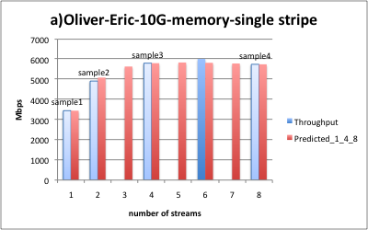
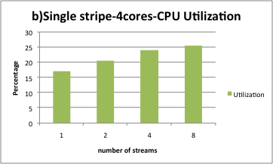
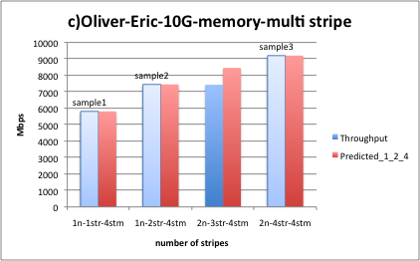
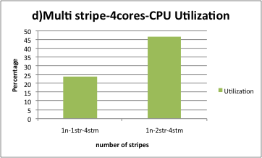
OPT_{B}-LONI-memory-to-memory-10G

Slide 21
OPT_{B}-LONI-memory-to-memory-1G-Algorithm Overhead

Slide 22
Conclusions
We have achieved end-to-end data transfer throughput optimization with data flow parallelism
  Network level parallelism
    Parallel streams
  End-system parallelism
    CPU/Disk striping
At both levels we have developed models that predict best combination of stream and stripe numbers

Slide 23
Future work
We have focused on TCP and GridFTP protocols and we would like to adjust our models for other protocols
We have tested these models in 10G network and we plan to test it using a faster network
We would like to increase the heterogeneity among the nodes in source or destination

Slide 24
Acknowledgements
This project is in part sponsored by the National Science Foundation under award numbers
  CNS-1131889 (CAREER) – Research & Theory
  OCI-0926701 (Stork) – SW Design & Implementation
  CCF-1115805 (CiC) – Stork for Windows Azure
We also would like to thank to Dr. Miron Livny and the Condor Team for their continuous support to the Stork project.
http://www.storkproject.org

