Slide 1
Software-as-a-Service for
Research Data Management
Steve Tuecke
Deputy Director, Computation Institute
University of Chicago & Argonne National Laboratory
Notes:
Need slide with

Slide 2
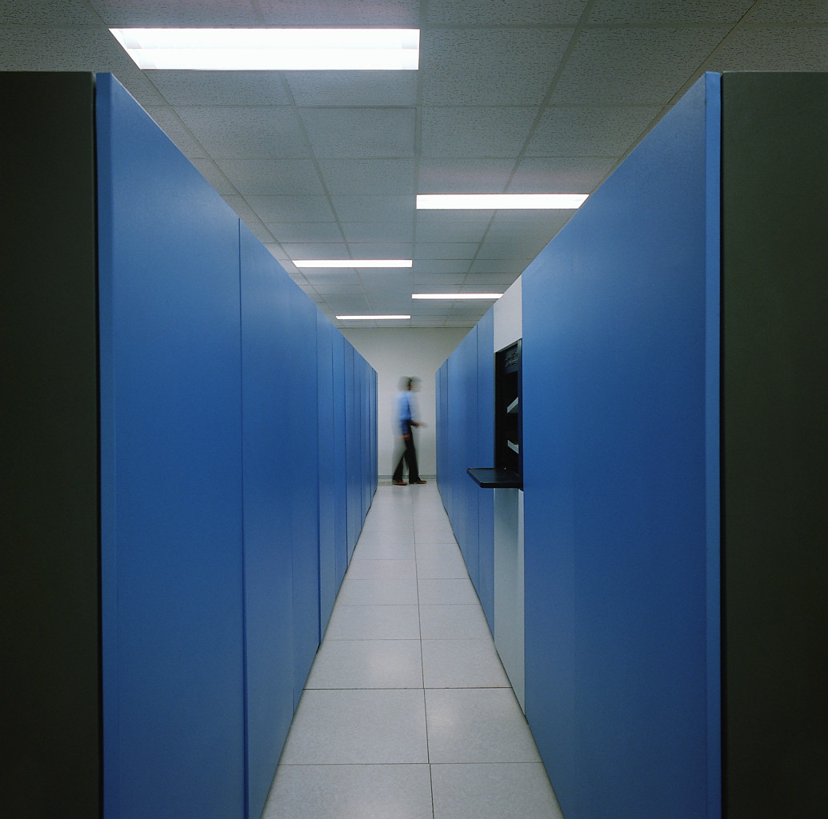
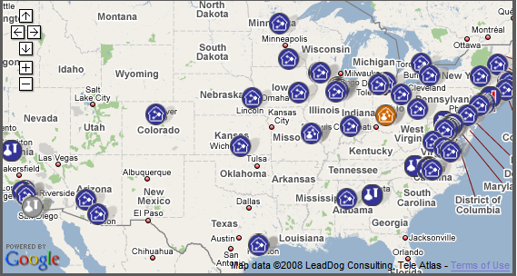
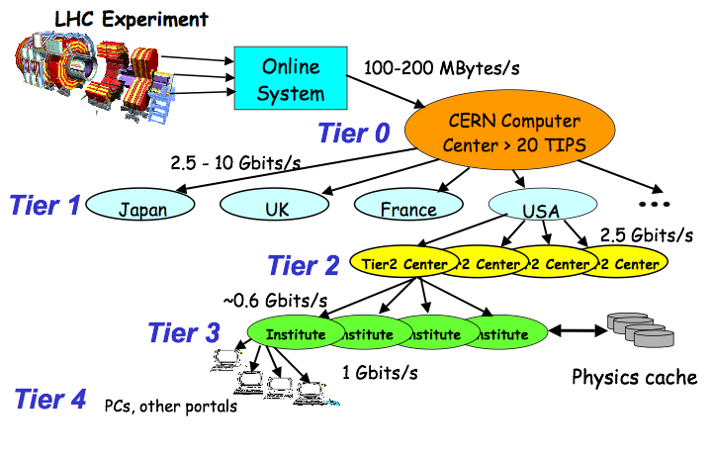
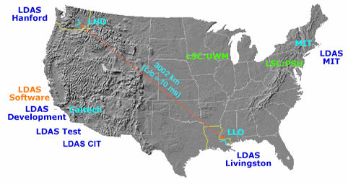
Big Science built on Globus Toolkit
Cancer Biologiy
Informatics Grid
LHC
Earth System Grid
LIGO data grid

Slide 3
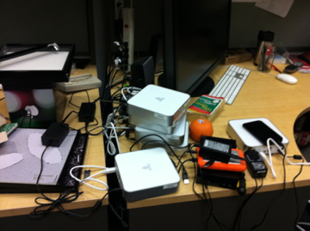
Thinking about “small and medium labs”
Big projects like LHC, LIGO, ESG, etc., can run resource-level services reliably—and build and operate effective collective services
Small labs and collaborations have problems with both
They need solutions, not toolkits—ideally outsourced solutions
Can we harness the power of the cloud to scale access to the grid?

Slide 4
Time-consuming tasks in science
Run experiments
Collect data
Manage data
Move data
Acquire computers
Analyze data
Run simulations
Compare experiment
with simulation
Search the literature
Communicate with colleagues
Publish papers
Find, configure, install relevant software
Find, access, analyze relevant data
Order supplies
Write proposals
Write reports
…
Notes:
So let’s look at that list again.
I and my colleagues started an effort a little while ago aimed at applying SaaS to one of these tasks …

Slide 5
Researchers lack advanced IT infrastructure
Most research performed in small laboratories
Researchers are trained in their field, not in IT
  They are not experts in collecting, moving, storing, indexing, analyzing, mining, sharing, updating, publishing, and archiving massive amounts of data
Only limited capital is available for them to spend on data and IT support
Investment is spent on traditional research tools (e.g., microscopes)—but the world is changing
  Now need substantial and sophisticated IT to perform research, data manipulation, data mining, collaboration
Notes:
Why do Mike Vannier and others need Midway? Don’t they have the required IT? Or, if not, can’t they buy it?
No they don’t have it, and they can’t easily acquire and operate it. For a number of reasons.
Exacerbated by funding agency preferences
The same problem as small companies outside IT: they need to run complex business processes, can’t afford to do it themselves.

Slide 6
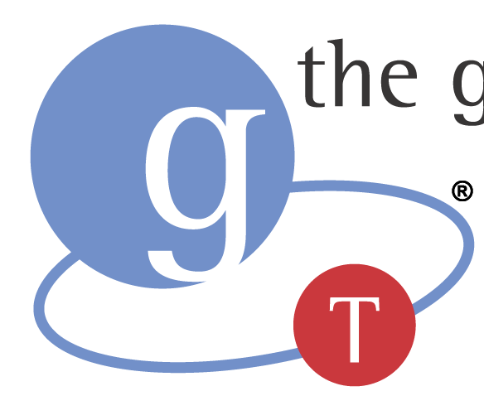

Globus Toolkit
Globus Online
Build the Grid
Components for building custom grid solutions
globustoolkit.org
Use the Grid
Reliable file transfer Software-as-a-Service
globusonline.org
Notes:
This is something new. Not just more of the same Globus Toolkit stuff.
Globus Toolkit: hasn’t change. Been around 15 years. Still a toolkit for building custom Grids such as LHC and ESG.
Globus Online: Provides easy access for end users to use Globus GridFTP-based grids (e.g. TeraGrid, OSG, BIRN, EGEE, LIGO, etc.). If you don’t have GridFTP,

Slide 7
Time-consuming tasks in science
Run experiments
Collect data
Manage data
Move data
Acquire computers
Analyze data
Run simulations
Compare experiment
with simulation
Search the literature
Communicate with colleagues
Publish papers
Find, configure, install relevant software
Find, access, analyze relevant data
Order supplies
Write proposals
Write reports
…
Notes:
So let’s look at that list again.
I and my colleagues started an effort a little while ago aimed at applying SaaS to one of these tasks …

Slide 8


Starting with data movement
Discover endpoints, determine available
protocols, negotiate firewalls, configure software,
manage space, determine required credentials,
configure protocols, detect and respond to failures, determine expected performance, determine actual performance, identify diagnose and correct network misconfigurations, integrate with file systems, …
A
B
Notes:
Why? Discover endpoints, determine available protocols, negotiate firewalls, configure software, manage space, determine required credentials, configure protocols, detect and respond to failures, identify diagnose and correct network misconfigurations,…

Slide 9

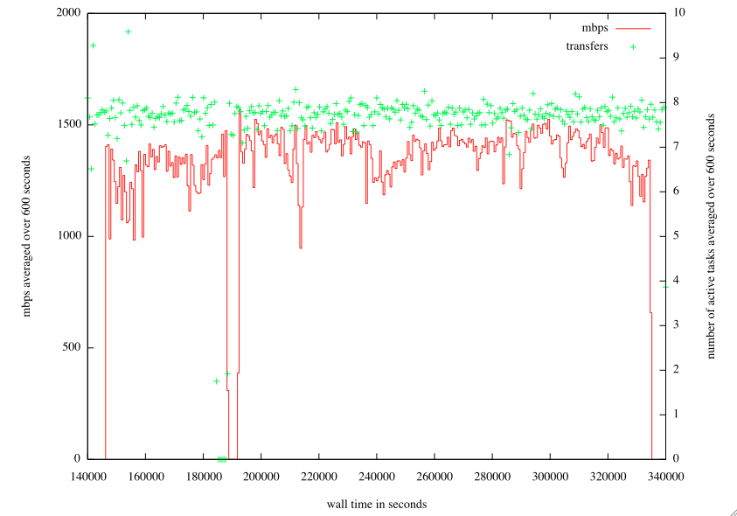
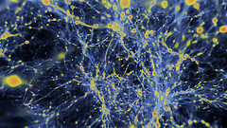
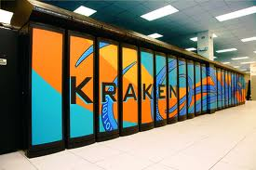
Globus Online In Action
28.6 Terabytes
31,000 files
56h 44m
No human involvement
Astrophysics simulation data
generated in Tennessee,
moved to Illinois for visualization
(Enzo, UCSD; Futures Lab, Argonne)
Notes:
How are we going to help you?
October 2010
Image from: http://www.flickr.com/photos/argonne/4244642347/sizes/s/in/photostream/
Briefly describe 2-3 other use cases here

Slide 10
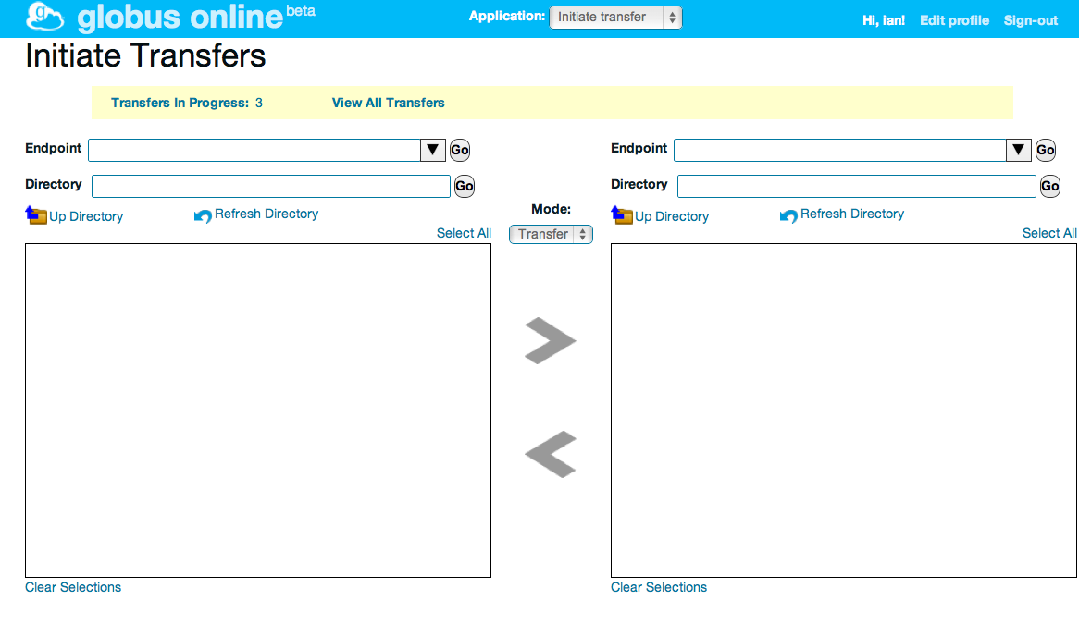
Globus Online highlights
Command line interface
ls alcf#dtn:~
scp alcf#dtn:~/myfile \
nersc#dtn:~/myfile
HTTP REST interface
POST https://transfer.api.
globusonline.org/ v0.10/
transfer <transfer-doc>
Web interface
Fire-and-forget data movement
Many files and lots of data
Third-party transfers
Performance optimization
Across multiple security domains
Expert operations and support
GridFTP servers
FTP servers
High-performance
data transfer nodes
Globus Connect
on local computers

Slide 11
Globus Online architecture

Slide 12
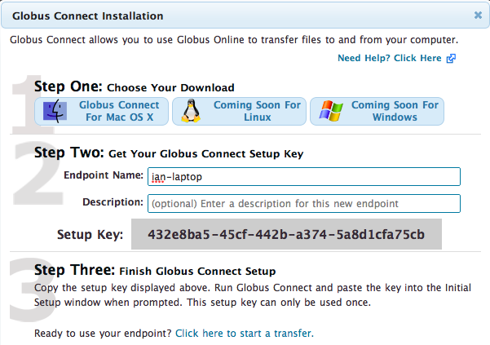
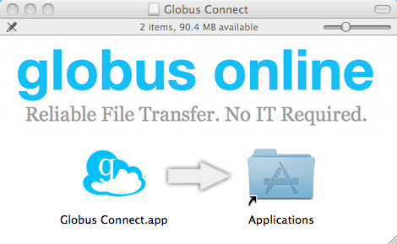
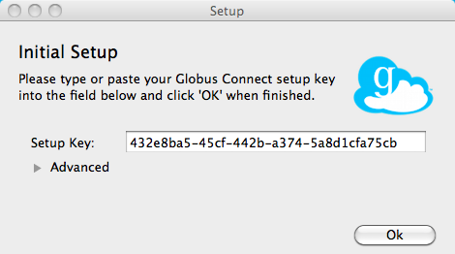
Globus Connect to/from your laptop

Slide 13
What’s next?
Run experiments
Collect data
Manage data
Move data
Acquire computers
Analyze data
Run simulations
Compare experiment
with simulation
Search the literature
Communicate with colleagues
Publish papers
Find, configure, install relevant software
Find, access, analyze relevant data
Order supplies
Write proposals
Write reports
…
Notes:
So let’s look at that list again.
I and my colleagues started an effort a little while ago aimed at applying SaaS to one of these tasks …

Slide 14
Looking to the future
Our goal: To leverage software-as-a-service (SaaS) to accelerate the pace of discovery and innovation worldwide, by providing millions of researchers with unprecedented access to powerful research tools
    “Civilization advances by extending the number of important operations which we can perform without thinking of them”
    Alfred North Whitehead , 1911
Notes:
I will describe to you today an exciting opportunity to greatly accelerate discovery and innovation on a global scale—in the words of famous mathematician Alfred North Whitehead, to advance civilization, in this case by automating a set of demanding IT tasks that hinder research progress

Slide 15
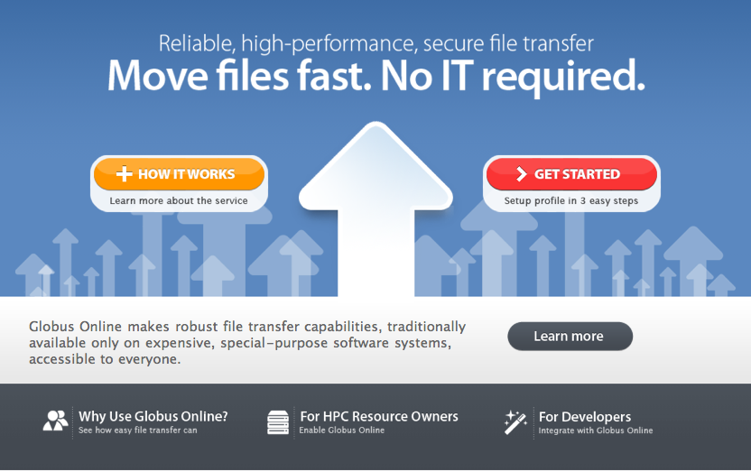
www.globusoline.org

