Slide 1
Running Interpreted Jobs

Slide 2
Overview
Many folks running Matlab, R, etc.
Interpreters complicate Condor jobs
Let’s talk about best practices.

Slide 3
What’s R?
#!/usr/bin/R
X <- c(5, 7, 9)
cat (X)
What could possibly go wrong?
Notes:
P

Slide 4
Submit file
universe = vanilla
executable = foo.r
output = output_file
error = error_file
log = log
queue
Notes:
P

Slide 5
What’s so hard?
#!/usr/bin/R
What if /usr/bin/R isn’t there?
#!/usr/bin/env R
isn’t good enough -- Condor doesn’t set the PATH for a Condor job.
Notes:
P

Slide 6
Pre-staging: One (not-so-good) solution
If you control the site, pre-stage R
#!/software/R/bin/R
Fragile!

Slide 7
Pre-staging: If you must…
“test and advertise”
Use a Daemon ClassAd hook like:
STARTD_CRON_JOBLIST = R_INFO
STARTD_CRON_R_INFO_PREFIX =
STARTD_CRON_R_INFO_EXECUTABLE = \ $(STARTD_CRON_MODULES)/r_info
STARTD_CRON_R_INFO_PERIOD = 1h
STARTD_CRON_R_INFO_MODE = periodic
STARTD_CRON_R_INFO_RECONFIG = false
STARTD_CRON_R_INFO_KILL = true
STARTD_CRON_R_INFO_ARGS =

Slide 8
R_info script contents
#!/bin/sh
if [[ -d /path/to/r/bin &&
/path/to/R/bin/R –version > /dev/null ]]
then
echo “has_r = true”
fi
What about multiple installations of R ?

Slide 9
Pre-staging is bad
Limits where your job can run
Must be an administrator to set up
Difficult to change
Pre-staged files can change unexpectedly
Upgrade, new system installation, disk problems, …

Slide 10
Solution: take it with you
Bundle up the whole runtime
Transfer the bundle with the job
Wrapper script unbundles and runs
Downsides:
Extra time overhead to unbundle
Not so good for short* jobs

Slide 11
Benefits
Can run anywhere*:
Flocked, Campus Grids, OSG, etc.
Each job can have own runtime version/configuration.

Slide 12
Revised submit file
universe = vanilla
executable = wrapper.sh
output = output_file
error = error_file
transfer_input_files = runtime.tar.gz, foo.r
should_transfer_files = true
when_to_transfer_output = on_exit
log = log
queue

Slide 13
wrapper.sh
#!/bin/sh
tar xzf runtime.tar.gz
./bin/R foo.r

Slide 14
Downside: Those Huge Runtimes
Full R, matlab runtime 100 Mb
Adds up when running thousands of jobs
Trivia: How long to transfer 100 Mb?
Is this really a problem?

Slide 15
Mitigating Huge Runtimes
Trim the bundle down
(identify unneeded files with strace)
Second, perhaps > 1 task per job
Finally, cache with Squid

Slide 16
Users, not admins

Slide 17
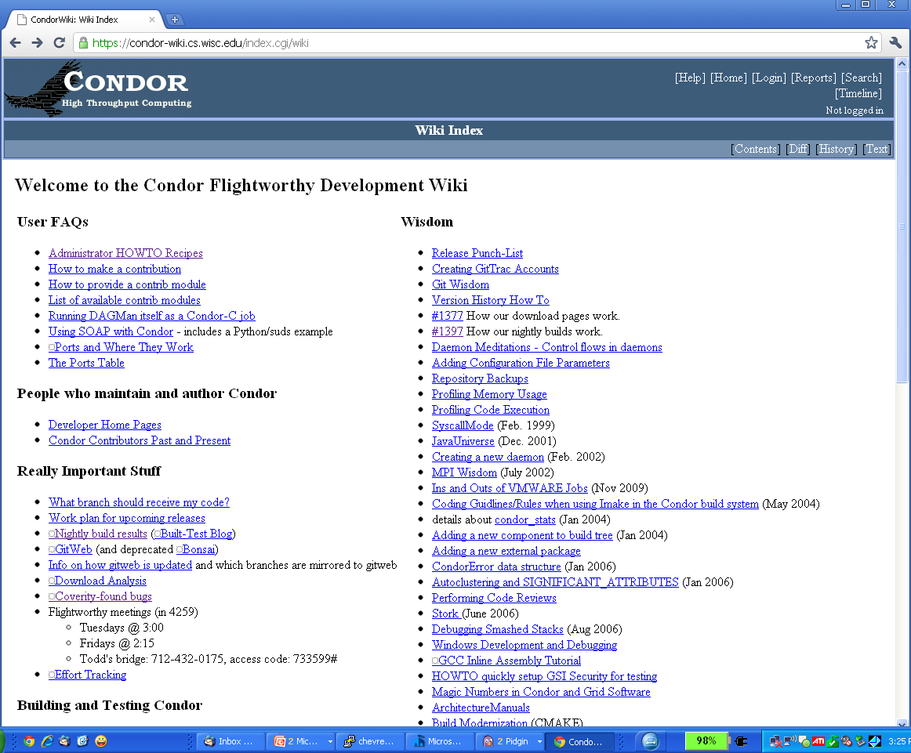
http://condor-wiki.cs.wisc.edu
http://condor-wiki.cs.wisc.edu

Slide 18
Using HTTP/Squid
Change wrapper to manually wget
Set env http_proxy to squid source
OSG_SQUID_LOCATION in OSG
Otherwise, set with Daemon ClassAd hooks and $$
Cut runtime.tar.gz from transfer_input_files, add
wget –retry-connrefused –waitretry=10 your_http_server
To the wrapper script – note retries
Don’t use curl!
Or set –H pragma

Slide 19
Matlab complications
Licensing…
Octave (?)
Matlab compiler!
Matlab parallel toolkit
HTPC

Slide 20
Cross Platform submit
Many grids > 1 platform:
Unix vs. Windows; 32 vs 64 bit
Huge benefit of High Level language:
Write once, run, … well…
Use Condor $$ to expand:

Slide 21
executable = wrapper.$$(OPSYS).bat
Condor will expand OPSYS to LINUX or WINNT<XX>
Write both wrappers, make sure to wget correct runtime

Slide 22
Summary
Many folks running lots of interpreted jobs
Transferring runtime along beneficial, but requires set up
Cross platform submits can be huge win

