Slide 1
Cisco Unified Computing System (UCS)
Tina Nolte, Ph.D.
Product Management, Cisco Server Access Virtualization
May 5, 2011

Slide 2
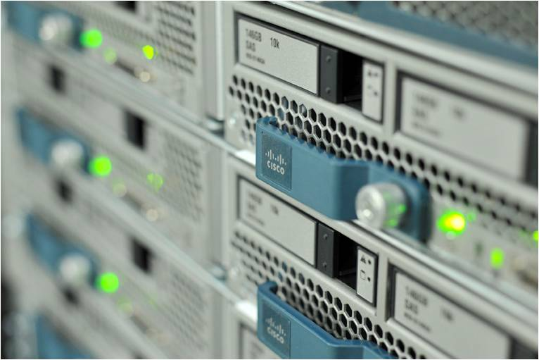
UCS Architecture and Innovations

Slide 3
Cisco Unified Computing
FY11
SCALABLE
Unified Management
Rapid Deployment
Open API
Workload Mobility
DYNAMIC
Service Profile HW Abstraction
Optimized Scaling
Unified Fabric
Simplified Operations
Virtual Interfaces
Unified IT Workflows
OPEN
Extended Memory
Lower TCO
FY10

Slide 4
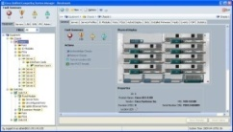
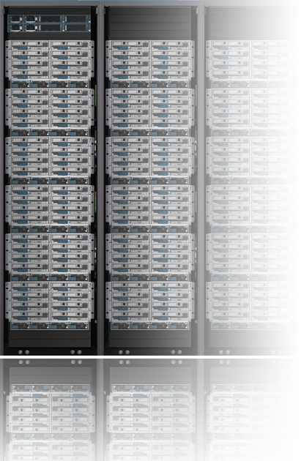
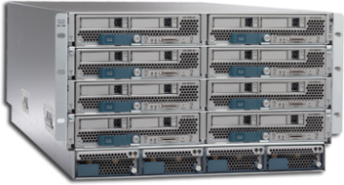
Building Blocks of Cisco’s UCS Optimized and Designed as a Integrated System
UCS Manager Service Profiles Embedded management
UCS Fabric Interconnect 10GE unified fabric switch 20 or 40 port
UCS Fabric Extender Remote line card
UCS Blade Server Chassis Flexible bay configurations
UCS Blade and Rack Servers x86 industry standard Patented extended memory
UCS I/O Adapters Choice of multiple adapters Virtualization awareness
Notes:
4
4

Slide 5
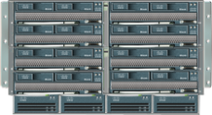
Unified Computing Platform
Single Point of Embedded Management
Unified Fabric
Expanded Memory
Virtualized Adapters
Stateless Servers

Slide 6
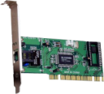
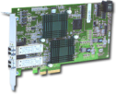
Hardware State Abstraction Concept
Innovation: Service Profiles
LAN
SAN
LAN Connectivity
OS & Application
SAN Connectivity
State abstracted from hardware
MAC Address
NIC Firmware
NIC Settings
Drive Controller F/W
Drive Firmware
UUID
BIOS Firmware
BIOS Settings
Boot Order
BMC Firmware
WWN Address
HBA Firmware
HBA Settings
UUID: 56 4d cd 3f 59 5b…
MAC : 08:00:69:02:01:FC
WWN: 5080020000075740
Boot Order: SAN, LAN
Chassis-1/Blade-2
Chassis-8/Blade-5
Separate firmware, addresses, and parameter settings from server hardware
Make physical servers into interchangeable hardware resources
Move OS & applications easily across server hardware

Slide 7
Service Profiles: Heart of Stateless
Innovation: Service Profiles
Contain server state information
MAC & WWN addresses for NICs & HBAs
Boot order and BIOS parameter settings
Firmware bundle for the various hardware components
User-defined
Each profile can be individually created
Profiles can be generated from a template
Applied to anonymous physical (nonhomogeneous) blades at run time
Server Name
UUID
MAC
WWN
Boot info
LAN Config
SAN Config
Server Name
UUID
MAC
WWN
Boot info
LAN Config
SAN Config
Server Name
UUID, MAC,WWN
Boot info
firmware
LAN, SAN Config
Firmware…
Run-time
association
Consistent and simplified server deployment – “pay-as-you-grow” deployment
Simplified server upgrades – minimize risk
Dynamic server provisioning – reduce purchases by time-sharing servers
Enhanced server availability – purchase fewer servers for HA

Slide 8
UCS Management

Slide 9
Innovating with UCS Manager
Innovation: Embedded Management
Tightly Coupled
Partner Management Tools
Existing
Customer
Management Tools
Unified Management Domain
Automatic Discovery
Dynamic Provisioning
Reduced Points of Management
Building Blocks of Resources for Rapid Provisioning
Simplify Infrastructure Management for Datacenters
No Added Costs
XML API
Traditional APIs
Service Profile: HR-App1
Network: HR-VLAN
Network QoS: High
MAC: 08:00:69:02:01:FC
WWN: 20:65:32:25:B5:00:A4:28
BIOS: Version 1.03
Boot Order: SAN, LAN
Single-click configuration of LAN, SAN and firmware parameters
Notes:
9
9

Slide 10
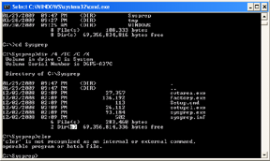
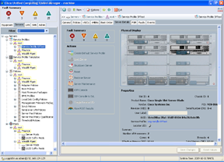
Programmatic Infrastructure
Comprehensive XML API, standards-based interfaces
Bi-Directional access to physical & logical internals
Self Serve portals
Management Tools
Auditing Tools
Direct
UCS CLI
UCS GUI
3rd Party
Customer
XML API
System Status
Physical Inventory
Logical Inventory
Broad 3rd party integration support
Faster custom integration for customer use cases
Consistent data and views across ALL interfaces

Slide 11
Cisco UCS XML Interface
Embedded apache webserver
XML content sent in body of http post
HTTP
{xml}
Result contained within body of http response
Events
URL:
http://<Virtual IP of UCS Manager>
UCSM
Clients invoke methods to query and configure the server
APACHE
MIT
DME
Method categories: instance, class, generic
AG₁
AG₂
AG_{n}
http (port 80) and https (port 443)
GUI uses the same API – look at logs in:
C:\Documents and Settings\{user}\Application Data\Sun\Java\Deployment\log\.ucsm

Slide 12
UCS API Overview
UCS API Features
Communicates over HTTP/HTTPS
XML Based, Transactional
Object Model Hierarchy
Published Schema
Java Doc Style documentation
High Availability
Standard Request/Response cycle
Role Based Authentication
Built-in Object Browser
EventStream
XML API

Slide 13
Use case examples for the UCS XML API
Manage Multiple UCS Systems
Overarching system to maintain resource pools, users, policies, etc…
Monitor and Integrate the Event Stream
Capture events, parse, store, report
Create event gateway to monitoring solutions
Automate Issue Remediation
Generate appropriate responses to events
Configuration Backup
Export entire UCS Information Model
Firmware Image Management
Ensure Firmware consistency across all components

Slide 14
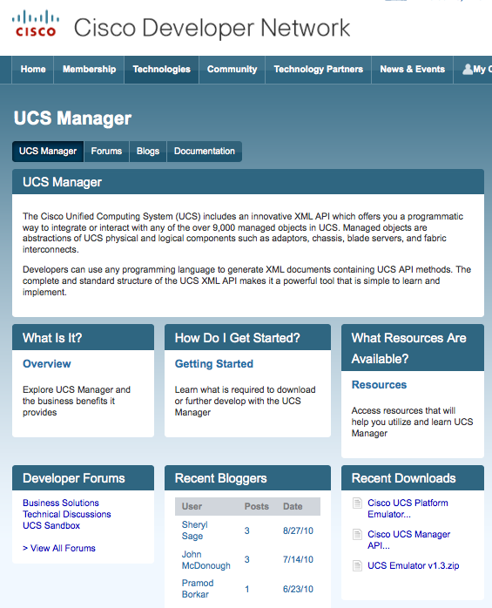
Cisco Developer Network
Free!
Web based developer community
http://developer.cisco.com/web/unifiedcomputing/home
Downloads:
UCS Platform Emulator
goUCS Automation Tool
XML API, Perl, Powershell code samples (44 and counting)
Documentation:
Programming & developer guides
White papers
Reference guides (XML model, Faults)
Collaboration:
Blogs
Peer to peer forums
Videos
Access to Cisco subject matter experts

Slide 15
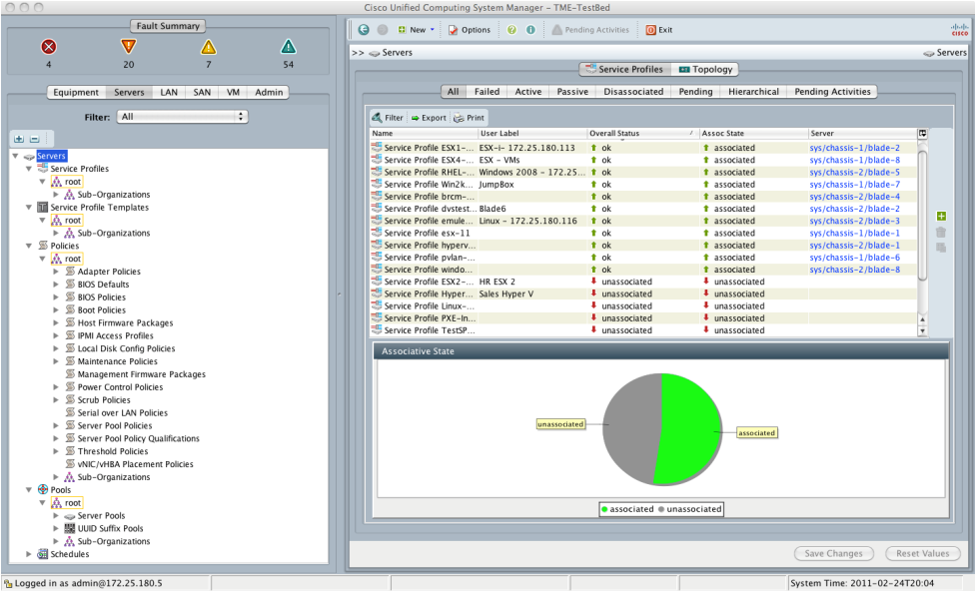
UCS Platform Emulator
Full featured emulator for the UCS Manager
Installs as a Virtual Machine
Provides complete support for all XML API calls
Object Browser to peruse the UCSM model
Import & replicate existing live UCS Manager physical inventory
Share saved physical inventories among UCS PEs
Drag-n-drop hardware builder to create custom physical inventory

Slide 16
goUCS framework
A simple way to capture and replay XML on UCS
goUCS invocation syntax:
X:\goucs <session> <xml/cmd wrapper> <process type> <output type> <user args>
IP address
Web server port
Credentials
Multiple concurent sessions possible
Sessions to multiple UCS Managers
Determines execution mode for commands
REALTIME
RAW
OUTCACHE
INCACHE
Controls data output location for returned data
Arguments to be used in conjunction with parameters on the XML wrapper
Upto 10 arguments are passable
Collection of XML “commands” that need to be executed
Can be derived from running UCS Manager
Storable for repetitive use
Parametrized with arguments passing
Output format control
Indented XML
Raw XML
Quiet – no output
xpath
Comma Separated Values (CSV)
Table

Slide 17
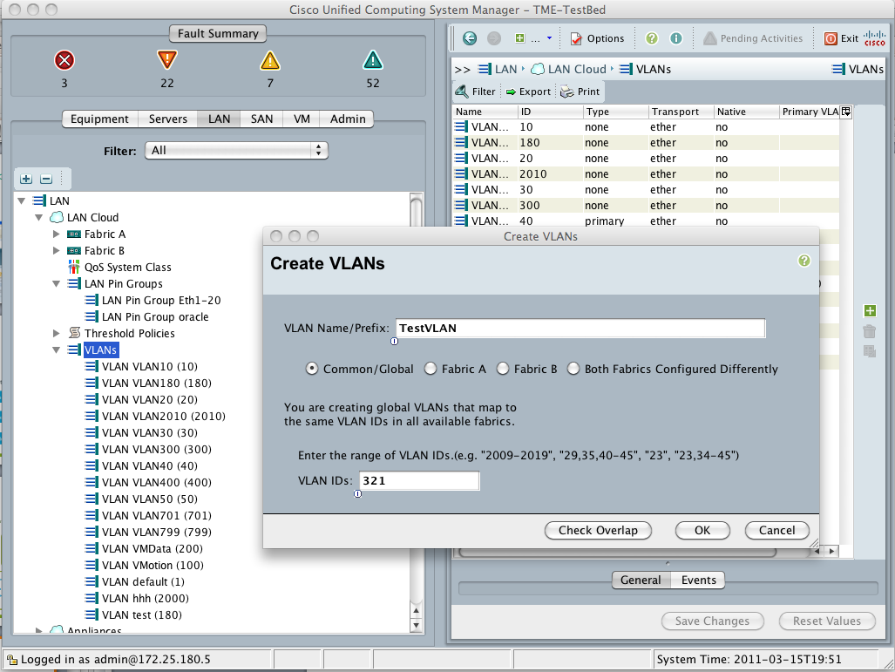
goUCS Automation Tool
An Example: Automating VLAN creation
Perform the task in UCS Manager
Use goUCS filterlog to capture the transaction
1
Capture
2
Create
X:\>mkdir X:\goucs\cmdwrappers\CreateNewVlan
User Arguments
UserArg1=%inUserArg1%
UserArg2=%inUserArg2%
UserArg3=
...
UserArg10=
Create the XMLwrapper using the captured logs
Create variables for parameters
3
X:\>goucs createvlan realtime indent TestVLAN 321
Execute
Run the command on one or more UCS systems substituting values for variables
Available now on Cisco Developer Network: http://developer.cisco.com/web/unifiedcomputing/goucs

