Slide 1
Security Risks in Clouds and Grids
Elisa Heymann
Computer Architecture and Operating Systems Department
Universitat Autònoma de Barcelona
Elisa.Heymann@uab.es
Barton P. Miller
James A. Kupsch
Computer Sciences Department
University of Wisconsin
bart@cs.wisc.edu
Condor Week
May 5, 2011
1
Notes:
Vulnerability Assessment and Secure Coding Practices
1

Slide 2
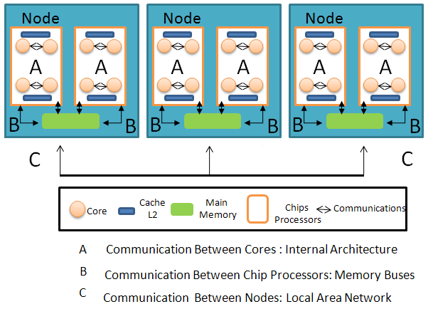
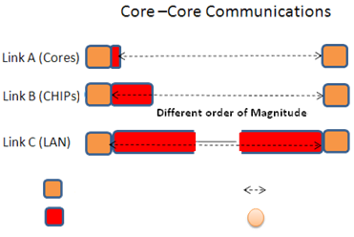
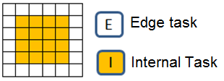
Efficient execution of SPMD Applications on Multicore Environments
Multicore Environment
Objective
Hierarchical
communication
architecture
Maximum Speedup
Efficiency over a defined
threshold
Problem
How?
Methodology
SPMD Application
SPMD Tile
Idle Time
Communications
Core
Edge tile
Message Passing
Interface
Internal tile
1
SuperTile allows to overlap the internal computation with edge communication
4
5
2
3
Ideal Size of Supertile
Ideal Number of Core

Slide 3
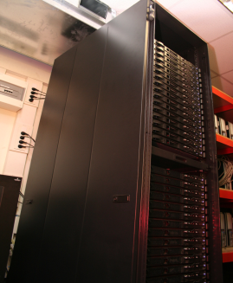
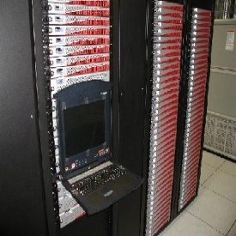
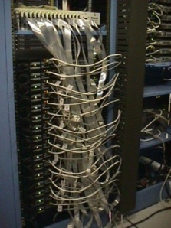
Parallel Application Signature for performance prediction
Parallel Application
Instrumentation
S
Base Machine
S
Build Parallel Application Signature
(Coordinated Checkpoint + Phases + Weights)
Collection data
Patterns Identification
Parallel Application Model
Extract Phases and Weights
Target Machine A
Target Machine B
Program | Cores | Application Execution Time reduction (%) | Prediction Error (%)
BT-256 | 128 | 98.52% | 1.5%
SP-256 | 128 | 99.23% | 6.4%
SMG2000-256 | 128 | 98.25% | 3.8%
Sweep3D-256 | 128 | 92.38% | 3.5%
Program | Cores | Application Execution Time reduction (%) | Prediction Error (%)
BT-256 | 256 | 98.63% | 6.4%
SP-256 | 256 | 99.37% | 3.4%
SMG2000-256 | 256 | 98.24% | 3.8%
Sweep3D-256 | 256 | 92.35% | 6.2%
Time of each Phase by weight
Time of each Phase by weight
Prediction
Prediction
Notes:
to characterize message passing parallel applications, which are instrumented and executed on a parallel machine, producing a trace log from which we proceed to collect the data to characterize computation and communication. Then, to obtain the machine independent application model, we sort the information by means of a logical clock. In this way, we obtain a single unified trace, logically ordered. Once we have the logical trace of the application, we identify and extract the most relevant parts (phases) and a weight vector given by the number of times a phase occurs. Afterwards, we create a Parallel Application Signature defined by a set of phases which are selected taking into account how many times
it occurs as well as its execution time,

Slide 4
Possible Threat?
Clouds and Grids have databases with management and operational information
Denial of Service:
Prevent updates in the database
4
Notes:
Condor Quill: A mirror of Condor data in a database.
condor_qedit 1.0 `perl –e ‘print “x”x2001’` foo
Atributtes are assumed to be 2000 characters long or less. Condor doesn’t check that limit.
Quill gets an error submitting the query to the database, then stops reading the log file and updating the database.
Condor_qedit: modifies job attributes in the Condor job queue.

Slide 5
Possible Threat?
Hijack machines
Process escapes Cloud/Grid/control: Keeps forking and exiting to escape detection.
?
Evil Job PID n
Evil Job PID 3
Evil Job PID 2
Evil Job PID 1
. . .
fork
fork
fork
5

Slide 6
Possible Threat?
Cloud/Grid Accounting System
Maintains a Grid-wide view of resource utilization.
Job Submission (Priority in the batch queue, CPU time, Memory usage)
Storage (Disk usage, Tape storage)
Accounting Information easily available to people (web interface) and to applications (Web Services)
Use the Accounting System for bad purposes.
6
Notes:
GRATIA: OSG Accountig System

Slide 7
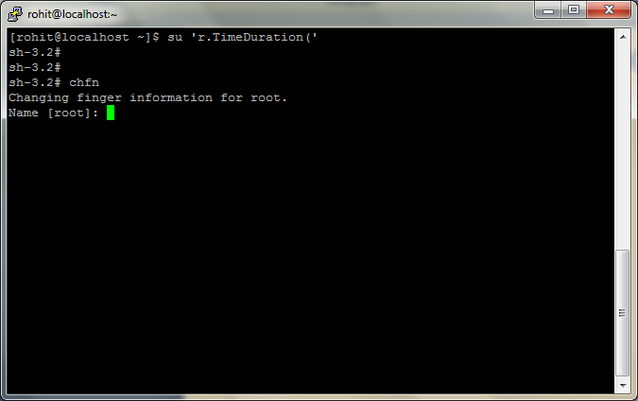
Possible Threat?

Slide 8
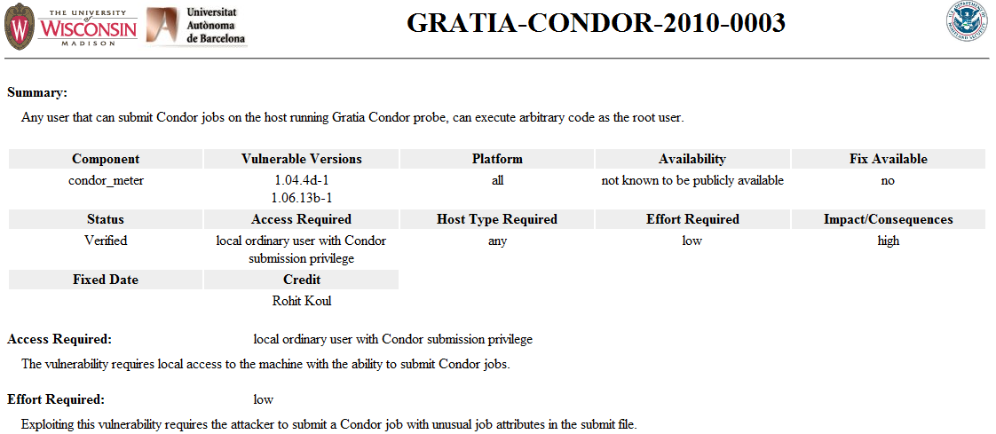
Real Threat!
Found
and Fixed

Slide 9
What the bad guys can do
Gain root access
Privilege escalation
Gain higher privilege access (admin, condor)
Hijack machines
Attack the process running there
Notes:
This is the user perspective.

Slide 10
What the bad guys can do
Injections
Command
SQL
Directory traversal
Log
String user = request.getParameter("user");
String password = request.getParameter("password");
String sql = "select * from user where username=' " + user + " ' and password=' " + password + " ' ";
' or '1'='1'--
Notes:
Field with user input. Command turned into something different.
But programers sometimes don’t check that.
Example user logging.

Slide 11
What the bad guys can do
Injections
Command
SQL
Directory traversal
Log
Denial of Service (DoS)
Notes:
It’s expected tht programers take care of input validation. But they don’t to that. Like here:

Slide 12
What the bad guys can do
Injections
Command
SQL
Directory traversal
Log
Denial of Service (DoS)
Notes:
Field with user input. Command turned into something different.
But programers sometimes don’t check that.
Example user logging.

Slide 13
Why do we care
Machines belonging to a cloud/grid site are accessible from the Internet
Hundred of thousands of machines are appealing
Those machines are continuously probed:
Attackers trying to brute-force passwords
Attackers trying to break Web applications
Attackers trying to break into servers and obtain administrator rights

Slide 14
Why do we do it
SW has vulnerabilities
Cloud and Grid SW is complex and large
Vulnerabilities can be exploited by legal users or by others

Slide 15
Why do we do it
Attacker chooses the time, place, method, …
Defender needs to protect against all possible attacks (currently known, and those yet to be discovered)

Slide 16
Key Issues for Security
Need independent assessment
Software engineers have long known that testing groups must be independent of development groups
Need an assessment process that is NOT based solely on known vulnerabilities
Such approaches will not find new types and variations of attacks
Notes:
Street light story
Everyone with a computer knows this.
If you’re not seeing vulnerability reports and fixes for a piece of software, it doesn’t mean that it is secure. It probably means the opposite; they aren’t looking or aren’t telling.
The grid community has been largely lucky (security through obscurity).
Fact #1: Software engineers have long known that testing groups must be independent of development groups
Fact #2: Designing for security and the use of secure practices and standards does not guarantee security
Independent vulnerability assessment is crucial…
…but it’s usually not done

Slide 17
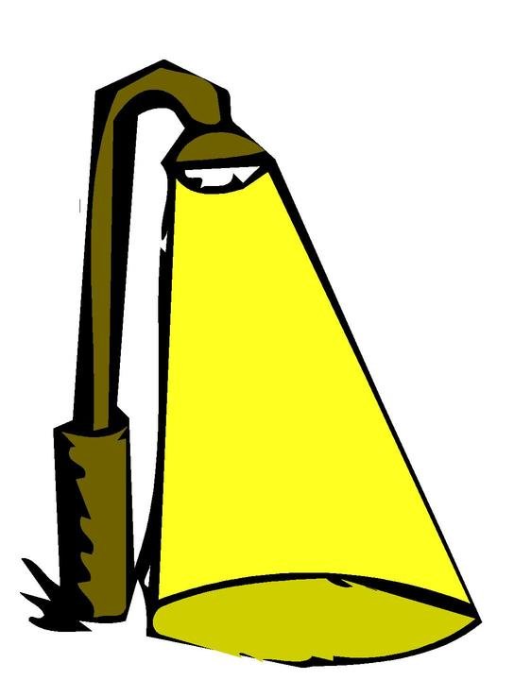
Our Piece of the Solution Space
First Principles Vulnerability Assessment:
An analyst-centric (manual) assessment process.
You can’t look carefully at every line of code so:
Don’t start with known threats …
… instead, identify high value assets in the code and work outward to derive threats.
Start with architectural analysis,
then identify key resources and privilege levels, component interactions and trust delegation, then focused component analysis.
17
Notes:
Vulnerability Assessment and Secure Coding Practices
17

Slide 18
First Principles Vulnerability Assessment Understanding the System
Step 1: Architectural Analysis
Functionality and structure of the system, major components (modules, threads, processes), communication channels
Interactions among components and with users

Slide 19
Architectural Analysis: Condor
Condor execute host
master
OS privileges
1. fork
1. fork
condor & root
user
negotiator
collector
5. Negotiator cycle
Condor submit host
Condor execute host
master
master
5. Negotiator cycle
6. Report match
1. fork
6. Report match
2. machine ClassAd
1. fork
schedd
startd
4. job ClassAd
Stork server host
8. fork
7. claim host
8. fork
master
shadow
starter
3. submit job ClassAd
9. establish channel
10. start job
1. fork
submit
job
stork_server

Slide 20
First Principles Vulnerability Assessment Understanding the System
Step 2: Resource Identification
Key resources accessed by each component
Operations allowed on those resources
Step 3: Trust & Privilege Analysis
How components are protected and who can access them
Privilege level at which each component runs
Trust delegation
Notes:
How are the component protected? Who can access them?

Slide 21
Resource Analysis: Condor
(a) Common Resources on All Condor Hosts
(b) Unique Condor Checkpoint Server Resources
OS privileges
ckpt_server
generic Condor daemon
condor
root
user
etc
spool
log
Send and Receive Checkpoints
(with Standard Universe Jobs)
Condor
Binaries &
Libraries
Condor
Config
Operational
Data &
Run-time
Config Files
Operational
Log Files
ckpt
Checkpoint Directory
(c) Unique Condor Execute Resources
(d) Unique Condor Submit Resources
User Job
starter
shadow
System Call Forwarding and Remove I/O
(with Standard Universe Jobs)
execute
user
Job Execution
Directories
User’s Files

Slide 22
First Principles Vulnerability Assessment Search for Vulnerabilities
Step 4: Component Evaluation
Examine critical components in depth
Guide search using:
Diagrams from steps 1-3
Knowledge of vulnerabilities
Helped by Automated scanning tools

Slide 23
First Principles Vulnerability Assessment Taking Actions
Step 5: Dissemination of Results
Report vulnerabilities
Interaction with developers
Disclosure of vulnerabilities

Slide 24
Our Experience
Condor, University of Wisconsin Batch queuing workload management system 15 vulnerabilities 600 KLOC of C and C++
SRB, SDSC Storage Resource Broker - data grid 5 vulnerabilities 280 KLOC of C
MyProxy, NCSA Credential Management System 5 vulnerabilities 25 KLOC of C
glExec, Nikhef Identity mapping service 5 vulnerabilities 48 KLOC of C
Gratia Condor Probe, FNAL and Open Science Grid Feeds Condor Usage into Gratia Accounting System 3 vulnerabilities 1.7 KLOC of Perl and Bash
Condor Quill, University of Wisconsin DBMS Storage of Condor Operational and Historical Data 6 vulnerabilities 7.9 KLOC of C and C++
24
Notes:
24
24
Note some just “admin” software. Assessed and remediated.

Slide 25
Our Experience
Wireshark, wireshark.org Network Protocol Analyzer in progress 2400 KLOC of C
Condor Privilege Separation, Univ. of Wisconsin Restricted Identity Switching Module 21 KLOC of C and C++
VOMS Admin, INFN Web management interface to VOMS data 35 KLOC of Java and PHP
CrossBroker, Universitat Autònoma de Barcelona Resource Mgr for Parallel & Interactive Applications 97 KLOC of C++
25
Notes:
25
25

Slide 26
Our Experience
ARGUS 1.2, HIP, INFN, NIKHEF, SWITCH gLite Authorization Service in progress
glExec 0.8, Nikhef Identity mapping service
26
Notes:
26
26

Slide 27
What do we do
Make cloud/grid software more secure
Make in-depth assessments more automated
Teach tutorials for users, developers, admin, managers:
Security risks
Vulnerability assessment
Secure programming

Slide 28
Who we are
Bart Miller
Jim Kupsch
Karl Mazurak
Rohit Koul
Daniel Crowell
Wenbin Fang
Elisa Heymann
Eduardo Cesar
Jairo Serrano
Guifré Ruiz
Manuel Brugnoli

Slide 29
Security Risks in Clouds and Grids
Elisa Heymann
Elisa.Heymann@uab.es
Barton P. Miller
James A. Kupsch
bart@cs.wisc.edu
http://www.cs.wisc.edu/mist/
http://www.cs.wisc.edu/mist/papers/VAshort.pdf
29
Notes:
Vulnerability Assessment and Secure Coding Practices
29

