Slide 1
Enabling Plant Sciences Research with the iPlant Discovery Environment and Condor
Juan Antonio Raygoza Garay, Sonya Lowry, John Wregglesworth
Notes:
I changed the capitalization.

Slide 2
Outline
What is iPlant?
iPlant Discovery Environment
Architecture overview
Tool integration and analysis creation APIs
Execution environment
Simple analysis example

Slide 3
What is iPlant?
Is a cyberinfrastructure collaborative rather than purely a cyberinfrastructure.
Enables multidisciplinary teams to address grand challenges in plant science.
Is an entity that is by, for, and of the community.
Helps train the next generation in computational thinking is designed to be able to reinvent itself as the needs of the community and technologies change.
Notes:
I rephrased several points.
State this, don’t include it as a bullet: Grand Challenges were not defined in advance, but identified through engagement with the community

Slide 4
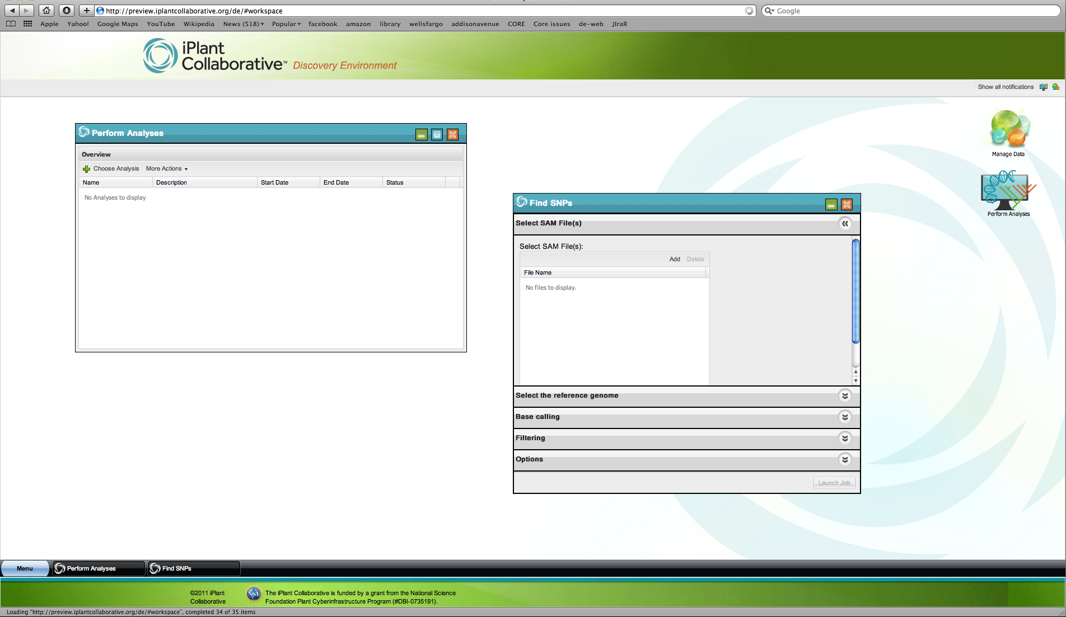

Slide 5
Architecture Overview
Discovery Environment
Services API
Metadata Management System
Job Execution Process
Object State Management
CONDOR
iRODS
PostgreSql
MongoDb
Physical HPC resource

Slide 6
Tool integration and analysis creation API
Is a textual description of a command line tool’s interface and workflow definition in JSON format.
Allows Scientists to run off-the-shelf tools with the resources provided by iPlant.
Drives the building of user interfaces shown to the user for a specific tool or analysis.
Is the lingua franca within iPlant for Job Execution.
Notes:
Same as earlier on logical order (tool->analysis) and same question about one or two APIs.
This is the first set of bullet points where you use end punctuation. Decide which style you want for all the slides and stick with that one style. Either is okay.

Slide 7
Conceptual Components
Analysis
Step 1
Step 2
…
Step N
Tool 1 Interface
Tool 2 Interface
Tool N Interface
Tool 1 binary
Tool 2 binary
Tool N binary

Slide 8
>cat –b filename.txt >cat.out grep cat.out text > out.txt
>cat –b filename.txt | grep text > out.txt
cat
grep
Filename.txt
out.txt

Slide 9
>cat
{
"id":"ahoi3uheralsdkfjasl8ked3",
"name": "",
"type": "cat",
"input":[
{
"id":"catin",
"name":"File to read:",
"type":"File",
"multiplicity":"single",
"order": 2
},
],

Slide 10
"groups": [
{
"name": "",
"id": "",
"type": "step",
"properties": [
{
"id":"bflag",
"name":" -b ",
"type":"Flag",
"label":"Show line numbers",
"visible":false,
"value": true
"validator":{
"name":"",
"required":true
},
"order":1
}
]
}
],
"output":[
{
"id":"catout",
"name":”cat.txt",
"type":"file",
"multiplicity":"single",
"order":2
"switch":" > "
}
]
}

Slide 11
{
"analysis_id":"",
"analysis_name":"File Read and Filter",
"type":”unix",
"description":"Reads a file and filters it",
"steps":[
{
"name":"cat",
"description":"Reads a file and prints to standard output",
"template_id":"ahoi3uheralsdkfjasl8ked3",
"config":{
}
},
{
"name":"grep_search",
"description":"Searches within a file for supplied text",
"template_id":"",
"config":{
}
},
]

Slide 12
"mapping":[
{
"source_step":"cat",
"target_step":"grep_search",
"map":{
"catout":"grepin"
}
},
]

Slide 13
Execution flow
Discovery Environment
iRODS
Metadata Services
JEX
Condor Monitor
Condor
Object State Management System

Slide 14
Execution flow
Discovery Environment
iRODS
Metadata Services
JEX
Condor Monitor
Condor
Object State Management System

Slide 15
Execution flow
Discovery Environment
iRODS
Metadata Services
JEX
Condor Monitor
Condor
Object State Management System

Slide 16
Execution flow
Discovery Environment
iRODS
Metadata Services
JEX
Condor Monitor
Condor
Object State Management System

Slide 17
Execution flow
Discovery Environment
iRODS
Metadata Services
JEX
Condor Monitor
Condor
Object State Management System

Slide 18
Execution flow
Discovery Environment
iRODS
Metadata Services
JEX
Condor Monitor
Condor
Object State Management System

Slide 19
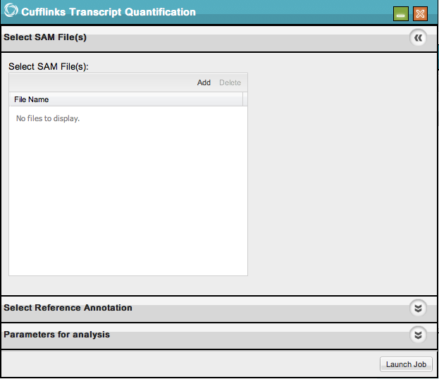
{
JSON
}

Slide 20
Complete material & tutorials at:
http://www.iplantcollaborative.org
https://pods.iplantcollaborative.org/wiki/display/docs/Tool+Integration+Tutorial
https://pods.iplantcollaborative.org/wiki/display/docs/Analysis+Authoring+Tutorial

Slide 21
Acknowledgements
The iPlant Collaborative is funded by a grant from the National Science Foundation Plant Cyberinfrastructure Program (#DBI- 0735191
Thanks to the condor week coordinators
Special thanks to Sonya Lowry
Notes:
Dan doesn’t like the phrase “analysis authoring” and prefers “analysis creation” or “creating an analysis.”
Also, I changed the order because tools need to be integrated first, before analyses can be created.
Finally, I’m not sure whether it is one API or two, so adjust “APIs” appropriately.

