Slide 1
Deconstruction of Dyninst:
Best Practices and Lessons Learned
Bill Williams

Slide 2
What is Componentization?
Software Project
Public Interface
Neat Idea

Slide 3
What is Componentization?
Software Project
Public Interface
Public Interface
Neat Idea
Component
Component

Slide 4
Why Components?
Expose existing functionality
Build new tools easily
Orthogonality
Testability
Improved code quality
Notes:
Fix separability

Slide 5
Dyninst and the Components
= Existing Component
= New Component
= Proposed
AST
DyninstAPI
Code
Gen
Symtab
API
Parse
API
Process
Patch
API
Binary
Binary
Instruction
API
DataFlow
API
ProcControl
API
Stackwalker
API
Notes:
Legend shows up with black box disappearing
Fix parseAPI name
PatchAPI and SymtabAPI on two lines
Call out who’s talking about each component
Simple interface hiding real complexity

Slide 6
ParseAPI: Defining the component
Dyninst CFG model
Block
Edge
Cached register liveness info
InstPoints
Instrumentability
Function
Notes:
Move to first?
Animate separation of bubbles to bridge
Well-understood requirements mitigated need for external user
Good separation of Dyninst quirks from parsing essentials
Refactoring in-place enabled tremendous speed
No new tests, but Dyninst’s tests exercise parsing quite thoroughly
Now looking at extensions to handle malware
Self-modifying code, obfuscated code

Slide 7
ParseAPI: Defining the component
ParseAPI CFG model
Dyninst extensions
Cached register liveness info
Block
Edge
InstPoints
Function
Instrumentability
Notes:
Well-understood requirements mitigated need for external user
Good separation of Dyninst quirks from parsing essentials
Refactoring in-place enabled tremendous speed
No new tests, but Dyninst’s tests exercise parsing quite thoroughly
Now looking at extensions to handle malware
Self-modifying code, obfuscated code

Slide 8
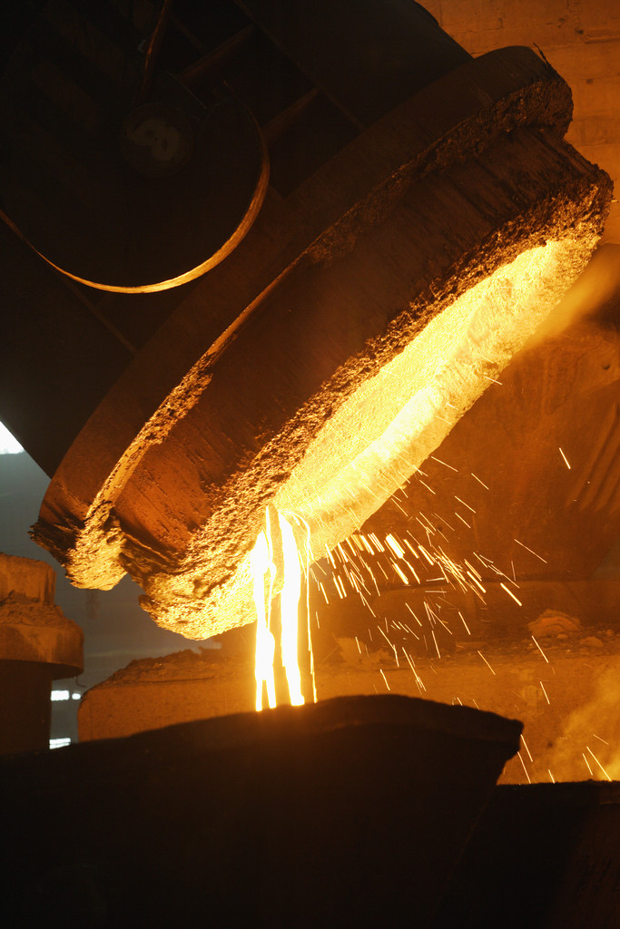
PatchAPI: Refine your assumptions
Paradyn
Dyninst
PatchAPI
Notes:
Paradyn->Dyninst->PatchAPI: refinement of how we present where you can instrument to users
* Well-defined external use case (self-propelled)
* (Insertion) Concepts were thought to be well-understood, but weren't until we started looking closely
* (Deletion) Another case where Dyninst got it wrong initially (cf. ProcControl, InstructionAPI)
* (Deletion) Needed to experiment with the wrong abstraction before we found the flaws
* Unlike ProcControl, being refactored in-place
* Abstraction in Dyninst was _almost_ right which made it harder to generalize
* Still in early stages, too soon to say how it will turn out

Slide 9
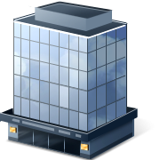

SymtabAPI: Creating good abstractions
Great interface…
…hiding messy internals
XCOFF
ELF
PE
Notes:
Existing concepts (libelf) were too concrete
Needed to define a more general interface
Reflect what actually happens in a binary
Don’t confuse users
Iteratively refined interface
Example: is a function a symbol?
Focus on interface affected development effort
Implementation still needs cleanup
Add platforms

Slide 10
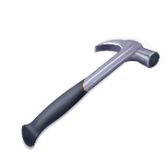
InstructionAPI: Adding missing features
Old: Control flow and not much else
Notes:
Existing instruction representation was good at control flow
Parsing
Dyninst started caring about data flow as well
Liveness, jump tables
Fundamental problem: how much to extend instruction representation?
Syntax, partial semantics, full semantics?
Expanded Dyninst capabilities (e.g. slicing) but scoping, design, integration were all slowed
Larger font
Top-down on features
Knife, pliers, something else served by a swiss army knife

Slide 11
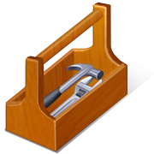
InstructionAPI: Adding missing features
New: control flow and data flow
Notes:
Existing instruction representation was good at control flow
Parsing
Dyninst started caring about data flow as well
Liveness, jump tables
Fundamental problem: how much to extend instruction representation?
Syntax, partial semantics, full semantics?
Expanded Dyninst capabilities (e.g. slicing) but scoping, design, integration were all slowed
Swap to toolbox

Slide 12
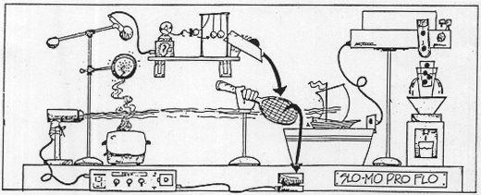
ProcControlAPI: Build one to throw away
Too many features, and I don’t need all of them!
Notes:
Old Dyninst model was flawed
Hard to port
Hard to debug
Overly complicated
Took lessons learned and built and tested new model separately
Reintegrating that model into Dyninst

Slide 13
ProcControlAPI: Build one to throw away
Ah, something that just does what I need!
Notes:
Old Dyninst model was flawed
Hard to port
Hard to debug
Overly complicated
Took lessons learned and built and tested new model separately
Reintegrating that model into Dyninst
Coffee maker

Slide 14
Stackwalker: When customers attack
STAT requirements
Dyninst requirements
Platform
Location
Frame type
Call Stack
Linux
BlueGene
3rd party
Normal
Optimized
Signal handler
1st party
Platform
Location
Frame type
Call Stack
Linux
Windows
Solaris
AIX
3rd party
Normal
Optimized
Signal handler
Instrumentation
Notes:
Stackwalking in Dyninst: in dynamic-mode instrumentation, need to know where you are in a process
Stackwalker: STAT requirements were more ambitious than Dyninst (BG/P, walking through anything)
Dyninst development: binary rewriting was focus during Stackwalker development
Integration never became a #1 priority
Side-by-side with next slide; requirements instead of stackwalking
Meat grinder?

Slide 15

DataflowAPI: Cool isn’t enough
Customers: the difference between a module
and a component
Notes:
Needs an external customer; Data flow analysis is a very broad field
Built as a module, but there’s a difference between a module and a component
* No overall theme
* No defined owner
* Likely to cook slowly until theme/owner emerges
Check caps on dataflow

Slide 16
What we’ve learned
Internal and external users driving interface design
Test new interfaces
Change code incrementally
Keep your project’s details where they belong
Notes:
Make transition explicit & obvious
All of these are good software engineering

Slide 17
Componentization Tradeoffs
Stability vs. improvement
Internal requirements vs. external requirements
Development time vs. scope
Structured vs. organic
Early feedback vs. interface stability
Notes:
Center-justify?
These are things we relearned
Move this to the end (possibly also 6)

