Slide 1
Where Did This Code Come From?
Recovering the Provenance of Program Binaries
Nathan Rosenblum

Slide 2
GCC 4.2.x
011101011010101010101110101001010101110001001001011010110011010101010101010010100101001001001101101101010110010010101101010010100101110101010101010101
unoptimized
C++
Toolchain Provenance

Slide 3
ICC 10.x
011101011010101010101110101001010101110001001001011010110011010101010101010010100101001001001101101101010110010010101101010010100101110101010101010101
optimized
C
[mixed]
Toolchain Provenance
I
C++

Slide 4
Why provenance?
linux-vdso.so.1
libpthread.so.0
libasound.so.2
libdl.so.2
libstdc++.so.6
libm.so.6
libgcc_s.so.1
libc.so.6
/lib64/ld-linux-x86-64.so.2
librt.so.1
Debugging remote deployments
compiler bug?
subtle incompatibility?
Forensics
reverse engineering
decompiling
tools, obfuscations?

Slide 5
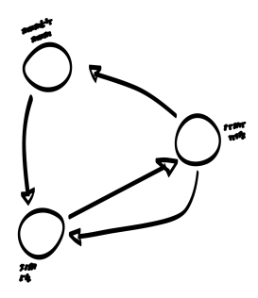
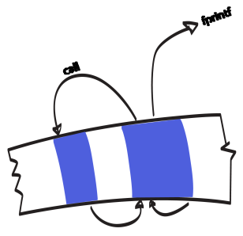
Outline
SYSTEM DESIGN
PROVENANCE STUDIES
BINARY CODE ABSTRACTIONS
MODELING PROGRAM PROVENANCE

Slide 6
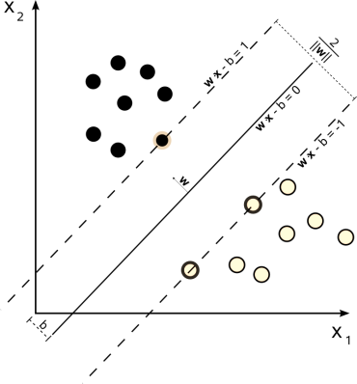
System overview
MSVS
BINARY ANALYSIS TOOL
LEARNING FRAMEWORK
TARGET BINARY
TRAINING DATA
011101011010101010101110101001010101110001001001011010110011010101010101010010100101001001001101101101010110010010101101010010100101110101010101010101
01110101101010101010111010100101101
01110101101010101010111010100101101
01110101101010101010111010100101101
01110101101010101010111010100101101
program
representation
+
feature selection
ICC
discovering evidence of provenance

Slide 7
Binary code model
program binary
code
… 55 89 e5 83 ec 2c 57 56 53 8b 45 0c 8b 00 a3 90 a3 05 08 85 c0 74 2b 83 c4 …
011101011010101010101110101001010101110001001001011010110011010101010101010010100101001001001101101101010110010010101101010010100101110101010101010101
〈 push ebp ; * ; mov esp, ebp 〉
〈 mov [imm], rax ; sub [imm], rax 〉
Control Flow Graph
layout, block contents
program
Call Graph
fprintf
External Libraries

Slide 8
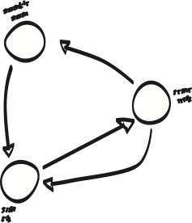
Graphlets
typed edges
code element nodes
(branch, call, etc.)
(e.g. basic blocks)
node
colors
Ex: instruction summary graphlets
Color bit field
14 instruction categories
2¹⁴ possible colors
arithmetic
privileged instruction
sparse in practice

Slide 9
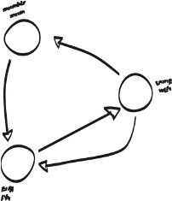
Modeling approach
basic block
function
whole program
some amount of code
“decompiles to <push ebp,...”
contains 27 occurrences of
“
”
feature vector

Slide 10
Compiler toolchain
C
C++
F77
3.4
4.2
4.4
2003
2005
2008
10
11
optimized
not optimized

Slide 11
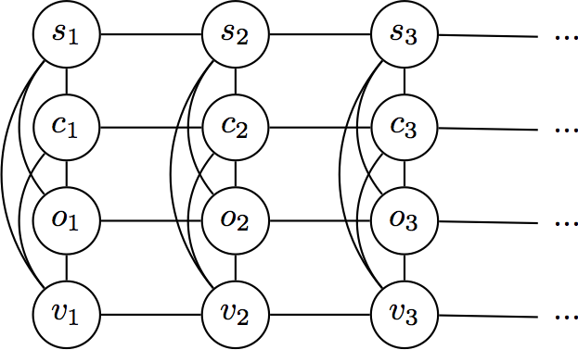
Toolchain details
[ISSTA 2011]
source language
compiler family
version
optimization level
GNU, Intel, Microsoft
C, C++, Fortran
[several]
low, high
functions
language
Model as Conditional Random Field
family
Instruction sequence features
optimization
Summary graphlet features
version

Slide 12
Evaluation
Functions Individually (SVM)
Linear CRF
statistical dependencies
Language
.910
.999
Compiler
.987
.998
Optimization
.971
.993
Version
.616
.910
same label likely
MSVC code generation changes little between versions

Slide 13
Program authorship
std::vector<int>::iterator it
= foo.begin();
while(it != foo.end()) {
// etc
for(int i=0; i<sz;++i)
{
// etc
I
C++

Slide 14
Long-range control flow
merged instruction summaries
Summary graphlets
⇒
supergraphlets
basic blocks

Slide 15
Interprocedural graphlets
FPRINTF
Unique “color” for external functions
Anonymous internal functions
[local]
FOPEN

Slide 16
Program-author dataset
Ideal:
3. Linguistic homogeneity
1. Author labels
2. Parallel corpus
several contest years
(CS 537)
C and C++ programs
C programs
8-16 programs per contestant
some provided/template code

Slide 17
Author attribution
391,056 N-grams
37,358 graphlets
54,705 idioms
117,997 supergraphlets
1,900 features
152 library calls
8,062 call graphlets
20 programmers
CJ 2009
CJ 2010
CS 537
Exact
77.8%
76.8%
38.4%
Top-5
94.7%
93.7%
84.3%
Students have less distinctive styles?
1. CS537 has much less data
2. Template code + instructor guidance confound results
Notes:
Discuss the difficulty of interpreting the features selected for classification

Slide 18
Summary
011101011010101010101110101001010101110001001001011010110011010101010101010010100101001001001101101101010110010010101101010010100101110101010101010101

Slide 19
questions

Slide 20
Backup slides follow

Slide 21
Program provenance
Authorship
Compiler
family
Link & post-link
version
optimization level
whole-program optimization
rewriting tools
source language
obfuscation tools
System
glibc static code
library imports

Slide 22
Instruction-level features
single-instruction wildcard
‹push ebp ; * ; mov esp, ebp›
IDIOMS
‹mov [imm], rax ; sub [imm], rax›
opcode class abstraction
hidden immediates
N-GRAMS
<4889c2be>
<018b45f8>
<8d45f8>
4-grams
3-grams

Slide 23
Digression: finding code
program binary
code
… 55 89 e5 83 ec 2c 57 56 53 8b 45 0c 8b 00 a3 90 a3 05 08 85 c0 74 2b 83 c4 …
in 0x83,eax in [dx],al sub 0x57,al ...
push ebp mov esp, ebp sub 0x2c, esp ...
[AAAI 2008]
Model compiler-specific “function entry points”
Compute max-likelihood labels
F1 from .86 - .99 depending on compiler

Slide 24
Byte-sequence model
[PASTE 2010]
GCC
ICC
ICC
GCC
program binary
… 55 89 e5 83 ec 2c 57 56 53 8b 45 0c 8b 00 a3 90 a3 05 08 85 c0 74 2b 83 c4 …
…
sequence labels
yi-1
yi
yj
yj+1
∈ {icc,gcc,...,data}
Compiler labels modeled as CRF...

Slide 25
Digression: Conditional Random Fields
labels
weights (learned)
evidence
feature functions
Linear chain CRF
Idiom feature function
⎧
if xi decompiles to idiom u
1
fu
=
⎨
0
otherwise
exact inference tractable
⎩

Slide 26
Byte-sequence model
[PASTE 2010]
program binary
… 55 89 e5 83 ec 2c 57 56 53 8b 45 0c 8b 00 a3 90 a3 05 08 85 c0 74 2b 83 c4 …
…
sequence labels
yi-1
yi
yj
yj+1
∈ {icc,gcc,...,data}
01110101101010101010111010100101010111000100100101101011001101010101010101001
01110101101010101010111010100101010111000100100101101011001101010101010101001
94% accuracy labeling mixed-compiler sequences
01110101101010101010111010100101010111000100100101101011001101010101010101001
+18% accuracy increase in function finding

Slide 27
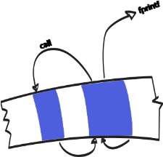
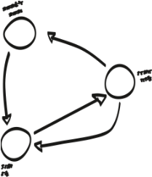
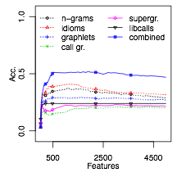
Feature selection
training programs
(condor)

Slide 28
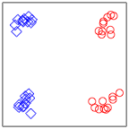
Distance metrics
Mahalanobis distance
distance metric
Equivalently:
How do we get A?

Slide 29
Style clustering
01110101101010101010111010100101010111000100100101101011001101010101010101001
01110101101010101010111010100101010111000100100101101011001101010101010101001
01110101101010101010111010100101010111000100100101101011001101010101010101001
01110101101010101010111010100101010111000100100101101011001101010101010101001
01110101101010101010111010100101010111000100100101101011001101010101010101001
01110101101010101010111010100101010111000100100101101011001101010101010101001
Programs, no training data
01110101101010101010111010100101010111000100100101101011001101010101010101001
01110101101010101010111010100101010111000100100101101011001101010101010101001
01110101101010101010111010100101010111000100100101101011001101010101010101001
01110101101010101010111010100101010111000100100101101011001101010101010101001
01110101101010101010111010100101010111000100100101101011001101010101010101001
01110101101010101010111010100101010111000100100101101011001101010101010101001
01110101101010101010111010100101010111000100100101101011001101010101010101001
01110101101010101010111010100101010111000100100101101011001101010101010101001
X
Conclude:

Slide 30
Transfer learning
Alice
Bob
?
?
01110101101010101010111010100101010111000100100101101011001101010101010101001
01110101101010101010111010100101010111000100100101101011001101010101010101001
01110101101010101010111010100101010111000100100101101011001101010101010101001
Large-margin Nearest Neighbors (LMNN)
01110101101010101010111010100101010111000100100101101011001101010101010101001
01110101101010101010111010100101010111000100100101101011001101010101010101001
01110101101010101010111010100101010111000100100101101011001101010101010101001
01110101101010101010111010100101010111000100100101101011001101010101010101001
01110101101010101010111010100101010111000100100101101011001101010101010101001
01110101101010101010111010100101010111000100100101101011001101010101010101001
01110101101010101010111010100101010111000100100101101011001101010101010101001
01110101101010101010111010100101010111000100100101101011001101010101010101001
01110101101010101010111010100101010111000100100101101011001101010101010101001
01110101101010101010111010100101010111000100100101101011001101010101010101001
01110101101010101010111010100101010111000100100101101011001101010101010101001
01110101101010101010111010100101010111000100100101101011001101010101010101001
01110101101010101010111010100101010111000100100101101011001101010101010101001
01110101101010101010111010100101010111000100100101101011001101010101010101001
01110101101010101010111010100101010111000100100101101011001101010101010101001
Weinberger, Saul 2009
semi-definite program
☹
one-time cost
☺
01110101101010101010111010100101010111000100100101101011001101010101010101001
01110101101010101010111010100101010111000100100101101011001101010101010101001
01110101101010101010111010100101010111000100100101101011001101010101010101001
01110101101010101010111010100101010111000100100101101011001101010101010101001
01110101101010101010111010100101010111000100100101101011001101010101010101001
01110101101010101010111010100101010111000100100101101011001101010101010101001
01110101101010101010111010100101010111000100100101101011001101010101010101001
01110101101010101010111010100101010111000100100101101011001101010101010101001
01110101101010101010111010100101010111000100100101101011001101010101010101001
01110101101010101010111010100101010111000100100101101011001101010101010101001
01110101101010101010111010100101010111000100100101101011001101010101010101001
01110101101010101010111010100101010111000100100101101011001101010101010101001
01110101101010101010111010100101010111000100100101101011001101010101010101001
01110101101010101010111010100101010111000100100101101011001101010101010101001
01110101101010101010111010100101010111000100100101101011001101010101010101001
01110101101010101010111010100101010111000100100101101011001101010101010101001
01110101101010101010111010100101010111000100100101101011001101010101010101001
01110101101010101010111010100101010111000100100101101011001101010101010101001
Notes:
Put the take-away results on this page

Slide 31
Component models
semi-open world provenance
component sharing (e.g. command and control)
programmer movement between groups
mixture of styles
01110101101010101010111010100101010111000100100101101011001101010101010101001
01110101101010101010111010100101010111000100100101101011001101010101010101001
style vs. functionality?
infinite mixture models
interpreting style clusters

Slide 32
Social code networks
program binaries

