Slide 1
The Scalable Checkpoint/Restart Library (SCR): Overview and Future Directions
Kathryn Mohror

Slide 2
Increased component count in supercomputers means increased failure rate
Today’s supercomputers experience failures on the order of hours
Future systems are predicted to have failures on the order of minutes
Checkpointing: periodically flush application state to a file
Parallel file system (PFS)
Bandwidth from cluster to PFS at LLNL: 10’s GB/s
100’s TB to 1-2 PB of storage
Checkpoint data size varies
100’s GB to TB

Slide 3
Writing checkpoints to the parallel file system is very expensive
Compute Nodes
Network Contention
Gateway Nodes
Contention for Shared File System Resources
Atlas
Contention from Other Clusters for File System
Hera
Zeus
Parallel File System

Slide 4
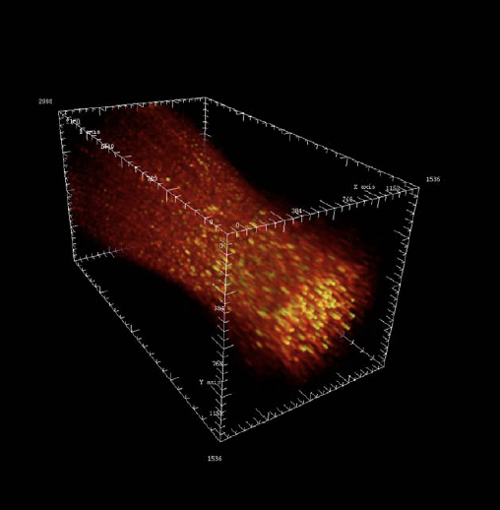
Failures cause loss of valuable compute time
BG/L at LLNL
192K cores
Checkpoint every 7.5 hours
Achieved 4 days of computation in 6.5 days
Atlas at LLNL
4096 cores
Checkpoint every 2 hours
20 - 40 minutes
MTBF 4 hours
Juno at LLNL
256 cores
Average 20 min checkpoints
25% time spent in checkpointing
Notes:
Image from: http://www.lanl.gov/orgs/hpc/salishan/pdfs/Salishan%20slides/Random%20Access/LangerSalishan2008.pdf

Slide 5
Node-local storage can be utilized to reduce checkpointing costs
Observations:
Only need the most recent checkpoint data.
Typically just a single node failed at a time.
Idea:
Store checkpoint data redundantly on compute cluster; only write a few checkpoints to parallel file system.
Node-local storage is a performance opportunity AND challenge
+ Scales with rest of system
- Fails and degrades over time
- Physically distributed
- Limited resource

Slide 6
SCR works for codes that do globally-coordinated application-level checkpointing
int main(int argc, char* argv[]) {
MPI_Init(argc, argv);
for(int t = 0; t < TIMESTEPS; t++)
{
/* ... Do work ... */
checkpoint();
}
MPI_Finalize();
return 0;
}
void checkpoint() {
int rank;
MPI_Comm_rank(MPI_COMM_WORLD, &rank);
char file[256];
sprintf(file, “rank_%d.ckpt”, rank);
FILE* fs = fopen(file, “w”);
if (fs != NULL) {
fwrite(state, ..., fs);
fclose(fs);
}
return;
}

Slide 7
SCR works for codes that do globally-coordinated application-level checkpointing
int main(int argc, char* argv[]) {
MPI_Init(argc, argv);
SCR_Init();
for(int t = 0; t < TIMESTEPS; t++)
{
/* ... Do work ... */
int flag;
SCR_Need_checkpoint(&flag);
if (flag)
checkpoint();
}
SCR_Finalize();
MPI_Finalize();
return 0;
}
void checkpoint() {
SCR_Start_checkpoint();
int rank;
MPI_Comm_rank(MPI_COMM_WORLD, &rank);
char file[256];
sprintf(file, “rank_%d.ckpt”, rank);
char scr_file[SCR_MAX_FILENAME];
SCR_Route_file(file, scr_file);
FILE* fs = fopen(scr_file, “w”);
if (fs != NULL) {
fwrite(state, ..., fs);
fclose(fs);
}
SCR_Complete_checkpoint(1);
return;
}

Slide 8
SCR utilizes node-local storage and the parallel file system
SCR_Start_checkpt();
SCR_Route_file(fn,fn2);
…
fwrite(data,…);
…
SCR_Complete_checkpt();
X
SCR_Start_checkpt();
SCR_Route_file(fn,fn2);
…
fwrite(data,…);
…
SCR_Complete_checkpt();
SCR_Start_checkpt();
SCR_Route_file(fn,fn2);
…
fwrite(data,…);
…
SCR_Complete_checkpt();
SCR_Start_checkpt();
SCR_Route_file(fn,fn2);
…
fwrite(data,…);
…
SCR_Complete_checkpt();
…
…
SCR_Start_checkpt();
SCR_Route_file(fn,fn2);
…
fwrite(data,…);
…
SCR_Complete_checkpt();
SCR_Start_checkpt();
SCR_Route_file(fn,fn2);
…
fwrite(data,…);
…
SCR_Complete_checkpt();

Slide 9
SCR uses multiple checkpoint levels for performance and resiliency
Low
Local: Store checkpoint data on node’s local storage, e.g. disk, memory
Checkpoint Cost and Resliency
Level 1
Partner: Write to local storage and on a partner node
Level 2
XOR: Write file to local storage and small sets of nodes collectively compute and store parity redundancy data (RAID-5)
⊕
Stable Storage: Write to parallel file system
Level 3
High

Slide 10
Aggregate checkpoint bandwidth to node-local storage scales linearly on Coastal
Local on RAM
disk 1,000x
Partner / XOR on
RAM disk 100x
SSDs 10x
faster than
PFS
Parallel file system built for 10GB/s

Slide 11
Speedups achieved using SCR with PF3d
Cluster Nodes Data | PFS name Time BW | Cache type Time BW | Speedup in BW
Hera 256 nodes 2.07 TB | lscratchc 300 s 7.1 GB/s | XOR on RAM disk 15.4 s 138 GB/s | 19x
Atlas 512 nodes 2.06 TB | lscratcha 439 s 4.8 GB/s | XOR on RAM disk 9.1 s 233 GB/s | 48x
Coastal 1024 nodes 2.14 TB | lscratchb 1051 s 2.1 GB/s | XOR on RAM disk 4.5 s 483 GB/s | 234x
Coastal 1024 nodes 10.27 TB | lscratch4 2500 s 4.2 GB/s | XOR on RAM disk 180.0 s 603 GB/s | 14x

Slide 12
SCR can recover from 85% of failures using checkpoints that are 100-1000x faster than PFS
42 Temporary parallel file system write failure (subsequent job in same allocation succeeded)
Level 1: Local checkpoint
sufficient
31%
10 Job hang
7 Transient processor failure
(floating-point exception or segmentation fault)
Level 2:
Partner / XOR
checkpoint
sufficient
104 Node failure
(bad power supply, failed network card, or unexplained reboot)
54%
Level 3: PFS
checkpoint
sufficient
23 Permanent parallel file system write failure (no job in same allocation succeeded)
15%
3 Permanent hardware failure (bad CPU or memory DIMM)
2 Power breaker shut off
Observed 191 failures spanning 5.6 million node hours from 871 runs of PF3d on 3 different clusters (Coastal, Hera, and Atlas).

Slide 13
Create a model to estimate the best parameters for SCR and predict its performance on future machines
Several parameters determine SCR’s performance:
Checkpoint interval
Checkpoint types and frequency, e.g. how many local checkpoints between each XOR checkpoint
Checkpoint costs
Failure rates
Developed a probabilistic Markov model
Metrics
Efficiency: How much time is spent actually progressing the simulation
Accounts for time spent checkpointing, recovering, and recomputing
Parallel file system load: Expected frequency of checkpoints to the parallel file system

Slide 14
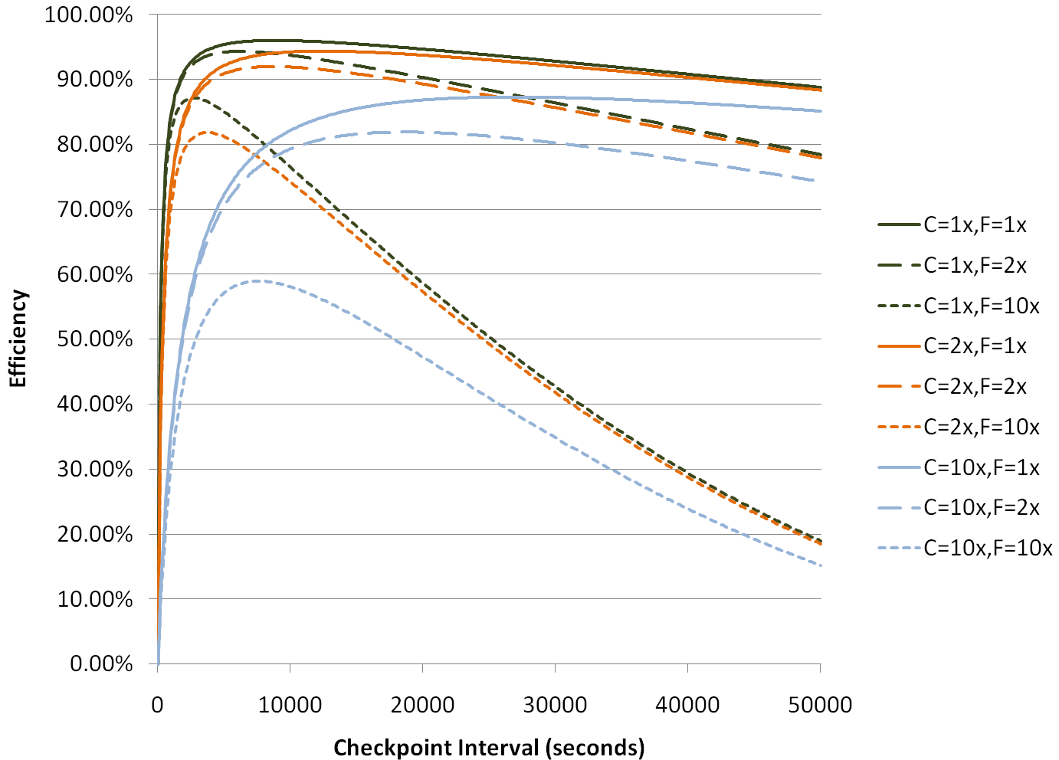
How does checkpointing interval affect efficiency?
When checkpoints are rare, system efficiency depends primarily on the failure rate
Maximum efficiency depends on checkpoint cost and failure rates
When checkpoints are frequent, system efficiency depends primarily on the checkpoint cost
C: Checkpoint Cost
F: Failure Rate
1x: Today’s Values

Slide 15
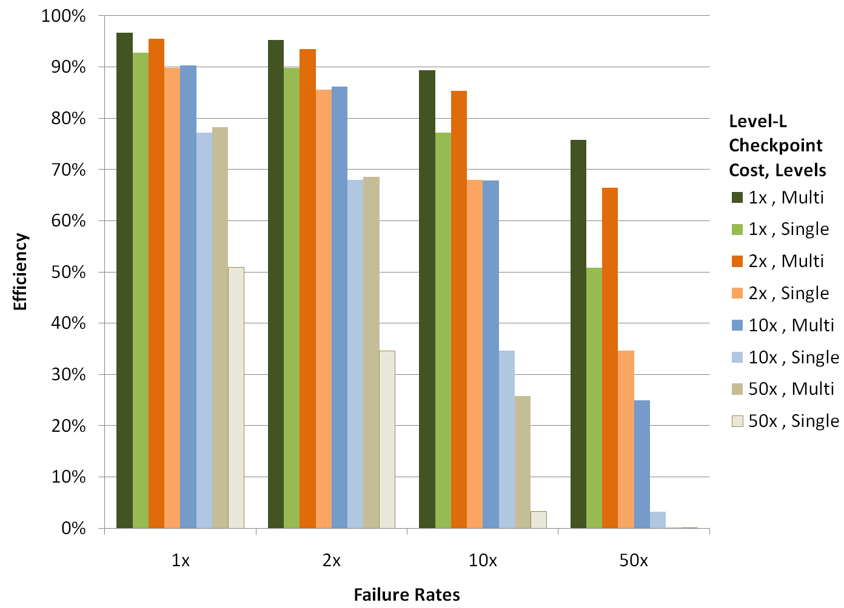
How does multi-level checkpointing compare to single-level checkpointing to the PFS?
PFS Checkpoint Cost, Levels
Today’s Cost

Slide 16
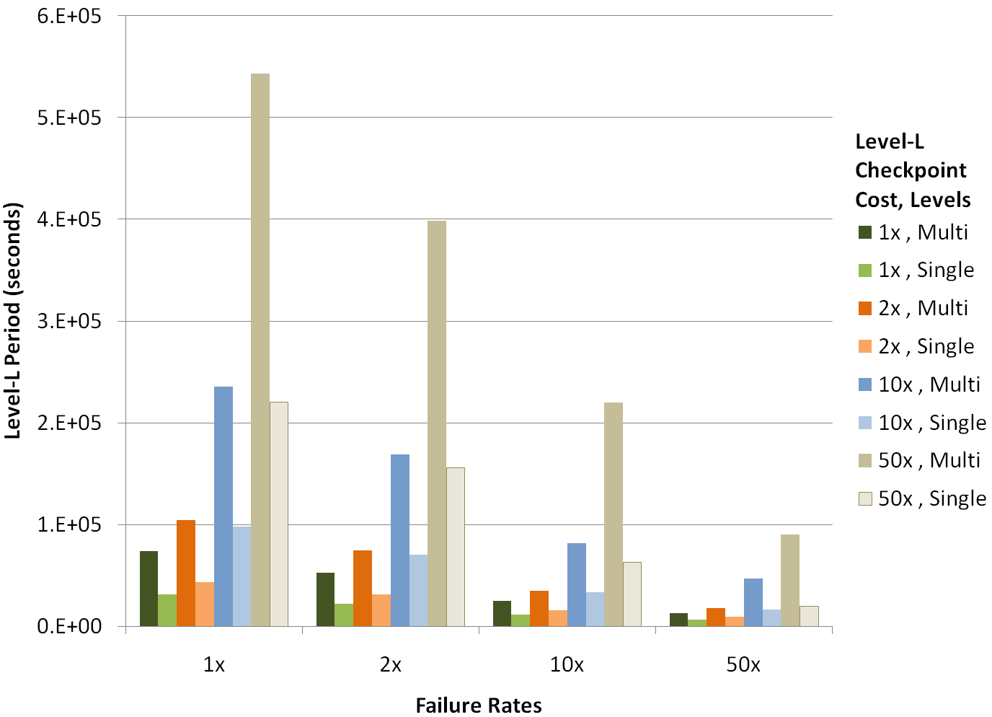
Multi-level checkpointing requires less writes to the PFS
More expensive checkpoints are rarer
Multi-level checkpointing
requires fewer writes to parallel file system
PFS Checkpoint Cost, Levels
Higher failure rates
require more frequent checkpoints
Expected Time Between Checkpointing to PFS (seconds)
Today’s Cost
Today’s Failure Rate

Slide 17
Summary
Multi-level checkpointing library, SCR
Low-cost checkpointing schemes up to 1000x faster than PFS
Failure analysis of several HPC systems
85% of failures can be recovered from low-cost checkpoints
Hierarchical Markov Model that shows benefits of multi-level checkpointing:
Increased machine efficiency
Reduced load on the parallel file system
Advantages are expected to increase on future systems.
Can still achieve 85% efficiency on 50x less reliable systems

Slide 18
Current and future directions -- There’s still more work to do!
Contention
Parallel File System

Slide 19
Use an overlay network (MRNet) to write checkpoints to the PFS in a controlled way
“Forest” of writers
Parallel File System

Slide 20
Average Total I/O Time per checkpoint with and without SCR/MRNet
Single writer
Every checkpoint to the parallel file system

Slide 21
SCR/MRNet Integration
Still work to do for performance
Current asynchronous drain uses a single writer
Forest
Although I/O time is greatly improved, there’s a scalability problem in SCR_Complete_checkpoint
Current implementation uses a single writer and takes too long to drain the checkpoints at larger scales

Slide 22
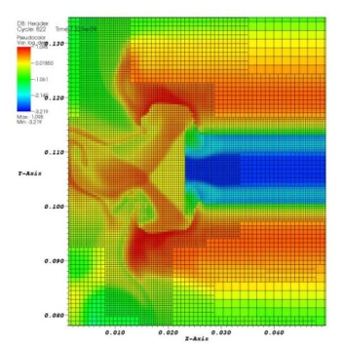
Compress checkpoints to reduce checkpointing overheads
A₀=
A₁=
A₂=
A₃=
Partition array A
Interleave array A
Compress array A
~70% reduction in checkpoint file size!
Parallel File System

Slide 23
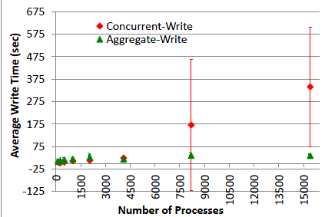
Comparison of N->N and N->M Checkpointing

Slide 24
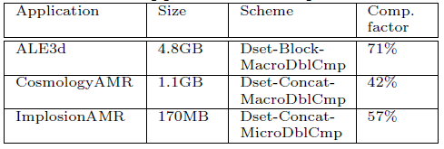
Summary of Compression Effectiveness
Comp Factor = (uncompressed – compressed) / compressed * 100

Slide 25
The MRNet nodes add extra levels of resiliency
X
X
X
X
X
Geographically disperse nodes in an XOR set for increased resiliency
Parallel File System

Slide 26
Thanks!
Adam Moody, Greg Bronevetsky, Bronis de Supinski (LLNL)
Tanzima Islam, Saurabh Bagchi, Rudolf Eigenmann (Purdue)
For more information
kathryn@llnl.gov
Open source, BSD license: http://sourceforge.net/projects/scalablecr
Adam Moody, Greg Bronevetsky, Kathryn Mohror, Bronis R. de Supinski, "Design, Modeling, and Evaluation of a Scalable Multi-level Checkpointing System," LLNL-CONF-427742, SC’10.

