Slide 1
Open|SpeedShop
&
Component Based Tool Framework (CBTF)
project status and news
Jim Galarowicz, Don Maghrak
The Krell Institute
Paradyn Week 2011

Slide 2
Open|SpeedShop Agenda
Open|SpeedShop Project Overview
What has changed since last update
What we are working on now
Current Release and Status

Slide 3
Project Overview: What is Open|SpeedShop?
Comprehensive open source performance analysis framework
Combining Profiling and Tracing
Common workflow for all experiments
Flexible instrumentation (dynamic and offline)
Extensibility through plugins
Partners
DOE/NNSA Tri-Labs (LLNL, LANL, SNLs)
DOE/Office of Science
Krell Institute
Universities of Wisconsin and Maryland
ORNL

Slide 4
Project Overview: What is Open|SpeedShop?
What can Open|SpeedShop do for the user?
Give lightweight overview of where program spends time
Find hot call paths in user program and libraries
Give access to hardware counter event information
Record calls to POSIX I/O functions, give timing, call paths, and optional info like: bytes read, file names...
Record calls to MPI functions. give timing, call paths, and optional info like: source, destination ranks, .....
Help pinpoint numerical problem areas by tracking FPE
Maps the performance information back to the source and displays source annotated with the performance information.

Slide 5
Project Overview: What is Open|SpeedShop?
Platforms supported currently:
Linux Clusters with x86, IA-64, Opteron, and EM64T
Ports to Linux: PPC, BG/L, BG/P, Cray-XT/XE completed
Gather performance data on unmodified application binaries
Static applications on BG/L, BG/P and Cray-XT/XE require relinking application to add Open|SpeedShop collection code
Open|SpeedShop provides “osslink” script to help re-link

Slide 6
Project Overview: Sampling Experiments
PC Sampling (pcsamp)
Record PC in user defined time intervals
Low overhead overview of time distribution
Good first step to find hot spots in program
User Time (usertime)
PC Sampling + Call stacks for each sample
Provides inclusive & exclusive timing data
Find hot call paths in application
Hardware Counters (hwc, hwctime, hwcsamp)
Sample HWC overflow events (hwc, hwctime)
Sample HWC events using timer (hwcsamp)
Access to data like cache and TLB misses

Slide 7
Project Overview: Tracing Experiments
I/O Tracing (io, iot)
Record invocation of all POSIX I/O events
Provides I/O aggregate and individual timings
iot – Shows bytes read/written, etc. & event by event list
MPI Tracing (mpi, mpit, mpiotf)
Record invocation of all MPI routines
Provides MPI aggregate and individual timings
mpit – Shows bytes transferred, ranks involved, etc. & event by event list
mpiotf – Writes open trace format files using vampirtrace under the hood.

Slide 8
Project Overview: Tracing Experiments
Floating Point Exception Tracing (fpe)
Triggered by any FPE caused by the code
Helps pinpoint numerical problem areas
Mapped back to source where FPE occurred

Slide 9
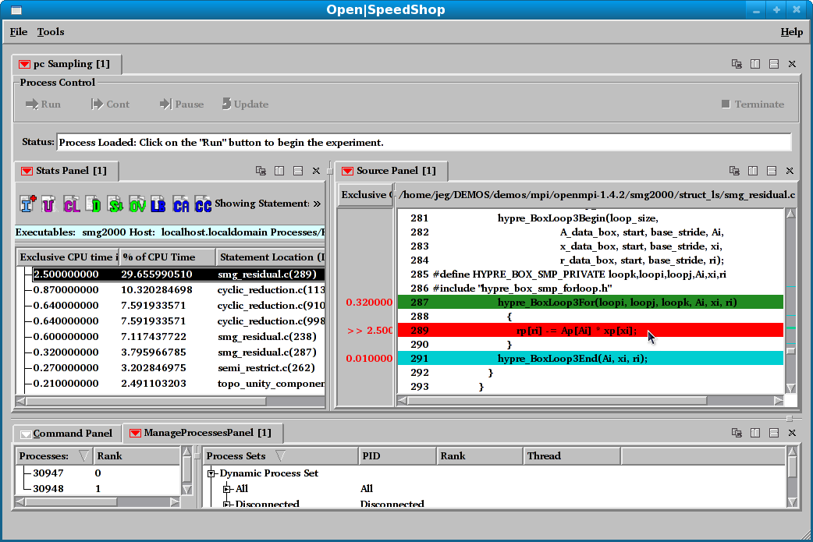
Associate Source & Performance Data
Double click to open source window
Use window controls to split/arrange windows
Selected performance
data point

Slide 10
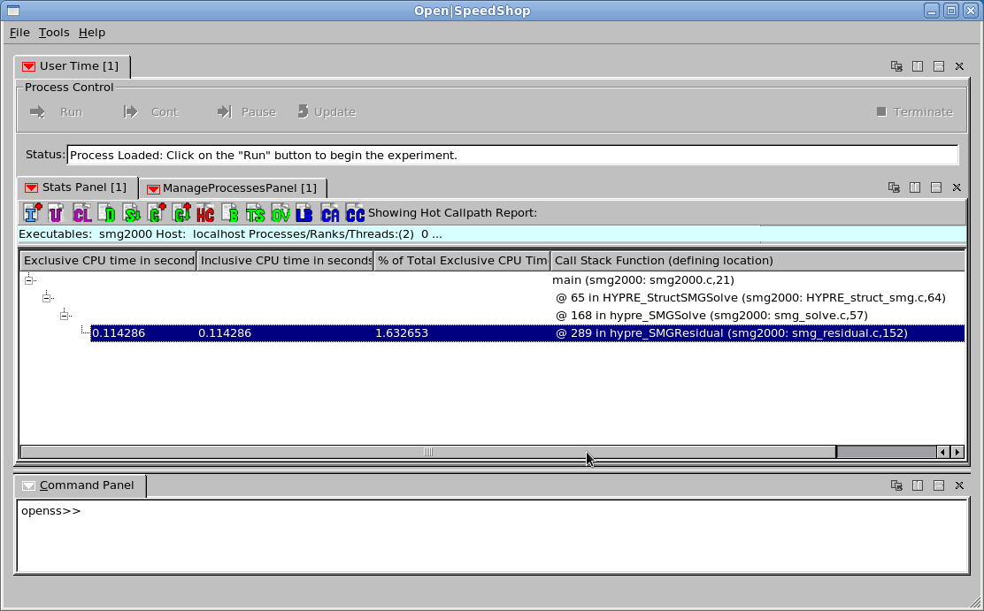
Stack Trace Views: Hot Call Path
Hot Call Path
Click HC-icon

Slide 11
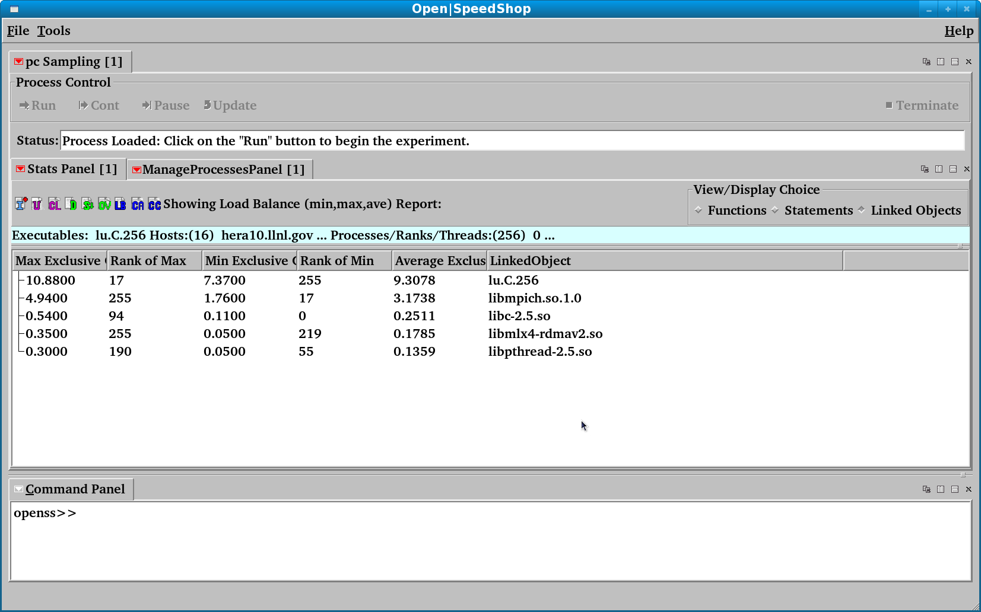
Load Balance View: Using NPB: LU
Load Balance View based on Linked Objects (libraries)
Rank 255 has maximum MPI library time value

Slide 12
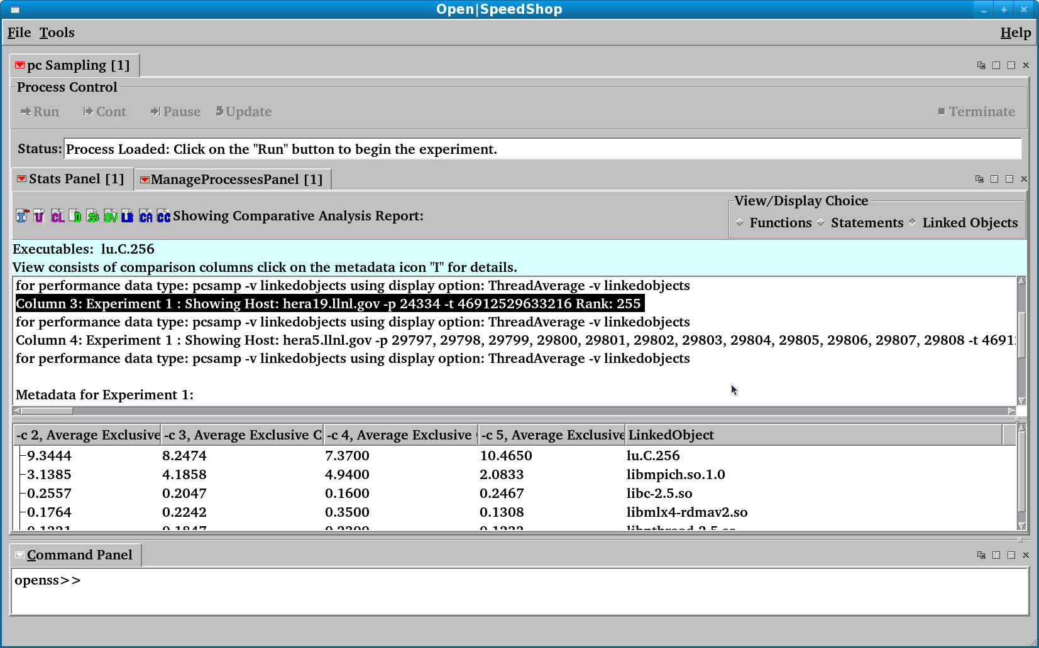
Finding Outliers: Using NPB: LU
Cluster Analysis View based on Linked Objects (libraries)
In Cluster Analysis results
Rank 255 showing up as an outlier.

Slide 13
Project Overview: Code Instrumentation Options
How does Open|SpeedShop collect performance data?
Offline/External Data Collection
Instrument application at start-up
Write data to raw data files to directories on shared file system
After application completes, convert raw data to O|SS database
Performance data available at end of execution.
Online Scalable Data Collection via Dyninst/MRNet
Use Scalable transport layer (MRNet)
Insert instrumentation (collectors) using Dyninst
Performance data delivered directly to tool online via daemons
Ability for interactive online analysis and viewing intermediate results

Slide 14
Project Overview: Updates since Paradyn 2010
Updates to the open source components we use:
sqlite, libdwarf, libunwind, libmonitor, Dyninst, MRNet, PAPI,…
Modularization of Open|SpeedShop
Completed: Ability to build a viewer only version
Completed: Ability to build only the runtime libraries and collectors
Refactored runtime library component to be more modular
Ported Open|SpeedShop to these platforms:
Linux PPC
BG/L and BG/P
Cray-XT4, Cray-XT5, Cray-XE

Slide 15
Project Overview: Updates since Paradyn 2010
Better online/dynamic instrumentation version
Upgraded to latest Dyninst/MRNet versions
Working on detach-on-the-fly patch with Dyninst team (Dan)
Improvements to the comparison facilities
osscompare script compares up to eight (8) experiments
Produce side-by-side comparison output
Optionally, create comma separated list (csv) list for import into spreadsheet tools
Added a new hwcsamp experiment to access hardware counters
Uses sampling timer instead of the overflow/threshold mechanism
Sample up to six (6) PAPI events on each application run
Also reports program counter sampling timing in addition to event counts
Derived analysis view options, such as flops (-m flops) are available

Slide 16
Project Overview: What are we working on now
NASA SBIR phase I GUI feasibility study and prototyping
Supporting current users and assisting new users
Release updates
New features and bug fixes to existing code
Integrate the latest versions of MRNet and Dyninst into Open|SpeedShop
Using Dyninst-7.0 and MRNet 3.0.1+ for development
Component Based Tool Framework (CBTF) project
Using Open|SpeedShop as test bed for CBTF feasibility and development
Subject of next half of this talk

Slide 17
Project Overview: Current Release and Status
Open|SpeedShop 2.0.1 available
Packages and source from sourceforge.net
Tested on a variety of platforms
Cray-XT, BG, and PPC platforms now supported
Open|SpeedShop website (Documentation, Tutorials, etc): http://www.openspeedshop.org/
Download options:
Package with Install Script (install.sh or install-oss)
Source for tool and base libraries

Slide 18
Project Overview: Questions
Questions?
jeg@krellinst.org
dpm@krellinst.org
oss-questions@openspeedshop.org

Slide 19
Building a Community Infrastructure for Scalable
On-Line Performance Analysis Tools
also known as
Component Based Tool Framework
“CBTF”
Jim Galarowicz, Don Maghrak, Bill Hachfeld
The Krell Institute

Slide 20
CBTF (Component Based Tool Framework) Agenda
Project Goals
Project Team
Rationale for Project
Project Goals/Objectives
Last Years Status vs Current Status (Progress)
What is next?

Slide 21
CBTF Project Goals and Objectives
Project Goals/Objectives:
Create a set of reusable components for building high-level end user tools and/or quickly build tool prototypes.
Tools should be easily configurable without rebuilding core infrastructure.
Able to mix components from several groups and/or vendors. Everyone would be able to contribute and use the new components.
Recreate Open|SpeedShop from CBTF provided components and services.

Slide 22
CBTF Project Team
Project Team
The Krell Institute
University of Maryland
University of Wisconsin
Oak Ridge National Laboratory
Lawrence Livermore National Laboratory
Los Alamos National Laboratory
Sandia National Laboratories
Carnegie Mellon University
Others welcome……

Slide 23
CBTF Project Rationale
Why the need for the project?
Petascale environments need tool sets that are flexible
Need to quickly create new and specialized tools
Better availability of tools across more platforms
Helps in building modular tools and in the avoidance of creating stove pipe tools

Slide 24
CBFT: Components
Data-Flow Model
Accepts Inputs
Performs Processing
Emits Outputs
C++ Based
Provide Metadata
Type & Version
Input Names & Types
Output Names & Types
Versioned
Concurrent Versions
Packaging
Executable-Embedded
Shared Library
Runtime Plugin
Notes:
The purpose of this slide is to define a component. Components are based on a data-flow model, accepting zero or more inputs, performing arbitrary processing, and emitting zero or more outputs. They are written using C++, inheriting from a base class that provides basic infrastructure. The provide metadata in form of the component’s type, version, and input/output names and types. All components are versioned and multiple versions the same component can co-exist. Finally, components can be packaged in a variety of different ways.

Slide 25
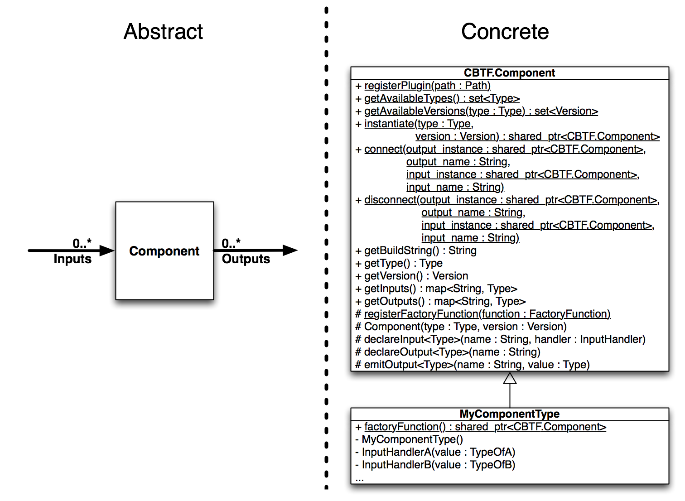
CBTF Component Interfaces
Notes:
Component is the key class that all component inherit from.
attribute phrase… hides the name of the component to the outside
registerPlugin – tells CBTF that the specified plugin is available
getAvailableTypes – list all the available component types
instantiate – creates an instance of the component
- can request a specific version of the component
- by default get the latest version
connect – forms the interconnection of one component with another
need a connect for each output argument
Specify the input arguments and the output arguments to the “black box” component
factoryFunction call registers the component as an available component
LIBRARY: libCBTF implements support for this API

Slide 26
CBTF: Component Networks
Components
Specific Versions
Connections
Matching Types
Arbitrary Topology
Recursive
XML-Specified
Notes:
The purpose of this slide is to define component networks. Each network contains one or more component instances and connections between those component instances. Any topology is possible, from pipelines to graphs with cycles. Networks are recursive in the sense that the network is itself a component, with input and outputs, which can be instantiated and further connection to other networks. Finally, the components to be instantiated (including version ranges), along with the interconnections, are specified via XML files.

Slide 27
CBTF: Component Networks (API)
# must tell cbtf about plugins avail.
registerPlugin(A)
registerPlugin(B)
# create the instantiation of the plugin
instance_of_a1=instantiate(Type(A))
instance_of_a2=instantiate(Type(A))
…
instance_of_b2=instantiate(Type(B))
# now connect the components
connect(instance_of_a1, “out”,
instance_of_a2, “in”)
connect(instance_of_a2, “out”,
instance_of_a3, “in”)
…
connect(instance_of_b1, “out”,
instance_of_b3, “in”);

Slide 28
CBTF: Component Networks (XML)
….
<Type>ExampleNetwork</Type> <Version>1.2.3</Version> <SearchPath>.:/opt/myplugins</SearchPath> <Plugin>myplugin</Plugin>
<Component>
<Name>A1</Name>
<Type>TestComponentA</Type>
</Component>
…
…
<Connection>
<From>
<Name>A1</Name>
<Output>out</Output>
</From>
<To>
<Name>A2</Name>
<Input>in</Input>
</To>
</Connection>
…
</Network>

Slide 29
CBTF: Distributed Component Networks
MRNet Based
Per-Node Networks
Homogenous Within Tree Levels
Heterogeneous Between Tree Levels
Named Streams
Up and Down
Connect Networks
Also Recursive
Also XML-Specified
Supports LW MRNet
Notes:
The purpose of this slide is to define distributed component networks. These are (currently) MRNet based. A complete component network is located on each node in the MRNet network. These component networks are connected via symbolically-named MRNet streams (shown in red) which can move data either up or down the MRNet network. As with non-distributed component networks, distributed component networks are recursively defined and specified via XML files. Finally, light-weight MRNet is supported by allow messages with specific MRNet tags to be associated with named streams.

Slide 30
CBTF: Software Stack (Framework)
Minimal Dependencies
Easier Builds
Tool-Type Independent
Performance Tools
Debugging Tools
etc…
Completed Components
Base Library
XML-Based Component Networks
MRNet Distributed Components
Planned Components
TCP/IP Distributed Component Networks
GUI Definition of Component Networks
Notes:
The purpose of this slide is to present the software stack used by the core CBTF framework. Existing open-source components are shown in dark green, already-developed CBTF framework components in light green, and planned CBTF framework components in red.

Slide 31
CBT: Software Stack (Services,Messages,Core)
Services
Libraries (C or C++) of functionality that don't fit into the data-flow model of the CBTF component framework.
Collection services
Unwinding service
Timer service
HWC (PAPI) service
…..
Messages
Defines the data that is exchanged between data-flow components.
Core
C++ Base Classes
Time, Address, Blob, Path support
Collector service plugin
Component service plugin

Slide 32
CBT: Software Stack (Future Tools)
Open|SpeedShop
Using Services, Messages, Core, and CBTF
Full fledged multipurpose performance tool
Customized Tools
Built from Services, Messages, Core, and CBTF
Aimed at specific tool needs determined by application code teams

Slide 33
CBTF Project Status: April 2010
Last Years (April 2010) Status
Held a number of Open|SpeedShop team design meetings
Started holding extended CBTF team meetings to discuss ideas for component interfaces
Created a CBTF wiki
Started prototyping the component interface design
Doing a number of improvements and decompositions in Open|SpeedShop for deployment in CBTF

Slide 34
CBTF Project Status: May 2011
This Years (May 2011) Current Status
CBTF design/status meetings with extended team
Used Open|SpeedShop as a test bed driver for CBTF design
Designed, Implemented and Tested three of the core libraries that define the CBTF infrastructure
libcbtf
libcbtf-xml
libcbtf-mrnet
Designed another core library: libcbtf-tcp
Writing components, services, and messages to use with the CBTF infrastructure with the goal of supporting program counter sampling, then other collection types.

Slide 35
CBTF Next Steps
Next steps for CBTF:
Add support for LW MRNet's backend attach mode
GUI tool for CBTF component network configuration. The XML files get tedious to write by hand…
TCP/IP library implementation and test. (libcbtf-tcpip)
Tool start up investigation and implementation (launchmon, libi, …)
Tool component creation to support more types of collection
Filtering components for MRNet communication node deployment

Slide 36
CBTF: UW & UMD Software Usage
MRNet and Dyninst Features/Requirements/Desires
Implementing usage of the MRNet lightweight library
Prototyped using OSS, now implementing in CBTF
Working with UW on the detach on the fly
Plan to use the binary rewriter feature
Plan to use symtabAPI
Would like a floating point register fix up feature
Would like a 1st party stackwalker API
Plan to create an “new” CBTF tool/feature based on Active Harmony

Slide 37
CBTF Questions?
Questions?
jeg@krellinst.org
cbt_framework@krellinst.org

Slide 38
CBTF: Supplemental Information
Supplemental Information

Slide 39
CBTF Component Interfaces
List of the Component Interface Libraries
libcbtf
Provides Cores Services:
Component Abstraction, Metadata, Interconnection
Minimal Dependencies (GNU Build Tools & Boost)
libcbtf-xml
Provides XML-Based Definition of Single-Process Component Networks
Depends on libcbtf and Xerces-C
libcbtf-mrnet
Provides XML-Based Definition of MRNet-Based Distributed Component Networks
Depends on libcbtf, libcbtf-xml, and MRNet
libcbtf-tcpip
Provides XML-Based Definition of TCP based networks
Depends on libcbtf, libcbtf-xml, and TCP/IP
Notes:
There is a slide on each one of these in the Supplemental Information section of this set of slides

Slide 40
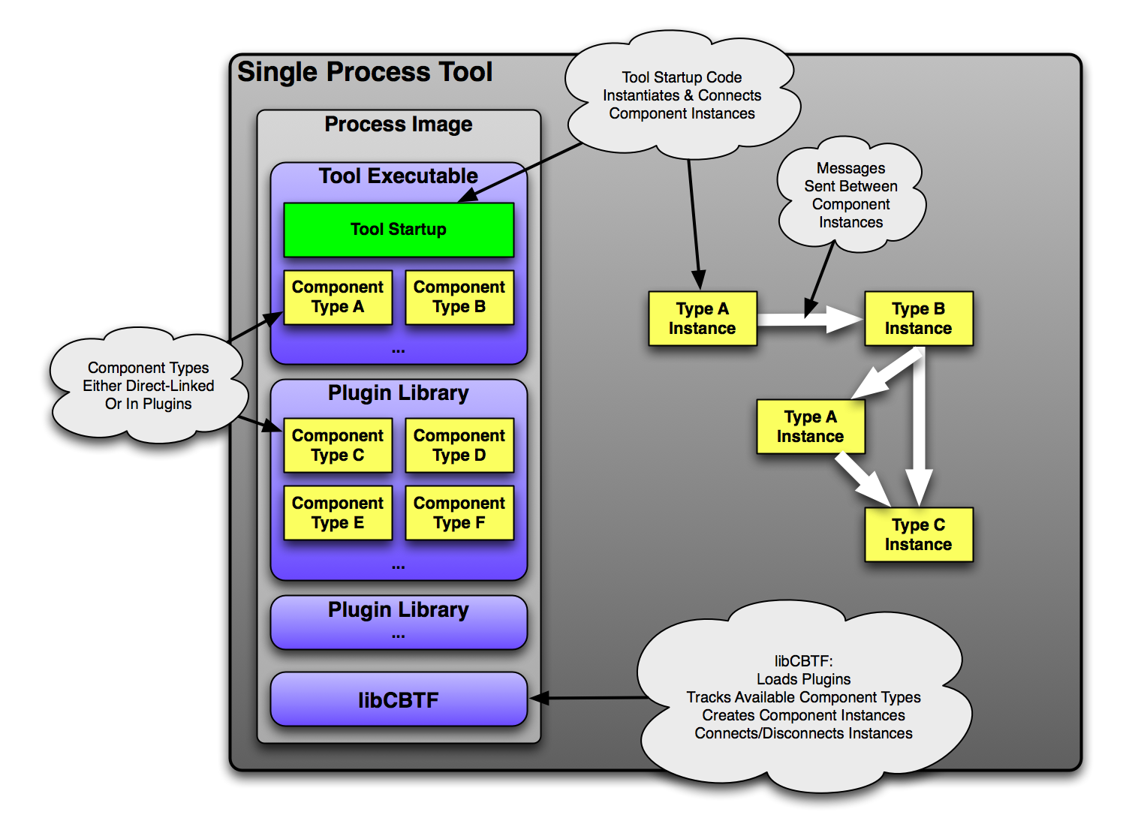
Notes:
High level graphical view of an example CBTF component network
Show components can be directly linked or in a shared object plugin library
Tool start up code creates the instances of each component and connects the components into a network.
libCBTF contains the actual code that supports the CBTF API.

Slide 41
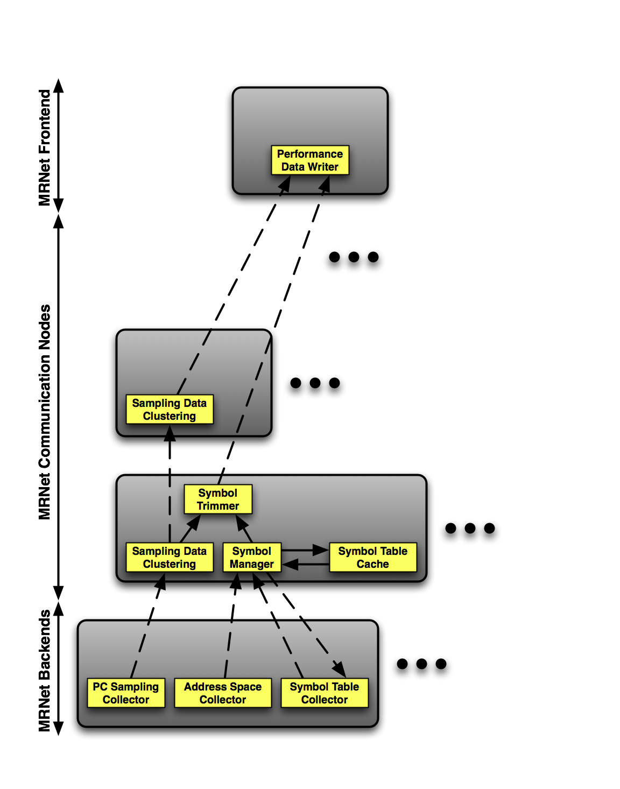
MRNet component network example
Notes:
Only shows one node at each level in the tree. Of course in reality there will be many, many, of these nodes. SNAPSHOT of one NODE at EACH LEVEL IN MRNET TREE
It is important to understand the distinction that within a single node, we specify the exact interconnection of the components, but between nodes we simply direct traffic to/from upward and downward traveling named streams. This difference is noted in the slide as the dotted (stream) vs. solid (direct connection) lines. .*** Following from the above point, each incoming dotted line into a node actually represents multiple incoming connections from all the leaves of that node - not just the one that is actually shown. * Filters can be specified as applying to all depths, or two one specific depth (as an offset relative to the leaves or root), with depth-specific filters taking precedence over filters at all depths. I.e. one can declare a component network to be applied at all filter nodes, but then specialize the component network at one or more specific depths in the tree. * Regardless of the level of the tree, it is assumed (for now) that all nodes within that level have identical component networks. * Streams that are not handled at a particular level are simply passed through to the next level. * When declaring component instances, one has the option of specifying a minimum and/or maximum version to be used. See the SymbolTableCollector component on the backend node for an example.

Slide 42
Overview of CBTF Library Association in MRNet Tree
libcbtf.so
libcbtf-xml.so
libcbtf-mrnet.so
libcbtf.so
libcbtf-xml.so
libcbtf-mrnet.so
MRNet Frontend
libcbtf-mrnet-filter.so
libcbtf-mrnet-filter.so
MRNet Communication Nodes
MRNet Backend
libcbtf-mrnet-backend
Notes:
Show where libraries are used and library association with levels in the MRNet tree.

Slide 43
Communication Node Filter Example
Outgoing
Upstream
LB Type
Performance Data
I/O
T
LB
Experiment
Data Type
Detection
usertime
pcsamp
T
LB
Incoming
Upstream
Performance Data
Notes:
Show a component network that would do load balance filtering at a/the communication level of the MRNet tree.

