Slide 1
From Open|SpeedShop to a Component Based Tool Framework
Jim Galarowicz
Don Maghrak
The Krell Institute

Slide 2
Open|SpeedShop
Performance Tool Status Update
Overall Agenda
Open|SpeedShop Project Update
Component Based Tool Framework Project Introduction

Slide 3
Open|SpeedShop
Performance Tool Status Update
Open|SpeedShop Agenda
Open|SpeedShop Project Overview
Current Features
What has changed since last update
What we are working on now
Current Release and Status

Slide 4
Open|SpeedShop
Performance Tool Status Update
Project Overview:
What is Open|SpeedShop?
Comprehensive open source performance analysis framework
  Combining Profiling and Tracing
  Common workflow for all experiments
  Flexible instrumentation (dynamic and offline)
  Extensibility through plugins
  GUI, CLI, immediate command and Python API user interfaces
Partners
  DOE/NNSA Tri-Labs (LLNL, LANL, SNLs)
  Krell Institute
  Universities of Wisconsin and Maryland
  ORNL

Slide 5
Open|SpeedShop
Performance Tool Status Update
Project Overview:
What is Open|SpeedShop?
What can Open|SpeedShop do for the user?
  Give lightweight overview of where program spends time
  Find hot call paths in user program and libraries
  Give access to hardware counter event information
  Trace calls to POSIX I/O functions, give timing, call paths, and optional info like: bytes read, file names...
  Trace calls to MPI functions. give timing, call paths, and optional info like: source, destination ranks, .....
  Help pinpoint numerical problem areas by tracking FPEs
Maps the performance information back to the source and displays source annotated with the performance information.

Slide 6
Open|SpeedShop
Performance Tool Status Update
Project Overview:
What is Open|SpeedShop?
Platforms supported currently:
  Linux Clusters with x86, IA-64, Opteron, and EM64T
  Ports to Linux: PPC, BlueGene, Cray-XT in progress
Gather performance data on unmodified application binaries
  Where no shared library support build statically
    Open|SpeedShop provides “osslink” script to help re-link our collector code into the application

Slide 7
Open|SpeedShop
Performance Tool Status Update
Terminology
Concept of an Experiment
  What to measure (metric) and what to analyze (appl.)
  Experiment chosen by user
Experiment consists of Collectors and Views
  Collectors define specific performance data sources
    Hardware counters
    Tracing of certain routines
  Views specify data aggregation and presentation
  Multiple collectors per experiment possible

Slide 8
Open|SpeedShop
Performance Tool Status Update
Sampling Experiments
PC Sampling (pcsamp)
  Record PC in user defined time intervals
  Low overhead overview of time distribution
  Good first step to find hot spots in program
User Time (usertime)
  PC Sampling + Call stacks for each sample
  Provides inclusive & exclusive timing data
  Find hot call paths in application
Hardware Counters (hwc, hwctime)
  Sample HWC overflow events
  Access to data like cache and TLB misses

Slide 9
Open|SpeedShop
Performance Tool Status Update
Tracing Experiments
I/O Tracing (io, iot)
  Record invocation of all POSIX I/O events
  Provides I/O aggregate and individual timings
  iot – Shows bytes read/written, etc. & event by event list
MPI Tracing (mpi, mpit, mpiotf)
  Record invocation of all MPI routines
  Provides MPI aggregate and individual timings
  mpit – Shows bytes transferred, ranks involved, etc. & event by event list
  mpiotf – Writes open trace format files using vampirtrace under the hood.

Slide 10
Open|SpeedShop
Performance Tool Status Update
Tracing Experiments (2)
Floating Point Exception Tracing (fpe)
  Triggered by any FPE caused by the code
  Helps pinpoint numerical problem areas
  Mapped back to source where FPE occurred

Slide 11
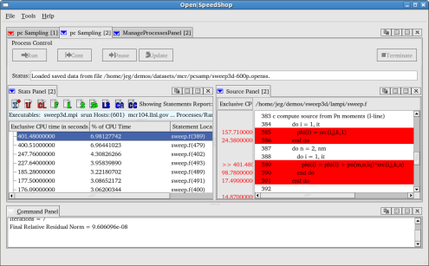
Open|SpeedShop
Performance Tool Status Update
Instrumentation Choices
Offline
MRNet
MPI Application
MPI Application
Easy setup
Low overhead
No additional resources
Higher portability
post-
mortem
O|SS
O|SS
Online analysis
Intermediate updates
Attach to running code
Optional aggregation

Slide 12
Open|SpeedShop
Performance Tool Status Update
Code Instrumentation
How does Open|SpeedShop collect performance data?
Offline/External Data Collection
  Instrument application at start-up
  Write data to raw data files to directories on shared file system
  After application completes, convert raw data to O|SS database
  Performance data available at end of execution.
Online Scalable Data Collection via Dyninst/MRNet
  Use Scalable transport layer (MRNet)
  Insert instrumentation (collectors) using Dyninst
  Performance data delivered directly to tool online via daemons
  Ability for interactive online analysis and viewing intermediate results

Slide 13
Open|SpeedShop
Performance Tool Status Update
What is new since last Paradyn Week update in 2008?
Moved away from DPCL to MRNet as online transport
Developed the offline mode of operation.
  Using libmonitor (Rice) to hook into application, monitor sys calls
  Link our collectors into the application to gather data
  Write raw data files, then create OSS database file
  Transitioned to having offline the default instrumentation mode
  Low start-up overhead and works well in batch environments
Continued to update the open source components we use
  sqlite, libdwarf, libunwind, libmonitor, Dyninst, MRNet, PAPI,…
Improved installation scripts, tools

Slide 14
Open|SpeedShop
Performance Tool Status Update
What is new since last Paradyn Week update in 2008? (2)
Usability Improvements
  Optional View window to select which metrics to be used to create the view
  Ability to quickly switch to function, statement, or library view
  Improvements (tool bar) for custom comparison view
  Integrated offline mode support into GUI wizards
  Created offline convenience scripts to hide the previous syntax
    osspcsamp, ossusertime, osshwc, osshwctime, ossio, ….
In general, tool is more robust. Has been exposed to more applications, compilers, job schedulers, MPI versions.

Slide 15
Open|SpeedShop
Performance Tool Status Update
What are we working on now?
Work on selected modularization of Open|SpeedShop
  Ability to build a viewer only version
  Ability to build only the runtime libraries and collectors
  Refactor runtime library component to be more modular
Porting Open|SpeedShop:
  Linux PPC
  BG/L and BG/P
  CNL: Cray-XT4 and Cray-XT5
Supporting current users and assisting new users
  Release updates
  New features and bug fixes to existing code

Slide 16
Open|SpeedShop
Performance Tool Status Update
What are we working on now?
Scalability Improvements
Integrate the latest versions of MRNet and Dyninst into Open|SpeedShop (CBTF project)
  Using Dyninst-6.1 and MRNet 2.2 beta for development
  More on this later in the talk
Component Based Tool Framework project
  Subject of next half of this talk

Slide 17
Open|SpeedShop
Performance Tool Status Update
Current Release and Status
Open|SpeedShop 1.9.3.3 available
  Packages and source from sourceforge.net
  Tested on a variety of platforms
Cray-XT, BG, and PPC versions coming soon
Open|SpeedShop website:
http://www.openspeedshop.org/
Download options:
  Package with Install Script (install.sh or install-oss)
  Source for tool and base libraries

Slide 18
Building a Community Infrastructure for Scalable
On-Line Performance Analysis Tools
Component Based Tool Framework
“CBTF”
Jim Galarowicz
Don Maghrak
The Krell Institute

Slide 19
Building a Community Infrastructure for Scalable On-Line Performance Analysis Tools
CBTF Agenda
Project Origin and Team
Project Rationale
Project Goals/Objectives
Research Challenges/Project Requirements
Performance Tools Pipeline
Project Results/Outcomes
Current Status

Slide 20
Building a Community Infrastructure for Scalable On-Line Performance Analysis Tools
Project Origin
Project Origin
  OASCR Proposal: "Building a Community Infrastructure for Scalable On-Line Performance Analysis Tools Around Open SpeedShop" for Software Development Tools for Improved Ease-of-Use of Petascale Systems
  Jointly funded by OASCR and NNSA
  Three year project

Slide 21
Building a Community Infrastructure for Scalable On-Line Performance Analysis Tools
Project Team
Project Team
  The Krell Institute
  University of Maryland
  University of Wisconsin
  Oak Ridge National Laboratory
  Lawrence Livermore National Laboratory
  Los Alamos National Laboratory
  Sandia National Laboratories
  Carnegie Mellon University
  Others welcome……

Slide 22
Building a Community Infrastructure for Scalable On-Line Performance Analysis Tools
Project Rationale
Why the need for the project?
  Petascale environments need tool sets that are flexible
  Need to quickly create new and specialized tools
  Better availability of tools across more platforms
  Need to avoid creating stove pipe tools

Slide 23
Building a Community Infrastructure for Scalable On-Line Performance Analysis Tools
Project Goals/Objectives
Project Goals/Objectives:
  Create a toolbox of components for building high-level end user tools and/or quickly build tool prototypes.
  Tools should be easily configurable/adjustable w/o rebuilding.
  Able to mix components from several groups and/or vendors. Everyone should be able to contribute and use the new components.
  We would like contributors to define the interfaces with us so that we can share components later in both directions.

Slide 24
Building a Community Infrastructure for Scalable On-Line Performance Analysis Tools
Project Goals/Objectives
Project Goals/Objectives:
  Research into efficient and effective online data aggregation, reduction, filtering, and data transfer
    MRNet
  Research lightweight data acquisition techniques
    Binary rewriting
  Assemble new tool components to create a more modular Open|SpeedShop performance tool
  Support BlueGene and Cray-XT platforms

Slide 25
Building a Community Infrastructure for Scalable On-Line Performance Analysis Tools
Research Challenges
Project Requirements
Research Challenges/Project Requirements:
  Components must be designed for scale but also have a need for generality.
  Support specialized tool components intended for serial or small scale usage.
  Infrastructure must support online data aggregation because of potentially high data volume at scale.
  Petascale machines are likely to have limited OS capabilities requiring new and light-weight data acquisition techniques.
  Must be able to efficiently store the performance data.
  Must be able to map any combination of tool components to the target architecture.

Slide 26
Building a Community Infrastructure for Scalable On-Line Performance Analysis Tools
Performance Analysis Pipeline

Slide 27
Building a Community Infrastructure for Scalable On-Line Performance Analysis Tools
Performance Tools Pipeline
Creating a first Performance Tools Pipeline prototype
  Start with Open|SpeedShop components as one set of examples for such an infrastructure.
  Decompose core components into general building blocks.
  Arrange building blocks into a logical performance analysis pipeline.
    Allows users and tool builders to select individual components for each pipeline stage.
    Supports a flexible mapping onto the target architecture which provides efficient execution and visualization (incl. remote operation) environments.

Slide 28
Building a Community Infrastructure for Scalable On-Line Performance Analysis Tools
Project Results/Deliverables
Project Results/Deliverables:
  Set of reusable components for creating performance tools
  Modified version of gprof using reusable components
  Components for online data aggregation, reduction, filtering, and transfer at high scale
  Tool or Open|SpeedShop experiment based on Active Harmony
  A new, more modular Open|SpeedShop performance tool
  Support for BlueGene and Cray-XT platforms
  Special purpose tool, based on need at ORNL

Slide 29
Building a Community Infrastructure for Scalable On-Line Performance Analysis Tools
Project Results/Outcomes
Dyninst/MRNet Features/Requirements/Desires
  Plan to use symtabAPI
  Plan to be using the MRNet lightweight library
  Plan to use the detach on the fly feature
  Plan to use the binary rewriter feature
  Would like a floating point register fix up feature
  Plan to use the “1st party” stackwalker API
  Plan to create an “new” OSS feature based on Active Harmony
  Plan to use MRNet transport mechanism

Slide 30
Building a Community Infrastructure for Scalable On-Line Performance Analysis Tools
Current Status
Current Status
  Open|SpeedShop team design meetings
  Holding extended CBTF team meetings to discuss ideas for component interfaces
  Created a CBTF wiki
  Started prototyping the component interface design
  Doing a number of improvements and decompositions in Open|SpeedShop in preparation to move to CBTF
  Plan to focus on transport components first

Slide 31
Building a Community Infrastructure for Scalable On-Line Performance Analysis Tools
Questions?
Questions?
jeg@krellinst.org
dpm@krellinst.org

Slide 32
Open|SpeedShop
Performance Tool Status Update
Open|SpeedShop Appendix
Open|SpeedShop Appendix
www.openspeedshop.org

Slide 33
Open|SpeedShop
Performance Tool Status Update
Running in Offline mode
pcsamp example
osspcsamp “<executable> <arguments>”
  One line command to gather PC Sampling results
  Note: “” around executable line
  Run command without extra arguments for help or view man page
Separate command for each experiment
  osspcsamp, ossusertime, osshwc, osshwctime
  ossio, ossiot, ossmpi, ossmpit, ossfpe
  Example Sequential run: (example run in following slides)
    osspcsamp “./smg2000 –n 80 80 80”
  Example multi-process run:
    ossmpi “mpirun -np 64 sweep3d.mpi”
Notes:
33
33
33

Slide 34
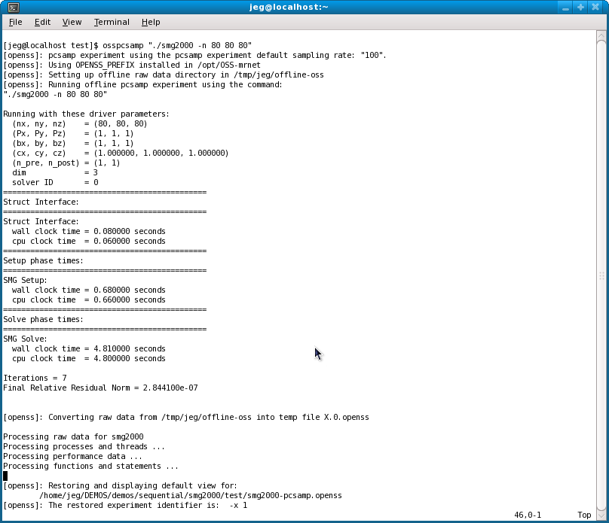
Open|SpeedShop
Performance Tool Status Update
Example Offline Run
With Output
osspcsamp “./smg2000 –n 80 80 80”
Application output
followed by OSS output
Notes:
34
34
34

Slide 35
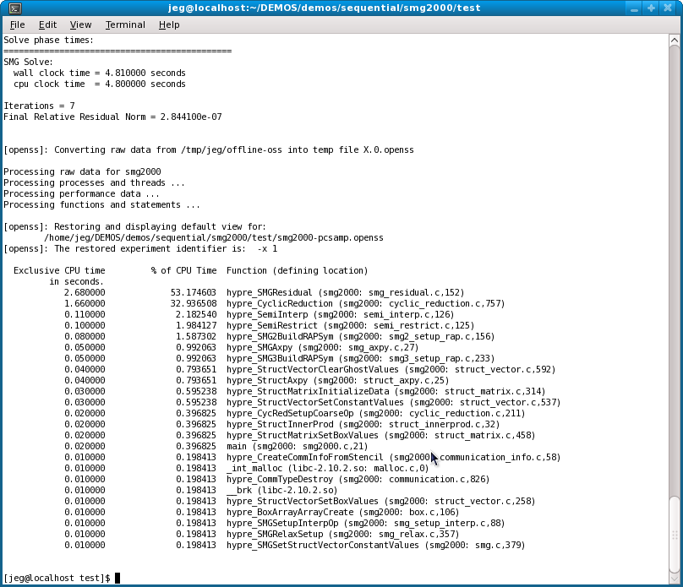
Open|SpeedShop
Performance Tool Status Update
Example Offline Run
With Output (2)
osspcsamp “./smg2000 –n 80 80 80”
Performance Data
Default view: by Function
Notes:
35
35
35

Slide 36
Open|SpeedShop
Performance Tool Status Update
Offline Experiment Outputs
Outputs from: osspcsamp “executable”
  Normal program output while executable is running
  The sorted list of performance information
    A list of the functions taking the most time
    The corresponding sample derived time for each function
  A performance information database file (.openss file)
    The database file contains all the information needed to view the data at anytime in the future without the executable(s).
      Symbol table information from executable(s) and system libraries
      Performance data openss gathered
      Time stamps for when dynamic shared libraries were loaded and unloaded
Notes:
36
36
36

Slide 37
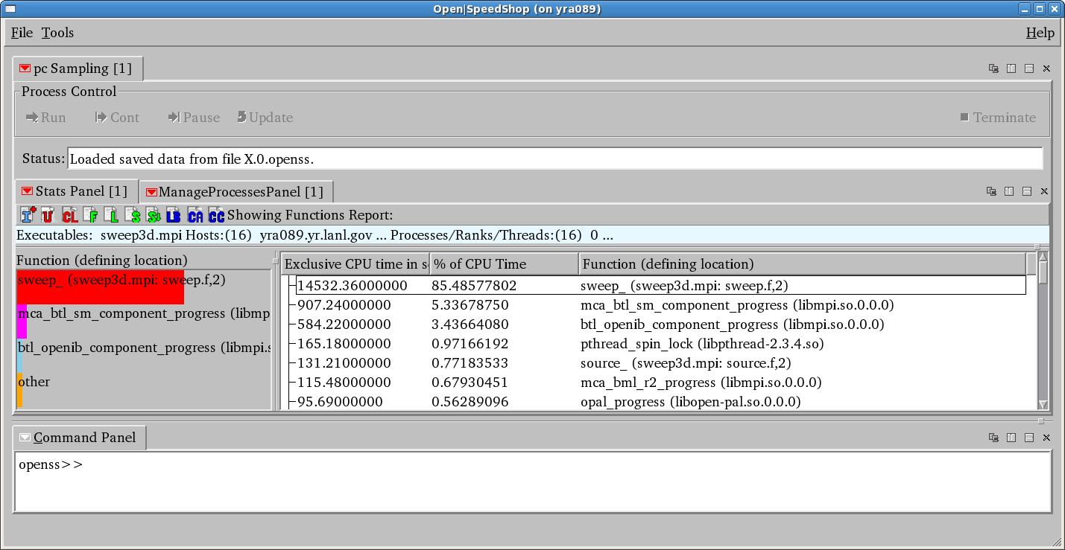
Open|SpeedShop
Performance Tool Status Update
Default GUI View
Toolbar to switch Views
Performance Data
Default view: by Function
Graphical Representation
Notes:
37
37
37

Slide 38
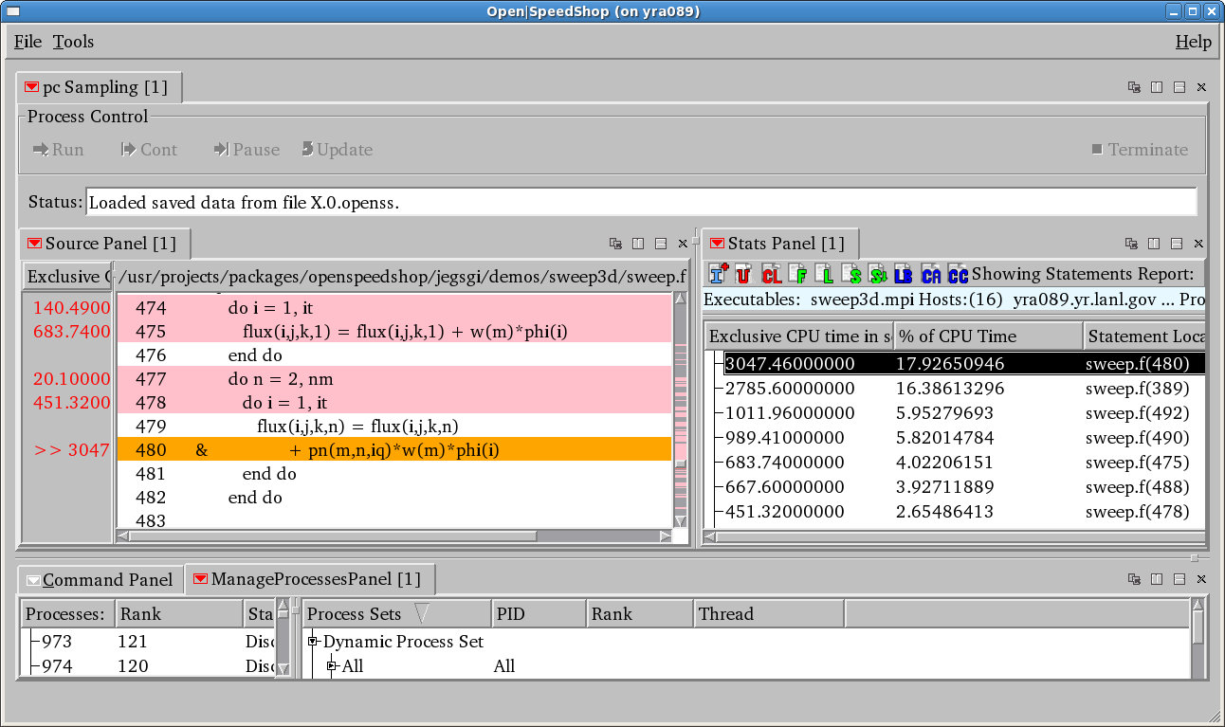
Open|SpeedShop
Performance Tool Status Update
Associate Source and Performance Data
Use window controls
to split/arrange windows
Double click to open
source window
Selected performance data point
Notes:
38
38
38

