Slide 1
Running Map-Reduce
Under Condor

Slide 2
Cast of thousands
Mihai Pop
Michael Schatz
Dan Sommer
  University of Maryland Center for Computational Biology
Faisal Khan, Ken Hahn UW
David Schwartz, LMCG

Slide 3
In 2003…
http://labs.google.com/papers/gfs.html
http://labs.google.com/papers/mapreduce.html

Slide 4
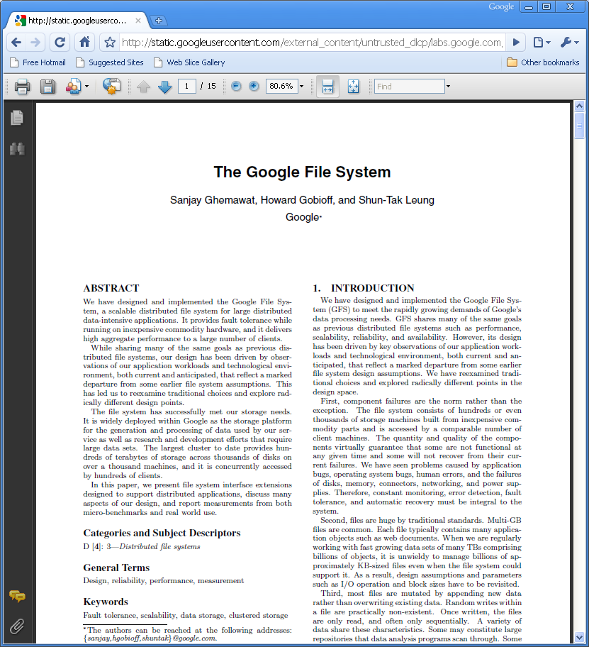

Slide 5
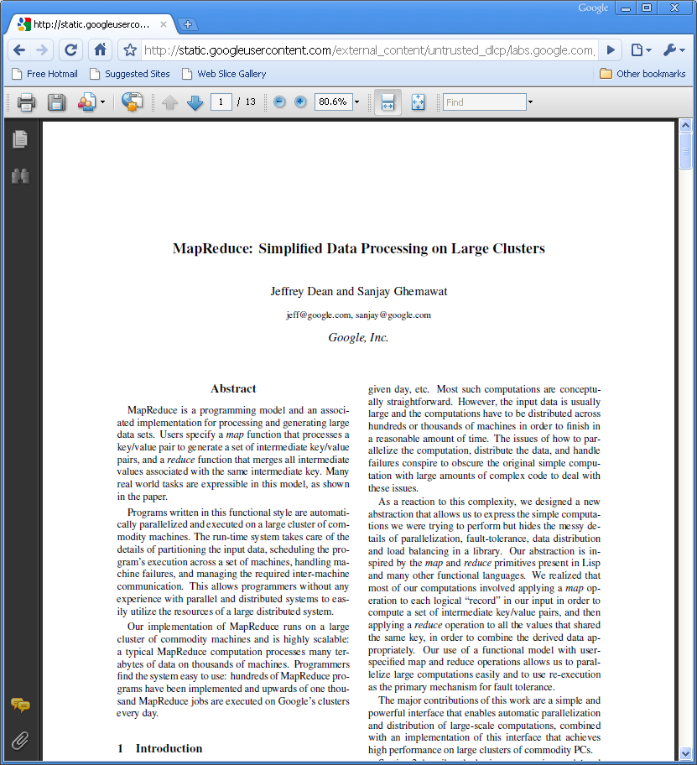

Slide 6

Shortly thereafter…

Slide 7



Two main Hadoop parts

Slide 8
For more detail
CondorWeek 2009 talk
Dhruba Borthakur
http://www.cs.wisc.edu/condor/CondorWeek2009/condor_presentations/borthakur-hadoop_univ_research.ppt

Slide 9


Slide 10
HDFS overview
Making POSIX distributed file system go fast is easy…

Slide 11
HDFS overview
…If you get rid of the POSIX part
Remove
  Random access
  Support for small files
  authentication
  In-kernel support

Slide 12
HDFS Overview
Add in
  Data replication
    (key for distributed systems)
  Command line utilities

Slide 13
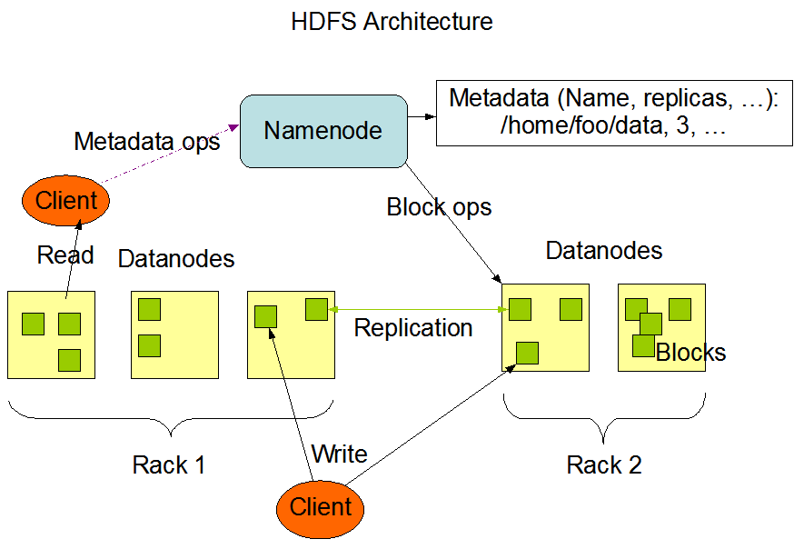
HDFS Architecture

Slide 14
HDFS Condor Integration
HDFS Daemons run under master
  Management/control
Added HAD support for namenode
Added host based security

Slide 15
Condor HDFS: II
File transfer support
transfer_input_files = hfds://…
Spool in hdfs

Slide 16
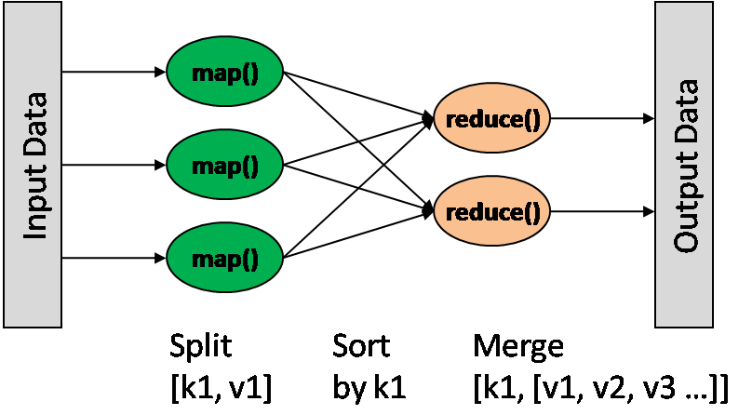
Map Reduce

Slide 17
Shell hackers map reduce
grep tag input | sort | uniq –c | grep

Slide 18
MapReduce lingo for the native Condor speaker
Task tracker → startd/starter
Job tracker → condor_schedd

Slide 19
Map Reduce under Condor
Zeroth law of software engineering
Job tracker/task tracker must be managed!
  Otherwise very bad things happen

Slide 20

Hadoop on Demand w/Condor

Slide 21
Map Reduce as overlay
Parallel Universe job
Starts job tracker on rank 0
Task trackers everywhere else
Open Question:
  Run more small jobs, or fewer bigger
One job tracker per user (i.e. per job)

Slide 22
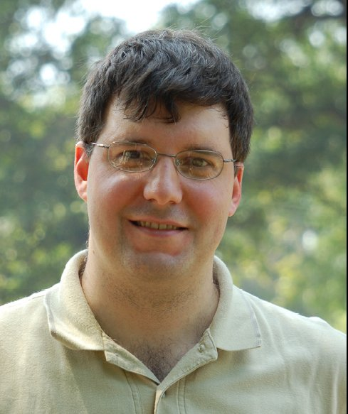

On to real science…
David Schwartz, matchmaker
Mihai Pop

Slide 23
Contrail – MR genome assembly
http://sourceforge.net/apps/mediawiki/contrail-bio/index.php

Slide 24
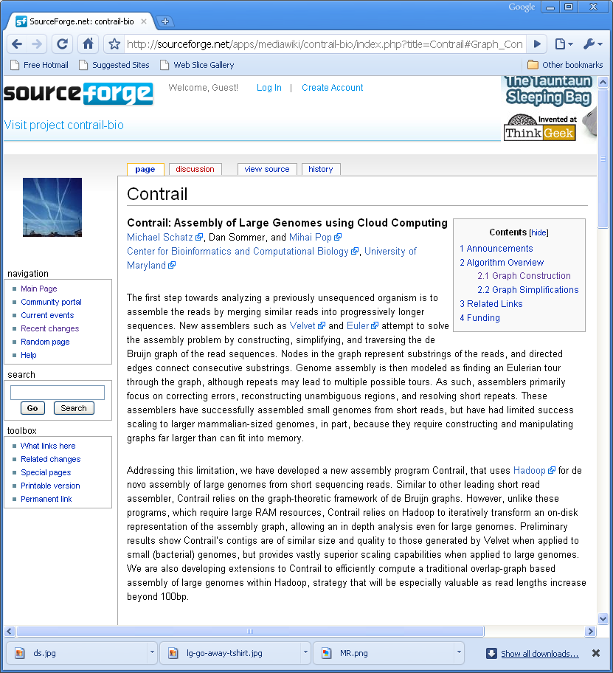
Genome assembly

Slide 25

DNA
3 Billion base pairs
Sequencing machines only read small reads at a time

Slide 26
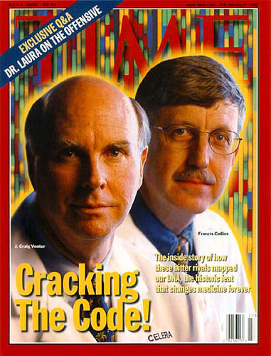
Already done this?

Slide 27
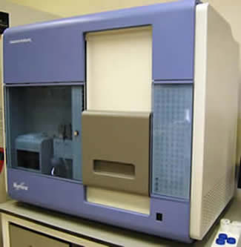
High throughput sequencers

Slide 28

Contrail
Scalable Genome Assembly with MapReduce
Genome: African male NA18507 (Bentley et al., 2008)
Input: 3.5B 36bp reads, 210bp insert (SRA000271)
Preprocessor: Quality-Aware Error Correction
Initial
Compressed
Error Correction
Resolve Repeats
Cloud Surfing
N
Max
N50
>10B
27
27
>1 B
303 bp
< 100 bp
5.0 M
14,007
650 bp
4.2 M
20,594
923 bp
In
Progress
.
Notes:
The figure shows incremental improvement of assembly (max = maximum size of fragments reconstructed, N50 – weighted median of reconstructed fragments) as assembly graph is iteratively transformed. Each box represents a different graph operation performed in parallel.

Slide 29
Running it under Condor
Used CHTC B-240 cluster
~100 machines
  8 way nehalem cpu
  12 Gb total
  1 disk partition dedicated to HDFS
  HDFS running under condor master

Slide 30
Running it on Condor
Used the MapReduce PU overlay
Started with Fruit Flies
…
And it crashed
Zeroth law of software engineering
  Version mismatch
Debugging…

Slide 31
Debugging
After a couple of debugging rounds
Fruit Fly sequenced!!
  On to humans!

Slide 32
Cardinality
How many slots per task tracker?
  Task tracker, like schedd multi-slots
One machine
  8 cores
  1 disk
  1 memory system
How many mappers per slot

Slide 33
More MR under Condor
More debugging, NPEs
Updated MR again
Some performance regressions
One power outage
12 weeks later…

Slide 34
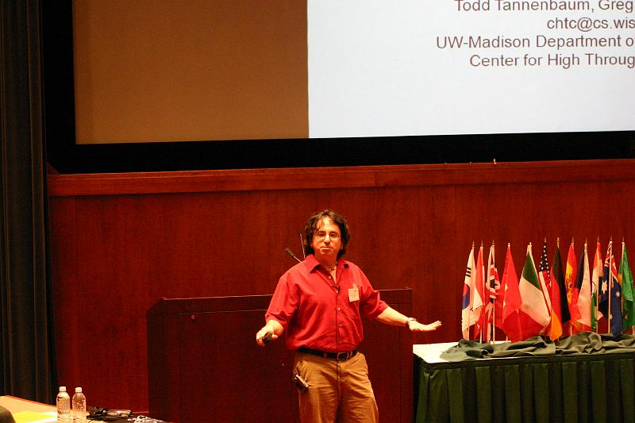
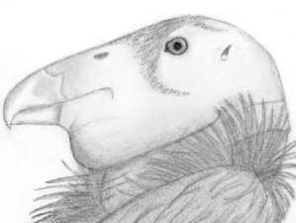
Success!

Slide 35



Slide 36
Conclusions
Job trackers must be managed!
  Glide-in is more than Condor on batch
Hadoop – more than just MapReduce
HDFS – good partner for Condor
All this stuff is moving fast

