Slide 1

Condor to Every
Corner of Campus
Condor Week 2010
Preston Smith
Purdue University
Notes:
Highlights on activities, accomplishments and todos

Slide 2
Outline
Campus Grids
Condor Nests at Purdue
  Central Clusters
  Computing Labs
  Departmental Resources
  TeraGrid
Budget Realities in 2010
  IT Cost Reduction
Spreading Wings Across Campus
  Making Condor Easy for IT
  Dashboard
Virtualization
  VMGlide

Slide 3
Campus Grids
Open Science Grid Campus Grids Workshop held in January
  Identified themes common to many Campus Grid implementations
    Barriers are often diplomatic rather than technological
At the core, a campus grid is a way for an institution to share resources, and maximize its investment in computing
  Many different ways to share resources
    Purdue, FermiGrid, GLOW, others all implement in their own way
http://www.isgtw.org/?pid=1002447
Notes:
Sharing resources, maximizing investment are the two key points

Slide 4
Community Clusters
Purdue’s model for resource sharing begins here
Peace of Mind
  Professional systems administration so faculty and graduate students can concentrate on research.
Low Overhead
  Central data center provides infrastructure such as networking, storage, racks, floor space, cooling, and power.
Cost Effective
  Works with vendors to obtain the best price for computing resources, pooling funds from different disciplines to leverage greater group purchasing power.
    Large purchases also leveraged for departmental server acquisitions

Slide 5
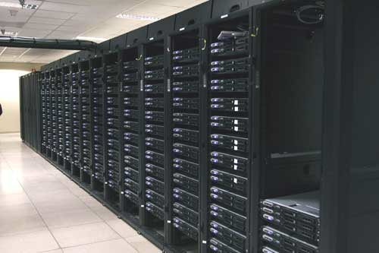
Community Clusters
Backfilling on idle HPC cluster nodes
  Condor runs on idle cluster nodes (nearly 16,000 cores today) when a node isn’t busy with PBS (primary scheduler) jobs

Slide 6
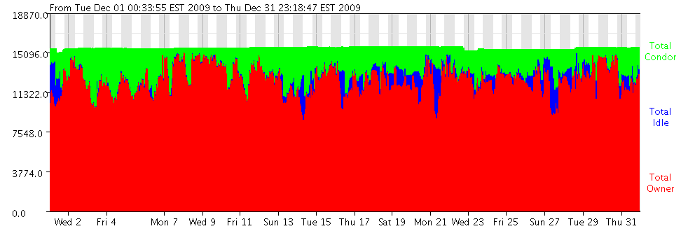
Central Cluster Usage
Maximizing value from investment
Condor: 15.7%
Harvesting 15% of this many
machines’ availability is
22 million potential hours per year!
PBS: 81%
Notes:
Condor is how we *share* the resources to campus, even if users don’t own pieces of the clusters

Slide 7
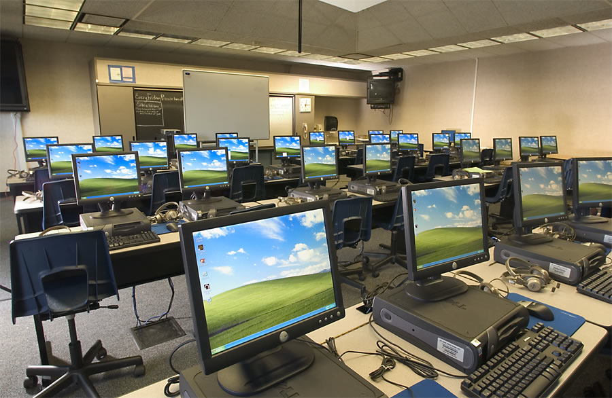
Student Labs
ITaP operates nearly 2000 lab machines used in classrooms, general student labs, and for departments.
  Nearly 6000 cores among those 2000 machines

Slide 8
Distributed IT
Less than half of IT at Purdue is centralized
  Remainder is in individual colleges and departments
  27,317 desktop machines at West Lafayette, relatively few of which are operated by ITaP
Many of these islands of IT are quite large
  Agriculture, Computer Science, Engineering, Management, Physical Facilities, Liberal Arts, Education
  1000+ machines each
    Many of these IT organizations are in the Condor Grid already
    But many are not…
This is where the room for growth is!

Slide 9
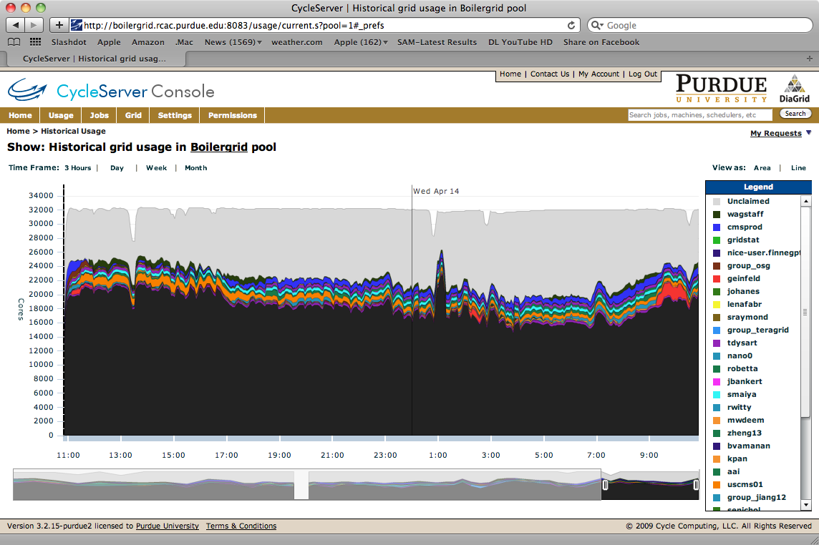
Grid Overview

Slide 10
TeraGrid
Purdue provides the campus Condor pool to the nation via the TeraGrid
  50% of jobs on TeraGrid in 2004-2006 were single-CPU
  Of those, 64% ran for an hour or less
    (Arvind Gopu of Indiana University – TG’07)
Robetta gateway, many others regularly use Purdue Condor on TeraGrid
Condor will continue to be a TeraGrid resource through the end of the TeraGrid project

Slide 11
Blah Blah Blah
You say “Sure, we’ve heard all this before.. What’s new?”

Slide 12
State Budgets in 2010
A common conversation on campuses today
  Higher Ed in Indiana has been directed to reduce budget by 5.5%
At Purdue, we have been given the following charge for IT:
  “Identifying cost savings approaches that will generate at least $15M recurring over time while providing high quality information technology (IT) services to meet the University’s strategic goals.”
    Data Centers
    Computer Labs
    Power Savings
    Strategic Sourcing for Purchasing

Slide 13
What does this have to do with Condor?
The Campus Grid ties into several of these areas
  Data Centers
    Building community clusters instead of private ones, and then maximizing usage with Condor
  Computer Labs
    Centralize management of labs – and run Condor on the machines
  Strategic Sourcing in purchasing
    For example, community cluster purchase for good pricing
  Power Savings
    Virtualized data centers, power off idle computers
    “Power credits” for running Condor

Slide 14
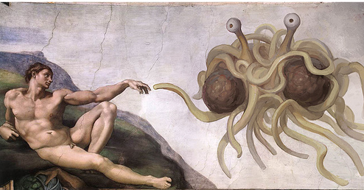
Power Off or Install Condor
Recommendations from committee report
  “Thou shalt turn off thy computer or install Condor and join the Campus Grid”
  “Thou should power-save your machines and we should find tools to manage their waking-up”

Slide 15

Power?
The Blue-Ribbon committee making recommendations probably didn’t know this..
But this also sounds like a job for Condor!
  Killing two “birds” with one stone
      Add machines to the Campus Grid – harvest the cycles, as already recommended
      Power-save machines by a policy
      Wake them up when needed

Slide 16

Now What?
Currently a “recommendation”, not quite a “policy” yet
What happens when it becomes a policy?
  The bet is that IT folks won’t want to shut their machines down overnight, when they’re currently do backups/software distribution/deep freezing….
  Expect a tsunami of demand coming our way

Slide 17
How to Prepare?
Host periodic on-campus Condor “Boot camp” for users and sysadmins
  These are very much like the User and Administrator tutorials many of you were in yesterday
    (Thanks to the Condor team for letting us base things off of their materials)
Ease of deployment
  Provide pre-configured binaries
    Windows, Linux (RHEL, Debian, Ubuntu, Fedora)
Configurability
  Centrally managing Condor Configurations on machines with distributed ownership
  … while leaving configuration also in the hands of the machine’s owners
Machine owners need to be confident that they remain in control of how their machines are used.
  Condor is perfect for this!
Scoreboard:
  “My Dean wants to know how much work our machines have provided”
  The president asks how much work her individual machine has done
Security questions?

Slide 18

Manageability
So, given:
  Thousands upon thousands of Windows lab machines, or all sorts of machines around campus that my staff don’t administratively control..
How do we manage Condor on them?
PLUG ALERT
We use Cycle Computing’s CycleServer
VM appliances are configured to report in to CycleServer for management
As are the native OS installers that we distribute
Notes:
Example for windows.. We wanted to turn on the setting to use TCP to update the collector on ALL windows nodes
Or set up a classad for each machine to advertise their “owner”

Slide 19
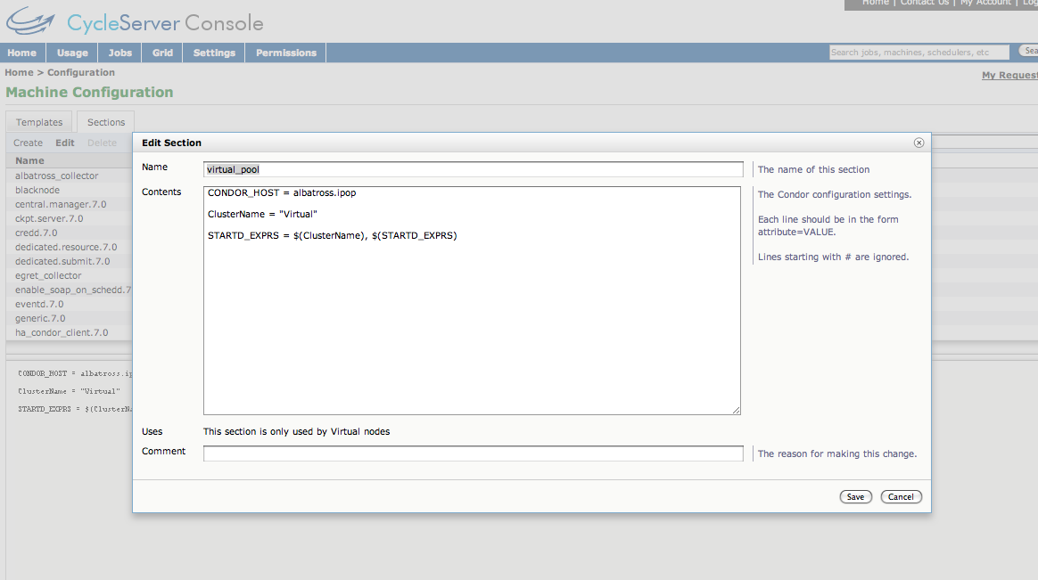
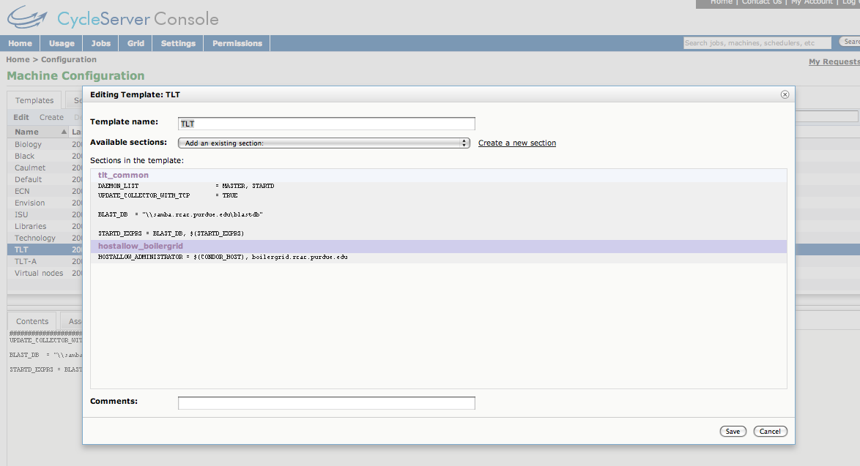
Managing Configurations
Around Campus

Slide 20
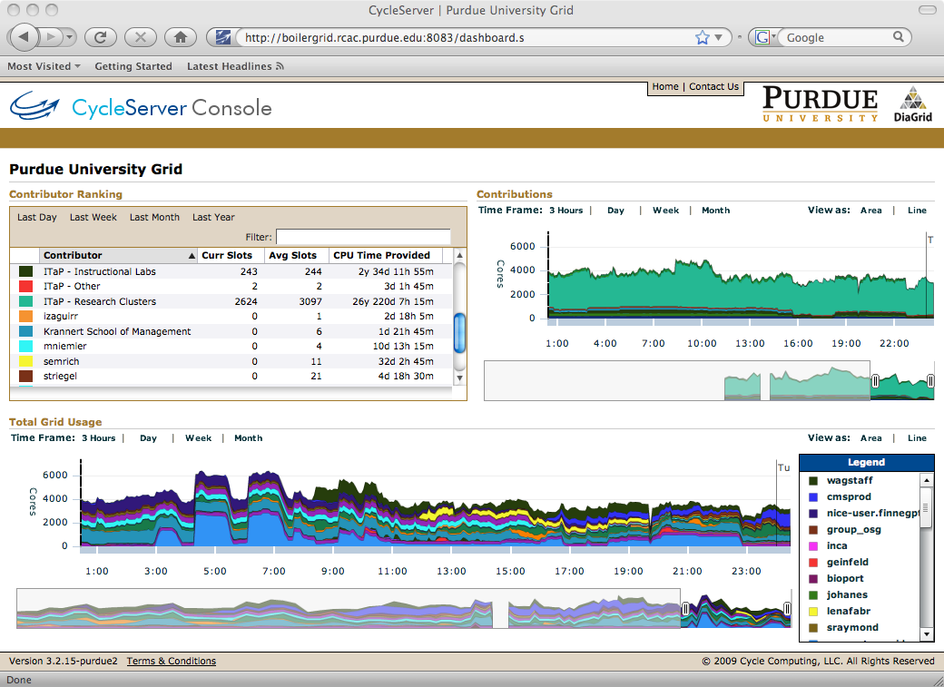
Scoreboard
A common question –
  How much work has my machine done for Condor?
    Even the president has asked…
  System-tray application (a la condor_birdwatcher) being developed to query startd history to answer that very question.
For an high-level view:
  CondorView is helpful, but not quite what we want
  CycleServer has been able to help

Slide 21
F A’d Qs about Security
Can any ding-dong submit any code to my machine?
  No – only specific machines with access limited to people with Purdue Career Accounts run a schedd
Ok, fine, but what if they submit something nasty to our machine?
  Then we know who they are and go club them with the appropriate IT policies.
What about data on our faculty members’ workstations Is it safe? Could a job steal it?
  Well, maybe. Are their file permissions set appropriately?

Slide 22
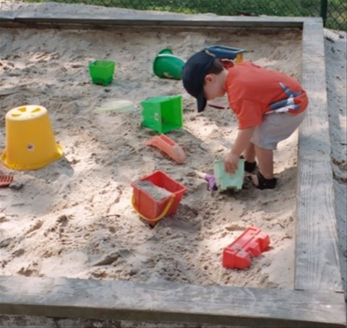
Sandbox
College of Engineering asks –
  Can we sandbox Condor jobs away from the execution host?
We think “sure” – and it’ll also make those Windows boxes more generally useful.
  Maximizing investment again

Slide 23
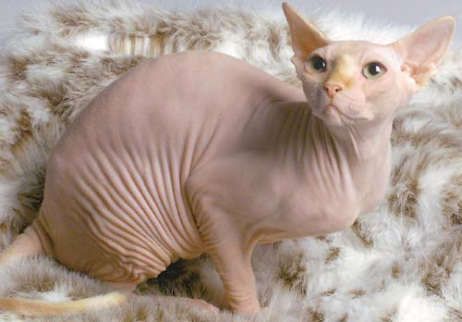
Condor in VM appliances
Many ways to skin that cat
  CoLinux from several years ago
  Marquette from a few minutes ago
  Condor as a virtual machine manager from a few minutes before that
Some effort spent similar to what Marquette’s doing
But mostly on what we’ve dubbed VM-Glide
  Using Condor to submit VM “nodes” as jobs to the lab machines
  Lab machines run VMWare workstation –
    Which is ok for Universities to use for “instruction and research” and for “grid and utility computing” if you enroll in a partner program

Slide 24
VM-Glide
Our solution is based on the Grid Appliance infrastructure from Florida’s ACIS lab
IPOP P2P network fabric
  Solves NAT issues and IP space problems that come with bridged networking
  No requirement for single VPN router to connect real network with the virtual overlay network.
  See talk from Condor Week 2009
We only need to run IPOP services (a userland application) on all central submit nodes to access nodes in the virtual pool

Slide 25
How well did this work?
Set up a dedicated schedd with lots of disk to hand out VMs to student labs
  (Fast) disk is important – checkpointing memory adds up!
Configure lab machines to claim the entire machine when a single VM Universe job runs
  Apparently users notice when 4 or more VMs try and evict when they sit down
Now we’re cooking – got nearly 1000 VMs running in labs over a weekend
  All of which are running user jobs
  IPOP fabric holds up great

Slide 26
So, you run this all the time now, right?
Well, not quite
  Even with just 1 VM per machine, vacating is still noticeable by the end users
  Lab admins say: “Maybe it’s the 100Mbit connection the machines are on”.
After we cried a little inside..
  How to deal with this?
    Use squids local to labs to cache VM images?
      Nope, the lab network architecture doesn’t lend to that
    Pre-stage VMs on machines and just start with Condor?
      Nope, VM-GAHP doesn’t actually let you do that.
    Upgrade network in labs?
      Cost-prohibitive – switch gear is old enough that it’s not gigabit capable

Slide 27
Next steps?
Fortunately, a campus network upgrade is in progress
  With new switches, will benchmark again
Lab admins enabling vt support in BIOS
  Allow for 64-bit VMs (more jobs want this)
  Will probably make VMWare run faster, too
Pre-stage VMs
  Hack the VM-GAHP to start pre-staged VMs
  Or use a file transfer plugin to copy from local hard drive

Slide 28
What’s Next
We expect to add Condor to machines from all across campus
  And system-wide..
We hope to use Condor as the tool to manage power on machines across campus
Virtualization of compute environments will be a key characteristic of this environment
  In labs and desktops, as well as on cluster nodes (KVM)
Thanks to the Condor Team for all the Software!

Slide 29
The End
Questions?
http://www.rcac.purdue.edu

