Slide 1
Dryad and DryadLINQ for data-intensive research
(and a bit about Windows Azure)
Condor Week 2010, Madison, WI
Christophe Poulain
Microsoft Research

Slide 2
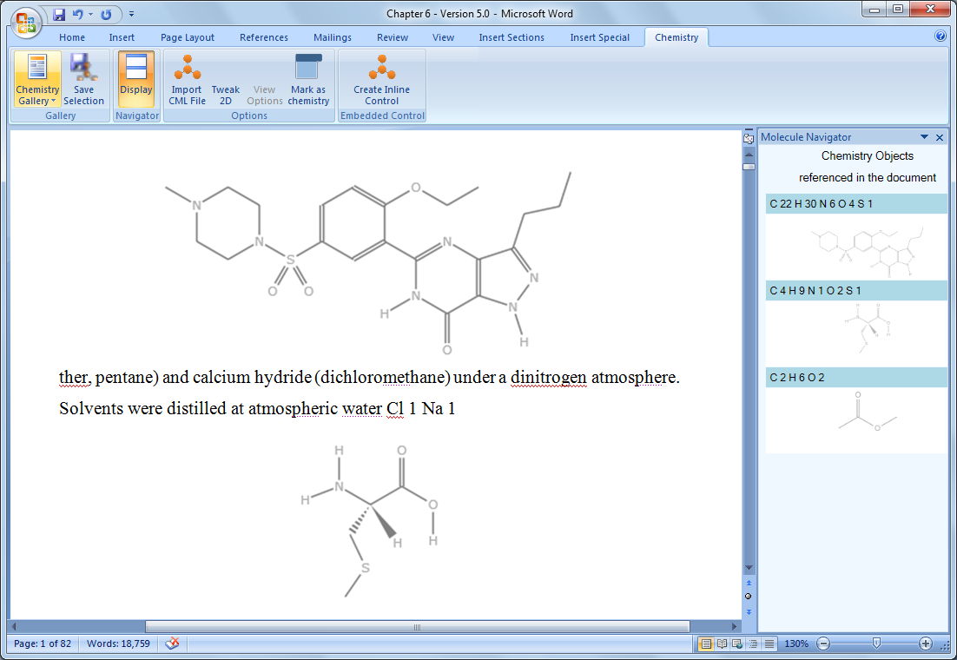
An Introduction
Microsoft External Research
Tony Hey, Corporate VP
Work with the academic and research community to speed research, improve education, foster innovation, and improve lives around the world.
Core Computer Science
Earth, Energy &
Environment
Education & Scholarly Communication
Health & Wellbeing
Advanced Research Tools and Services
http://research.microsoft.com/collaboration/tools
One of our aim is to help scientists spend less time on IT issues and more time on discovery by creating open tools and services based on Microsoft platforms and productivity software

Slide 3
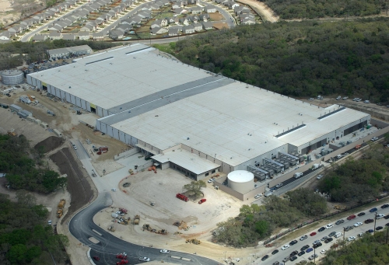
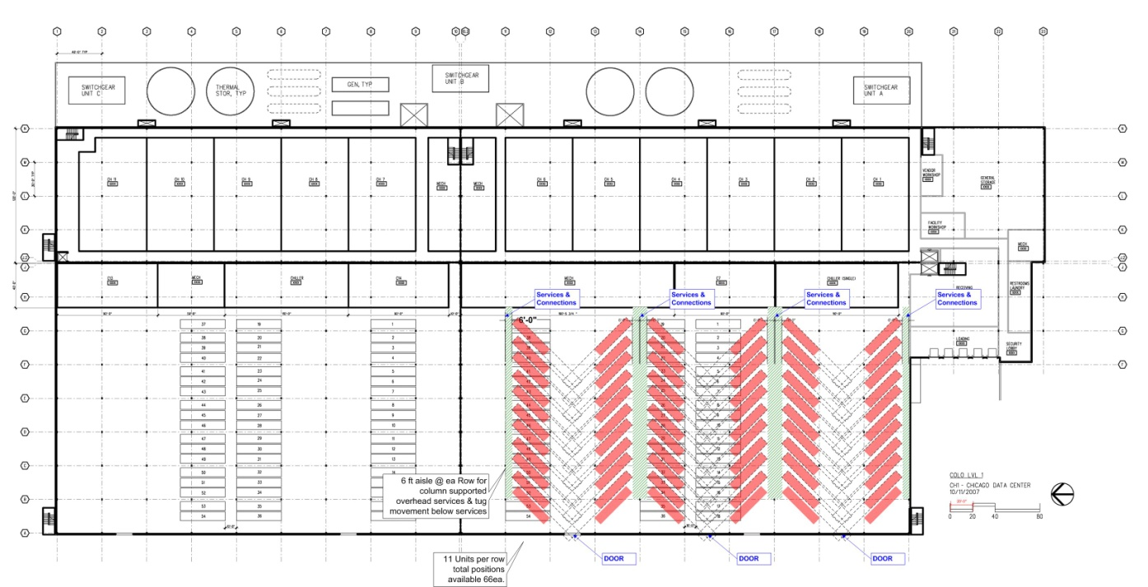
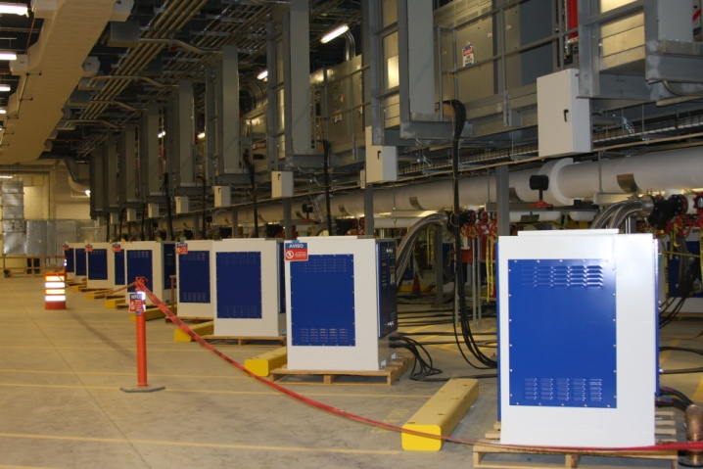
Windows Azure
It is Microsoft’s cloud services platform, designed to host web services and applications in Microsoft-owned, Internet-accessible data centers.
112 containers x 2000 servers = 224000 servers

Slide 4
A Spectrum of Application Models
Constraints in the App Model
Less Constrained
More Constrained
Amazon AWS
VMs Look Like Hardware
No Limit on App Model
User Must Implement Scalability and Failover
Microsoft Azure
.NET CLR/Windows Only
Choice of Language
Some Auto Failover/ Scale (but needs declarative application properties)
Google App Engine
Traditional Web Apps
Auto Scaling and Provisioning
Force.Com
SalesForce Biz Apps
Auto Scaling and Provisioning
Automated Management Services
Less Automation
More Automation

Slide 5
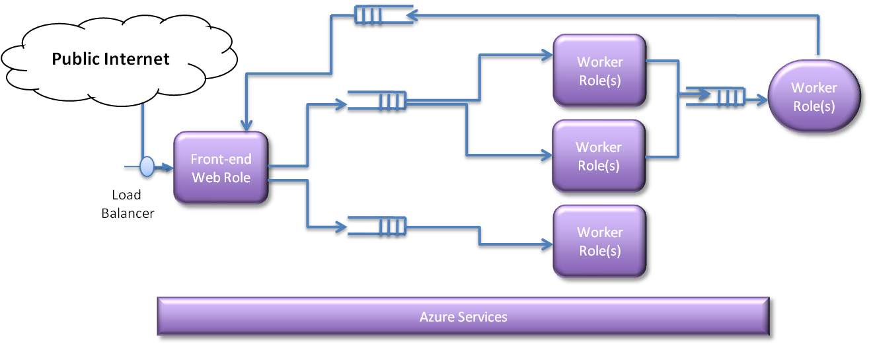
Windows Azure Compute and Storage Services
Compute Services
  Web Roles provide web service access to the app by the users. Web roles generate tasks for worker roles
  Worker Roles do “heavy lifting” and manage data in tables/blobs
  Communication is through queues.
  Roles are replicated as needed to provide massive scalability.
Storage Services
Blobs: large, unstructured data (blobs in containers)
Tables: massive amounts of simply structured data (entity with properties)
Queues: messages or requests, allowing web-roles and worker-roles to interact
Drives: durable NTFS file system volumes sharable across instances
SQL Azure for relational data

Slide 6
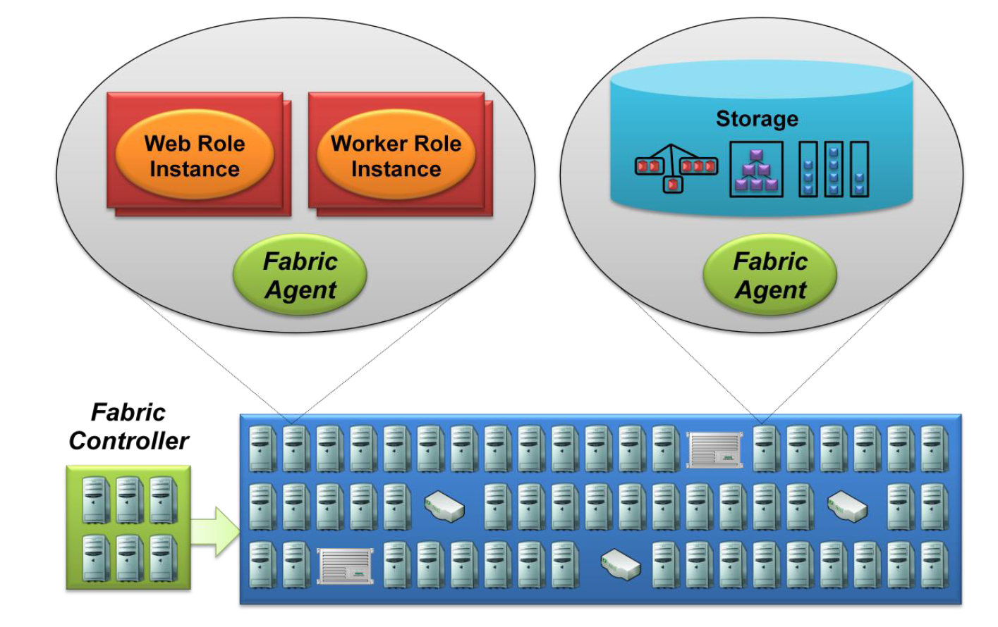
The Azure Fabric
Consists of a (large) group of machines all managed by software called the fabric controller
The fabric controller is replicated across a group of five to seven machines and owns all of the resources in the fabric
Because it can communicate with a fabric agent on every computer, the controller is aware of every Windows Azure application running on the fabric
It manages Windows Azure services and hosted applications (load balancing, backup, replication, failover, scale up/down...)

Slide 7
Characteristics of a Windows Azure Application
Immediate
  A credit card vs an e-mail to get started. No waiting.
Persistent
  Most applications run continuously
  Other applications are just fine
Scalable
  Meet demands for compute and storage paying as you go
  Scale according to needs
    Thousands concurrent users served by one application.
    One application using thousands of cores.

Slide 8
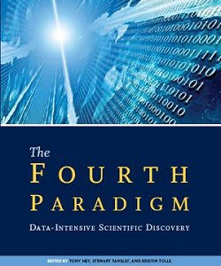
Emergence of a Fourth Research Paradigm
Thousand years ago – Experimental Science
  Description of natural phenomena
Last few hundred years – Theoretical Science
  Newton’s Laws, Maxwell’s Equations…
Last few decades – Computational Science
  Simulation of complex phenomena
Today – Data-Intensive Science
  Scientists overwhelmed with data sets
  from many different sources
    Data captured by instruments
    Data generated by simulations
    Data generated by sensor networks
  eScience is the set of tools and technologies
  to support data federation and collaboration
    For analysis and data mining
    For data visualization and exploration
    For scholarly communication and dissemination
Science must move from data to information to knowledge
With thanks to Tony Hey
With thanks to Jim Gray

Slide 9


Dryad and DryadLINQ
Research programming models for writing distributed data-parallel applications that scale from a small cluster to a large data-center.
A DryadLINQ programmer can use thousands of machines, each of them with multiple processors or cores, without prior knowledge in parallel programming.
Download available at http://connect.microsoft.com/DryadLINQ

Slide 10
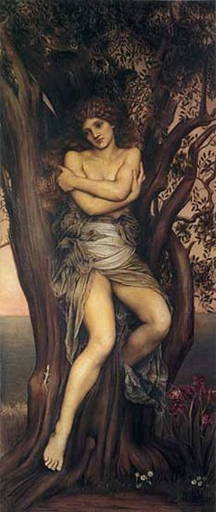
Dryad
Continuously deployed since 2006
Running on >> 10⁴ machines
Sifting through > 10Pb data daily
Runs on clusters > 3000 machines
Handles jobs with > 10⁵ processes each
Platform for rich software ecosystem
Used by >> 100 developers
Written at Microsoft Research, Silicon Valley

Slide 11

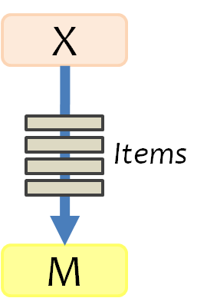
Dryad Job Structure
Channels
Input
files
Stage
Output
files
grep
sort
awk
sed
perl
grep
sort
sed
awk
grep
sort
Vertices
(processes)
Channel is a finite streams of items
NTFS files (temporary)
TCP pipes (inter-machine)
Memory FIFOs (intra-machine)

Slide 12

Dryad System Architecture
data plane
job schedule
Files, TCP, FIFO, Network
V
V
V
NS
PD
PD
PD
Job manager
control plane
cluster

Slide 13
Dryad Properties
Provides a general, clean execution layer
  Dataflow graph as the computation model
  Higher language layer supplies graph, vertex code, channel types, hints for data locality, …
Automatically handles execution
  Distributes code, routes data
  Schedules processes on machines near data
  Masks failures in cluster and network
But programming Dryad is not easy

Slide 14
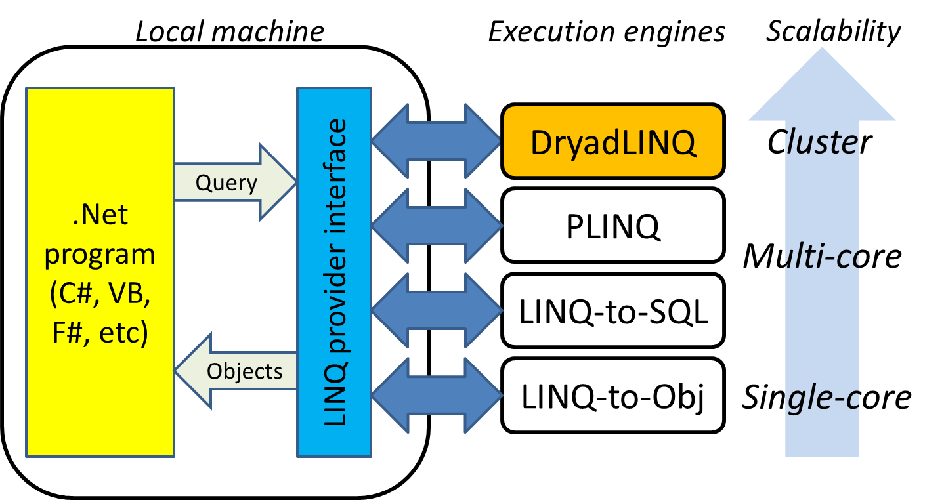
DryadLINQ Experience
  Sequential, single machine programming abstraction
  Same program runs on single-core, multi-core, or cluster
  Familiar programming languages
  Familiar development environment

Slide 15
LINQ
Microsoft’s Language INtegrated Query
  Released with .NET Framework 3.5, Visual Studio optional
A set of operators to manipulate datasets in .NET
  Support traditional relational operators
    Select, Join, GroupBy, Aggregate, etc.
  Integrated into .NET programming languages
    Programs can call operators
    Operators can invoke arbitrary .NET functions
Data model
  Data elements are strongly typed .NET objects
  Much more expressive than SQL tables
Extremely extensible
  Add new custom operators
  Add new execution providers

Slide 16
Example of LINQ Query
IEnumerable<string> logs = GetLogLines();
var logentries =
from line in logs
where !line.StartsWith("#")
select new LogEntry(line);
var user =
from access in logentries
where access.user.EndsWith(@"\ulfar")
select access;
var accesses =
from access in user
group access by access.page into pages
select new UserPageCount("ulfar", pages.Key, pages.Count());
var htmAccesses =
from access in accesses
where access.page.EndsWith(".htm")
orderby access.count descending
select access;

Slide 17

DryadLINQ Data Model
.Net objects
Partition
PartitionedTable<T>
PartitionedTable<T> implements IQueryable<T> and IEnumerable<T>

Slide 18
A complete DryadLINQ program
public class LogEntry {
public string user;
public string ip;
public string page;
public LogEntry(string line) {
string[] fields = line.Split(' ');
this.user = fields[8];
this.ip = fields[9];
this.page = fields[5];
}
}
public class UserPageCount{
public string user;
public string page;
public int count;
public UserPageCount(
string user, string page, int count) {
this.user = user;
this.page = page;
this.count = count;
}
}
PartitionedTable<string> logs = PartitionedTable.Get<string>(
@”file:\\MSR-SCR-DRYAD01\DryadData\cpoulain\logfile.pt”
);
var logentries =
from line in logs
where !line.StartsWith("#")
select new LogEntry(line);
var user =
from access in logentries
where access.user.EndsWith(@"\ulfar")
select access;
var accesses =
from access in user
group access by access.page into pages
select new UserPageCount("ulfar", pages.Key, pages.Count());
var htmAccesses =
from access in accesses
where access.page.EndsWith(".htm")
orderby access.count descending
select access;
htmAccesses.ToPartitionedTable(
@”file:\\MSR-SCR-DRYAD01\DryadData\cpoulain\results.pt”
);
Notes:
18

Slide 20
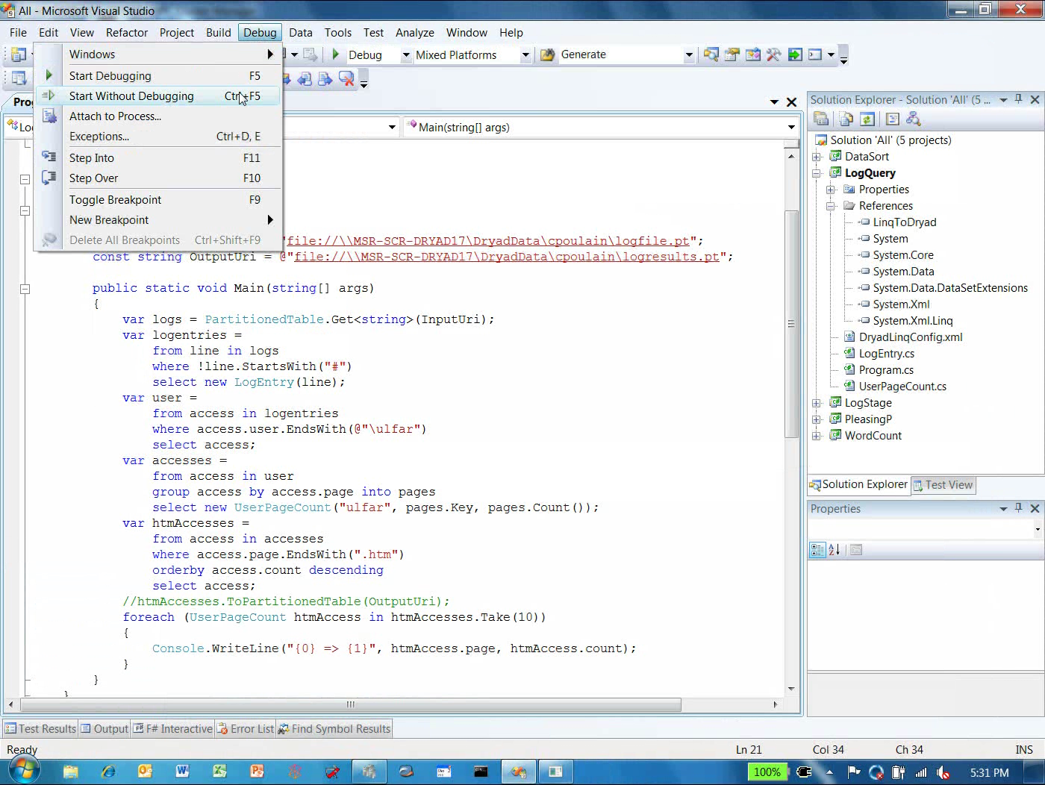

Slide 21

DryadLINQ Provider
Collection<T> collection;
bool IsLegal(Key k);
string Hash(Key);
var results = from c in collection
where IsLegal(c.key)
select new { Hash(c.key), c.value};
Vertex
code
Query
plan
(Dryad job)
Data
collection
C#
C#
C#
C#
results

Slide 22
Map-Reduce in DryadLINQ
public static IQueryable<S> MapReduce<T,M,K,S>(
this IQueryable<T> input,
Func<T, IEnumerable<M>> mapper,
Func<M,K> keySelector,
Func<IGrouping<K,M>,S> reducer)
{
var map = input.SelectMany(mapper);
var group = map.GroupBy(keySelector);
var result = group.Select(reducer);
return result;
}

Slide 23
Map-Reduce Plan
M
M
M
M
M
M
M
map
Q
Q
Q
Q
Q
Q
Q
sort
G₁
G₁
G₁
G₁
G₁
G₁
G₁
groupby
map
M
R
R
R
R
R
R
R
reduce
D
D
D
D
D
D
D
distribute
G
R
MS
MS
MS
MS
MS
mergesort
groupby
X
G₂
G₂
G₂
G₂
G₂
partial aggregation
R
R
R
R
R
reduce
X
X
X
MS
MS
mergesort
static
dynamic
dynamic
G₂
G₂
groupby
reduce
S
S
S
S
S
S
R
R
reduce
A
A
A
X
X
consumer
T

Slide 24

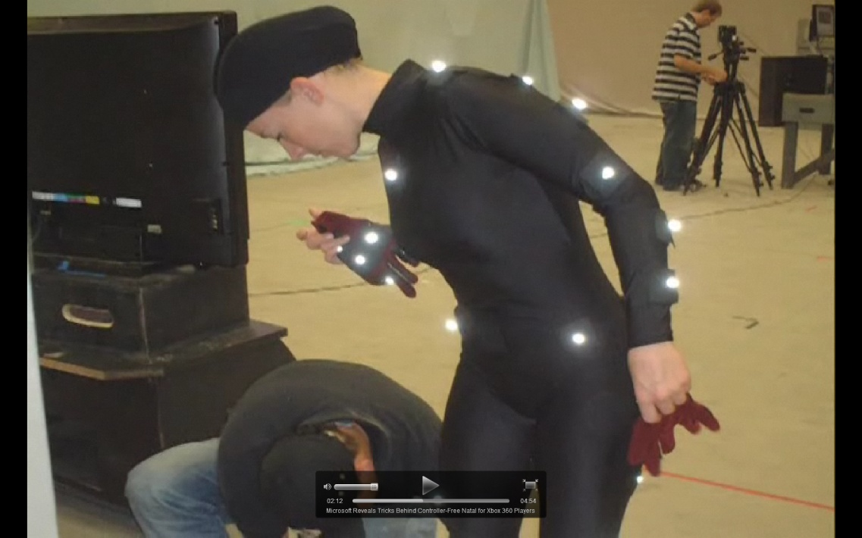



Project Natal: Learning From Data
Project Natal is using DryadLINQ to train enormous decision trees from millions of images across hundreds of cores.
Training examples
Rasterize
Motion Capture
(ground truth)
Machine
learning
Classifier
Recognize players from depth map at frame rate using fraction of Xbox CPU.

Slide 25
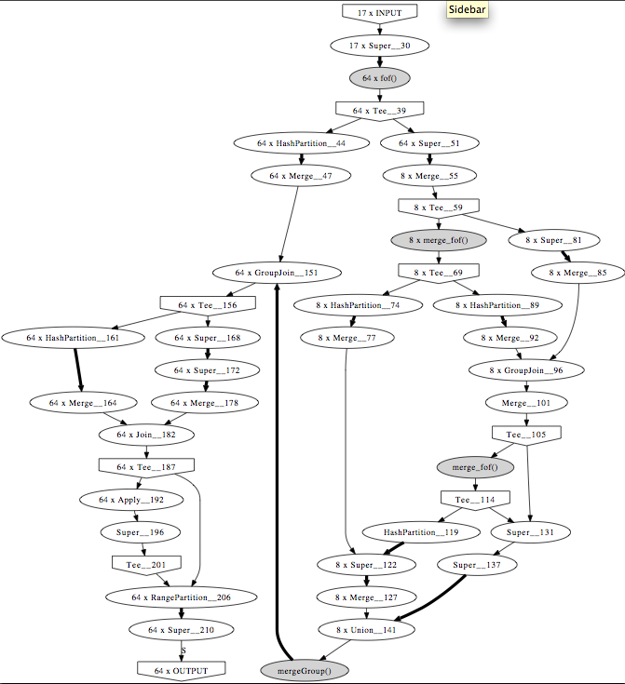
Scalable clustering algorithm for N-body simulations in a shared-nothing cluster
YongChul Kwon, Dylan Nunley, Jeffrey P. Gardner, Magdalena Balazinska, Bill Howe, and Sarah Loebman. UW Tech Report. UW-CSE-09-06-01. June 2009.
Large-scale spatial clustering
  916M particles in 3D clustered under 70 minutes with 8 nodes.
Re-implemented using DryadLINQ
  Partition > Local cluster > Merge cluster > Relabel
  Faster development and good scalability

Slide 26


CAP3 - DNA Sequence Assembly Program [1]
EST (Expressed Sequence Tag) corresponds to messenger RNAs (mRNAs) transcribed from the genes residing on chromosomes. Each individual EST sequence represents a fragment of mRNA, and the EST assembly aims to re-construct full-length mRNA sequences for each expressed gene.
Input files (FASTA)
Cap3data.pf
\DryadData\cap3\cap3data
10
0,344,CGB-K18-N01
1,344,CGB-K18-N01
…
9,344,CGB-K18-N01
V
V
Cap3data.00000000
\\GCB-K18-N01\DryadData\cap3\cluster34442.fsa
\\GCB-K18-N01\DryadData\cap3\cluster34443.fsa
...
\\GCB-K18-N01\DryadData\cap3\cluster34467.fsa
Output files
Input files
(FASTA)
IQueryable<LineRecord> inputFiles=PartitionedTable.Get<LineRecord>(uri);
IQueryable<OutputInfo> = inputFiles.Select(x=>ExecuteCAP3(x.line));
[1] X. Huang, A. Madan, “CAP3: A DNA Sequence Assembly Program,” Genome Research, vol. 9, no. 9, 1999.

Slide 27
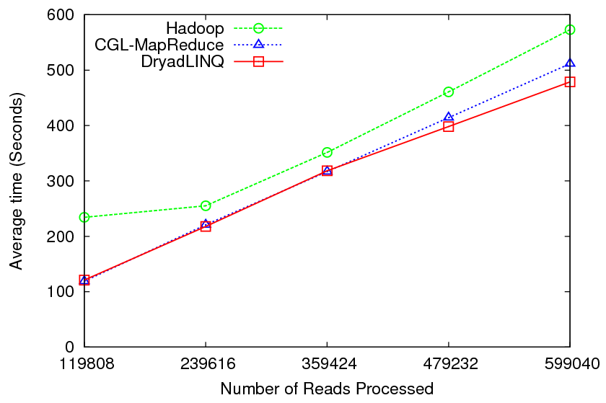
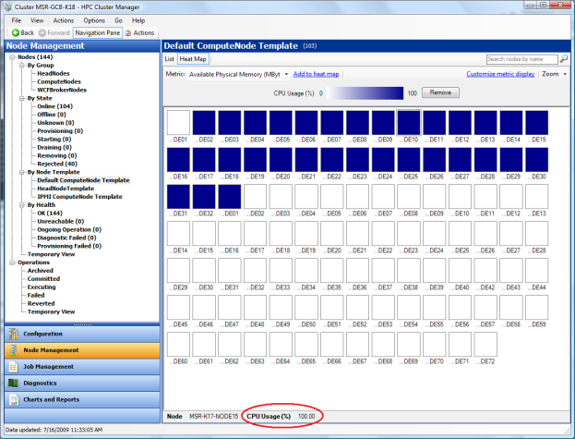
CAP3 - Performance
“DryadLINQ for Scientific Analyses”, Jaliya Ekanayake, Thilina Gunarathnea, Geoffrey Fox, Atilla Soner Balkir, Christophe Poulain, Nelson Araujo, Roger Barga (IEEE eScience ‘09)

Slide 28
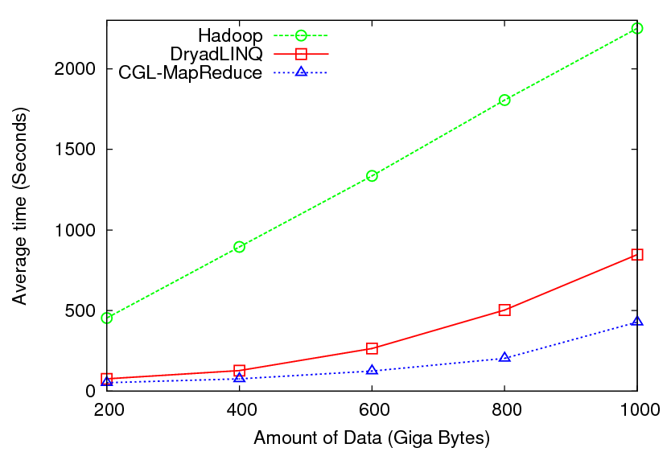
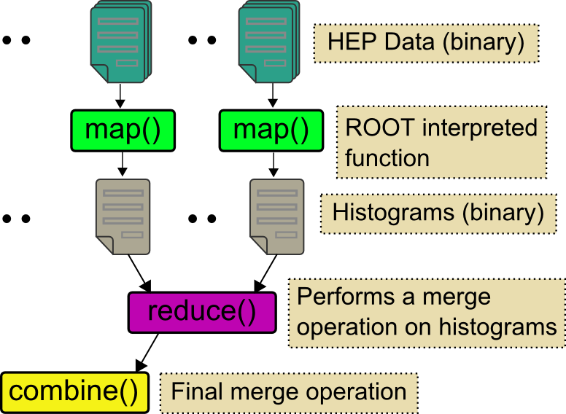
High Energy Physics Data Analysis
Histogramming of events from a large (up to 1TB) data set
Data analysis requires ROOT framework (ROOT Interpreted Scripts)
Performance depends on disk access speeds
Hadoop implementation uses a shared parallel file system (Lustre)
  ROOT scripts cannot access data from HDFS
  On demand data movement has significant overhead
Dryad stores data in local disks giving better performance over Hadoop

Slide 29
Parting Thought #1
Windows Azure is Microsoft’s cloud platform
  http://www.microsoft.com/windowsazure/
To Condor, this looks like one more resource to harness

Slide 30
Parting Thought #2
DryadLINQ provides a powerful, elegant programming environment for large-scale data-parallel computing.
Is this of interest to the Condor community?

Slide 31
Acknowledgements
MSR Silicon Valley Dryad & DryadLINQ teams
Andrew Birrell, Mihai Budiu, Jon Currey, Ulfar Erlingsson, Dennis Fetterly, Michael Isard, Pradeep Kunda, Mark Manasse, Chandu Thekkath and Yuan Yu .
http://research.microsoft.com/en-us/projects/dryad
http://research.microsoft.com/en-us/projects/dryadlinq
MSR External Research
Advanced Research Tools and Services Team
http://research.microsoft.com/en-us/collaboration/tools/dryad.aspx
MS Product Groups: HPC, Parallel Computing Platform.
Academic Collaborators
  Jaliya Ekanayake, Geoffrey Fox, Thilina Gunarathne, Scott Beason, Xiaohong Qiu (Indiana University Bloomington).
  YongChul Kwon, Magdalena Balazinska (University of Washington).
  Atilla Soner Balkir, Ian Foster (University of Chicago).

Slide 32
Dryad/DryadLINQ Papers
Dryad: Distributed Data-Parallel Programs from Sequential Building Blocks (EuroSys’07)
DryadLINQ: A System for General-Purpose Distributed Data-Parallel Computing Using a High-Level Language (OSDI’08)
Hunting for prolems with Artemis (Usenix WASL, San Diego 08)
Distributed Data-Parallel Computing Using a High-Level Programming Language (SIGMOD’09)
Quincy: Fair scheduling for distributed computing clusters (SOSP’09)
Distributed Aggregation for Data-Parallel Computing: Interfaces and Implementations (SOSP’09)
DryadInc: Reusing work in large scale computation (HotCloud 09).

Slide 33
Extra Slides

Slide 34
Software Stack
Machine
Learning
Image
Processing
Graph
Analysis
…
Data
Mining
Applications
Other Applications
DryadLINQ
Other Languages
Dryad
CIFS/NTFS
SQL Servers
Azure Storage
Cosmos DFS
Cluster Services (Azure, HPC, or Cosmos)
Windows Server
Windows Server
Windows Server
Windows Server

Slide 35
Design Space
Grid
Internet
Data-
parallel
Search
Dryad
Shared
memory
Private
data
center
Transaction
HPC
Latency
Throughput

Slide 36
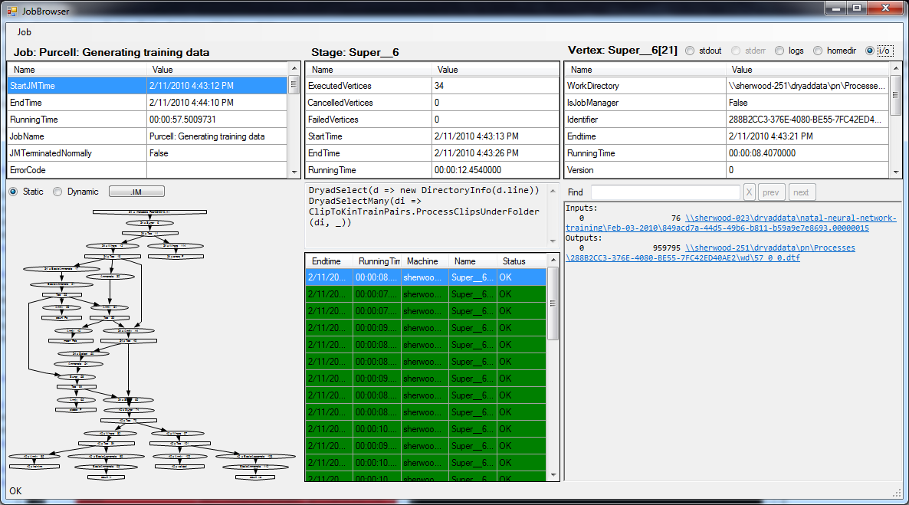
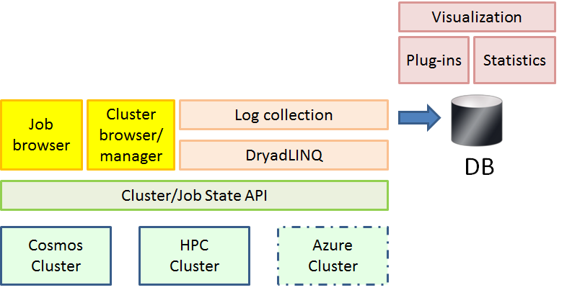
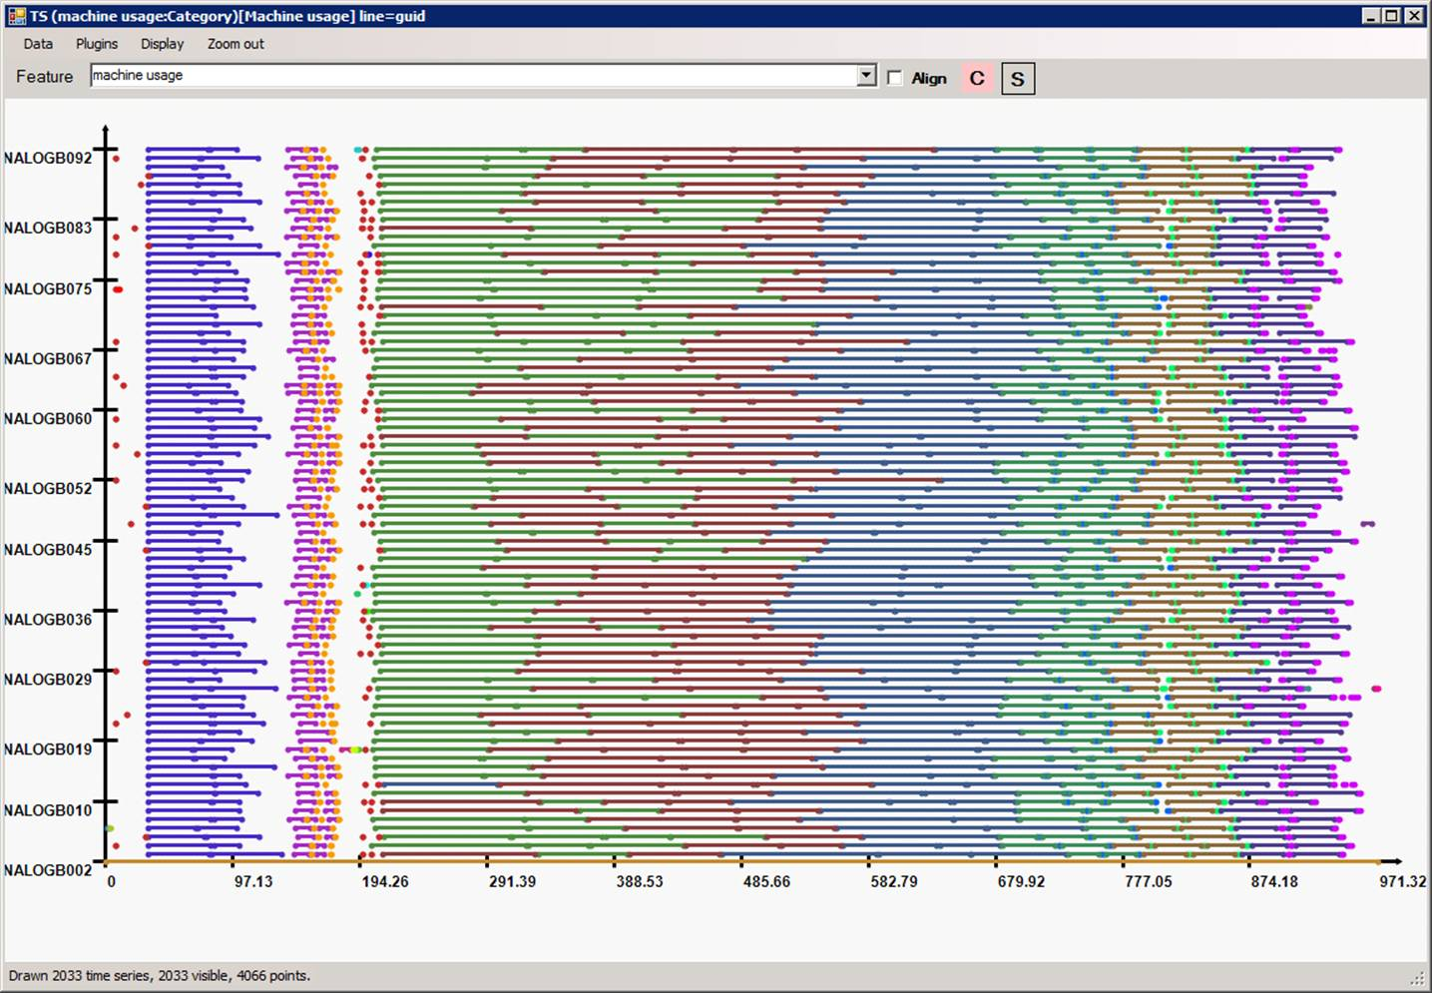
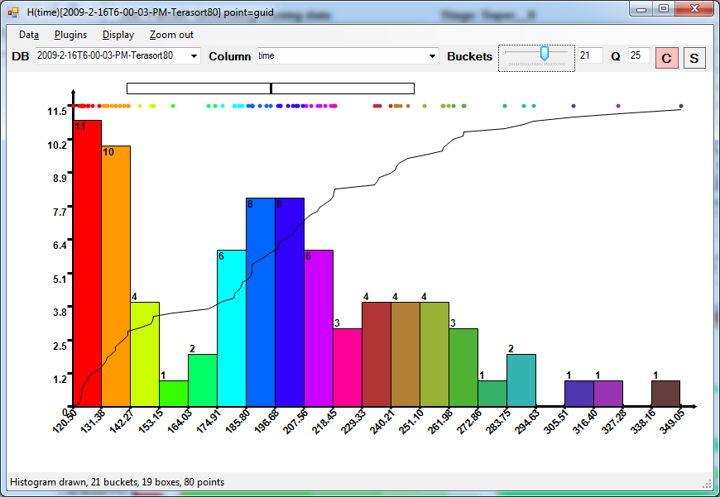
Debugging and Diagnostics
Artemis

