Slide 1
Asynchronous Notification in Condor
By
Vidhya Murali

Slide 2
Existing Condor Notification System
Condor Pool
Machine –N
startD
schedD
Email Notifier
logs

Slide 3


Goal -1
Condor Pool
Machine –N
startD
F
I
L
T
E
R
schedD
logs

Slide 4




Goal -2
Condor Pool
Machine –N
I
N
T
E
R
M
E
D
I
A
T
E
startD
schedD
logs

Slide 5
Goals
  Asynchronously transfer condor’s event logs(messages) to external listener client(s)
  Event Log Format Transformation
  Event Log Filtering
Without affecting current schedD setup!
Notes:
Event log forwarder: can filter and selectively pick specific eventlogs ,no log loss or duplication guaranteed.

Slide 6
Condor-Messaging System Architecture
Condor Pool
Messaging System
Machine –N
Event Log Forwarder
(Client Publisher)
Client -1
(Write to File)
startD
Queue1
E
X
C
H
A
N
G
E
schedD
Queue2
Client -2
(IM)
Client-n
(Email)
Queue-n
logs

Slide 7
Outline
MOM
Introduction to AMQP
Integration of Qpid with Condor
Applications – Skype Integration
Conclusion
Notes:
Future scope to be added

Slide 8
Message-oriented middleware
(MOM)
Infrastructure focused on sending and receiving messages that allows application modules to be distributed over heterogeneous platforms
Features:
  Asynchronous Delivery
  Routing messages (broadcast, multicast possible)
  Message transformation /mapping
Specifications eg: XMPP, AMQP

Slide 9
Advanced Message Queuing Protocol
(AMQP )
Open standard application layer protocol for MOM
Key Features:
  Message orientation
  Queuing
  Routing
  Reliability
  Security

Slide 10
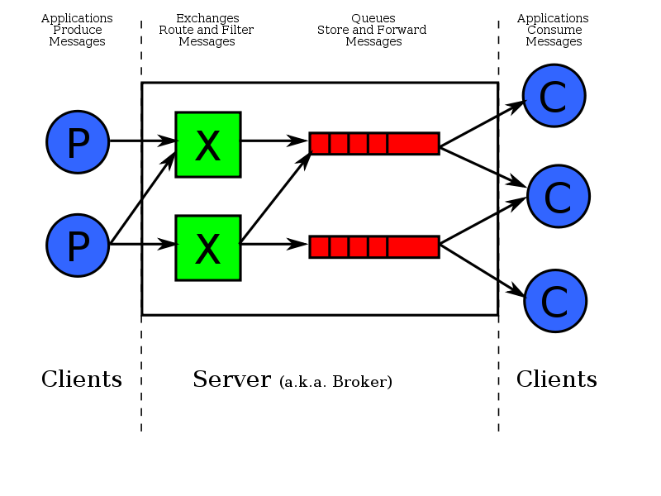
AMQP Model

Slide 11
AMQP Entities
Exchanges : entities to which messages are sent.
  Belongs to component Broker.
  Config : DURABLE
Queues : entities which receive messages
  Config : DURABLE,EXCLUSIVE
Binding : ties one queue to an exchange
  Config : Conditional on routing key
Notes:
Or multiple consumers can declare independent queues but share the bindings and get all the message every other consumer would get on the bound exchange with these bindings.

Slide 12
AMQP contd...
Typical messaging patterns
  Request-Response : messages are sent to or from specific recipients
  Publish-Subscribe : information is distributed to a set of recipients according to various subscription criteria
  Round-Robin : tasks are distributed fairly among a set of recipients.

Slide 13
Durable (persistent) Pub/Sub Delivery
AMQP Broker
Tail
Session
Client
Subscriber
Entry 2
Head
Link
Client
Publisher
Session
Tail
Link
Entry 1
Link
Entry 3
Queue (Worker)
- persistent
Entry 2
Head
Entry 1
Head
Queue (Source)
- persistent
Link
Session
Client
Subscriber
Entry 1
Head
Link
Queue (Worker)
- persistent

Slide 14
Integration of Qpid with Condor
Apache Qpid is an open source implementation of AMQP.
- Using C++ library
Condor_Qpid Daemon: runs the Qpid broker, initializes the queues ,publishes classAd
Condor_jobs:
CLIENT PUBLISHER: Condor_EventLog_Forwarder
CLIENT SUBSCRIBER : Any listener that reads messages writes to file,send emails, IMs

Slide 15

Condor-Qpid Integration Architecture
Qpid Broker
Client -1
(Write to File)
Queue1
Condor Event Log Forwarder
(Client Publisher)
Exchange
Queue2
Client-n
(Email)
Queue-n

Slide 16
Skype for Qpid Client
Configurations for sending messages:
  1 to 1
  1 to selected ids in the contact list
  1 to all in the contact list

Slide 17
Conclusion
Part of condor add-ons
Event log message filtering at client listener level – Feedback mode
Extension to integrate with other clients like Twitter, Facebook

Slide 18
Questions?

Slide 19
Thank You!

