Slide 1


Stork Data Scheduler: Current Status and Future Directions
Sivakumar Kulasekaran
Center for Computation & Technology
Louisiana State University
April 15, 2010
AT LOUISIANA STATE UNIVERSITY
CCT: Center for Computation & Technology @ LSU

Slide 2
Roadmap
Stork – Data aware Scheduler
Current Status and Features
Future Plans
Application Areas
AT LOUISIANA STATE UNIVERSITY
CCT: Center for Computation & Technology @ LSU

Slide 3
Motivation
In a widely distributed computing environment:
  data transfer performance between nodes may be a major performance bottleneck
High-speed networks are available, but users may only get a fraction of theoretical speeds due to:
    unscheduled transfer tasks
    suboptimal protocol tuning
    mismanaged storage resources
AT LOUISIANA STATE UNIVERSITY
CCT: Center for Computation & Technology @ LSU

Slide 4
Data-Aware Schedulers Stork
Type of a job?
  transfer, allocate, release, locate..
Priority, order?
Protocol to use?
Available storage space?
Best concurrency level?
Reasons for failure?
Best network parameters?
  tcp buffer size
  I/O block size
  # of parallel streams
AT LOUISIANA STATE UNIVERSITY
CCT: Center for Computation & Technology @ LSU

Slide 5

Data-aware Scheduling
S1
D1
S2
D2
S3
D3
Sm
Sm
Sm
Sm
Sm
Sm
Sm
Dn
Transfer k files between m sources and n destinations, optimize by:
Choosing the best transfer protocol; translations between protocols
Tuning protocol transfer parameters (considering current network conditions)
Ordering requests (considering priority, file size, disk size etc.)
Throttling - deciding number of concurrent transfers (considering server performance, network capacity, storage space, etc.)
Connection & data aggregation
Notes:
Is this good enough. No. Traditional schedulers are not aware of characteristics and semantics of data placement jobs. For them there is no difference between a computational job and a data placement job. Both consist of a binary and couple of arguments. And you’ve no idea what these mean, or what’s going inside.
Data placement jobs are not like the computational jobs. In a computational job, But you can easily characterize dap jobs, and you know what to expect for each type of dap job.

Slide 6
More Stork features
Queuing, scheduling and optimization of transfers
Plug-in support for any transfer protocol
Recursive directory transfers
Support for wildcards
Checkpointing transfers
Check-sum calculation
Throttling
Interaction with workflow managers and high level planners
AT LOUISIANA STATE UNIVERSITY
CCT: Center for Computation & Technology @ LSU

Slide 7
Features of Stork 1.2
Current release Stork Version 1.2
Almost available in 17 different platforms
Source code and binary forms of release
Two types of release
    Core Stork modules
    Stork with all external modules
AT LOUISIANA STATE UNIVERSITY
CCT: Center for Computation & Technology @ LSU

Slide 8
Features of Stork 1.2
First Stand alone version of Stork
Easy installation steps than previous versions
Support team to answer all your questions and to provide required help on Stork
Flexibility for users to customize stork and implement new features
Test suites to test the functionality of Stork
Newly updated user friendly Stork user manual
AT LOUISIANA STATE UNIVERSITY
CCT: Center for Computation & Technology @ LSU

Slide 9
Externals Supported By Stork
    GLOBUS
    OpenSSL
    SRB
    iRods
    Petashare
AT LOUISIANA STATE UNIVERSITY
CCT: Center for Computation & Technology @ LSU

Slide 10
Optimization Service
    To increase wide area throughput by using multiple parallel streams
    Opening too many streams results in bottleneck
    Important to decide on the optimal number of streams
    Predicting optimal number of streams is not easy
    Next release of Stork will include optimization features provided by Yildirim et al¹
AT LOUISIANA STATE UNIVERSITY
CCT: Center for Computation & Technology @ LSU

Slide 11
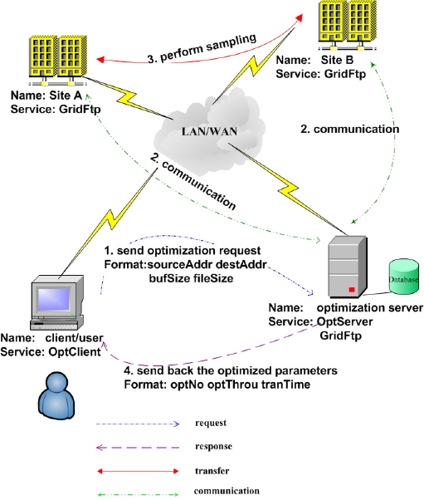
Optimization Service

Slide 12
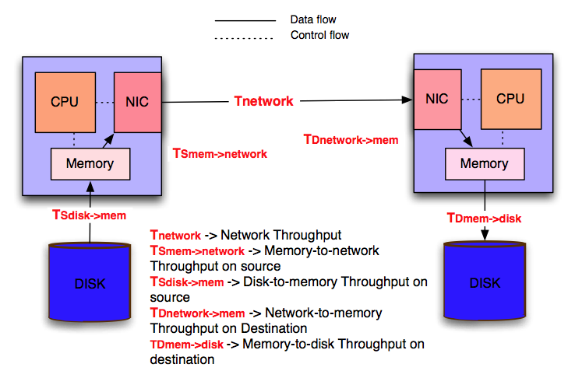
End-to-end Problem
In a typical system, the end-to-end throughput depends on the following factors:

Slide 13
End-to-end Optimization
To optimize the total throughput T_{opt}, each term must be optimized

Slide 14
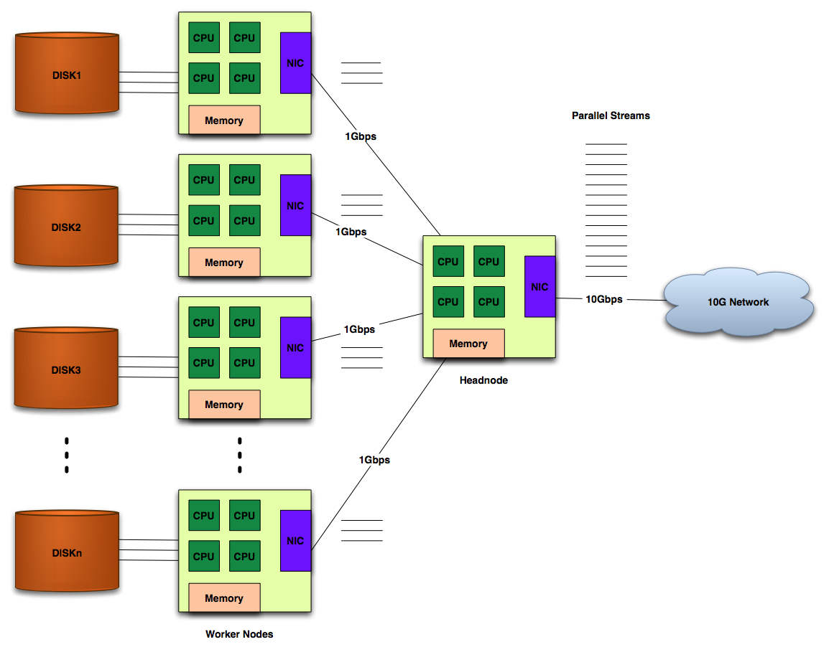
Data Flow Parallelism
Parameters to be optimized
# of disk stripes
# of CPUs/nodes
# of streams
buffer size per stream

Slide 15
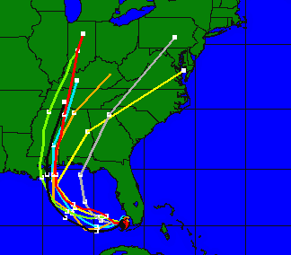

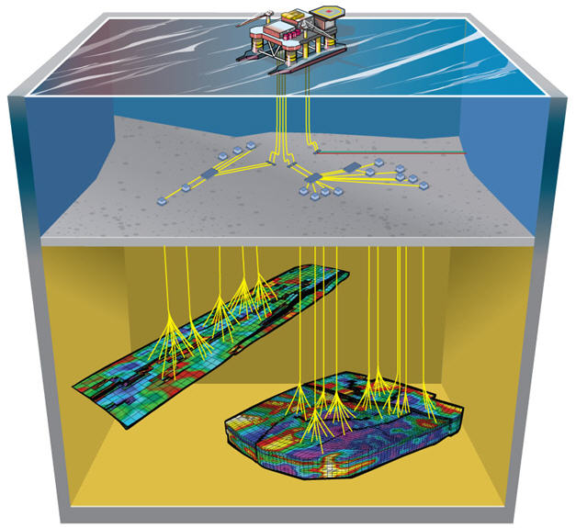
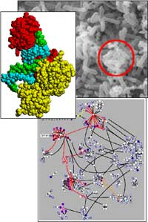
Application Areas
  Coastal & Environment Modeling (SCOOP)
  Reservoir Uncertainty Analysis (UCoMS)
  Computational Fluid Dynamics (CFD)
  Bioinformatics
(ANSC)

Slide 16
Other Groups
  CyberTools
  LONI Institute
  MIT
  University of Calgary, Canada
  Offis Institute for Informatics, Germany
  Illuminate Labs
AT LOUISIANA STATE UNIVERSITY
CCT: Center for Computation & Technology @ LSU

Slide 17
Future Directions
    Windows Portability
    Distributed Data Scheduling
      Interaction between data scheduler
      Better parameter tuning and reordering of data placement jobs
      Job Delegation
      peer-to-peer data movement
AT LOUISIANA STATE UNIVERSITY
CCT: Center for Computation & Technology @ LSU

Slide 18


Questions
    Team
    Tevfik Kosar kosar@cct.lsu.edu
    Sivakumar Kulasekaran sivakumar@cct.lsu.edu
    Brandon Ross bross@cct.lsu.edu
    Dengpan Yin dyin@cct.lsu.edu
    WWW.STORKPROJECT.ORG
AT LOUISIANA STATE UNIVERSITY
CCT: Center for Computation & Technology @ LSU

