Slide 1
Cloud Computing with Nimbus
April 2010
Condor Week
Kate Keahey
keahey@mcs.anl.gov
Nimbus Project
University of Chicago
Argonne National Laboratory

Slide 2
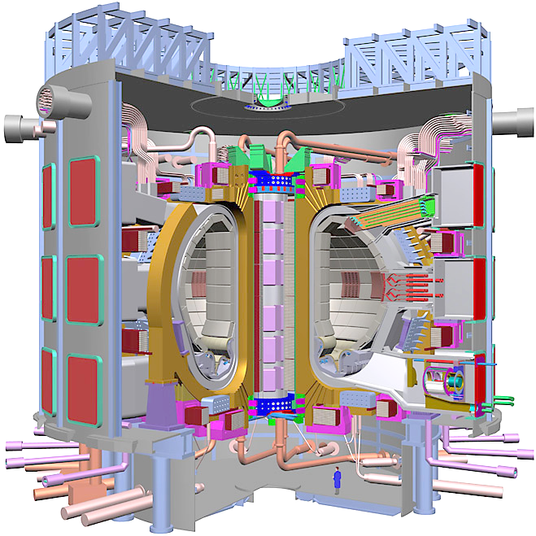
Cloud Computing for Science
Environment
  Complexity
  Consistency
Availability

Slide 3
“Workspaces”
Dynamically provisioned environments
  Environment control
  Resource control
Implementations
  Via leasing hardware platforms: reimaging, configuration management, dynamic accounts…
  Via virtualization: VM deployment
Isolation

Slide 4
Nimbus: Cloud Computing for Science
Allow providers to build clouds
  Workspace Service: a service providing EC2-like functionality
  WSRF-style and EC2-style (both SOAP and REST) interfaces
  Support for Xen and KVM
Allow users to use cloud computing
  Do whatever it takes to enable scientists to use IaaS
  Context Broker: turnkey virtual clusters
  Currently investigating scaling tools
Allow developers to experiment with Nimbus
  For research or usability/performance improvements
  Open source, extensible software
  Community extensions and contributions: UVIC (monitoring), IU (EBS, research), Technical University of Vienna (privacy, research)
Last release is 2.4: www.nimbusproject.org

Slide 5
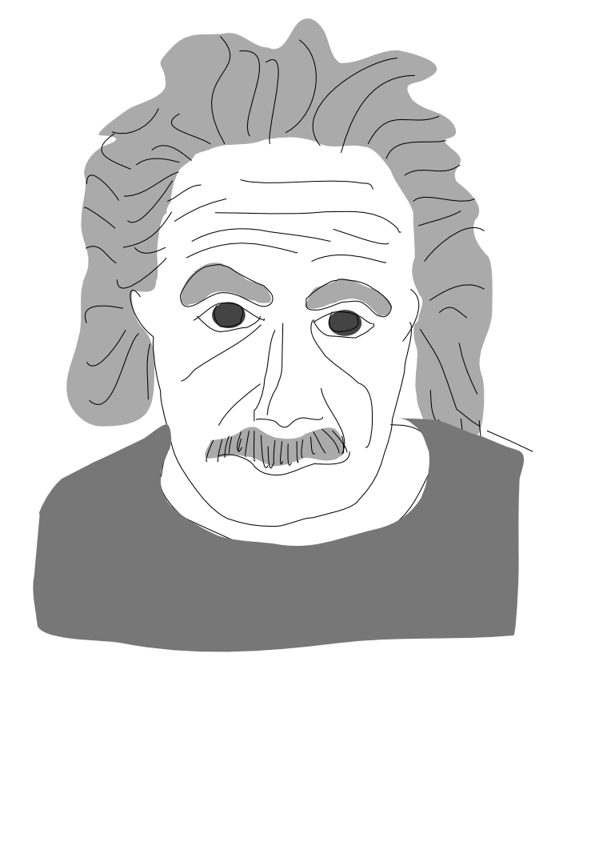
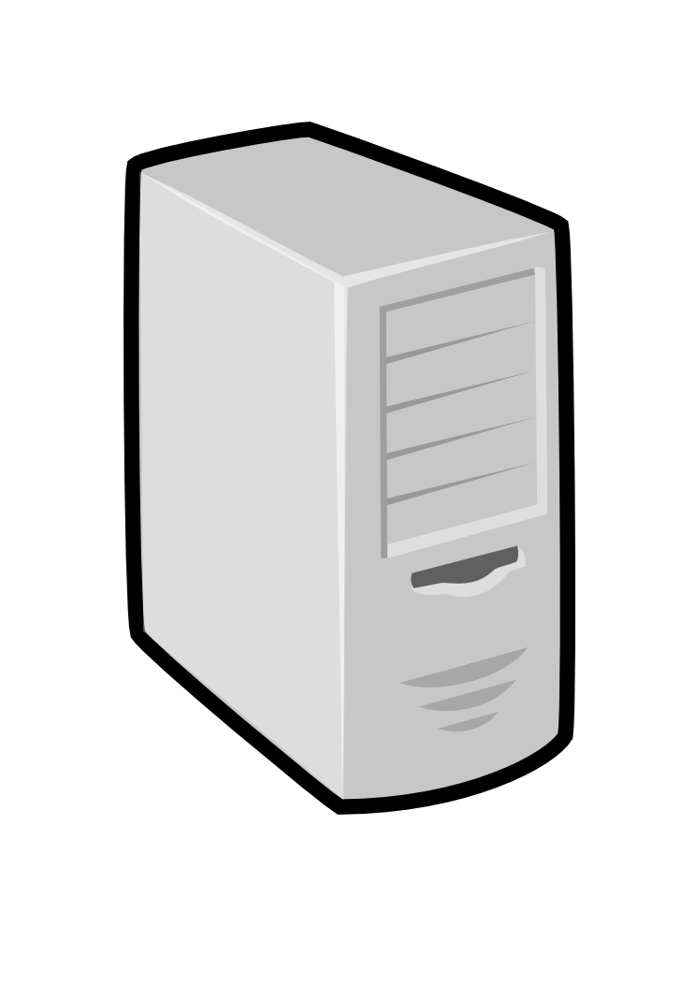
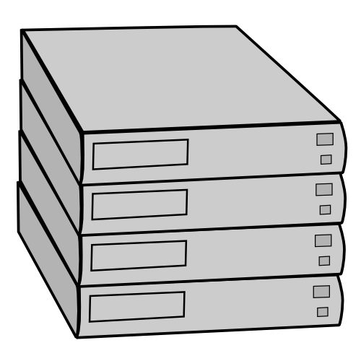
The Workspace Service
Pool
node
Pool
node
Pool
node
VWS
Service
Pool
node
Pool
node
Pool
node
Pool
node
Pool
node
Pool
node
Pool
node
Pool
node
Pool
node

Slide 6
The Workspace Service
The workspace service publishes
information about each workspace
Pool
node
Pool
node
Pool
node
VWS
Service
Pool
node
Pool
node
Pool
node
Users can find out
information about their
workspace (e.g. what IP
the workspace was bound to)
Pool
node
Pool
node
Pool
node
Pool
node
Pool
node
Pool
node
Users can interact directly with their workspaces the same way the would with a physical machine.

Slide 7
Turnkey Virtual Clusters
IP1
HK1
IP2
HK2
IP3
HK3
MPI
Turnkey, tightly-coupled cluster
  Shared trust/security context
  Shared configuration/context information
Context Broker goals
  Every appliance
  Every cloud provider
  Multiple distributed cloud providers
Used to contextualize 100s of virtual nodes for EC2 HEP STAR runs, Hadoop nodes, HEP Alice nodes…
Working with rPath on developing appliances, standardization

Slide 8
Science Clouds
Participants
  University of Chicago (since 03/08), University of Florida (05/08, access via VPN), Wispy @ Purdue (09/08)
  International collaborators
    Congratulations to Pierre Riteau for winning the Large Scale Deployment Challenge on Grid5K!
  Using EC2 for large runs
Science Clouds Marketplace: OSG cluster, Hadoop, etc.
100s of users, many diverse projects ranging across science, CS research, build&test, education, etc.
Come and run: www.scienceclouds.org
Now also FutureGrid

Slide 9
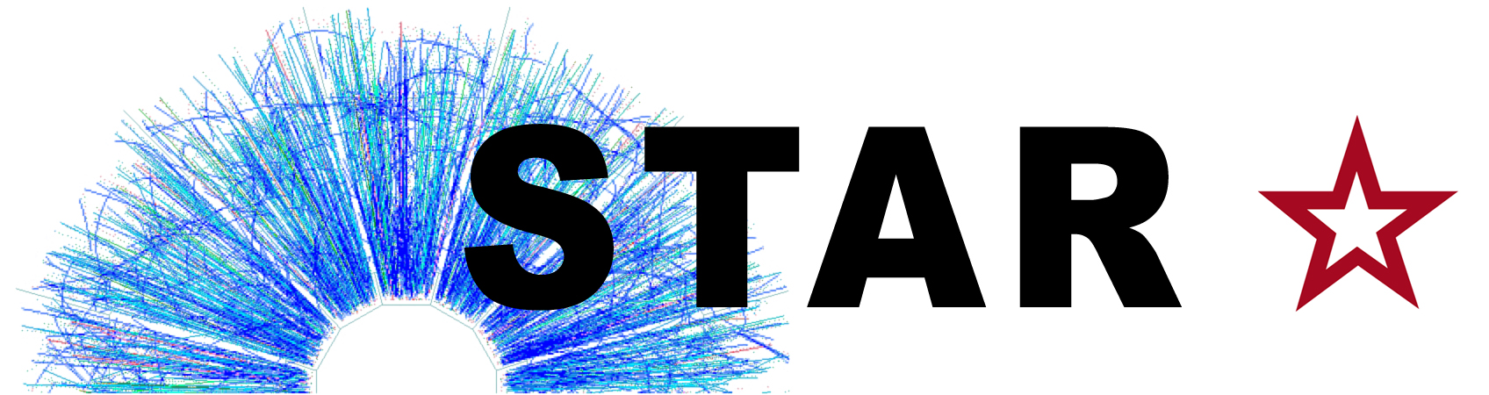
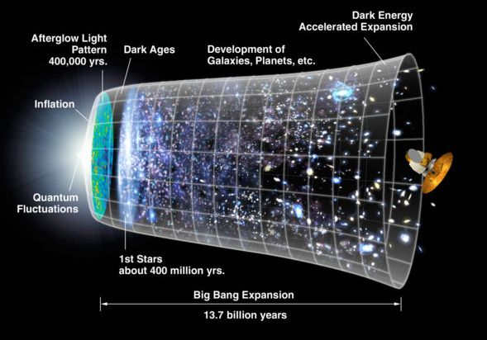
STAR experiment
Work by Jerome Lauret, Leve Hajdu, Lidia Didenko (BNL), Doug Olson (LBNL)
STAR: a nuclear physics experiment at Brookhaven National Laboratory
Studies fundamental properties of nuclear matter
Problems:
  Complexity
  Consistency
  Availability

Slide 10


STAR Virtual Clusters
Virtual resources
  A virtual OSG STAR cluster: OSG headnode (gridmapfiles, host certificates, NFS, Torque), worker nodes: SL4 + STAR
  One-click virtual cluster deployment via Nimbus Context Broker
From Science Clouds to EC2 runs
Running production codes since 2007
The Quark Matter run: producing just-in-time results for a conference: http://www.isgtw.org/?pid=1001735

Slide 11
Priceless?
Compute costs: $ 5,630.30
  300+ nodes over ~10 days,
  Instances, 32-bit, 1.7 GB memory:
    EC2 default: 1 EC2 CPU unit
    High-CPU Medium Instances: 5 EC2 CPU units (2 cores)
  ~36,000 compute hours total
Data transfer costs: $ 136.38
  Small I/O needs : moved <1TB of data over duration
Storage costs: $ 4.69
  Images only, all data transferred at run-time
Producing the result before the deadline…
…$ 5,771.37

Slide 12
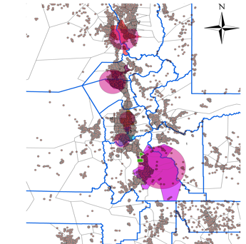
Modeling the Progression of Epidemics
Work by Ron Price and others, Public Health Informatics, University of Utah
Can we use clouds to acquire on-demand resources for modeling the progression of epidemics?
What is the efficiency of simulations in the cloud?
  Compare execution on:
    a physical machine
    10 VMs on the cloud
    The Nimbus cloud only
  2.5 hrs versus 17 minutes
  Speedup = 8.81
  9 times faster

Slide 13

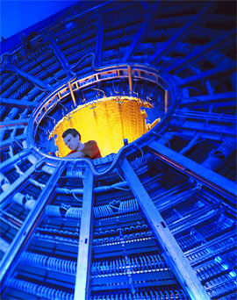
A Large Ion Collider Experiment (ALICE)
Work by Artem Harutyunyan and Predrag Buncic, CERN
Heavy ion simulations at CERN
Problem: integrate elastic computing into current infrastructure
Collaboration with CernVM project
Elastically extend the ALICE testbed to accommodate more computing

Slide 14
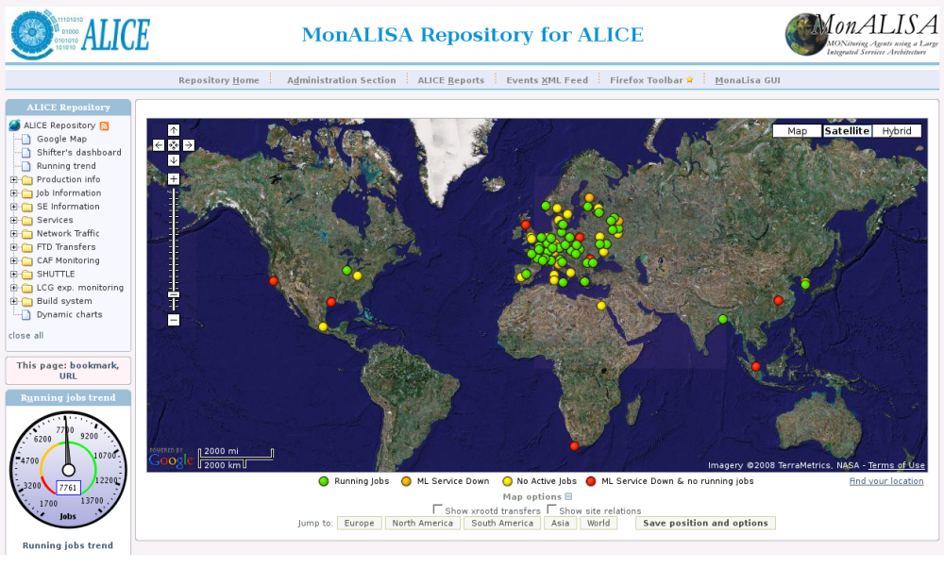
Elastically Provisioned Resources
CHEP 2009 paper, Harutyunyan et al., Collab. with CernVM
CCGrid 2010 paper, Marshall et al., “Elastic Sites”

Slide 15
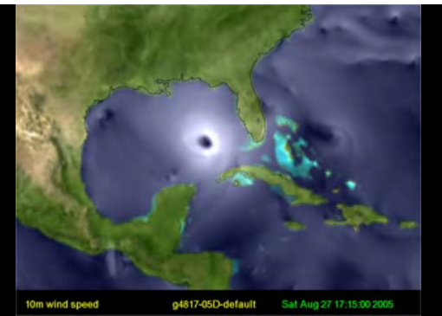
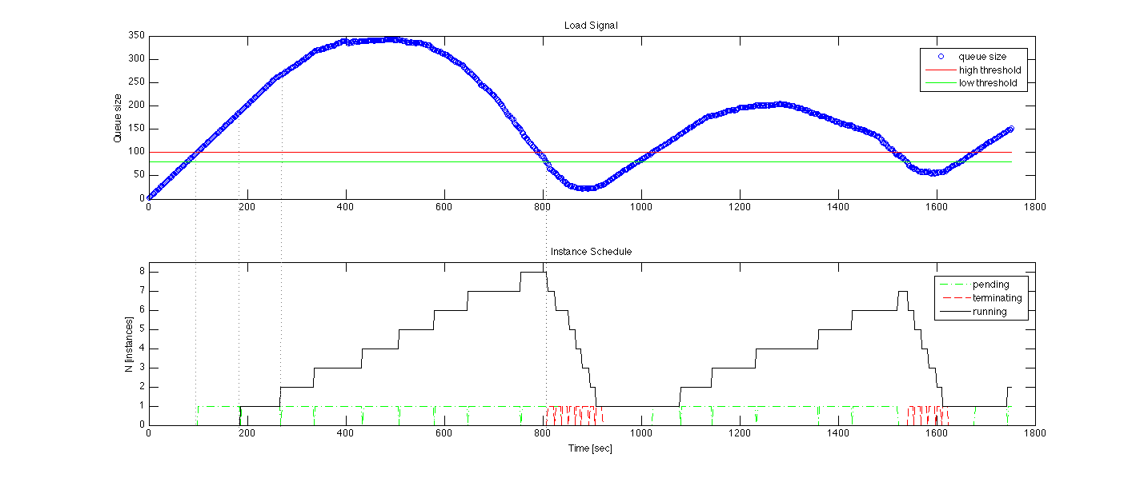
Ocean Observatory Initiative (OOI)
Highly Available Services
Rapidly provision resources
- Scale to demand

Slide 16
“Sky Computing” Environment
Work by A. Matsunaga, M. Tsugawa, University of Florida
U of Chicago
U of Florida
ViNE
router
ViNE
router
ViNE
router
Purdue
Creating a seamless environment in a distributed domain

Slide 17
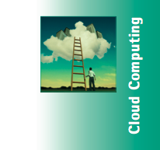
Hadoop in the Science Clouds
U of Chicago
U of Florida
Hadoop cloud
Purdue
Papers:
  “CloudBLAST: Combining MapReduce and Virtualization on Distributed Resources for Bioinformatics Applications” by A. Matsunaga, M. Tsugawa and J. Fortes. eScience 2008.
  “Sky Computing”, by K. Keahey, A. Matsunaga, M. Tsugawa, J. Fortes, to appear in IEEE Internet Computing, September 2009
Large Scale Deployment Challenge on Grid5K, Pierre Riteau

Slide 18

New & Noteworthy…
FutureGrid: experimental testbed
  Infrastructure-as-a-Service for FutureGrid
  IaaS cycles for science
  New capabilities: “sky computing” scenarios
Ocean Observatory Infrastructure (OOI)
  Highly available services
  Elastic provisioning

Slide 19
Nimbus: Friends and Family
Nimbus core team:
  UC/ANL: Kate Keahey, Tim Freeman, David LaBissoniere, John Bresnahan
  UVIC: Ian Gable & team
    Patrick Armstrong, Adam Bishop, Mike Paterson, Duncan Penfold-Brown
  UCSD: Alex Clemesha
Contributors:
  http://www.nimbusproject.org/about/people/

Slide 20
Nimbus and Condor
Two Nimbus projects using Condor starting this summer
  Using Condor as scheduler for VMs
  Using HTC to backfill cloud computing jobs

Slide 21
Nimbus and Condor
workspace
RM
WSRF
workspace
service
EC2
workspace
pilot
workspace
control
workspace
client
Condor
Leverage Condor capabilities for RM
Workspace control for VM management
  Wrapper for a collection of modules/libraries
  VM image management and construction, VM control (via libvirt), VM networking, contextualization, ssh-based notifications

Slide 22
Parting Thoughts
Infrastructure-as-a-Service for science
  Easy access to the “right configuration”
  Makes resource sharing more efficient
Understanding how to leverage these capabilities for science
  Challenges in building ecosystem, security, usage, price-performance, use of existing tools, etc.
Working on it! ;-)

