Slide 1
IPv6 in Condor
MinJae Hwang

Slide 2
Overview
1. IPv6?
2. What are required to run Condor in IPv6?
3. Issues in Porting Condor to IPv6

Slide 3

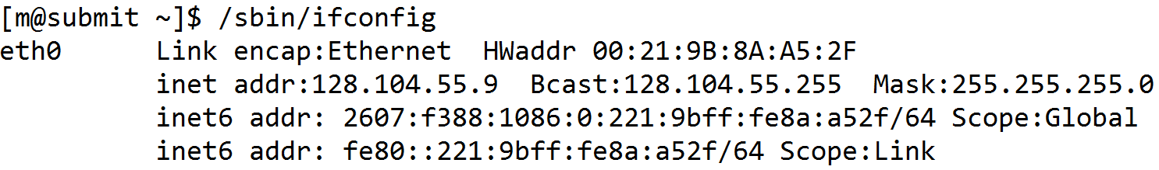
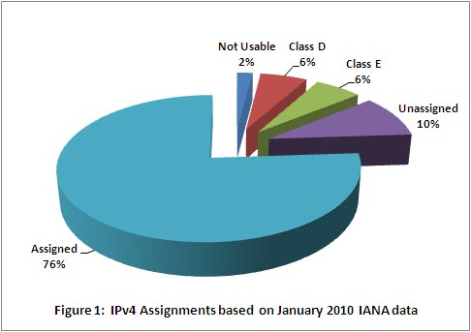
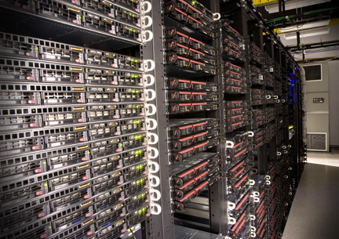
1. ?

Slide 4

What is IPv6?
Internet Protocol 6 by IETF
Simply, extension of address space
  You can even assign IP address to pebbles
  6.67∙10²⁷ IPv6 addresses/m² on earth

Slide 5
Why IPv6?
IPv4 addresses are expected to fully assigned by the end of 2011
Large scale grid deployment especially non-US countries will suffer from IP address shortage

Slide 6



2. What are required to use Condor in ?

Slide 7
Requirement for IPv6
Every software and hardware stack should be rebuilt and tested
  IPv6 has no ‘protocol-level’ compatibility to IPv4
Most of current operating systems, switches, routers fully support IPv6
  (Almost) Every OS that Condor supports provides IPv6

Slide 8
Condor Requirement for IPv6
Most of external libraries that Condor use are IPv6 supported
  Exception: Storage Resource Broker from SDSC (for Stork)

Slide 9

3. Porting Condor to

Slide 10
Issues in Porting Applications to IPv6
Using Old BSD Socket Interface
  gethostbyname(), inet_addr(), …
Address Parsing/Printing
  printf(“%u %u %u %u”, addr >> 24, …)
Storing Address in Integers
  unsigned int IP = …
IP address binding
  127.0.0.1, 255.255.255.255.0
Buffer Allocation/Data Structure
  char IPADDR[16] <- FALSE! IP address is now 46 letters long!

Slide 11
Issues in Porting Condor to IPv6
Large Codebase
  680,000 LOC
Scattered Source Code
  Every daemon has networking code
Implicit Use of IP Address
  Non-networking code handles IP address
  LOG( “%s: error ..”, local_ip_buffer ),
    local_ip_buffer may not have enough buffer
Various OSes, various architectures
  Condor supports more than 20+ OS, 6+ Architectures

Slide 12
Goals for deployment
Backward-compatibility is our top priority
Supporting IPv6 in incremental way
  Old system continues to use IPv4-only binary
  New system can use IPv6-enabled binary

Slide 13
Goals for users
User: does not need to know whether it is IPv4 or IPv6
Admin: minimal change to config file
 | IPv4 | IPv6
Web | http://192.168.0.1/ | http://[2002:1ab0:ab20:1000:2000:3000:4000]
Condor (Sinful String) | <192.168.0.1:4900> | <[2002:1ab0:ab20:1000:2000:3000:4000]:4900>

Slide 14
My experiences
Initially, tried to find a ‘automatic’ conversion
  A set of classes that deals with networking and IP address
  Use compiler tricks to detect ‘incompatible’ spots
No automatic way
  Implicit use of IP prevents automatic detection
  No incremental progress
  Hard to ensure backward-compatibility

Slide 15
Current Development Status
Work on small milestone and do extensive test on each milestone
Ensuring compatibility across OS, arch is still a problem
  More than 20 operating systems, 6 architectures
  Subtle difference in Socket API on each OS
How to deal with heterogeneous network?
  IPv4 clients, IPv6 servers?
  IPv6 clients, IPv4 servers?
  IPv4-to-IPv6 tunnel? Dual-stack?

Slide 16
Thank you
Special thanks to Beihang Univ. in P. R. China
  for providing IPv6 test-bed

Slide 17
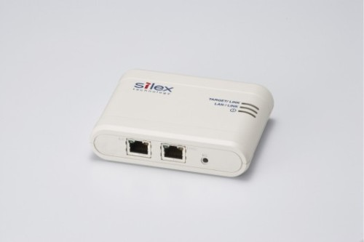
IPv4-to-IPv6 convertor
Cheap-and-easy! IPv4-to-IPv6 hardware convertor (possibly using tunneling) by silex technology

