Slide 1


Utilizing Condor and HTC to address archiving online courses at Clemson on a weekly basis
Project Blackbird
Sam Hoover
shoover@clemson.edu
Clemson Computing and Information Technology
Computing, Systems, and Operations

Slide 2


Slide 3
Project Blackbird
Blackboard at Clemson
End of Semester archives of all online courses in Blackboard since implementation in 2004
77 GB Oracle 10.2.0.4 DB tied to a 1.2 TB Content system with over 13 million files
Spring 2010: 4610 active Blackboard courses, 31,372 total courses in Blackboard
Full system backups once a week, nightly incremental backups of entire system
Clemson Computing and Information Technology
Computing, Systems, and Operations

Slide 4
Condor at Clemson
Clemson has deployed a Condor pool consisting of Windows Vista machines in the public computer labs and several other groups of machines (Linux, Solaris, etc.). These machines are available to Clemson faculty, students, and staff with high-throughput computing needs. Users can create their own Condor submit machines by downloading the appropriate software, and can even contribute their own idle cycles to the pool.
Clemson Computing and Information Technology
Computing, Systems, and Operations

Slide 5
Condor at Clemson
The Palmetto Cluster is a dedicated Linux cluster of 1111 nodes. Each node has 8 cores and 12-16 GB of RAM.
Nodes are sold as “Condos” so that the owner gets a guaranteed slice of time based on the number of nodes that they own each week.
Clemson Condor users get time on the system if it is not in use by a Condo owner.
We also share cycles via OSG, as the lowest priority user on the system.
Clemson Computing and Information Technology
Computing, Systems, and Operations

Slide 6
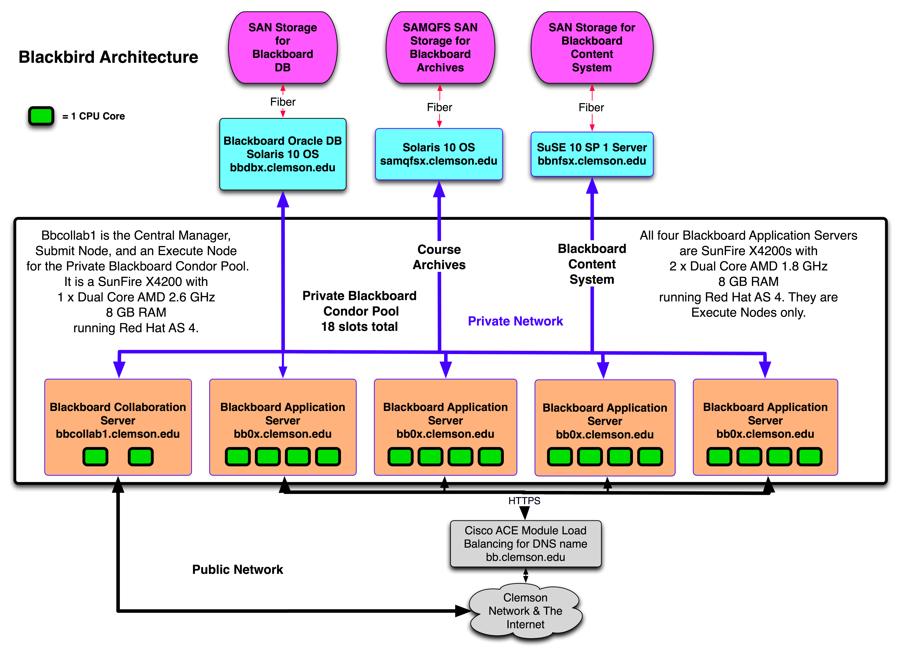
Notes:
Blackboard DB and Content system are tied together to a point in time. Public and Private Networks. NFS, DB, and Condor all use the Private network.

Slide 7
Blackbird Archive
Blackboard provides a script for executing batch archives given a list of courses as input.
Weekly archive process at Clemson began in Fall 2006 after an accidental deletion of many courses.
Started out splitting the course list into four equal chunks and giving each server ¼ of the total course list. All four servers usually finished within 2 hours of each other, total time for the batch was < 24 hours.
By Fall 2008, archiving the active courses took 85.5 hours, and the servers finished at widely varying times.
Clemson Computing and Information Technology
Computing, Systems, and Operations

Slide 8
Blackbird Archive
/usr/local/blackboard/apps/content-exchange/bin/batch_ImportExport.sh
Archive/Restore: The Archive Course function creates a record of the Course including User interactions. It is most useful for recalling Student performance or interactions at later time. The archive package is saved as a .ZIP file that can be restored to the Blackboard system at another time. In effect, Archive/Restore acts as a backup tool at the individual
course level.
Clemson Computing and Information Technology
Computing, Systems, and Operations

Slide 9
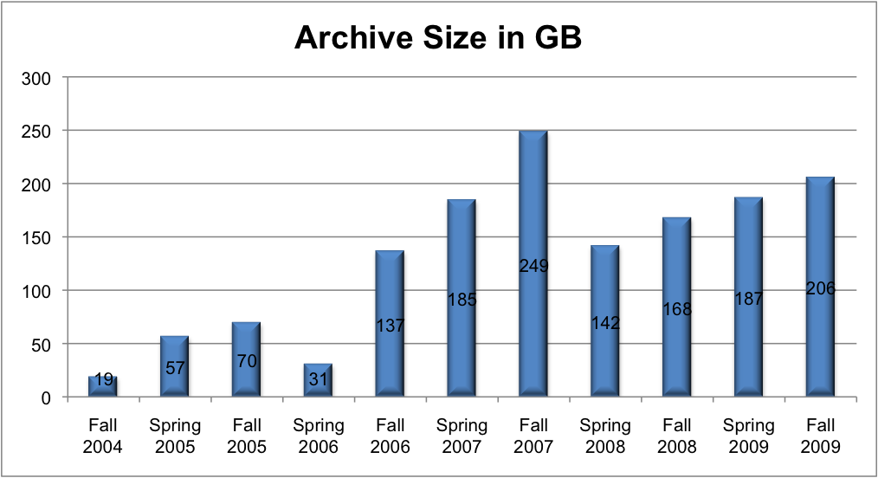
Project Blackbird
Clemson Computing and Information Technology
Computing, Systems, and Operations

Slide 10
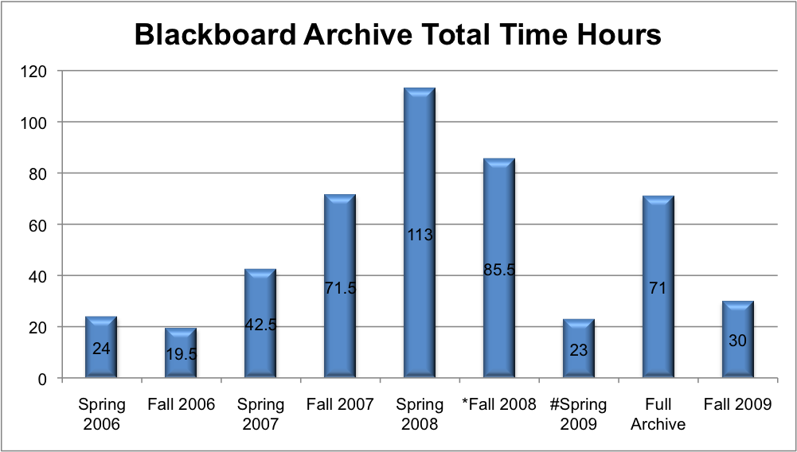
Project Blackbird
Clemson Computing and Information Technology
Computing, Systems, and Operations

Slide 11
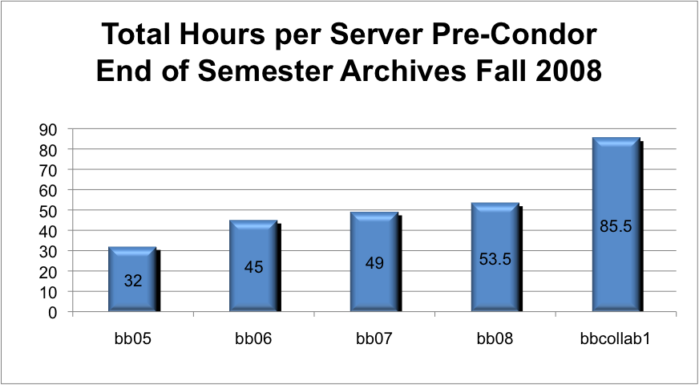
Project Blackbird
Clemson Computing and Information Technology
Computing, Systems, and Operations

Slide 12
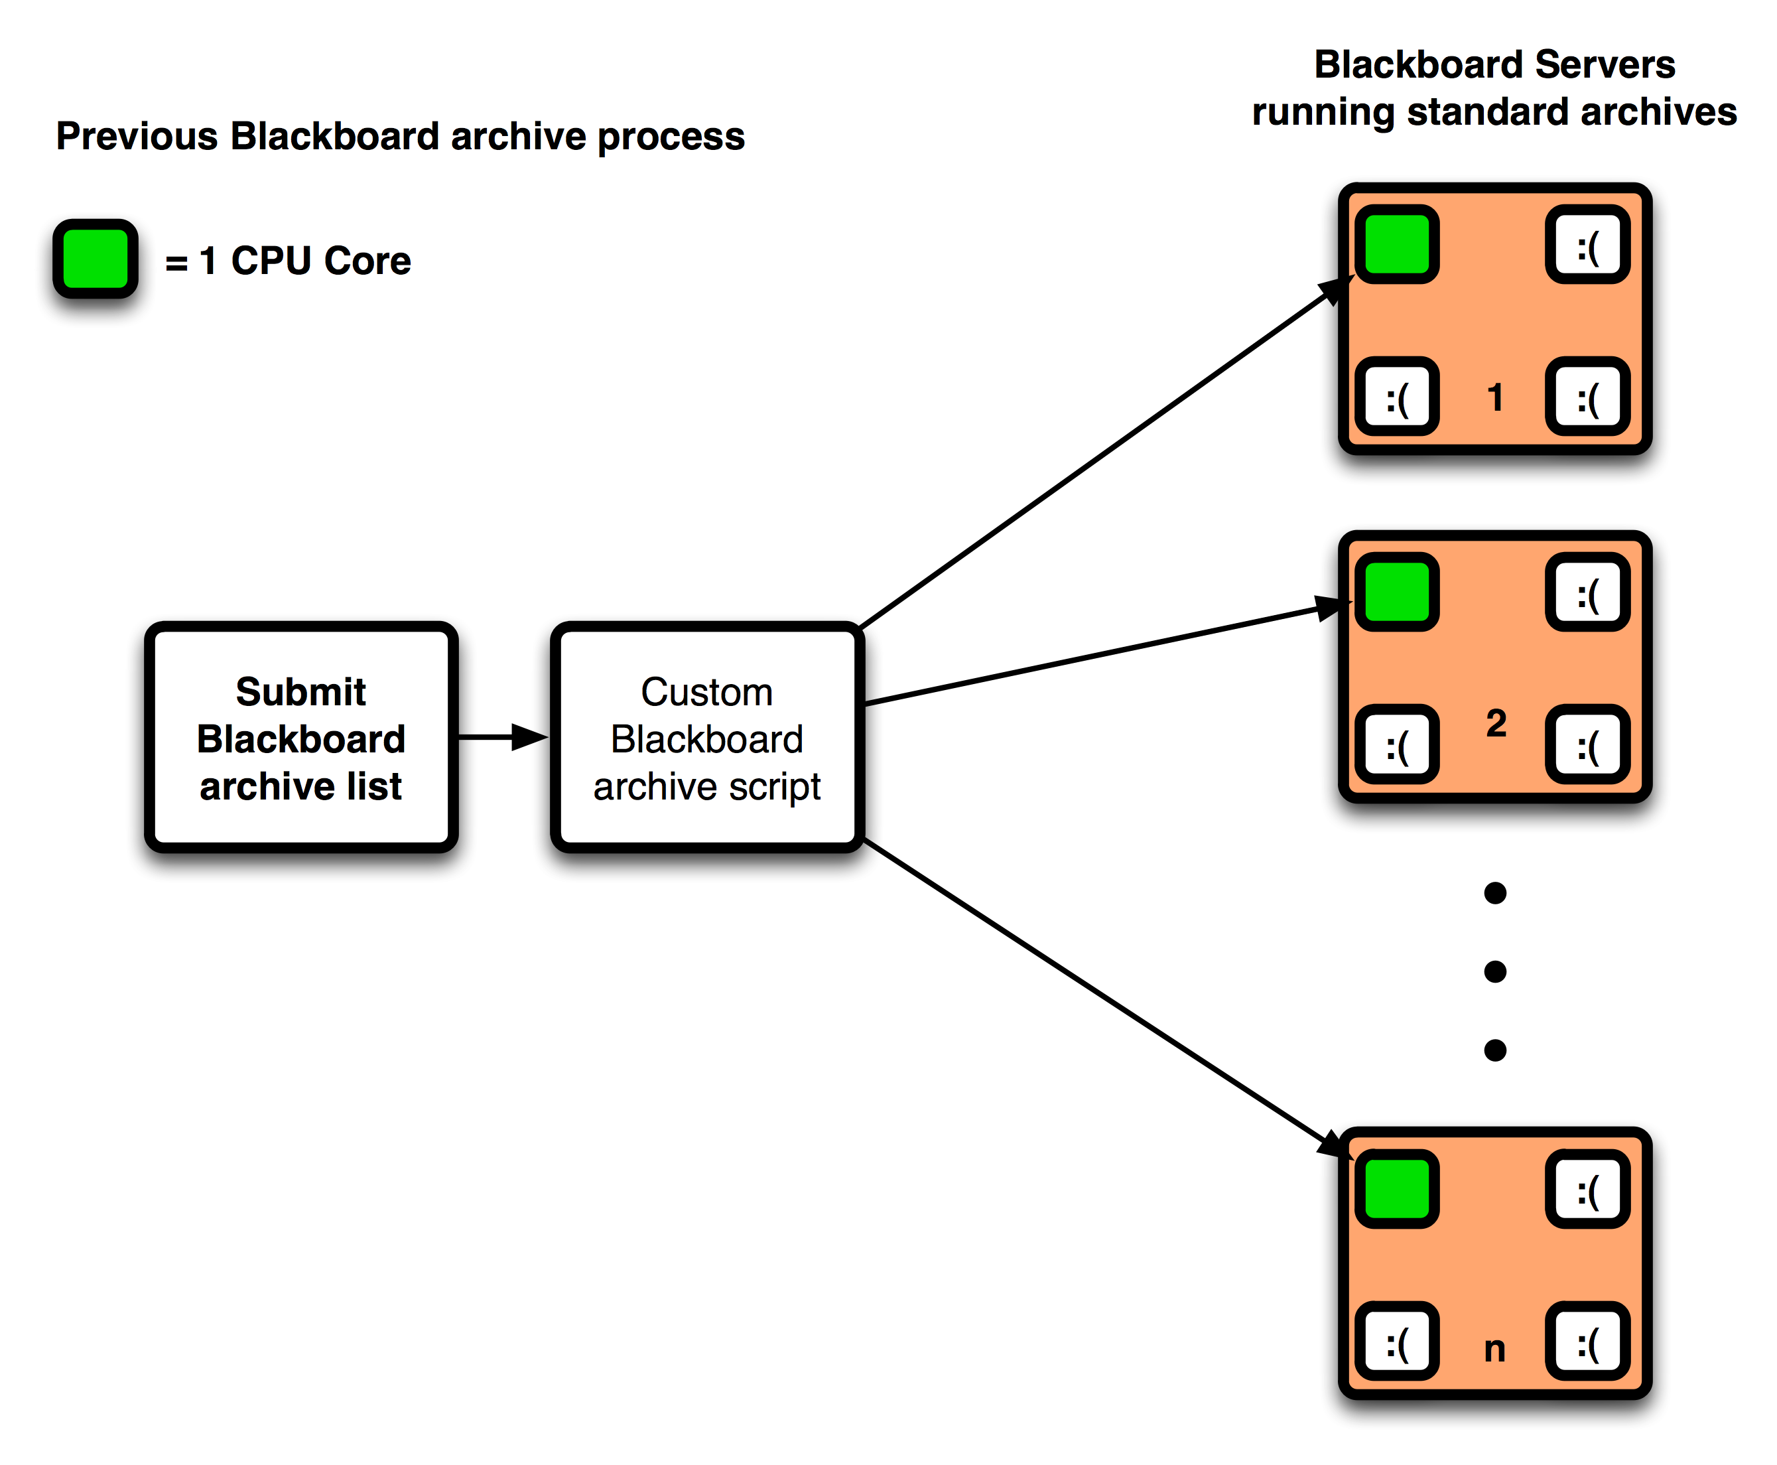
Multiple servers, but 3 cores idle
Clemson Computing and Information Technology
Computing, Systems, and Operations

Slide 13
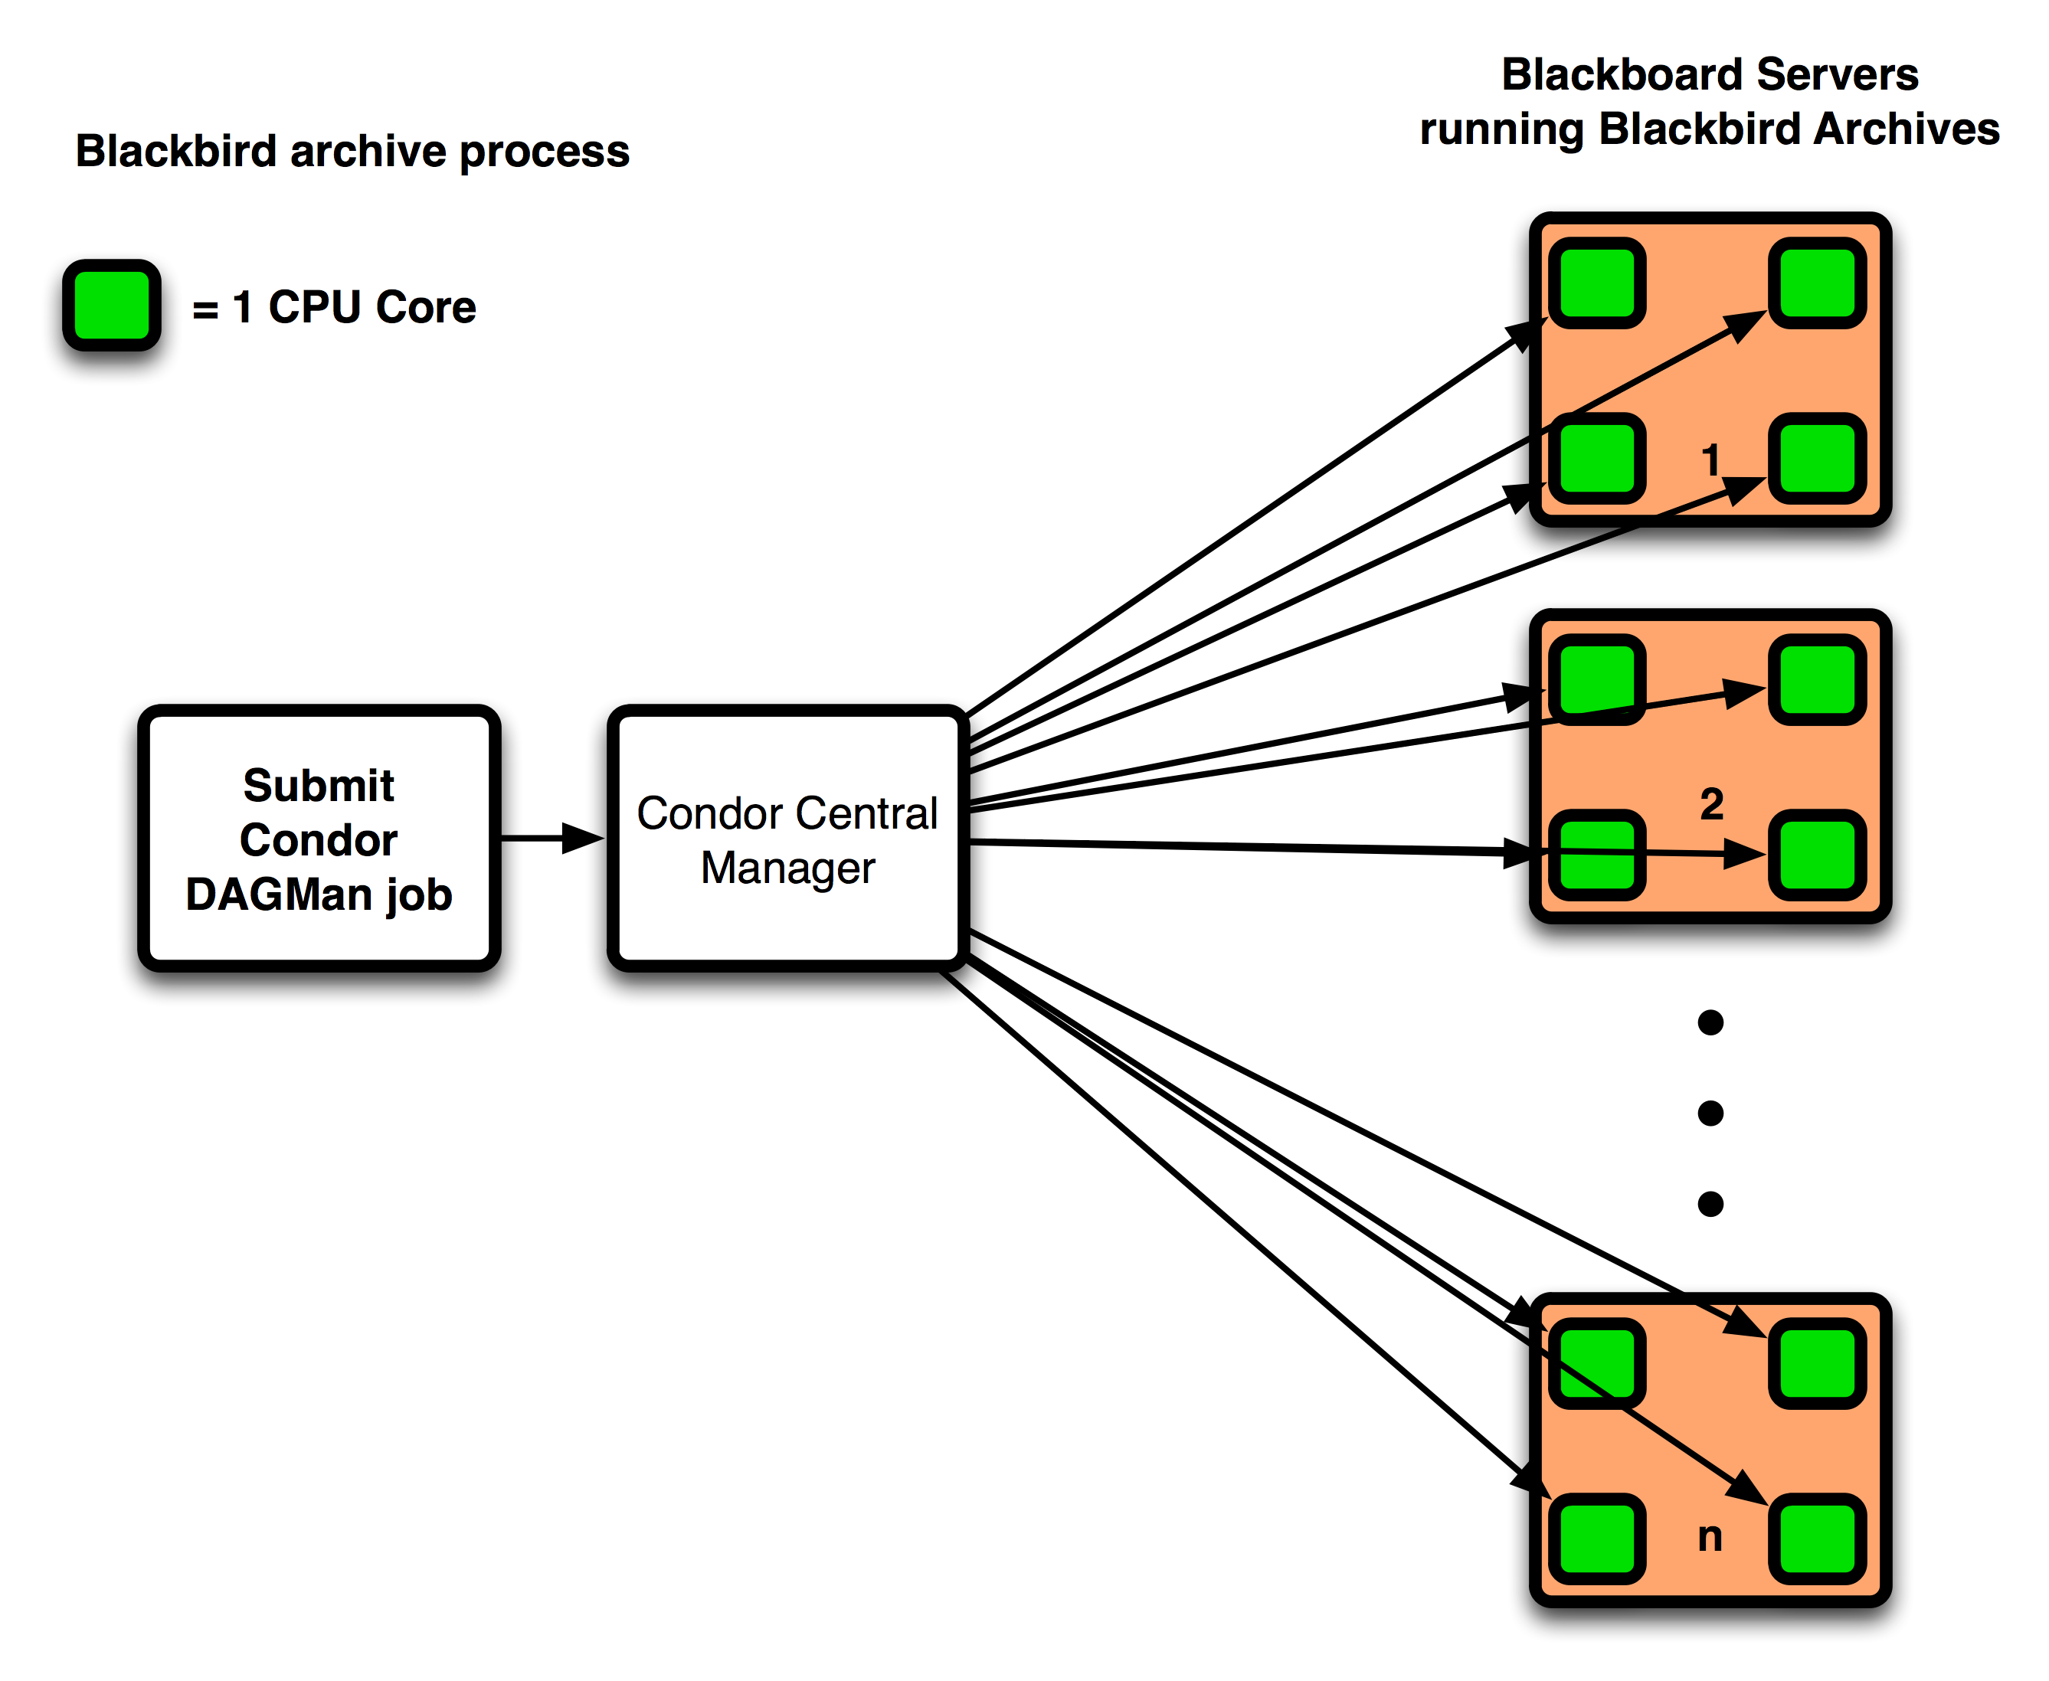
Multiple servers, all cores in use
Clemson Computing and Information Technology
Computing, Systems, and Operations
Notes:
Condor uses load average to utilize CPUs, so a CPU with low load will be used.

Slide 14
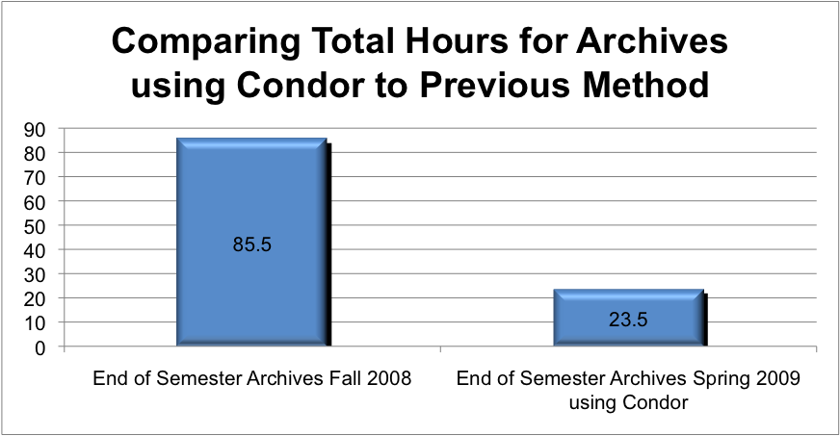
Project Blackbird
Clemson Computing and Information Technology
Computing, Systems, and Operations

Slide 15
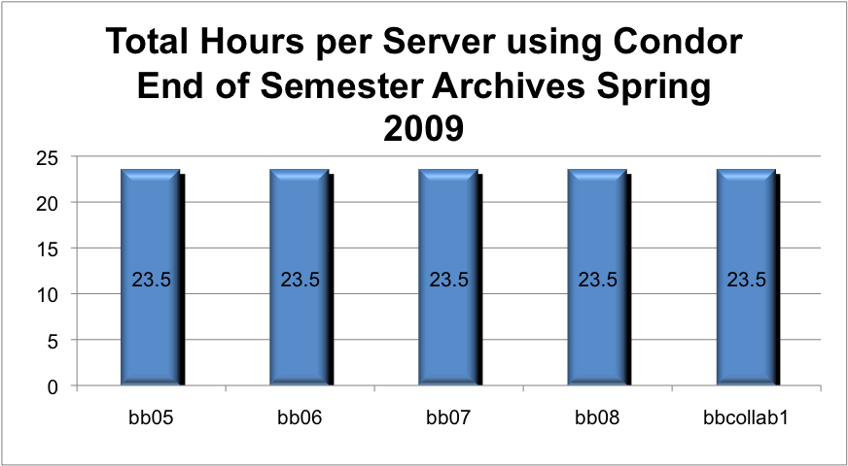
Project Blackbird
Clemson Computing and Information Technology
Computing, Systems, and Operations

Slide 16
Project Blackbird
Steps in the weekly archive process
Determine what to archive (active courses, orgs)
Build a course list
Create Blackbird submit files
Submit DAGMan job to Condor
Monitor Condor queue
Receive email notification when all courses have been archived
Clemson Computing and Information Technology
Computing, Systems, and Operations

Slide 17
Project Blackbird
What did it take to implement?
Have one or more multi-core machines
Choose one machine as your Central Manager
Install and configure Condor on each machine
Automate course list creation (Query DB or Directory)
Automate Condor submit files and Condor DAGMan file creation
Automate the whole thing with cron
Check log files for errors upon archive completion
Clemson Computing and Information Technology
Computing, Systems, and Operations

Slide 18
Project Blackbird
Custom Condor Configuration
DAGMAN_MAX_JOBS_IDLE = 25
DAGMAN_MAX_JOBS_SUBMITTED = 50
## Force Condor to use Blackboard Private Network
NETWORK_INTERFACE = Private Blackboard Net
Clemson Computing and Information Technology
Computing, Systems, and Operations

Slide 19
DAGMan example
# Filename: /usr/local/CMSIntegration/files/Blackbird20091008.condor.sub
# Generated by condor_submit_dag /usr/local/CMSIntegration/files/Blackbird20091008
universe = scheduler
executable = /usr/local/condor/bin/condor_dagman
getenv = True
output = /usr/local/CMSIntegration/files/Blackbird20091008.lib.out
error = /usr/local/CMSIntegration/files/Blackbird20091008.lib.err
log = /usr/local/CMSIntegration/files/Blackbird20091008.dagman.log
remove_kill_sig = SIGUSR1
# Note: default on_exit_remove expression:
# ( ExitSignal =?= 11 || (ExitCode =!= UNDEFINED && ExitCode >=0 && ExitCode <= 2))
# attempts to ensure that DAGMan is automatically
# requeued by the schedd if it exits abnormally or
# is killed (e.g., during a reboot).
on_exit_remove = ( ExitSignal =?= 11 || (ExitCode =!= UNDEFINED && ExitCode >=0 && ExitCode <= 2))
copy_to_spool = False
arguments = "-f -l . -Debug 3 -Lockfile /usr/local/CMSIntegration/files/Blackbird20091008.lock -AutoRescue 1 -DoRescueFrom 0 -Dag /usr/local/CMSIntegration/files/Blackbird20091008 -CsdVersion $CondorVersion:' '7.2.4' 'Jun' '15' '2009' 'BuildID:' '159529' '$"
environment = _CONDOR_DAGMAN_LOG=/usr/local/CMSIntegration/files/Blackbird20091008.dagman.out;_CONDOR_MAX_DAGMAN_LOG=0
notification = Complete
queue
Clemson Computing and Information Technology
Computing, Systems, and Operations

Slide 20
Condor Submit example
universe = vanilla
requirements = (OpSys=="LINUX") && (Memory > 100) && ((Arch=="INTEL") || (Arch=="X86_64"))
executable = /usr/local/bin/condorSubmitArchive.pl
arguments = shoover-S0000BKBRD_401001,/san/weeklyArchives/20091008/
getenv = True
log = /usr/local/logs/bbCondorLogs/archive20091008.log
notification = Error
notify_user = DCIT2803_BB_ON_CALL-L@clemson.edu
transfer_executable = False
when_to_transfer_output = ON_EXIT
queue 1
Clemson Computing and Information Technology
Computing, Systems, and Operations

Slide 21
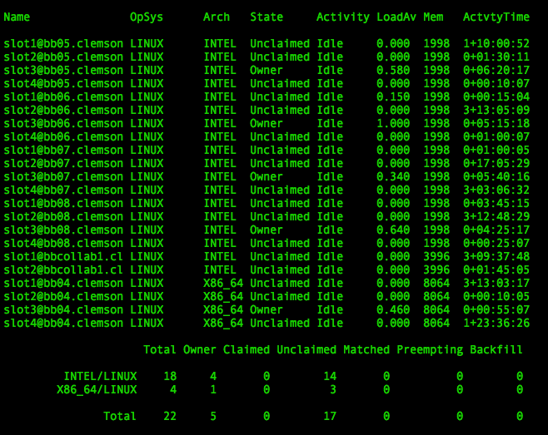

Slide 22
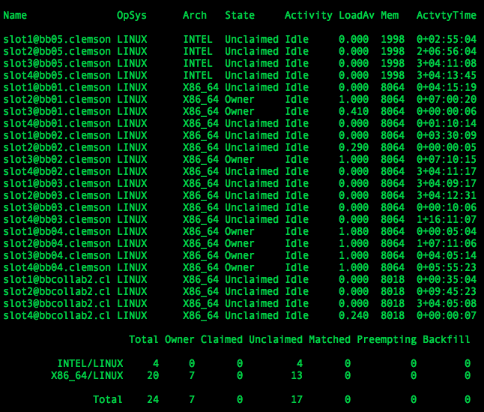

Slide 23
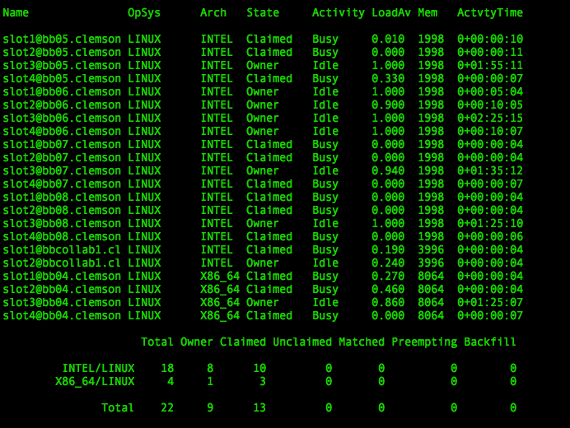

Slide 24
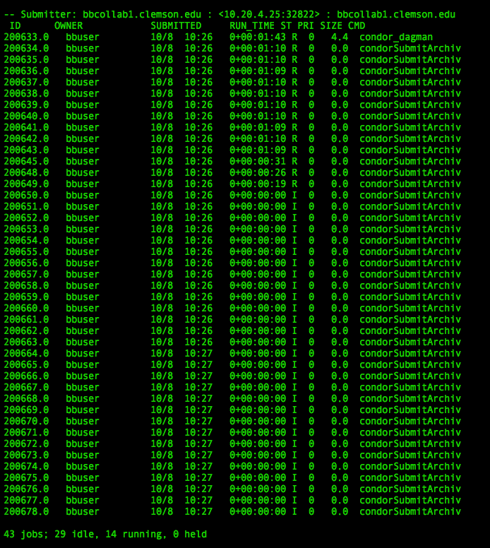

Slide 25
Blackbird Benefits
Reduced total archive time from > 85 hrs to < 24 hrs
Job scheduling – all servers finish at the same time
Zero impact to Blackboard Performance
Automatic suspension/resumption of archives if Load reaches threshold on any core
Email notification upon completion of all archives
Load balancing – archive jobs are distributed as cores become available
Takes advantage of all available CPU cores instead of just one core per server
Use ClassAds to specify architecture and memory requirements for large archive jobs
Clemson Computing and Information Technology
Computing, Systems, and Operations

Slide 26
Project Blackbird
Recent Updates
64 Bit Red Hat 5.4 OS and JVM 1.6
Maximum (affordable) RAM per machine – 32 GB
Web page to view queue and status
What’s next?
Add out of warranty machines to the Blackboard Condor Pool (keep users off of them)
Monitoring of queue
Automate installation and configuration
Clemson Computing and Information Technology
Computing, Systems, and Operations

Slide 27
Project Blackbird
Questions?
Sam Hoover
shoover@clemson.edu
Clemson Computing and Information Technology
Computing, Systems, and Operations

