Slide 1
A High Throughput Computing Analysis of Rounding in the
Beer Distribution Game
Nathan Patterson
Dr. Jeffrey Rhoads
Dr. Sangtae Kim
njpatter@purdue.edu
04.22.2009

Slide 2
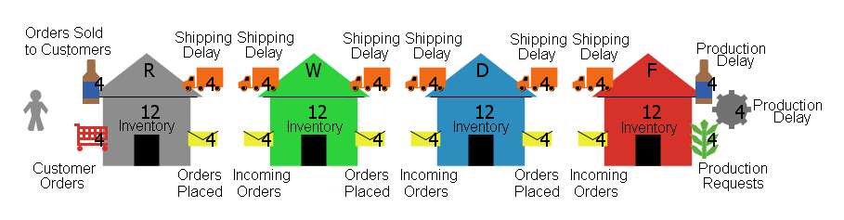
The Beer Distribution Game
Four players
Two week ordering delays
Two week shipping delays
Three week factory production

Slide 3
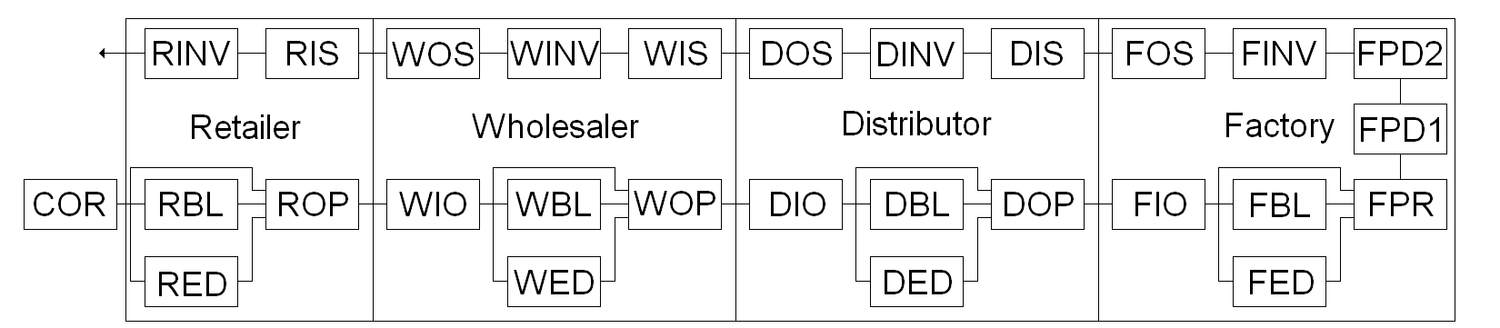
The Beer Distribution Game
Exogenous Customer demand
Goal of players is to minimize cost
Illustrates nonlinear supply chain behavior
  Bullwhip effect

Slide 4
Ordering Heuristic
Single decision variable for each supply chain member
John Sterman (MIT)
  Data from 192 students playing the Beer Game
Developed an Anchoring and Adjustment heuristic to mimic players’ behavior

Slide 5
Ordering Heuristic
Four variables
  Expected demand updating rate (anchor) – θ (0,1)
  Stock discrepancy adjustment – α (0,1)
  Supply line discrepancy adjustment – β (0,1)
  Desired stock and supply line level – Q (12,17)
Rounding methods
  No rounding, continuous variables
  Ceiling function
  Conventional rounding, nearest integer
  Floor function

Slide 6
Governing Equations

Slide 7
Response Identification Method
Uses Euclidean distance to determine system states
  Constant-Valued
  Periodic
  Aperiodic
  Tolerance of 10⁻⁸ was used
Allows code to stop when Constant-Valued solution occurs
Test for periodicity if Constant-Valued solution does not occur within 100,000 weeks

Slide 8
Performance and Rounding
Discrete- vs. continuous-valued implementations
Metrics used to analyze different rounding techniques
  Average steady-state operating cost ($0.50 holding and $2.00 backorder costs)
  Percentages of Constant-Valued, Periodic, and Aperiodic system responses

Slide 9
High Throughput Analysis
Previous work investigated α-β space for specified θ and Q values
Similar observations were made
  1001x1001 (α-β) variable sets
  4 rounding methods
  Separated into 1001 jobs
  800mb data files ready within a few hours

Slide 10
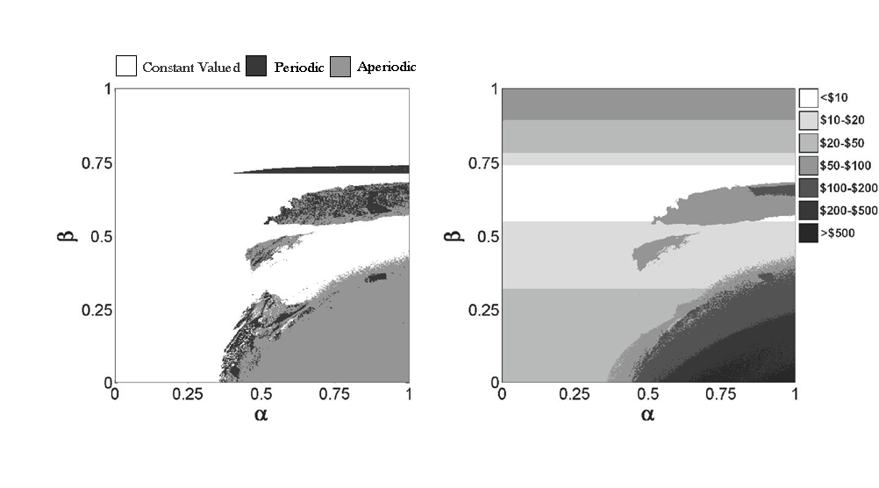
Continuous Variable

Slide 11
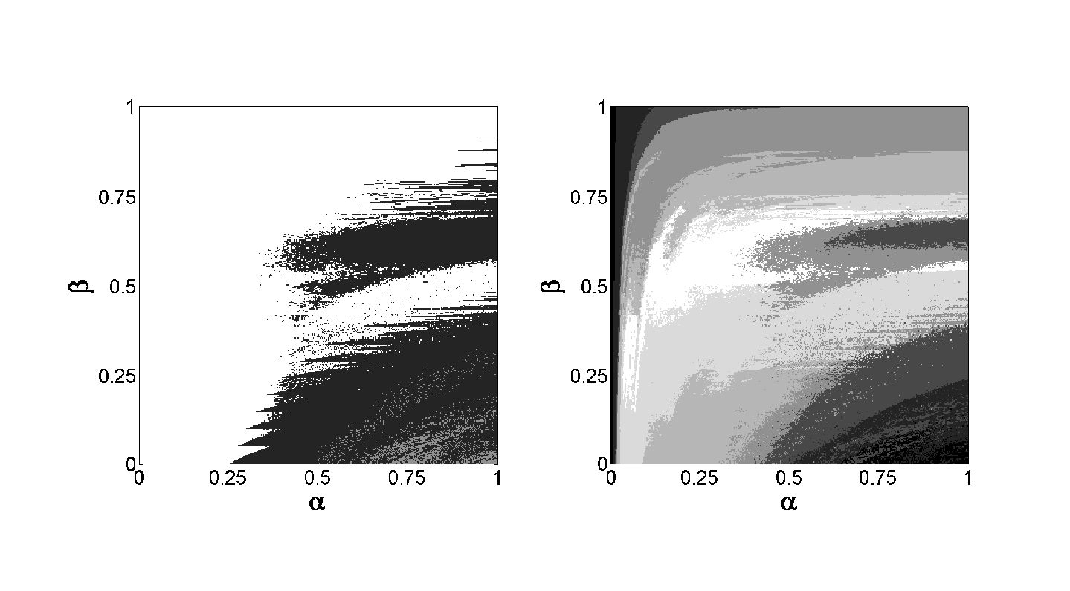
Floor Function

Slide 12
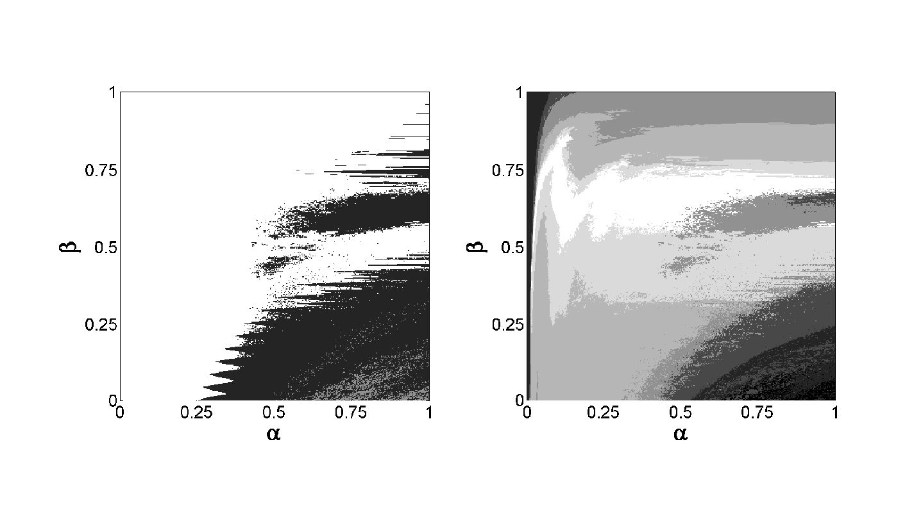
Nearest Integer

Slide 13
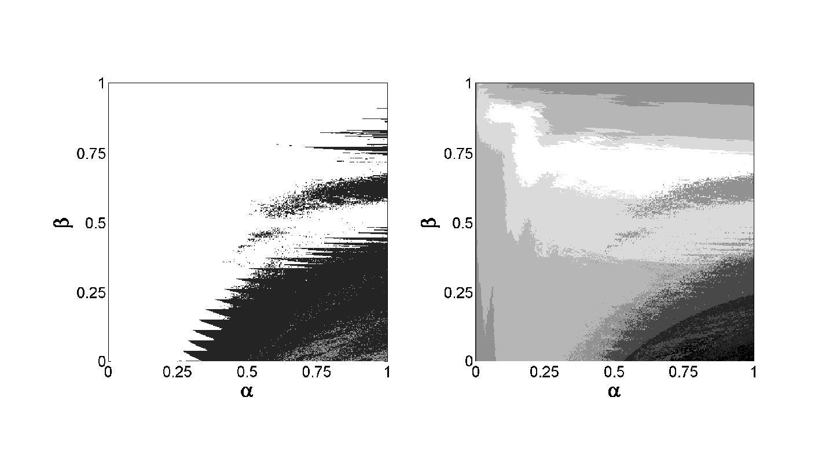
Ceiling Function

Slide 14
High Throughput Analysis
Expanded upon previous analysis
  201x201x201 (α-β-θ) variable sets
  Six Q values ranging from 12 to 17
  Four rounding methods
  194,894,424 variable possibilities
  Separated into 40401 jobs

Slide 15
Volumetric Analysis
Q = 17 | Constant Valued | Periodic | Aperiodic | Average Weekly Cost
No Rounding | 69.49% | 6.31% | 24.20% | $91.89
Floor | 61.69% | 36.41% | 1.90% | $3,130.54
Round | 66.36% | 32.14% | 1.50% | $89.67
Ceiling | 70.46% | 28.20% | 1.34% | $81.14

Slide 16
Cost Ratio Analysis
Holding and backorder costs can vary widely
  Holding cost to backorder cost ratio analysis
Ceiling function is best
  When holding costs < backorder costs
Floor function is best
  When holding costs >> backorder costs
Conventional rounding for intermediate ratios

Slide 17
Rounding Summary
High throughput numerical simulations allowed for observations of effects of rounding on solution types and system cost
Rounding – the value of the Ceiling function
  Largest constant-valued steady state regions
  Lowest average operating cost
Importance of cost ratio analysis
  Used to determine rounding method if cost is priority
Aggressive ordering is better
Don’t need 100k weeks to study CV responses

Slide 18
Resources Used
Used Condor high-throughput computing platform
  On average used 1000-2000 computers on campus at a time
  Lots of time spent transferring files
  Used csh script to submit jobs
Resources used to date
  Over 4.5 million job submissions
  1,350,000+ CPU hours (>150 CPU years used!)

Slide 19
Acknowledgements
Donald W. Feddersen Endowment
Condor Project (www.cs.wisc.edu/condor)
Rosen Center for Advanced Computing
  Phil Cheeseman

Slide 20
Questions?

